Slide 1
HIV Awareness Session
g
Reducing The Stigma

Slide 2
What comes to mind
when you hear HIV?
What age were you? What was the message? Where did you hear the message?
Hopes & Fears
What do you want to get from today?
What are your worries about the training session?

Slide 3
Training Objectives
By the end of the session you will…
(a) feel more confident challenging myths
and stigma associated with HIV
(b) be more aware of the issues
faced by people living with HIV
(c) have increased awareness
of the services we offer

Slide 4
About Us
We are in existence for over 30 years
We support people living with or affected by HIV
We offer an holistic approach – workshops, information sessions, complementary therapies, counselling, help with benefits and other practical matters.
You can refer clients living with or affected by HIV to us by calling 028 9024 9268 or they can call to the office at 20 Derryvolgie Avenue, Belfast, BT9 6RN

Slide 5
“AIDS – Don’t Die Of Ignorance”
“The big problem was that nobody knew anything about it. It was like an alien plague. Where did it come from? How big would it get? Panic and speculation was spreading” Malcom Gaskin, Designer

Slide 6
“AIDS is not a bad persons disease”
The Golden Girls

Slide 7
What is HIV?
Human
Immunodeficiency
Virus
What is AIDS?
Acquired
Immune
Deficiency
Syndrome

Slide 8
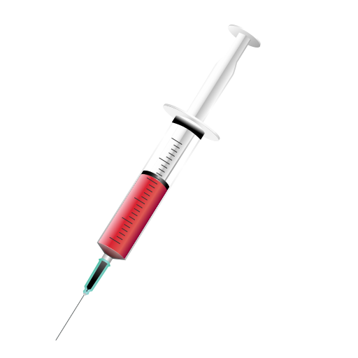
How is HIV transmitted
Unprotected sex → Anal/Oral/Vaginal
Blood to blood → Sharing needles
Mother to baby → Birth/breastfeeding

Slide 9
Timeline
1981 The first cases of what we now know to be HIV were seen in hospitals in SF & NYC.
Charles & Di marry. Bucks Fizz Eurovision
1986 HIV officially named as the virus that causes AIDS
Positive Life formed – Chernobyl – Neighbours launched on BBC1 – NI AIDS helpline opens
1987 Azt – MJ Bad Album
Reagan first mention of AIDS
1988 December 1st – World AIDS Day
1995 Meds breakthrough – Toy Story released. First DVDs
1999 33 million living with HIV and 14 million died from AIDS
Jill Dando murdered
Westlife have 3 UK number ones. (flying without wings/I have a dream)
2001 Pharma reduces price of HIV drugs
2006 SIV in Chimps in Cameroon
2009 Obama ends travel and immigration ban on PLWHIV
Woolworths closed their final store.

Slide 10
CD4 Count
A measure of how healthy a
persons immune system is
Viral Load
The amount of HIV in a person’s blood
(Undetectable viral load means there is so little of the
virus remaining that it cannot be counted)

Slide 11
HIV & Pregnancy
GOOD NEWS!!!
There has not been a child born with
HIV in Northern Ireland since 2010
Breastfeeding is still not recommended as we cannot be sure
how much of the virus remains in breast milk, however a
mother who wishes to breastfeed will be supported by her
medical team to do so as safely as possible

Slide 12
Group Activity
Top, Middle or Bottom!

Slide 13
Cleaning a cut on an HIV + child who has fallen and cut their knee.
A support worker in a charity for the homeless cleaning out a room which had been used by someone who was living with HIV.
Having sex with someone who is living with HIV whose viral load was undetectable the last time they were at the GUM clinic. They sometimes forget to take their medication.
Mutual masturbation.
Hugging someone who is living with HIV.
A woman who is HIV + having a baby.
Someone having sex with a sex worker.
Comforting someone who has just been told they are HIV +.
Being treated by a dentist who is HIV +.
Sharing towels, cutlery, or other household items with someone who is living with HIV.

Slide 14
11. Having unprotected sex with someone who has never been tested for HIV or any other STI.
12. Having unprotected sex with someone who was tested for HIV 2 months ago – the test was negative.
13. Having sex with someone who is living with HIV and has an undetectable viral load.
14. Kissing someone who is living with HIV.
15.Drug users sharing the same rolled up note to snort cocaine.

Slide 15
Family Case Studies
& Stigma Discussion

Slide 16
MATILDA
Matilda moved to Northern Ireland from Zimbabwe in 2010. She contracted HIV as a result of sexual assault when she was a child. She got married in 2018 and found out she was pregnant in 2019. When she went into hospital to give birth, two midwives came to see her. They stood at the end of her bed with their arms folded and spoke in hushed tones as they read her notes. Matilda felt that they were afraid of “catching” HIV from her. A nurse then came to her and showed her a toilet with an “Out of Order” notice on it and informed her that she was to use that toilet and no other. The other women in the ward heard this and asked Matilda why she was being told to use that toilet. Later, the nurse who came to check her blood pressure tried to put on two pairs of gloves and when Matilda asked her why she was doing that the nurse replied “It’s because of what you have”.
DISCUSS
Examples of stigma
How could Matilda’s treatment have been improved?
What can Matilda do about it?

Slide 17
WILFRED
Wilfred is a chef and single father of two young boys. He has been HIV positive for 15 years. He is on medication and has an undetectable viral load. Both boys are HIV negative. His wife died of cancer last year. Wilfred works in the kitchen of a large and successful restaurant. One evening during service he was informed that two customers had sent their food back and said that they should not have to eat something that was prepared by someone with AIDS. As more and more people began to stay away from the restaurant, Wilfred’s boss told him he had no alternative but to “let him go” although he told him he would provide him with a good reference to help him get another job. A few days later, two social workers came to his door. They said that someone had expressed concerns that Wilfred was caring for two young boys when he had a “contagious” condition.
DISCUSS
Examples of stigma
How could Wilfred’s treatment have been improved?
What can Wilfred do about it?

Slide 18
LAWRENCE
Lawrence is a train driver who has just found out that he is HIV positive. His doctor has told him that he should start taking medication to reduce his viral load. The medication he has been prescribed has several potential side effects, one of which is that it can make you very drowsy. In view of his occupation and the need to keep people safe, he decides that he will need to tell his employer. He speaks to his supervisor and tells her that he would like an appointment with a doctor in Occupational Health and Welfare. His supervisor asks him why and he explains that it is something he would rather discuss with the doctor at OHW. His supervisor tells him this is not how things work and that she needs to know what the issue is before she can decide whether an appointment with OHW is needed. Lawrence tells her and she arranges the appointment for him. A few days later Lawrence notices that people are staying away from him in the canteen and he sees groups of people whispering and looking over at him. Lawrence is considering leaving his job, which he loves, as he believes other staff have discovered his HIV status.
DISCUSS
Examples of stigma
How could Lawrence’s treatment have been improved?
What can Lawrence do about it?

Slide 19
PEP & PrEP
PEP (Post Exposure Prophylaxis)
PEP is a treatment that can stop an HIV infection after the virus has entered a person’s body. It must be taken within 72 hours of exposure. PEP is not guaranteed to be effective.
PrEP (Pre Exposure Prophylaxis)
PrEP is now also available in Northern Ireland. PrEP Can be effective in preventing HIV infection if taken properly

Slide 20
What does an Undetectable
Viral Load mean??
A healthy immune system
Reduced risk of ill health
Near normal life expectancy
Reduced risk of drug resistance

Slide 21
U=U
Undetectable = Untransmittable The British HIV Association endorsed
the following message in 2017
“A person living with HIV who has an undetectable viral load does not transmit HIV to their partners”
NB: Provided they …
are on stable treatment (for at least 6 months)
with a consistently undetectable viral load (for at least 6 months)
and continue to take their treatment every day (Breast feeding still carries a small risk)

Slide 22
HIV in Northern Ireland
The Stats
General upward trend since 2000
Approximately 100 new cases every year
During 2017, 1073 people were receiving treatment for HIV
84 new infections in 2017
6 were diagnosed with AIDS as their first diagnosis
5 deaths as a result of HIV

Slide 23
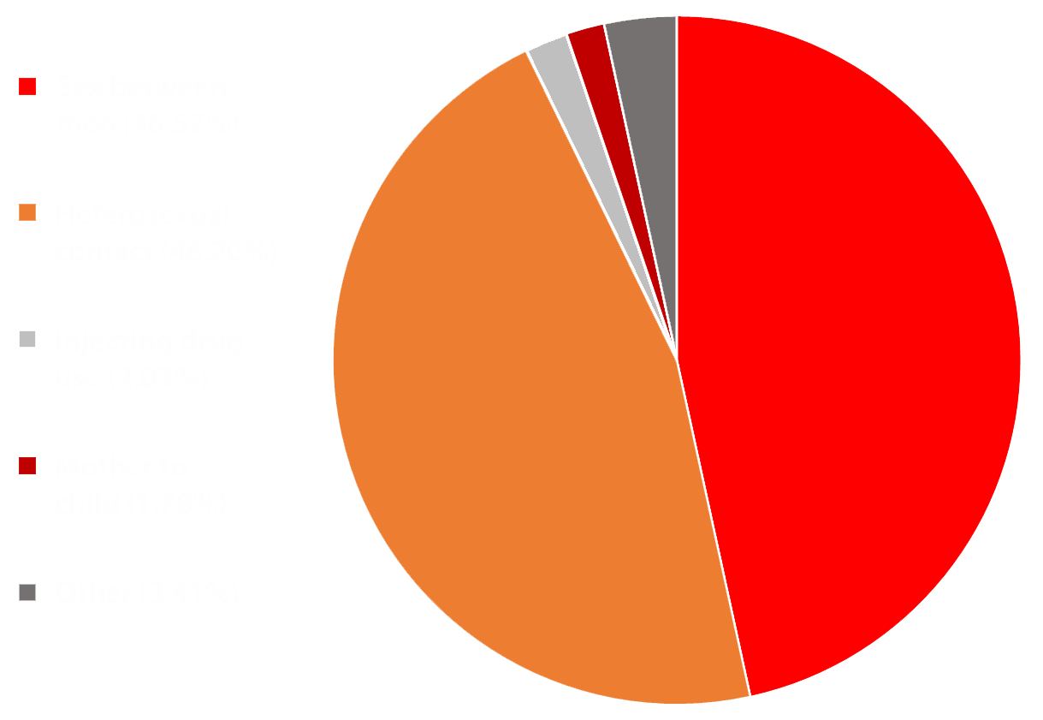
Modes of Transmission

Slide 25
POSITIVE LIFE
20 Derryvolgie Avenue, Belfast, BT9 6FN
FREE HELPLINE NUMBER
0800 137 437
TELEPHONE
028 9024 9268
EMAIL
gavin/lea/kennedy/drew@positivelifeni.com

