Slide 1
Lunchtime Seminar
Mainstreaming community development approaches in social work?

Slide 2
Addressing Loneliness and Poverty amongst the Older Population Sharing my Learning….
Leah Curlett
Senior Social Worker
Community Care Team
NHSCT

Slide 3
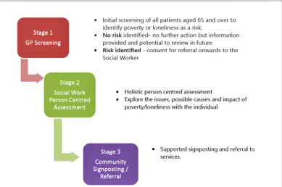
Poverty & Loneliness Screening Tool
This tool aimed to support frontline GPs in identifying those over the age of 65 years at risk of poverty and/or loneliness and to begin a conversation about how their health and wellbeing are being affected.
Why GPs?
-Loneliness is regarded a public health crisis and the Royal College of GPs report 1 in 5 patients visit their GP because they are lonely.
-Medical Model vs Social Model e.g. Medical staff will treat the “part of the body that is broken” not the whole body.

Slide 4
Key Theories..
Networking
Asset Based Community Development
Co-Production
Collective Leadership
Change Model

Slide 5
Outcomes/ Swot Analysis
Strengths
STRENGTHS
Strengthen communities via asset mapping
Improving personal knowledge
Building working relationships
NI Anti- Poverty Framework released
RCGPs research released
Launch of NHSCT Loneliness Strategy
WEAKNESSES
Work commitments
Resource limitations- waiting lists
Work force culture
OPPORTUNITIES
Building GP working relationships
Community Empowerment
Reducing pressures on HSC/GPS
Preventative work
Collective Leadership
Social Work Strategy
Enhancing team development
THREATS
Lack of referrals or overload
GP “buy in”
Attitudes
Budgetary constraints
Swot

Slide 6
Main Challenges..
GP engagement and commitment
Promoting Collective Leadership
Covid 19
Critical need criteria
To date Adaptation has been a key learning point
The success of the project will involve continuous learning, evaluation, reflection and adaptation.

