Slide 1
The COVID-19 pandemic,
inequality and
mental health
Gavin Davidson,
Professor of Social Care, and
Claire McCartan, Research Fellow,
School of Social Sciences, Education and Social Work

Slide 2
Overview of the presentation
Inequalities in mental health
Impact of COVID-19 on mental health in general
Impact of COVID-19 on people with pre-existing mental health problems
Policy responses to COVID-19 to promote mental health recovery
Longer term implications of the Covid-19 pandemic

Slide 3
Inequalities in mental health
Social determinants of health including mental health
The more difficult your circumstances, the more likely it is that you will experience mental health problems
The social gradient – Black Report (1980); Acheson Report (1998); Marmot Review (2010)
Why do more people in deprived circumstances have mental health problems?
Combination of complex factors including access to education and employment, income, good quality housing, community facilities, status/identity but the main process is additional stress

Slide 4
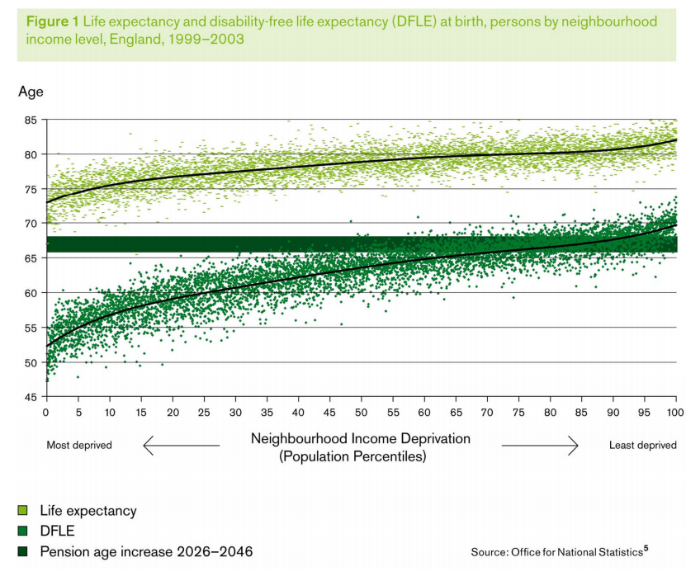
The social gradient (Marmot Review, 2010)

Slide 5
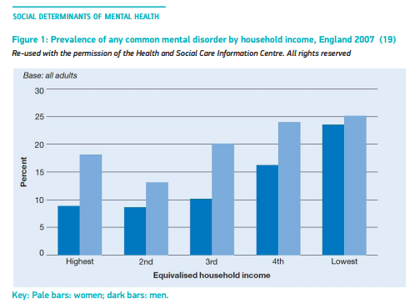
The social gradient in mental health (WHO, 2014, Social determinants of mental health)

Slide 6
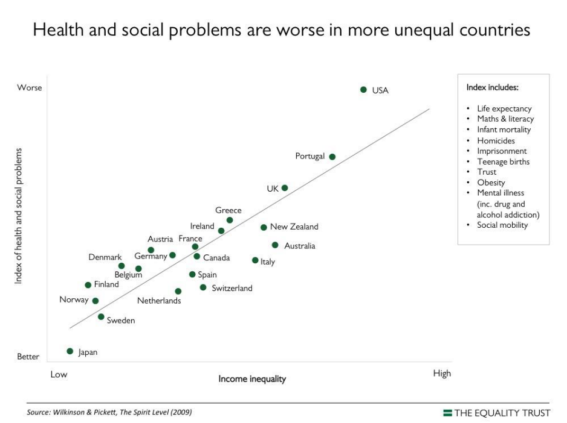
The role of inequity?
Spirit Level: Why More Equal Societies Almost Always Do Better by Richard Wilkinson and Katie Pickett (2009) – Ted Talk for a summary

Slide 7
Impact of COVID-19 on mental health in general:
Report One - The Covid-19 pandemic, financial inequality and mental health
(Mental Health Foundation, 2020a)
“the risk of experiencing mental ill-health is not equally distributed across our society. Those who face the greatest disadvantages in life also face the greatest risk to their mental health.”
“The distribution of infections and deaths during the COVID-19 pandemic, the lockdown and associated measures, and the longer-term socioeconomic impact are likely to reproduce and intensify the financial inequalities that contribute towards the increased prevalence and unequal distribution of mental ill-health.” (p. 3)

Slide 8
Methodology
“Since mid-March 2020, the project has undertaken regular, repeated surveys of more than 4,000 adults who are representative of people aged 18+ and living in the UK. The surveys are conducted online by YouGov.”
Citizens’ Jury to consider findings.
Focus on financial inequality and mental health
Reports available at https://www.mentalhealth.org.uk/our-work/research/coronavirus-mental-health-pandemic/

Slide 9
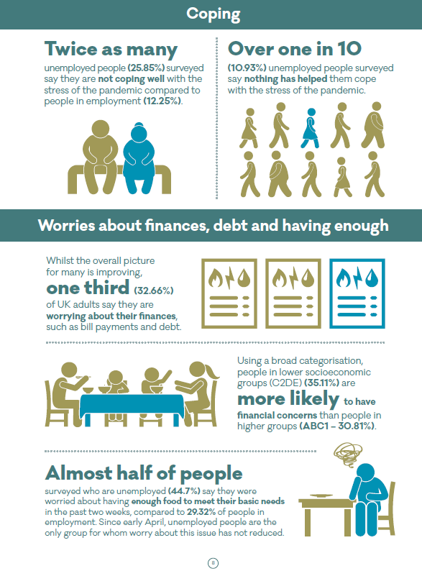
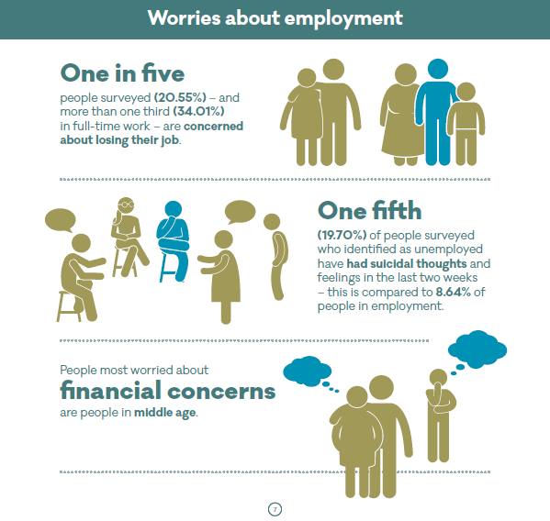
Findings

Slide 10
Citizens’ Jury
“While there will be generic worries about the future across the population, the detailed picture is far more nuanced. People are affected in different ways depending on their age, demographic background, employment sector, type of job and contract, geographical area, membership of at risk groups and more. Self-employed, small businesses, people with disabilities, people from Black, Asian and Minority Ethnic background, domestic abuse survivors and informal carers were considered high risk groups in this context.” (p. 9)

Slide 11
Impact of COVID-19 on people with pre-existing mental health problems
Report Two - Coronavirus: The divergence of mental health experiences during the pandemic
(Mental Health Foundation, 2020b)
Overall, the levels of distress are receding, and most people are feeling able to cope. As of the third week of June, 49% of the population had felt anxious or worried in the past two weeks due to the pandemic, down from 62% in mid-March.
Groups affected by socioeconomic inequalities have been more likely to experience anxiety, panic, hopelessness, loneliness, and to report not coping well with the stress of the pandemic.
The pandemic seems to have widened mental health inequalities, with the groups that had the poorest mental health pre-crisis also having had the largest deterioration in mental health during lockdown.
Additional stress, access to support and services.

Slide 12
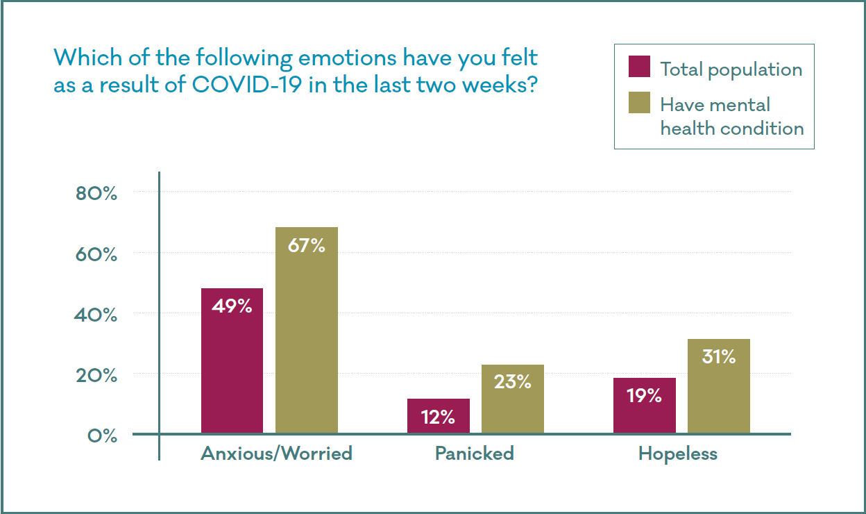
Impact of COVID-19 on people with pre-existing mental health problems
Report Two - Coronavirus: The divergence of mental health experiences during the pandemic
(Mental Health Foundation, 2020b)

Slide 13
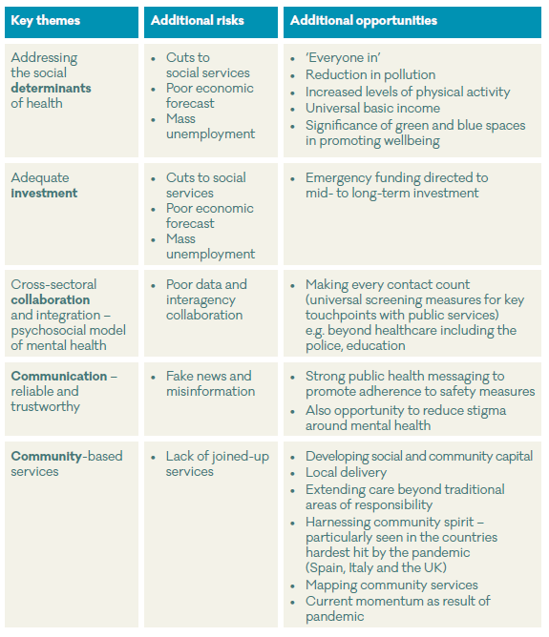
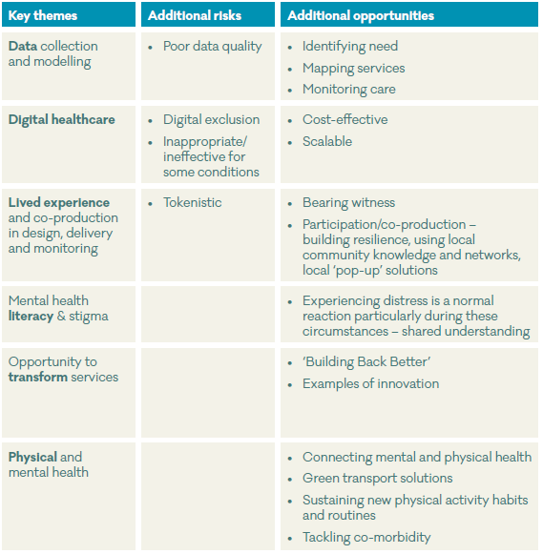
McCartan et al., 2020, International Policy Guidance and Responses to COVID-19 Mental Health Recovery: Rapid Review, July 2020
Available at https://www.health-ni.gov.uk/publications/international-policy-guidance-and-responses-covid-19-mental-health-recovery-rapid-review

Slide 14
McCartan et al., 2020, International Policy Guidance and Responses to COVID-19 Mental Health Recovery: Rapid Review, July 2020
COVID-19 has challenged and changed mental health services
Opportunity to positively transform mental health care
Should include tackling the social determinants of mental health
And build on: the adaptability and flexibility of community-based care; the recognition of the importance of lived experience in the design, development and monitoring of services; improved interagency collaboration; the acceleration of the digitalisation of healthcare; and the importance of connecting physical and mental health.

Slide 15
Wider implications for policy and practice
Economic security – income ?Universal Basic Income
Address poverty and debt; Reduce risk of eviction; Support employment; Support unemployed; Social connectedness
Recent Mental Health Action Plan - https://www.health-ni.gov.uk/publications/mental-health-action-plan
New 10 year Mental Health Strategy being developed
Societal discourse about mental health and what is important
Policy and service innovation and development
Role of social care and how it’s funded (Reform of Adult Social Care)

