Slide 1
Poverty and COVID19
Sinead McKinley
North Belfast Advice Partnership Co-ordinator

Slide 2
North Belfast Advice Partnership
To provide advice, information, support and advocacy to empower individuals to secure their rights and gain access to the services and entitlements that are available to them.
To help people to maximise their income and signpost/refer to other support organisations.
To address and tackle local poverty through service delivery, awareness raising and programmes.
To highlight policies that inflict poverty on our communities, families, individuals and children.

Slide 3
Poverty Pre Covid19
Welfare Reform Changes
Introduction of Universal Credit
Higher Cost of Living
Low Paid Jobs
Zero Hour Contracts
School Costs
Expensive Credit
Divided Communities
Higher Suicide, Addictions and Mental Health

Slide 4
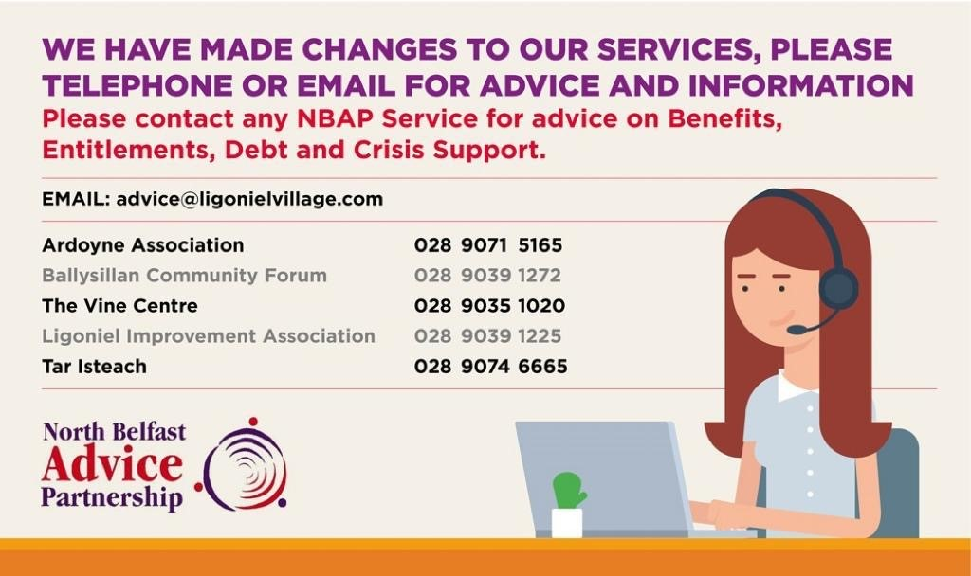
Crisis Intervention Support
Food Banks
Soup Kitchen
Fuel Costs – Gas/Electric/Oil
Baby items
School Uniforms Swap Shops
Christmas Support

Slide 5
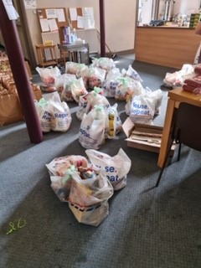
Lockdown and Food Poverty
Increase in Foodbank Demand and Hot Meals
To date we have delivered 6000 Food parcels to families and individuals and
12500 hot meals
Food Poverty meets Food Crisis
Shielding and Vulnerable/Isolated
Stockpiling
Access to supermarkets and affordability
Lone Parents and shopping
Tailored Food Parcels – Cultural Diversity
Cooking Skills

Slide 6
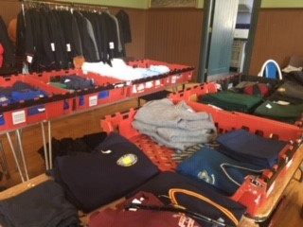
Lockdown and Poverty
School Lunches Scheme
500 School Lunches Provided
5 day of food for school children – July and August 2020
Problems with School Meals Vouchers and Accessing School Meals
School Uniform Swap Shop
School Bags and School Coats/Shoes

Slide 7
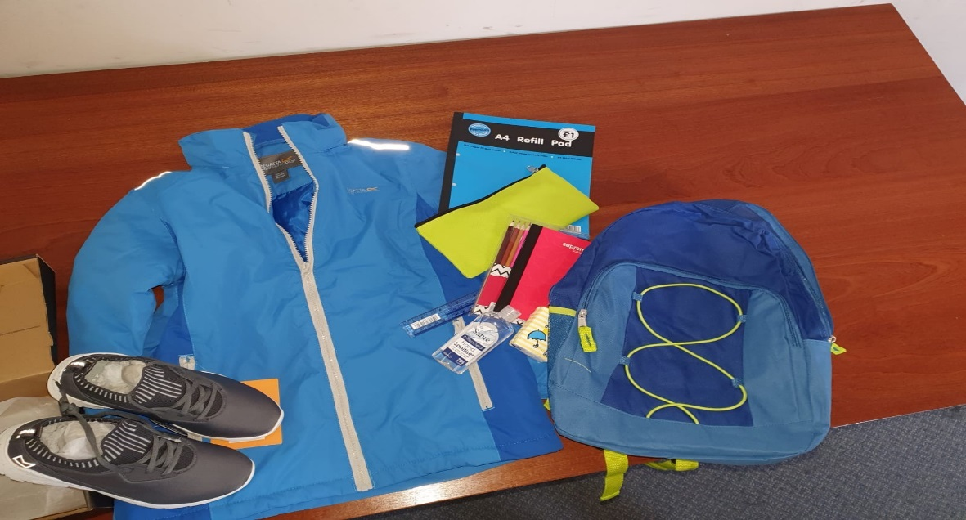
Lockdown and Poverty
Home Schooling
Lack of IT equipment
Lack of WIFI Access
Lack of parent capacity
Lack of routines at home
NBAP purchased 120 Ipads and WIFI cards plus provided school activity packs.

Slide 8
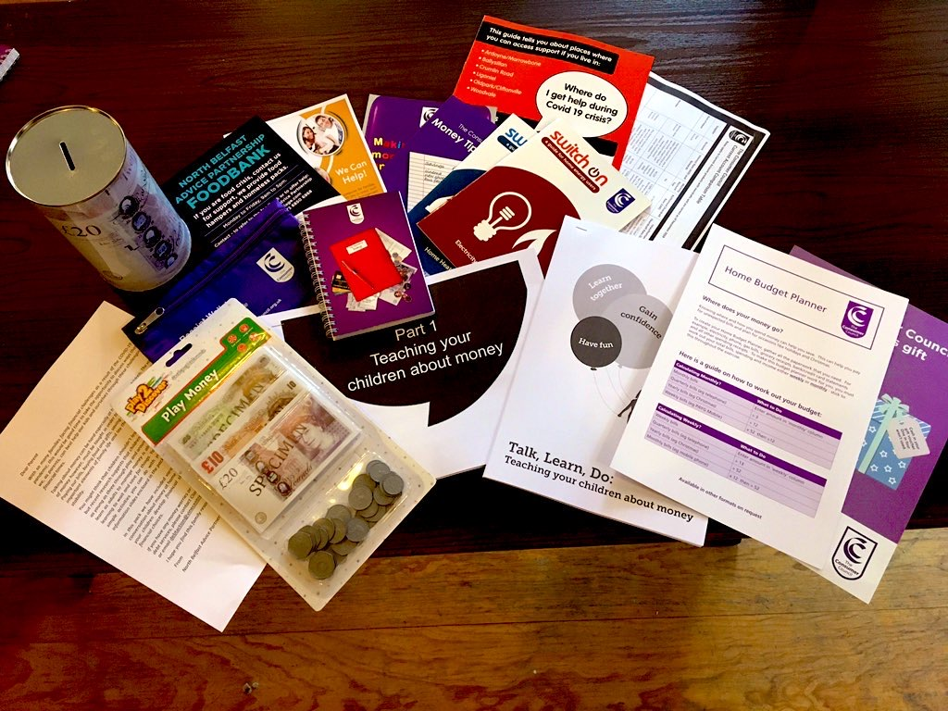
Lockdown and Poverty
Debt Advice and Money Worries
We developed #LetsTalkMoney@Home Packs
600 Packs delivered to families
How to access help and support for
and money worries
Learn Talk Do - Talking to our children
about money
Budgeting Tools

Slide 9
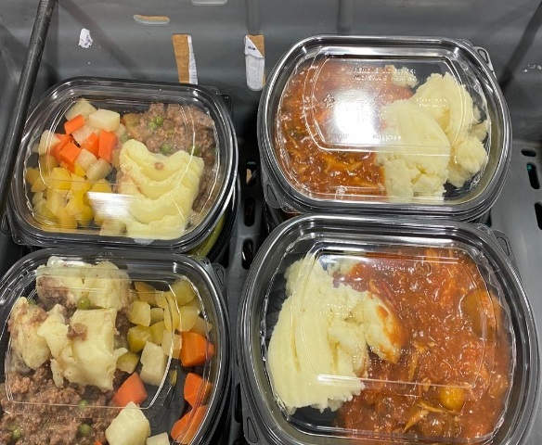
Lockdown – Homeless Support
Outreach Support Belfast City Centre
Monday – Thursday
40-50 Hot Meals Per Day Since Lockdown
Clothes, Toiletries, befriending
People’s Kitchen Belfast – Riders Square, Belfast
300 Hot Meals
Friday and Saturday

Slide 10
Going Forward
Concerns
Furlough Ending
Job Losses
Rent Arrears
School Closing and Home Learning
Christmas
Cold Winter – Heat/Eat
Homelessness
Stockpiling
Mental Health and Addictions

