Slide 1
Impediments to the recognition of the sexual exploitation of young males under 18
Dr Jacqui Montgomery-Devlin

Slide 2
BACKGROUND TO THE RESEARCH

Slide 3
Research Aims
Identify barriers to disclosure of CSE for young males
Identify impediments to identification of CSE in young males by professionals
Consider any relationship between these two phenomena.

Slide 4
Key Findings – Literature review
Significant shift in recognition CSE
Greater understanding
Recognition to victim status of young people
Challenges

Slide 5
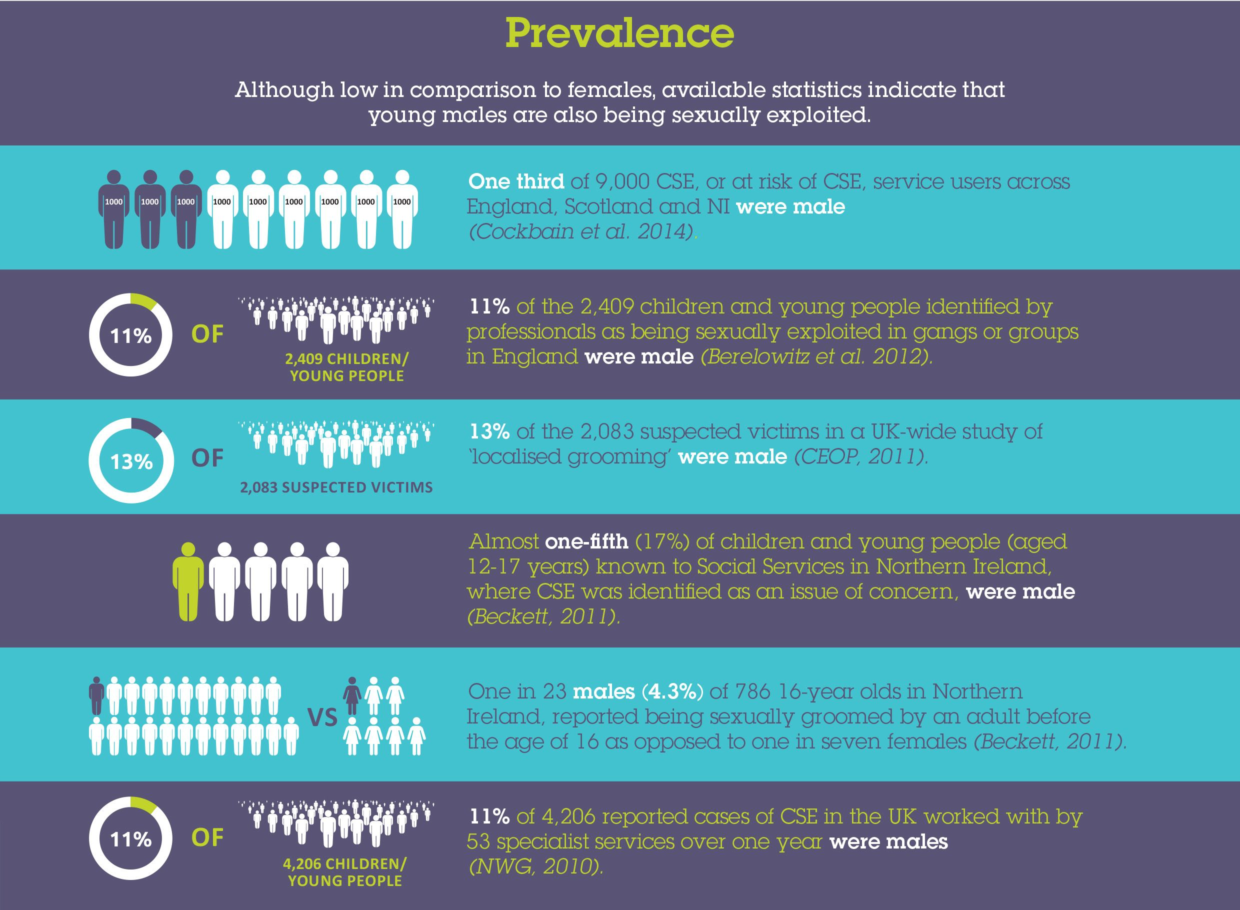

Slide 6
Definition of cse
Child sexual exploitation is a form of child sexual abuse. It occurs where an individual or group takes advantage of an imbalance of power to coerce, manipulate of deceive a child or young person under the age of 18 into sexual activity (a) in exchange for something the victim needs or wants, and/or (b) the financial advantage or increased status of the perpetrator or facilitator. The victim may have been sexually exploited even if the sexual activity appears consensual. Child sexual exploitation does not always involve physical contact; it can also occur through the use of technology.
Department for Education (DfE), 2017, p.5

Slide 7
Legal and policy context
Sexual Offences Act, 2003 (Eng & Wales) – equivalent NI and Scotland
Serious Crime Act, 2015 (Eng & Wales)
Development of distinct policies within each UK nation
Formation of concept of CSE as a child protection issue
DfE definition and guidance, 2017
Potential for differential responses

Slide 8
Theoretical framework

Slide 9
Ecological systems theory
Demonstrated that:
barriers to disclosure of CSE by males are multiply determined by factors:
individual traits in the young male; interpersonal relationships; other contextual factors
impediments to identification of CSE in males are multiply determined by factors:
individual professional; interpersonal relationships; other contextual factors
there can be simultaneous causes for non-disclosure and non-identification of CSE in males, creating connections between the two phenomena.

Slide 10
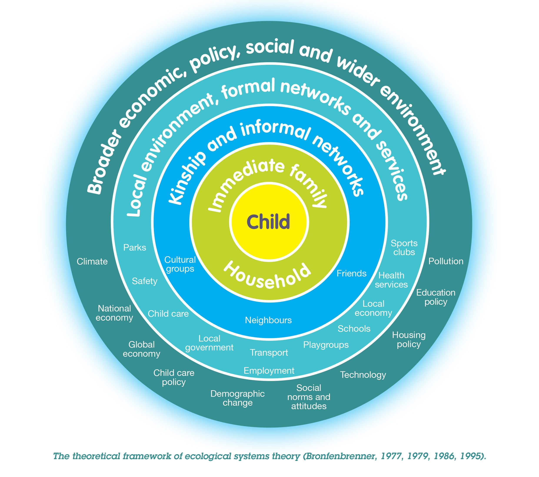
Theoretical Framework

Slide 11
Research Methodology
UK wide
Mixed methods approach
Professional surveys (n= 91 )
Professional interviews – 1:1 (n= 30)
Young male interviews – 1:1 (n= 10)
Young Life and Times Survey (n= 1,158 )

Slide 12
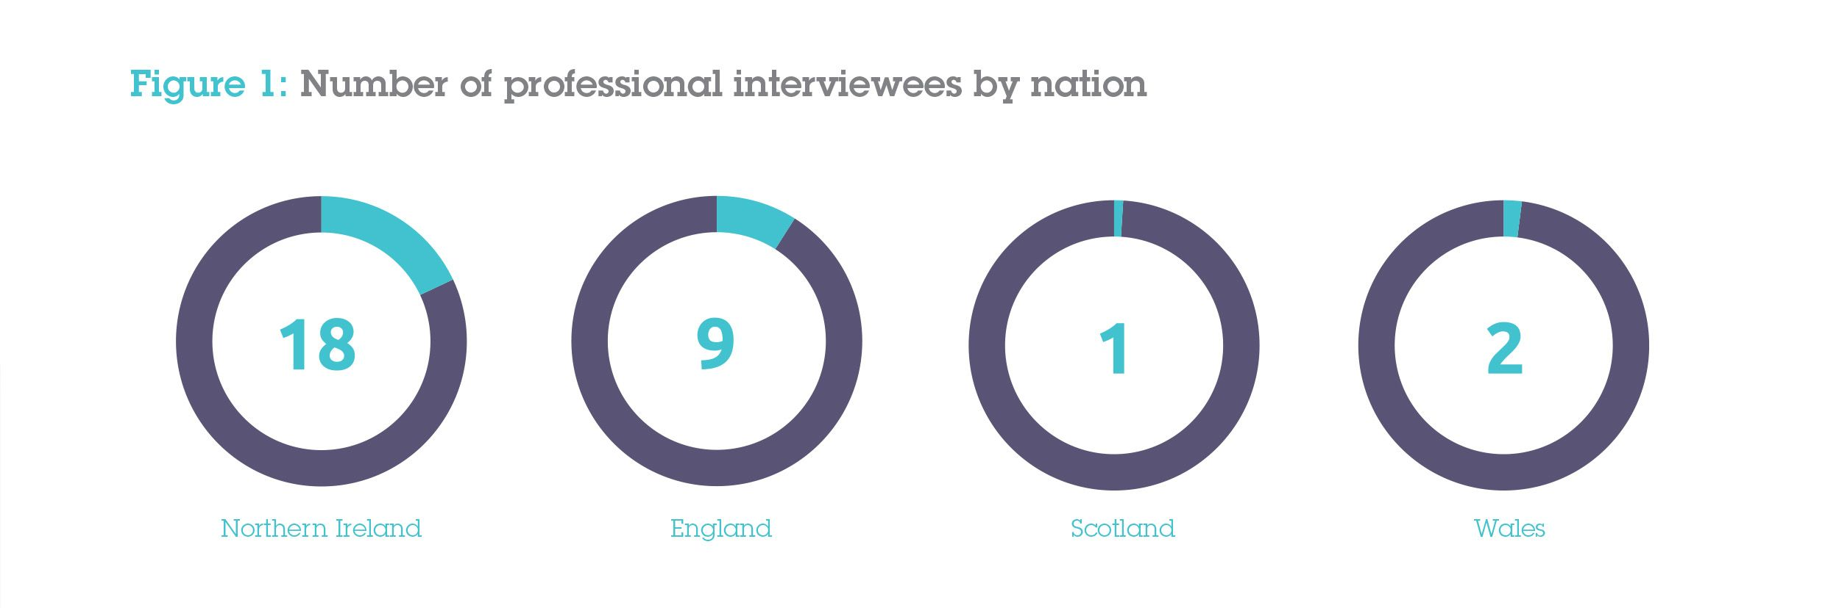

Slide 14
RESEARCH FINDINGS

Slide 15
Perceived top three groups of young males least likely to disclose
Involved in criminality
With a learning disability
From BME communities

Slide 16
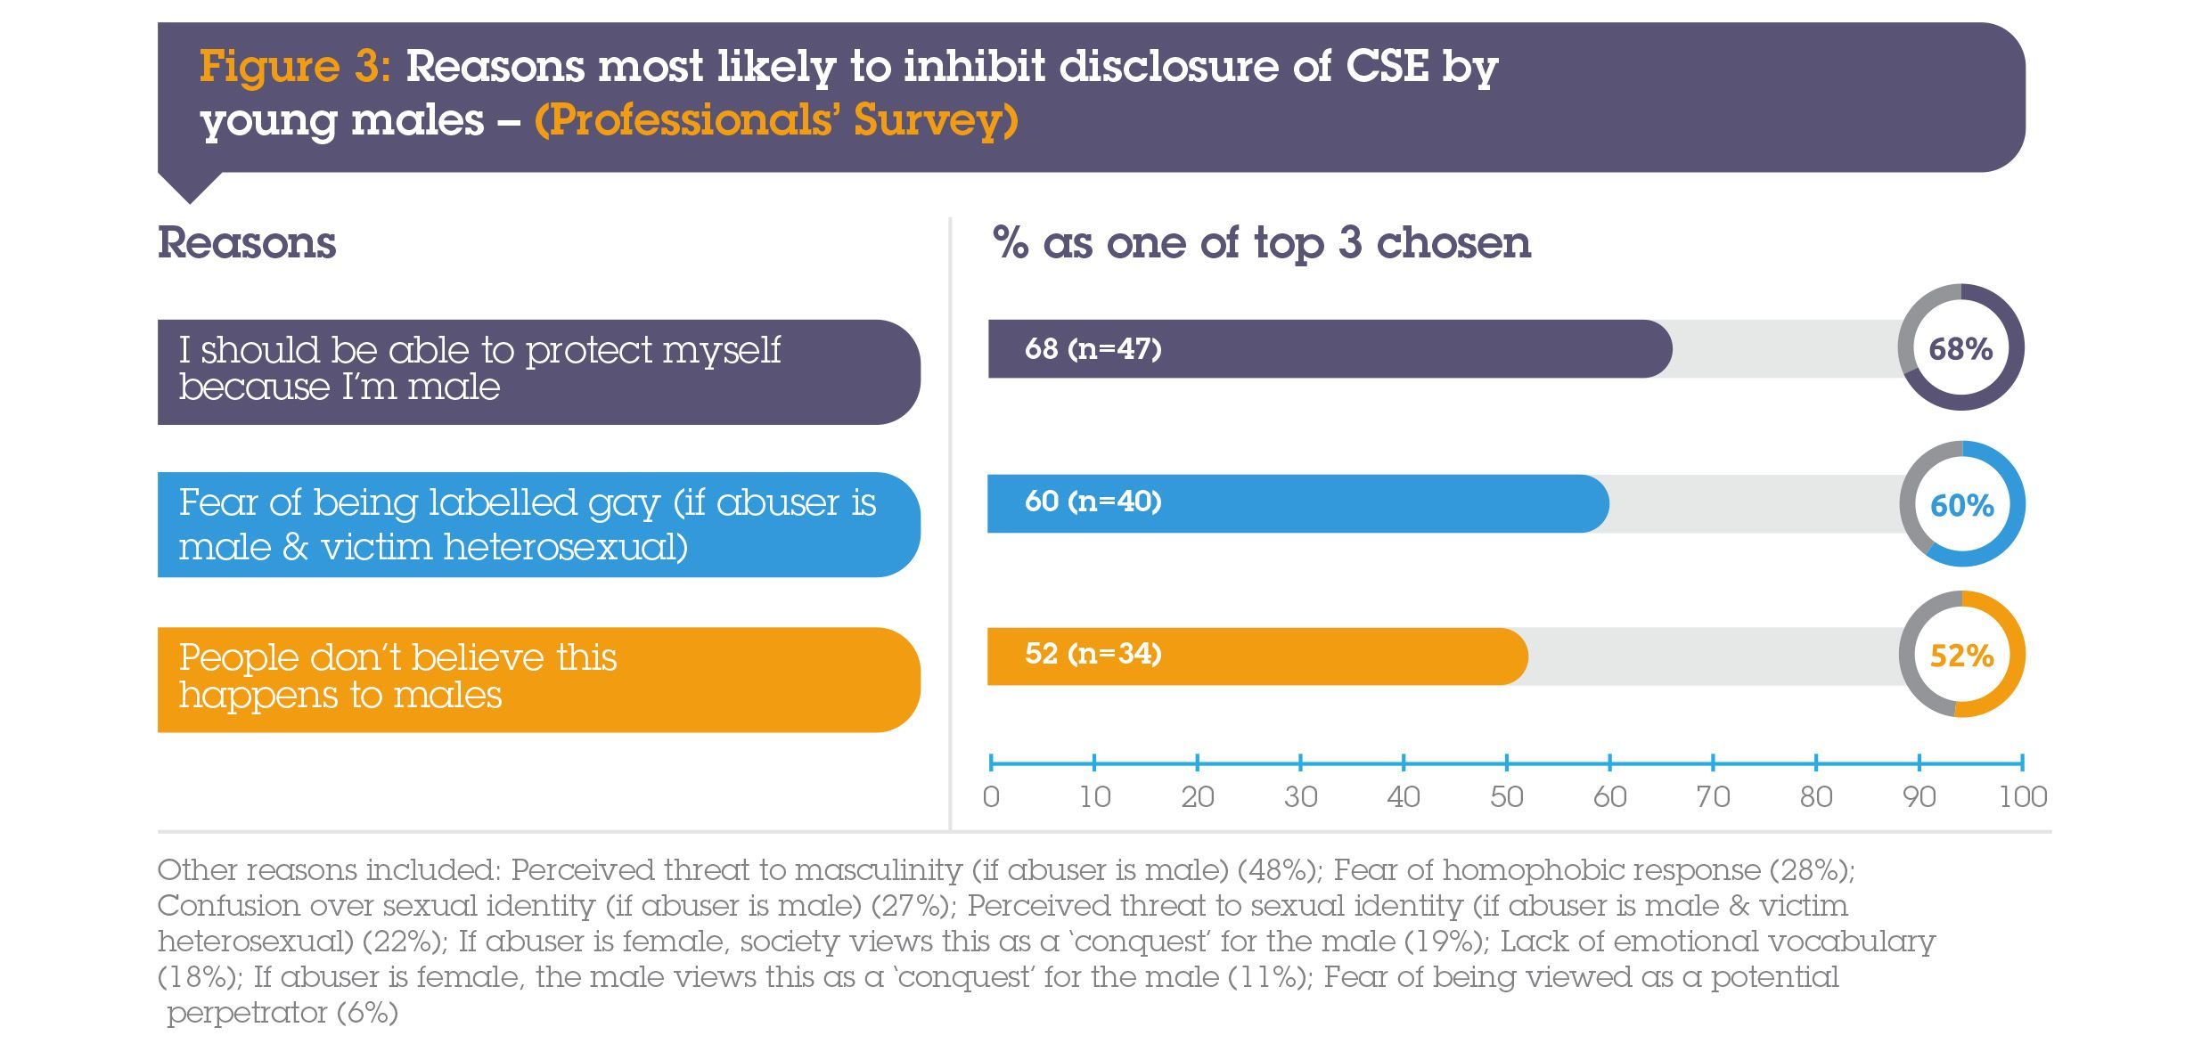

Slide 18
Stereotypical Assumptions regarding masculinity
Not the victim – others’ views/self views
The perpetrator
Protector of self and self preservation
Protector of others - shame, self-blame and helplessness
Threat to masculinity
Communication strategies

Slide 19
Not the victim
Where there has been a disclosure I think legislation is probably used in the same way, but I think where there is only suspicion, for example, where you might use a harbouring notice, I’m not quite sure people would automatically do that with boys because there seems to be an attitude that unless CSE is disclosed there is still a tendency to think that boys are just being boys, they are being naughty boys. (PI 6 Voluntary, CSE specialist).

Slide 20
Not the victim
I know there have been some areas where they’ve had large rings of boys being exploited… and I’ve said, ‘well we’ve never had any of those referrals’ and they look at me blankly and say ‘no we wouldn’t refer the boys’; so, I’m not quite sure who they refer the boys to, if anybody… (PI 6, Voluntary CSE specialist).

Slide 21
Not the victim
I have worked with men who have been raped and it did go to court but, because it came out that they did get an erection, the defence just slaughtered them saying ‘you must have enjoyed it because you got an erection’. (PI 27, Voluntary, CSE specialist).

Slide 22
Stereotypical Assumptions regarding masculinity
Not the victim – others’ views/self views
The perpetrator
Protector of self and self preservation
Protector of others - shame, self-blame and helplessness
Threat to masculinity
Communication strategies

Slide 23
The perpetrator
He has spoken about being befriended by a number of adult males who we knew to be of concern…But when we wanted to raise the vulnerabilities for this lad - and he is 15 but he’s six foot, he’s quite heavily built, he’s got a learning difficulty - but no-one wanted to see him as being vulnerable or being exploited, and were seeing him as a perpetrator only. …there are those definite risks [as him posing a risk] but equally, this is a boy we now know was being picked up of evenings, by adults of concern, taken from one area to another area and not being returned home until three or four in the morning with nobody reporting him as not being home. It took quite a lot of advocacy from the service to get people to accept this was a lad who is vulnerable as well as posing a risk… (PI 22, Voluntary CSE specialist).

Slide 24
The perpetrator
…we’ve had some contact with the Roma community. There is an example of a 12 year old lad where he and a young girl were both being sexually exploited by adults, but the language used about him was that he was a perpetrator. The girl involved, who was also being exploited by the adults, was marginally older and she was seen as a victim, but both had been exploited. He was seen as facilitating it...as sexually harmful rather than being seen as vulnerable to sexual exploitation too. (PI 4, Voluntary CSE specialist).

Slide 25
Stereotypical Assumptions regarding masculinity
Not the victim – others’ views/self views
The perpetrator
Protector of self and self preservation
Protector of others - shame, self-blame and helplessness
Threat to masculinity
Communication strategies

Slide 26
Protector of self
…a young lad maybe 15/16 goes missing, maybe three or four times in a month …They (professionals) think nothing of it because he’s a bloke and he can look after himself. A girl goes missing for one or two days and it’s all over Face Book, it’s all over [name of country] online, it’s out there… (P23, Voluntary CSE specialist).

Slide 27
Protector of self
whilst we all try to be impartial and non-judgemental, I think we are naïve to think it doesn’t influence us on some level. (P16, Social Services).

Slide 28
Self preservation
Obviously, I didn’t want to do it. I did it because it was a way of surviving; I needed money; I was homeless...this other bloke always put it that they were helping me out because I was homeless, and he was finding people for me… It’s just something you get into and it’s a way of surviving and sometimes you’ve just got no choice but to do the dirty things just to get on in life. (Pete, aged 30).

Slide 29
Self preservation
I worked with a young male who spends a lot of time sleeping rough and when it gets really cold and he just can’t face another night out, or he can’t break into a car for that night for somewhere to sleep, he actually said to me ‘you know well when I just can’t bear being cold again I go stay at this flat and I know I will just have to take it up the bum but that’s just what I’ve got to do sometimes’. (P24, Independent).

Slide 30
Self preservation
I felt a bit guilty as well that he [perpetrator] was being charged because…he was helping me. When he went to prison I felt ever so guilty because he was old, and I didn’t want him to go to prison… I did feel really bad. (Pete, aged 30).

Slide 31
Stereotypical Assumptions regarding masculinity
Not the victim – others’ views/self views
The perpetrator
Protector of self and self preservation
Protector of others - shame, self-blame and helplessness
Threat to masculinity
Communication strategies

Slide 32
Protector of others
He was very, very concerned about his mum. ’My mum lives in there and if my mum knew...it would devastate her, and all the neighbours would be looking at her’.

Slide 33
Protector of others
One of the other barriers is that sort of manipulation that goes on – ‘if you tell anybody about this…I’m going to kill you; your family is going to get it as well’. So, young men think ‘I can’t say this…I’m okay, I can do this…I’ll just be abused as long as my mother, as long as my father, as long as my granny, as long as my brothers and my sisters are perfectly fine; I can shield them from this’; and maybe it’s back to the masculinity issue – I can protect my family by just getting on with it

Slide 34
Shame
I think some of our young men are so ashamed that they are actually dangerous…their antenna for disrespect is so sensitive, because of what their trauma has been, that they are inclined… towards more extreme violence in terms of abuse of themselves and others…in terms of substance misuse, alcohol, involvement in fights and aggression. I think potentially some of the young people we would experience as most dangerous are most shame filled, and shame fuelled.

Slide 35
Self-blame
So, told my step mum and I burst into tears and I text my mum and my gran to say I’ve been involved in this ‘please don’t think less of me’. (Darren, aged 17).

Slide 36
Stereotypical Assumptions regarding masculinity
Not the victim – others’ views/self views
The perpetrator
Protector of self and self preservation
Protector of others - shame, self-blame and helplessness
Threat to masculinity
Communication strategies

Slide 37
Threat to masculinity
I think one of their biggest fears…is their loss of masculinity…and ‘I’m a man’. These communities are all built on strength and power and the size of your muscles, and to say those things out loud… is to take away from all of that never mind then if a report is written about it or the police get involved or these things start to get unpicked and that loss of masculinity is terrifying – terrifying to the point where I do believe young men would take their own lives before they would actually disclose that. (PI 8, Voluntary, non CSE specialist).

Slide 38
Stereotypical Assumptions regarding masculinity
Not the victim – others’ views/self views
The perpetrator
Protector of self and self preservation
Protector of others - shame, self-blame and helplessness
Threat to masculinity
Communication strategies

Slide 39
Communication strategies
Let’s not make assumptions about gender because there is a bit of a stereotype that boys don’t like to talk the way that girls do. Well, lots of boys don’t, but lots of boys do. (PI 24, Independent).

Slide 40
Communication strategies
the police were horrible to me, the education and welfare officers…they were horrible to me; my social worker didn’t understand me…no-one…I just wanted to not be judged…the police would come round to do a de-brief every time I went missing. I went missing 47 times and every time they came to do the de-brief they would normally come at two in the morning when I was sleeping and wake me up and tell me how much I’d wasted their time…just a bad kid and I’ve got loads of police looking for me while I’m out having fun. It was just unbelievable really, the sheer lack of interest the police had in my welfare and well-being. (Greg, aged 22).

Slide 41
Communication strategies
I went to A&E twice with injuries from the perpetrators of the abuse they had caused… the first time I told them I was in a fight and they just said, ‘you shouldn’t be getting into fight, we have lives to save’. Everyone just told me how much I was just a useless waste of time really. But the second time I went to A&E a triage nurse said ‘I don’t believe you were in a fight; I think there’s people that are doing this to you and I suspect you’re not going to tell me but if you do then I will have to pass it on. And I just said ‘well look, you know...’ because of her warmth and just her display of interest in my life and my welfare and, even though I’d only met this woman I did, I told her everything I said, ‘yes, I got beaten up by people and they make me have sex with them…’ (Greg, aged 22).

Slide 42
Level of awareness
Young males’ and professionals’ lack of awareness
Misinterpretation of behaviours
Inaccurate assumptions
Negative belief systems
Failure to respond
Lack of confidence
Fear of re-traumatising

Slide 43
Young males’ lack of awareness
I think there’s something more about young men not realising that what has happened is abuse…a huge barrier to young men being able to label the abuse, and therefore they are unable to disclose (because they don’t know there is anything to disclose). (PS 23, Voluntary, CSE specialist).

Slide 44
Young males’ lack of awareness
…because I consented to everything I didn’t think he was doing anything wrong, do you know what I mean? I wasn’t forced into it. He bought me gifts and bought me mobile phones, credit; took me out for nice meals. (Pete, aged 30).

Slide 45
Professionals’ lack of awareness
I hold my hands up, I don’t know a lot about it; I don’t know the signs. You are going on your gut. (PI 17a Voluntary, non-CSE specialist).
The amount of people who have said to me ‘I’ve been on CSE training, so I know all that’. And I will say, yes, I’m sure you have been on CSE training…but did it address boys, or did it just have a slide at the end that said, ‘and boys too’. (P27 – Voluntary, CSE specialist).

Slide 46
Professionals’ lack of awareness
I used to come home with blood in my boxers and all over my clothes when I had been abused… Nobody would ever reach out to me… (Simon, aged 22).

Slide 47
Professionals’ lack of awareness
I had money, nice new clothes, trainers, gifts – obviously stuff that a young lad can’t afford. I was in and out all the time, being picked up all the time, like outside where I was living and in people’s houses. I think they knew what I was doing. (Pete, aged 30).

Slide 48
Professionals’ lack of awareness
We would be getting in the same cars pretty much every night or in the same spot in the road and there is a police station about 10 feet down the road and the police would drive past and not one of them would say anything and they’d seen both of us getting in and out of cars…we would get in like 10 cars a night...we’d be out to like one in the morning, two in the morning, and not one police officer ever said anything. (Connor, aged 18).

Slide 49
...you’re scared to say because if you get it wrong and then it’s a real battle…and then if you don’t say it...Do you say to that young man and risk losing that relationship? (PI 17b, Voluntary, non-CSE specialist).

Slide 50
I remember sometimes I was so terrified of these people because I’d been beaten up for something…I’d be put in a taxi with another man and I would just stay silent the whole way, and the taxi driver… its things like ‘who is that older man you are travelling with at two o’clock in the morning – you look like you should be in school’. ‘Why are you not saying anything?’ I mean it’s clear from my face that something’s wrong and the taxi drivers and the hotel staff and even the public in the street in [name of town] town centre, when I got punched in the face, no-one did anything. But it’s not normal for an adult to punch a child in the face. (Greg, aged 22).

Slide 51
Solutions
Awareness for the general public, professionals, and young males
Training for professionals on the sexual exploitation of young males
An increase in challenge to professionals regarding their knowledge, attitudes and beliefs surrounding the sexual exploitation of young males.

Slide 52
SERVICE PROVISION
Additional time required to engage and work
Relevant experience more important than gender of workforce
Accessibility

Slide 53
Time available
…there is obviously stigma…‘boys don’t cry’…I think it takes a lot of time for a young man to build up a level of trust…to feel comfortable and be able to actually state what happened to him. For one particular male it took over a year and a half of working before he would actually state about the four years of abuse…I work for a service that is geared up in terms of not being governed by time constraints to actually be able to build up a good enough relationship to get to that… A lot of time it is testing the water, it’s seeing whether you do the things you say you are going to do to see if they can trust you to some degree…build the relationship with the young person before you introduce some of the things you need to do as part of the requirements within your service…Any assessment can wait. (PI 2, Voluntary, CSE specialist).

Slide 54
Gender of worker
…it’s very much about the worker. I don’t think they necessarily need a male worker. …in some instances, they may do but equally there are some who would need a female worker. We need a child centred approach and therefore, male/female, wouldn’t necessarily make a difference. All young males don’t display the same behaviours; some are very quiet, some are very boisterous, and some are very violent and dangerous, and we need to find a way of working with that young person. (PI 21, Voluntary, CSE specialist).

Slide 55
accessibility
I think there’s a whole lot of stuff there which a lot of mainstream projects aren’t picking up because a lot of services are working nine to five; they’re not out working late at night, they’re not out at weekends and this is when you see a lot of these young people. (PI 24, Independent).

Slide 56
IMPACT OF PERPETRATOR GENDER
Perpetration by females
Minimisation of harm
Concept of female as ‘nurturer’
Physical make-up of male

Slide 57
minimisation
...as a profession, we tend to minimise the impact on our boys, particularly if the abuse has been by a female, so we underplay that it may have been abusive... Now if we don’t accept that females can abuse in that way we are already minimising that impact before they tell us… (PI 22, Voluntary CSE specialist).

Slide 58
minimisation
You also get ‘the cougar’, but that’s not normal. But it’s that lad culture; ‘well done, gold star, you’ve earned your stripes, you’ve been with this older woman’. (Sammy, aged 21)
CSE is nearly a joke when it happens to males by a female. Something to laugh about, for example, ‘sexy older teacher’. (PI 19, Voluntary CSE specialist).

Slide 59
minimisation
…when it comes to females, people have a different attitude to that: ‘oh they had emotional problems, or they must have some kind of mental illness’. It’s never that the person is bad, just mad as it were. (Greg, aged 22).
She’s an older woman but I’m a guy – I should have known; it’s that whole thing – the men have control. No matter what age you are as a male, you can control yourself – you can do it – but it’s never true, is it? Less chance of her being prosecuted. I think people know that, so they just don’t bother. (Sammy, aged 21).

Slide 60
Physical make-up of the male
…you’ve got a good-looking female perpetrator grooms this boy…and she says, ‘well if you tell anyone I will just tell everyone that you forced me’. If that was the other way around, you would not really get a 25-year-old male turning round to a 14-year-old girl and saying, ‘I will tell everyone that you forced me’...there are a number of males who have been forced into things by women who have said ‘I can’t say anything because they are going to tell people that I raped her, and they will believe her not me’. (PI 27, Voluntary CSE specialist).

Slide 61
IMPACT OF PERPETRATOR GENDER
Perpetration by males
Threat to or confusion over sexual identity

Slide 62
...there is a bigger issue for boys and young men who are abused by males, that the victim then questions their sexuality… almost questioning whether they’ve ‘caught gayness’ or because they’ve been abused by the same sex it might give them some sort of interest in same sex relationships. (PI 9, Voluntary, CSE specialist).

Slide 63
The impact of homosexuality
Beliefs by others impacting recognition (including culture)
Reticence in naming sexual identity
Homophobia

Slide 64
Beliefs by others impacting recognition
Some people are embarrassed because they don’t want people to think they are gay. I’ve had that, and it’s caused me so many problems that you wouldn’t believe. (Simon, aged 22).

Slide 65
Cultural influences
I think it’s the culture of [named area] where actually you hear… ‘you can’t do this, you can’t do that…Why would you bother going to the police? Especially in [named] areas – that’s all I’ve known is [named culture]49 (Sammy, aged 21).

Slide 66
Cultural influences
Males who are from a South Asian background may be fearful to disclose due to reasons of honour-based violence and forced marriage. (PS 25, Voluntary, CSE specialist).

Slide 67
Cultural influences
Some people say ‘oh yes, being gay or bi-sexual is wrong and you shouldn’t really associate with anyone who is bi-sexual or gay, and for me I could understand that because if I went back to my home country, [named country], and they knew, I wouldn’t be able to go over there because they don’t handle that stuff lightly…(Malcolm, aged 14).

Slide 68
Cultural influences
Males from cultures where it would not be acceptable to disclose abuse or sexuality such as traveller communities. (PS 25, Voluntary, CSE specialist).
…a big no, no. And I have worked with young men who have been sexually exploited who are from the travelling community and especially where there are particular notions of masculinity. ...where you’re brought up to box, and that’s not your thing, and that terrifies you… (PI 24, Independent).

Slide 69
Cultural influences
I’m probably the youngest of my group of friends…so in that group there will be 5 or 6 of us, and most of my friends will be Christian and gay. It [CSE] happened to us all. And I think the church adds that extra bit into it which makes it a lot harder but also a lot easier to get into that because if you grow up in a place that says, ‘we love you, but we don’t actually’, you will go find it from somewhere else. (Sammy, aged 21).

Slide 70
misinterpretation
When I was in foster care social services put me with a gay foster carer because they thought that was more beneficial to do, but I never identified as a homosexual…I think because I was having some kind of friendship with older males and being found in the gay area of [named city] it was this thing of exploring my sexuality, so it was cooler that this gay male would be a positive role model. But I’ve never identified as bi-sexual or homosexual. That cunt abused me an’ all. (Simon, aged 22).

Slide 71
misinterpretation
Male CSE is mistakenly dealt with as ‘sexual exploration’. (PS 36, Police).
...we’ve had people say in the past that they’re not going to refer them into our project because they’re not gay…‘they are not gay, so they can’t be involved in CSE’. (PI 28, Voluntary, CSE specialist).

Slide 72
Reticence in naming sexual identity
It’s not just you’re saying that…I’ve been with this older man and he’s done this and this and this but…it’s a man so you have these two things going on. So, not only maybe they take the blame but ‘oh you’re gay now as well’. You’ve got a double one and then you’ve got to deal with that in school as well. (Sammy, aged 21).

Slide 73
Reticence in naming sexual identity
Ever since they found out about that it knocked my confidence and it literally made me feel wrong because I’m gay; ‘why am I doing this because it’s wrong…it’s because I’m gay’. It took a good four years for that to sink in that it wasn’t cause I’m gay. (Darren, aged 17).

Slide 74
Professionals’ reticence
We are maybe restricted by our own attitudes and moral compass or moral code. (PI 21, Voluntary, CSE specialist).

Slide 75
Homophobia
Society is either not aware or fearful of tackling the subject for fear of being labelled homophobic...and there is concern that an investigation may be seen as anti-homosexual. (PS 36, Police).
We live in a culture that generally still stigmatises male to male sexual experiences. (PS 78, CSE specialist).

Slide 76
Co-presenting issues impacting recognition (Criminality and gangs)
Youth Offending
Focus on offending behaviour
Offending as a manifestation
Misinterpretation of behaviour as criminal

Slide 77
Co-presenting issues impacting recognition (Criminality and gangs)
Youth Offending
Focus on offending behaviour
Offending as a manifestation
Misinterpretation of behaviour as criminal

Slide 78
Focus on offending behaviour
…a lot of criminality coming up, especially with boys and young men, where they maybe have the history of committing crimes. I have spoken to colleagues in other professions where there are young males committing offences and it’s not really looked at properly. (PI 3, Police).

Slide 79
Focus on offending behaviour
I do think there is too much of a tendency to rush boys into the criminal justice system when they are kicking off…I think it can be more of a mixed bag with boys and the sexual exploitation gets missed and they are more likely to go down the youth offending route. (PI 6, Voluntary, CSE specialist).

Slide 80
Focus on offending behaviour
I know we get a lot of referrals for young males where there are offending issues and other stuff going on and one of the challenges is to pick through to see if there is CSE. It’s difficult because everyone else is focused on their offending. (PI 4, Voluntary, CSE specialist).

Slide 81
Focus on offending behaviour
Services need to understand that boys’ response to dealing with trauma is often displayed by challenging behaviour; services need to see beyond the behaviours. (PS, 28, Voluntary CSE specialist).
Niggles and concerns may be quickly forgotten for the usually criminal/aggressive young man in the chaos of a children’s home. (PS, 51, Voluntary, non-CSE specialist).

Slide 82
Focus on offending behaviour
...I worked with a young guy who was groomed when he was younger...everyone thought this man was grooming him and he would say ‘no, no he’s a mate…Eventually he got a girlfriend who was the same age as him…He mentioned in passing to his social worker that he and his girlfriend were sending each other naked pictures. There’s no violence, no coercion, no pressure…the social worker heard it, freaked out, told the police, the police came and recorded a crime in his name… (PI 27, Voluntary, CSE specialist).

Slide 83
Focus on offending behaviour
In the future he wanted to be a [named profession]. He had a DBS52 check and it showed on his DBS, and he didn’t get the job because of that. The really sad thing about that is him and his girlfriend split up…and the man that everyone suspected of grooming him raped him, and because of the police’s overzealous response to the images, he did not want to engage with police and he did not want to give a statement and he said to me ‘if they hadn’t criminalised me for those images I would probably have spoken to the police’. (PI 27, Voluntary, CSE specialist).

Slide 84
Co-presenting issues impacting recognition (Criminality and gangs)
Youth Offending
Focus on offending behaviour
Offending as a manifestation
Misinterpretation of behaviour as criminal

Slide 85
Manifestation
There may be more acting out of the trauma through involvement in offending behaviour in the community. This behaviour may take the form of criminal damage, assaultive behaviour and possible fire setting, combined with risk taking behaviours linked to substance misuse. (PS 84, Police).

Slide 86
Manifestation
My fear is, they don’t talk about this, they keep it to themselves, can’t see any way out of their situation and sometimes the only way out is looking to end their life or to harm themselves in some way or to get involved in criminal activity… (PI 23, Voluntary CSE specialist).

Slide 87
Manifestation
They’ve no outlet and they can’t talk about it and I think that’s the biggest part of the impact and the difference of impact for a young man because they hold onto it…nowhere to put all that trauma, no-one to trust or no way of expressing it and most of them do finally implode and do something very serious to themselves or end up in prison. There’s an awful lot of young men in prison who have been in our house. (PI 8, Voluntary non-CSE specialist).

Slide 88
Aggression and drugs
I still have anger, but it was a lot worse last year. A lot has gone now…I know that because I haven’t hit a wall recently. (Adam, aged 17).
I think the problem is for somebody who doesn’t talk, that build things up, and when things build up you finally explode, and you go down two different roads – you go down taking drugs to get rid of everything or you end up being a nasty person towards everybody. I experienced both of those. (Simon, aged 21).

Slide 89
Aggression
…they use their power as something, so you feel you have to do something to them or they are going to do something to you, and the problem is, when I’ve taken action because no-one else was listening, I get arrested. That’s because I’ve had enough, and I take things into my own hands. But if no-one else is talking what do you do? (Simon, aged 21).

Slide 90
drugs
…you go down taking drugs to get rid of everything...before, I would just shove 12 grams down my nose in one night…Drugs are often used as a pain relief just as a normal person takes paracetamol to try to take away a headache. (Simon, aged 21).

Slide 91
drugs
Because when you are telling these people, and nothing is being done, well you think ‘It’s got to be normal, hasn’t it?’… kept myself stimulated to forget about everything. It was also an easier way to deal with the abuse, so I didn’t feel any pain at the time and after. (Simon, aged 21).

Slide 92
Imprisonment versus disclosure – a constrained choice
There’s one young man in particular stands out… and just from he was 16, every time he came out [of prison], he was maybe out a couple of weeks and he just did something, and he made sure it was the right amount to get back in. Not a really aggressive young man in any shape or form and now he’s 21 he has to work harder to make sure he’s inside you know; a wee petty theft isn’t going to do it… so he has to up the game. (PI 8, Voluntary, non-specialist).

Slide 93
Imprisonment versus disclosure – a constrained choice
He turned up at the house one day and he had a yellow box...and he was just weeping…He was just saying ‘look at this, look at this’… and it was an injection that, if you found this young man lying on the street…you had to snap open the box and put it into his heart. I mean that was how far gone with substance misuse he was, and this had really shocked him and upset him that the doctor had given him this, and he said, ‘look at what my life has come to, I’ve got to get myself back inside’… (PI 8, Voluntary, non-CSE specialist).

Slide 94
Imprisonment versus disclosure – a constrained choice
... and he’s able to say ‘I can’t live…I’m going to die…I’ve got to get off the streets’ and he did it, he got himself off the streets… And, of course, he did the most heinous thing, he attacked two paramedics, two people who were trying to help him… (PI 8, Voluntary, non-CSE specialist).

Slide 95
Co-presenting issues impacting recognition (Criminality and gangs)
Youth Offending
Focus on offending behaviour
Offending as a manifestation
Misinterpretation of behaviour as criminal

Slide 96
Misinterpretation of behaviour as criminal
Because of all the risk indicators of my CSE really…where I was coming home with injuries and bruises and things like that; I had the use of 2 mobile phones and I was very secretive about calls, I had new trainers, new clothes, anything I wanted I had and that was interpreted as being in criminal activity with other young people which wasn’t the case. (Greg, aged 22).

Slide 97
Misinterpretation of behaviour as criminal
I think that the project worker, because she works with young people in gangs every day, I think she could see from how I was that it was unlikely that I was in a gang, and it was her I told I was in a relationship with an 18-year-old man. She passed it on to social services, but nothing was done. (Greg, aged 22).

Slide 98
Paramilitarism
Impact of fear, control and constrained choice
Fear of consequences for self and others
Control through drugs
Coercion to perpetrate
Gains versus disclosure
From tolerance to normalisation

Slide 99
Paramilitarism
Impact of fear, control and constrained choice
Fear of consequences for self and others
Control through drugs
Coercion to perpetrate
Gains versus disclosure
From tolerance to normalisation

Slide 100
Impact of fear, control and constrained choice
There was one young man one night when I was on nightshift, and he came down in tears, floods of tears…and then he disclosed he was in huge drug debts and a paramilitary group were making him perform oral sex as a way to pay off this favour. His social worker at the time was involved and reported it to the police but he didn’t want to proceed with the investigation. He withdrew his statement and retracted what he had said. (PI 16, Social Services).

Slide 101
…that touts get a hard time or get beat up, especially by this known group of paramilitaries. (PI 16, Social Services).

Slide 102
Paramilitarism
Impact of fear, control and constrained choice
Fear of consequences for self and others
Control through drugs
Coercion to perpetrate
Gains versus disclosure
From tolerance to normalisation

Slide 103
fear
Northern Ireland has this real sense of community where… ‘we can work it out,’ but because of the way it is with the paramilitaries and no equal rights here, …everyone in the estate knows everyone… You walk outside your door and everyone knows what time you left at… but because of those other things (sexual exploitation) it’s just surface level. It’s ‘I will tell you about this and this and this, but I won’t tell you ever about this’. (Sammy, aged 21).

Slide 104
fear
Especially in [named paramilitary area] – that’s all I’ve known… these are all manly men and I know, if I went and told my dad, him and his manly paramilitary friends would go up and kill him, I mean literally kill him there and then on the spot. So, for a young male feeling that sense of responsibility, knowing you’ve caused someone’s death because you’ve told about something happening. (Sammy, aged 21).

Slide 105
Paramilitarism
Impact of fear, control and constrained choice
Fear of consequences for self and others
Control through drugs
Coercion to perpetrate
Gains versus disclosure
From tolerance to normalisation

Slide 106
Control through drugs
With females it’s more about control; in that they would be given a bit of the substance and ‘here’s a party’ and ‘you take a wee bit of this love’; it’s less of that party atmosphere and more of this big man, hard man atmosphere, you know ‘you’re part of our group now and you’re part of moving this [drugs] from here to here’ and it’s very much tied in…like a job rather than a party situation. (PI 8, Voluntary, non-specialist).

Slide 107
Paramilitarism
Impact of fear, control and constrained choice
Fear of consequences for self and others
Control through drugs
Coercion to perpetrate
Gains versus disclosure
From tolerance to normalisation

Slide 108
Coercion to perpetrate
…so there would be powerful individuals in the community who would organise line-ups and then there would be fear attached if young men don’t turn up and do as they are asked; then there would be repercussions – could be very, very sinister; they could be beaten up...Young males would be expected to perform sexual acts on girls as well so then they look like they are the predators but essentially, they are being controlled by the paramilitaries. So, there is a very fine line between victim and perpetrator. (PI 21, Voluntary, specialist).

Slide 109
Paramilitarism
Impact of fear, control and constrained choice
Fear of consequences for self and others
Control through drugs
Coercion to perpetrate
Gains versus disclosure
From tolerance to normalisation

Slide 110
Gains versus disclosure
You’ve got a lot of these young males coming from very deprived areas and I suppose a lot of the deprived areas, if they are run by paramilitaries, they are the men that are held in high esteem. (PI 12, Social Services).
The paramilitaries have access to guns, they have access to drugs and a lot of things that would be used to lure young men into involvement in certain things. (PI 21, Voluntary, specialist).

Slide 111
Paramilitarism
Impact of fear, control and constrained choice
Fear of consequences for self and others
Control through drugs
Coercion to perpetrate
Gains versus disclosure
From tolerance to normalisation

Slide 112
From tolerance to normalisation
…if you grow up in the wrong place…if you are born into the wrong house…He saw that he was never going to live anywhere else in his life; that was him for the rest of his days, he was never going to be employed or have proper education but…this was how he was going to make his money, this was his future; so everything was tied in to this and whatever was going on, on the side, you just had to soak it up, you just had to get on with it; that was life and just accept it. Young men get very stuck, ‘this is my life, this is the way it is. This is the way it was for my brother, my da, my cousin’. (PI 8, Voluntary, non-CSE specialist).

Slide 113
Conclusions
Commonality and dissonance – views of young people and CSA literature
Challenge stereotypical assumptions re males and masculinity
Importance of role of gender constructs and socialization
Dissonance between views of young people and professionals
Implications for interpretation and application of policies and procedures

Slide 114
Young peoples’ main perceived inhibitors to recognition of males as victims of CSE
 | Personal | Socio-cultural
Barriers to disclosure | A sense of shame
 | Difficulty explaining what happened
 | ‘I should be able to protect myself’
Impediments to identification |  | Males are seen as abusers rather than victims
 |  | Males cannot be victims of CSE
 |  | If abused by a female, it is seen as a ‘conquest’ for the young male

Slide 115
Professionals’ main perceived inhibitors to recognition of CSE in young males
 | Personal | Relational | Socio-cultural
Barriers to disclosure | I should be able to protect myself because I’m male | Fear of being labelled gay | People do not believe CSE happens to males
Impediments to identification | Lack of knowledge about male CSE | Criminal behaviour masks victimhood | Thinking males are perpetrators rather than victims

Slide 116
Recommendations
Policy and practice
Services
Training
Campaigns
Further research

Slide 117
Briefing Paper No. 1
https://www.safeguardingni.org/briefings

Slide 118
Coming soon……
Briefing Paper No. 2: The influence of paramilitary gangs in Northern Ireland on the recognition of CSE in young males
Briefing Paper No. 3: The association between youth offending and the recognition of CSE in young males.

Slide 119
Contact details
Email: Jacqui.devlin63@btinternet.com
07813373935
@DevlinJacqui

