Slide 5
1. When you become a Social Worker, you will have the opportunity to make a positive difference in people’s lives, and to champion human rights and social justice.
2. You will be part of a profession where you feel a sense of accomplishment and fulfilment.
3. You can apply for an incentive payment of £4,500 for each year of study if you live and study Social Work in Northern Ireland,
4. You can expect to choose from a number of social work employers - the Health and Social Care Trusts, Probation, Youth Justice, the Education Authority or in the third sector (voluntary, community and independent organisations).
5. Your starting salary as a newly qualified Social Worker in HSC will be over £22,000, with an automatic pay rise to £26,000-£32,000 after successfully completing the Assessed Year in Employment (AYE).
6. Newly qualified Social Workers receive extra support to develop their skills, knowledge and competence through the ‘Assessed Year in Employment’
7. Your Social Work training will blend academic and practice learning, offering you direct contact with service users and carers.
8. When you graduate, there will be a variety of job choices working across the life-span (with children, adolescents, adults and older people); as part of specialist teams (mental health, addictions, family support) residential and day care settings, hospitals, schools, prisons and community development projects.
9. As a qualified Social Worker, your career will offer excellent opportunities for promotion, and access to high quality post-qualifying courses at Master’s and doctoral level for continuous personal and professional development.
10. Your Degree in Social Work will enable you to work in countries outside of the UK throughout your career.

Slide 8
1. Social Care matters and it’s everyone’s business.
2. As a social care worker you are caring, respectful, flexible, supportive and professional and make a positive difference in people’s lives.
3. You will help to support, care for and empower people to live well and as independently as possible.
4. You will deliver a range of practical help and emotional support to people, families and communities.
5. You will be part of a profession where you will feel a sense of accomplishment and fulfilment.
6. When you choose social care as a career you will be part of the largest workforce within the Health and Social Care sector with a range of job opportunities across the Health and Social Trusts, private and voluntary sectors.
7. You will enter a workforce which offers a variety of job choices working with children, young people, adults and older people across a range of care settings such as in a person’s own home, community, nursing homes, residential homes, day care, supported living and much more.
8. During employment there are a range of learning and development pathways to help you progress in your career helping you with promotion opportunities.
9. As a social care professional you will be registered and working to the Standards of Conduct and Practice for Social Care Workers set by the Northern Ireland Social Care Council.
10. A career in social care will be a career for life and the workforce needs more caring people like you.

Slide 11
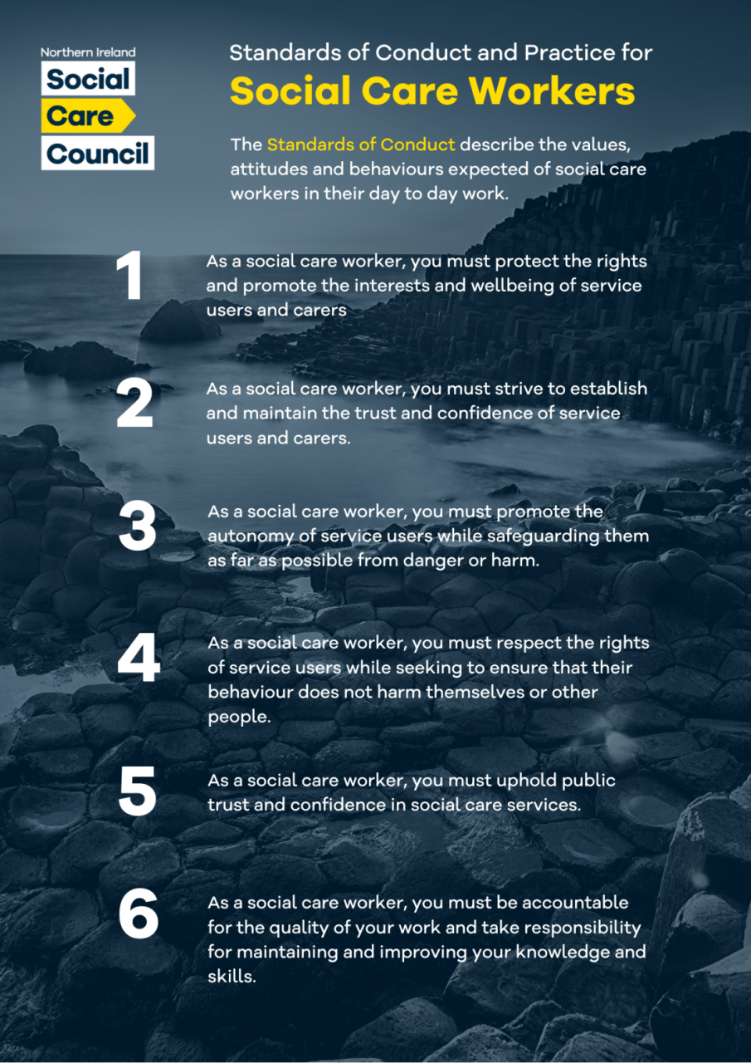
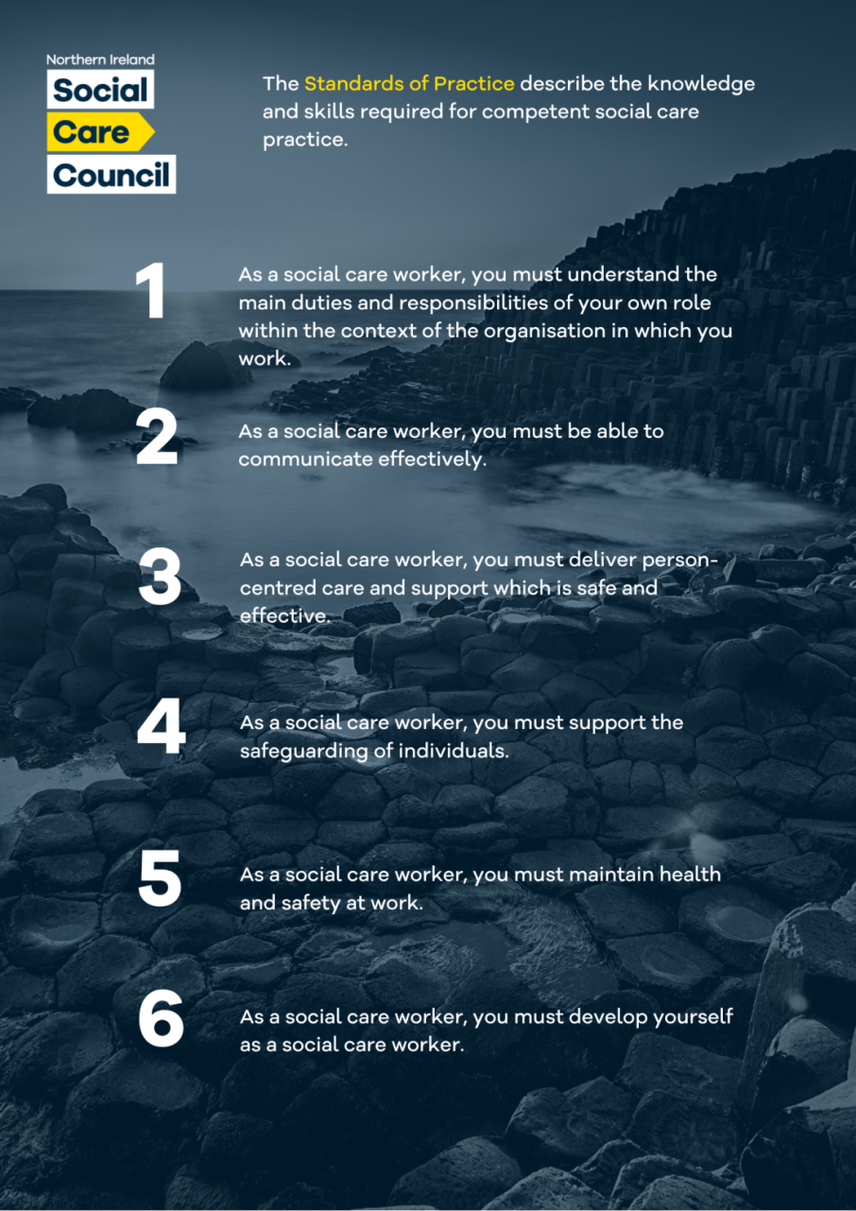
Notes:
Introduction to session, outline of objectives

Slide 12
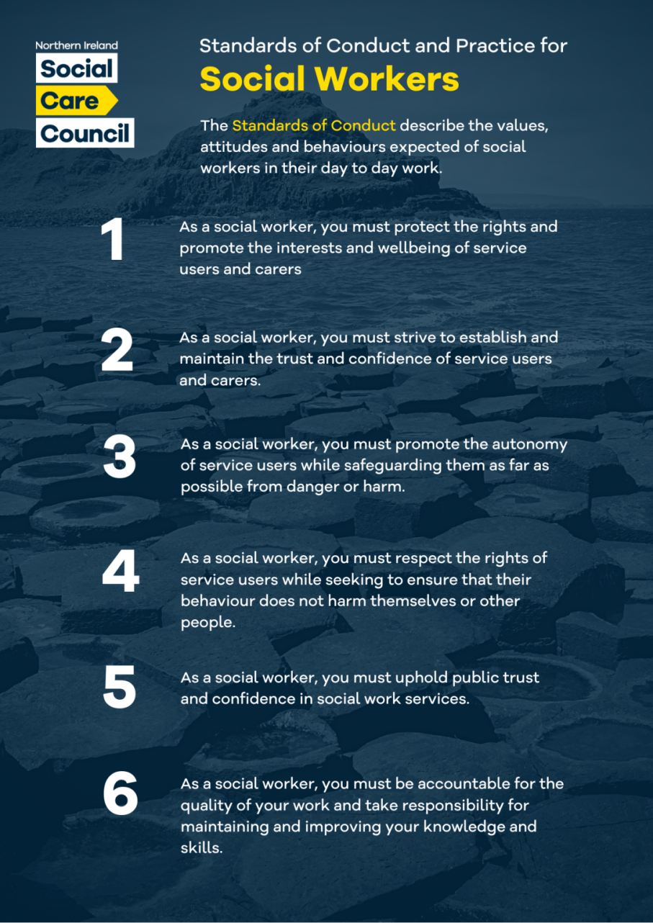
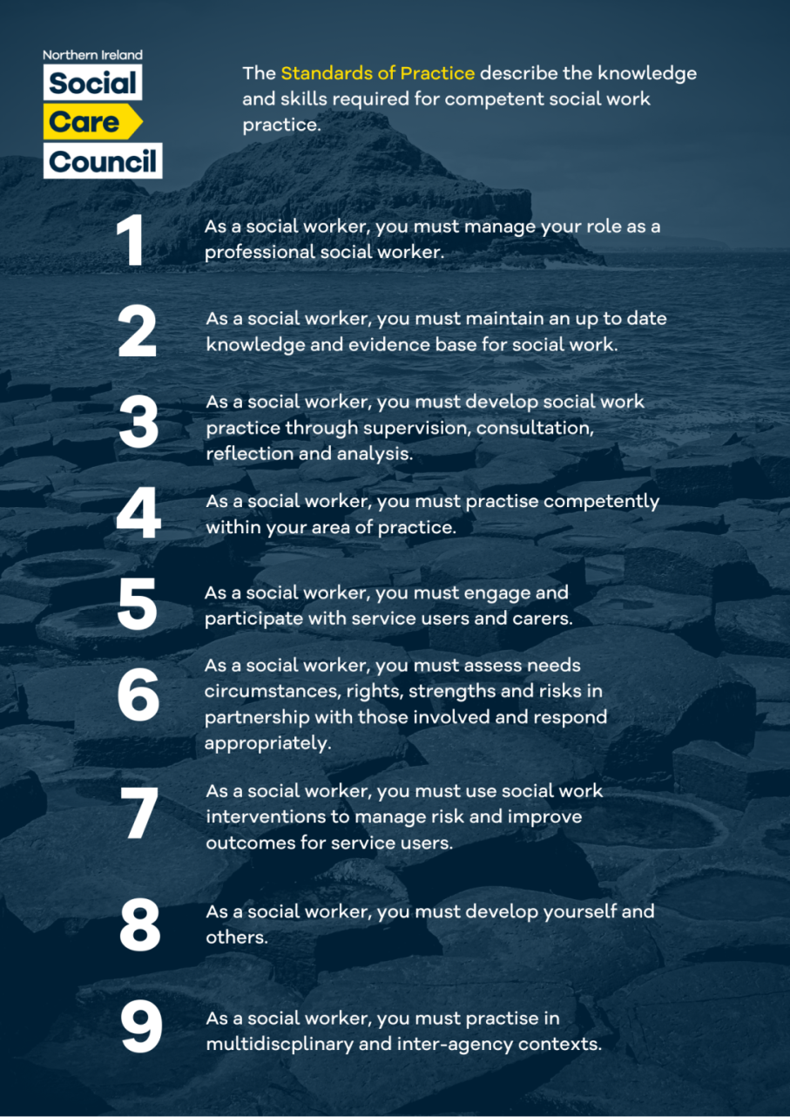

Slide 13
@NISocialCareCouncil
@NI_SCC
@ni_scc

