Slide 1
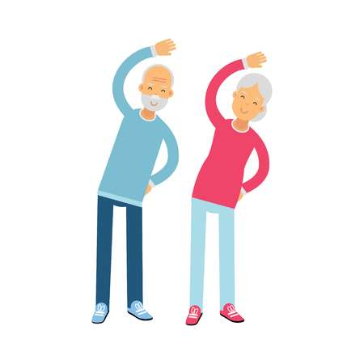
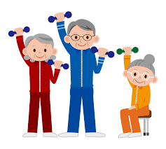
Activity Coordinators - Healthy ageing and physical activity: an awareness session
Angela Gemmell, Physiotherapist, Care Home Support Team, SHSCT.

Slide 2
The seed needs watering!

Slide 3
The Importance of Activity Coordinators
Activity Coordinators – role is to facilitate and support activities
Activities can improve life for residents: their memory, dexterity, appetite, fitness, confidence, social contacts
Cultural change in care homes – everybody’s business to promote activity
A wide range of everyday tasks can become engaging and meaningful activities
All staff actively engaged in this approach
Person centred activity – residents feel unique and valued, their wellbeing paramount: enjoyment, smiles

Slide 4
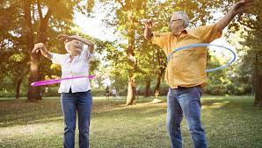
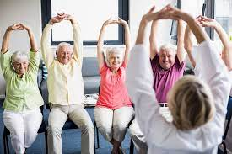
Physical Activity – what is it?

Slide 5
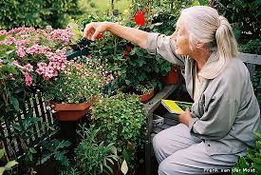
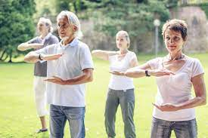
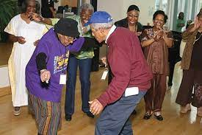

Slide 6
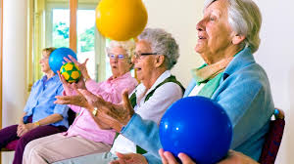
The importance of Physical Activity
Physical Activity in older people is critically important in the prevention of disease, maintenance of independence and improvement in quality of life
Being active can play an important part in positive ageing and reducing impact/delaying onset of frailty
Regular physical activity can bring health benefits to people of all ages and the need for physical activity does not end in later life, with evidence increasingly indicating that physical activity can extend years of independent living, reduce disability and improve Quality of Life

Slide 7
What physical activity is appropriate for Older Adults?
The type of activity and intensity will depend upon the ability of the person.
The intensity of the aerobic activity takes into account the older adult’s aerobic fitness: aerobic means “with oxygen” – breathing and HR ↑
Activities that maintain or increase flexibility are recommended
Balance exercises are recommended for older adults at risk of falls
Fun, enjoyment, choice!
Older adults who have medical conditions or disabilities should be screened by a medical
professional

Slide 8
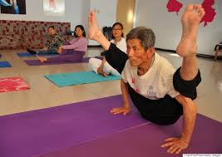

Slide 9
The health of the older person, physical activity and training
Some type of training is vitally important when encouraging/demonstrating/leading physical activities, regardless the age of the person
However, with ageing comes more risk:
Important to be able to provide the right activity at the right intensity to the right person
Important to monitor how the person is doing – it may be too easy, it may be too difficult. Consider dizziness, shortness of breath (able to speak in sentences), pain, general malaise, risk of falls, cardiac concerns
Important to adjust activity as required or discontinue
Important to know when to report concerns to medical staff
Safety is Paramount

Slide 10
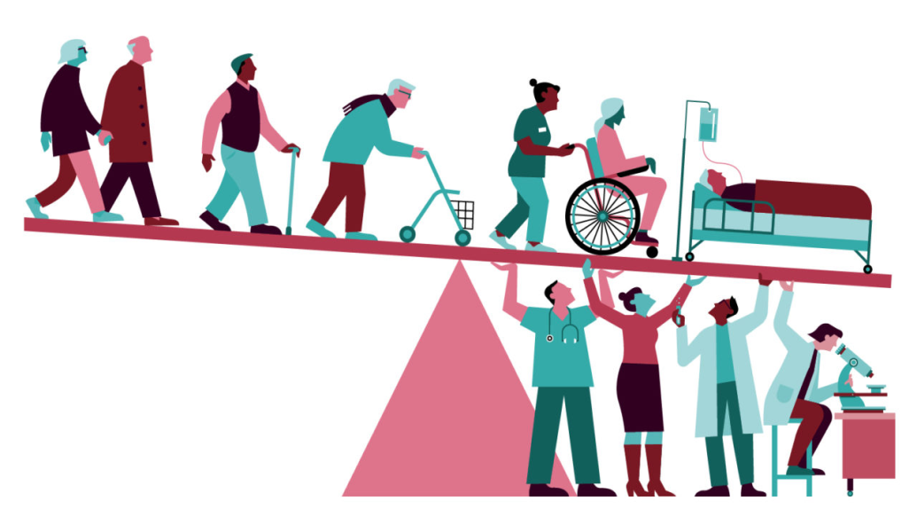
Ageing
Dramatic global population ageing has brought new demands to improve older people’s health by adding “quality” to their extended lives and increasing physical activity is one way to bring this about: adding life to years,
not just years to life!

Slide 11
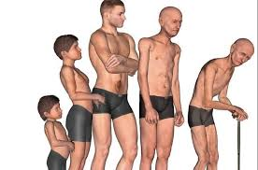
Normal Aging Process
Muscle strength lost
at 1-3% p.a. from 50+
Muscle power lost
at 3-4% p.a. from 50+
Bone density lost
at 1% in males,
2-3% in females from 40+
Aerobic capacity lost
at 1% p.a. from 50+
Ligament tensile strength 50% by 60yrs +
Notes:
In addition to loss of muscle mass

Slide 12
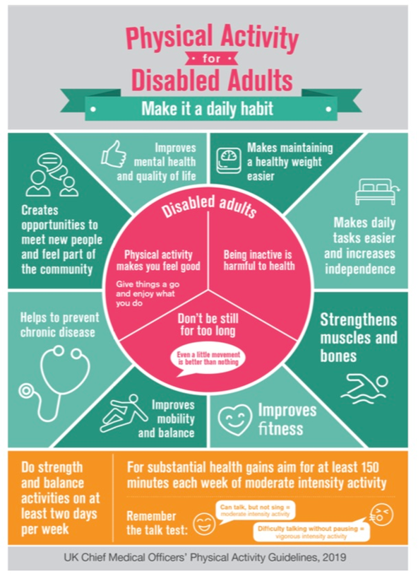

Slide 13
Principles for safer exercising
Inactive adults – gradually build up exercise to reach recommended levels
Assessment undertaken by health professional eg GP, physiotherapist, nurse
Pre-screen exercise questionnaire
Appropriate training
Warm up, commence low intensity exercises, safe environment (temperature, footwear, hydration, consent)
Up on feet? Increased risk of falls

Slide 14
Are We Ever to Old to Exercise??

Slide 15
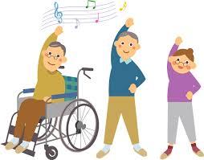
Exercise
In the >65 years old, studies have showed that on average 10.7 hours per day is spent sitting, with 40% living a sedentary lifestyle
It is crucial that this is addressed, and that older adults are encouraged to become more active, to do things they enjoy
There are many health benefits of exercise, this stands true for all ages

Slide 16
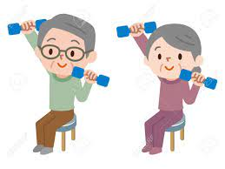
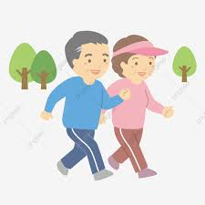
Benefits of Exercise
Resistance training will improve strength and can reverse or delay the decline of muscle mass and strength that occurs with ageing
Aerobic exercise can help to improve endurance in the skeletal muscles. Together, this can help older adults to maintain their participation in ADLs and therefore maintain independence.

Slide 17
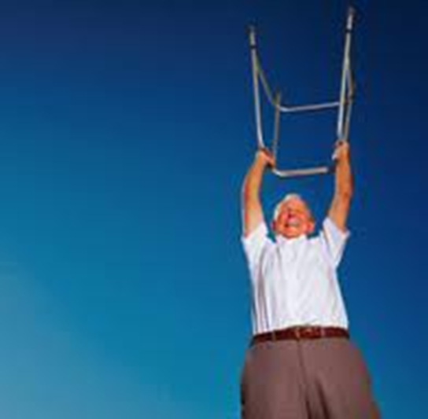
Muscle strength
25% of women, 7% of men aged 70-74 do not have sufficient strength in their legs to rise from a low chair without using their arms

Slide 18
Benefits of exercise
Importantly the benefits of physical activity can be enjoyed even if regular practice starts late in life. It has been suggested that older adults engaged in regular physical activity demonstrate improved:
Balance
Strength
Coordination and motor control
Flexibility
Endurance

Slide 19
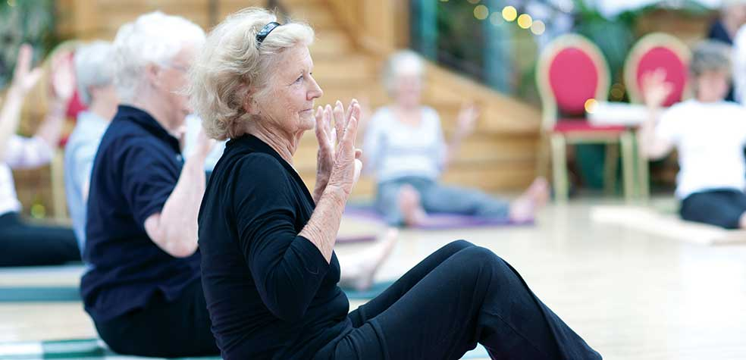
Which exercise might suit an older adult?
Activity/ exercise | Flexibility | Strength | Stamina | Balance
Brisk walking |  | ü | ü | ü
Climbing stairs |  | ü | ü
Swimming | ü |  | ü
Dancing | ü |  | ü | ü
Bowls or golf | ü |  | ü | ü
Yoga | ü | ü |  | ü
Tai chi | ü | ü |  | ü

Slide 20
Benefits of Exercise
Exercise can also help to reduce the risk of many non-communicable diseases. Exercise has been shown to:
Reduce the risk of Coronary heart disease, stroke, certain types of cancer & diabetes
Prevent post-menopausal osteoporosis and therefore reduce the risk of osteoporotic fractures
Reduce the complications of immobility
Reduce the risk of accidental falls
Improve mental/cognitive function, reduces stress/anxiety and improve self confidence

Slide 21
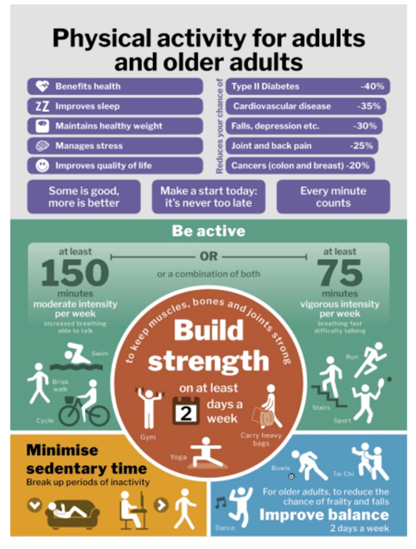

Slide 22
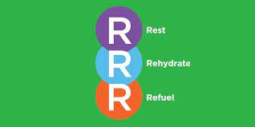
Good advice for everyone!
Do what you can and start slowly:
It is fine to push yourself a wee bit, but don’t do anything that doesn’t feel comfortable and trust your instincts about your own limits.
Stop if you are feeling any pain or lightheaded and make sure to rest and stay hydrated.
A little soreness in muscles and joints after exercise is quite normal for the first day or two.
And remember:
every little helps!

Slide 23
Other factors to consider:
1.Frailty is a distinctive health state related to the ageing process in which multiple body systems gradually lose their in-built reserves.
Frailty corresponds with increasing age, but is not an inevitable consequence of aging
Around 10% of people aged over 65 years have frailty, rising to between a quarter and a half of those aged over 85 years.
Frailty is a dynamic condition and is potentially reversible – now considered as a long term
condition

Slide 24
Other factors to consider:
2. Deconditioning can be defined as the multiple, potentially reversible changes in body systems brought about by physical inactivity and disuse. Such changes often have significant functional and clinical consequences in older people.
When medically fit to do so, an older adult should be up and moving as bed rest can result in respiratory compromise, skin breakdown, decreased muscle strength, joint stiffness, continence issues, decreased appetite, increased confusion, and so on…..

Slide 25
Other factors to consider:
3. Osteoporosis: Physical activity helps to keep bones strong and healthy
Bones are living tissues and get stronger when you use them
As we get older we lose bone strength
For exercise to be most effective at keeping bones strong, combine:
Weight-bearing exercise with impact
& muscle strengthening exercise

Slide 26
Other factors to consider:
4. Dementia: blood flow to brain and may help reduce risk of developing dementia
Exercise can help to promote a normal day-night routine, improve mood & social participation
Helps reduce stress and depression; repetitive activity e.g. walking help reduce anxiety
Exercise programme introduced in early stages of dementia more likely to be maintained
Tips: warm up, cool down, start with short sessions, safe environment, use rail/chair for safety, stop if feeling unwell, seek medical advice
Select activities resident enjoys and stick with it!
Safety awareness –close supervision, simple instructions, eye contact

Slide 27
Other factors to consider:
5. Covid: During the pandemic it is probable that function will have declined in some older adults due to:
Acute and chronic conditions
Challenges with access to non-urgent rehabilitative services
Physical inactivity
Becoming unwell with Covid 19
Physical activity and exercise are cornerstones of healthcare.

Slide 28
References/resources
www.10today.co.uk
10 Today involves short, ten-minute routines to get you stretching and moving and is broadcast on the radio and available online.
It’s adaptable, accessible and fun to do.
Our vision is a world where being physically active is part of daily life for older people.

Slide 29
References
www.culturehealthandwellbeing.org.uk Learning for older people in care settings – A guide for activity coordinators and care staff
www.dementiaworkshop.co.uk: 12 tips for Activity coordinators
www.who.int: Global recommendations on Physical activity for Health
www.nhs.uk : Physical activity guidelines for older adults – NHS
www.ageuk.org.uk : simple ways to keep active during the coronavirus pandemic

