Slide 2
Homelessness Awareness Week 2022 ‘Homelessness Prevention – Having the Conversation’
A presentation on behalf of the Homelessness Prevention Forum by;
Declan Morris (Extern) & Paul Fleming (NIACRO)

Slide 3
‘HOME’ video
H

Slide 4
Homelessness Prevention Forum – A brief history & Vision
Formed in 2013 to raise awareness of floating support services that help prevent homelessness
Develop a means for those who could benefit from floating support intervention to gain easy access - Common enquiry form/services directory 2015
Belfast Area Action Plan – Homelessness Prevention 2017
Create a strong collective response to consultations
Create a means of sharing, reflecting and learning from each other
Paul.Fleming@niacro.co.uk
Declan.Morris@extern.org
© Homelessness Prevention Forum

Slide 5
IMPROVING AND SAFEGUARDING SOCIAL WELLBEING A Strategy for Social Work in Northern Ireland 2012 – 2022
Promoting the rights and independence of the most vulnerable and marginalised in society.
Working to improve life chances and outcomes and prevent the onset or escalation of problems at all ages and stages.
Working to protect children and adults who are at risk of harm from neglect, abuse or exploitation.
Working with people in need and supporting their right to autonomy and self­management of their lives and/or care.
A Strategy for Change – Strengthening the capacity of the workforce

Slide 6
What is Floating Support
Floating Support is a vital Preventative tool that supports vulnerable people who might otherwise struggle to live independently

Slide 7
WHAT IS FS VIDEO

Slide 8
An analysis of survey responses (Nov 2021)

Slide 9
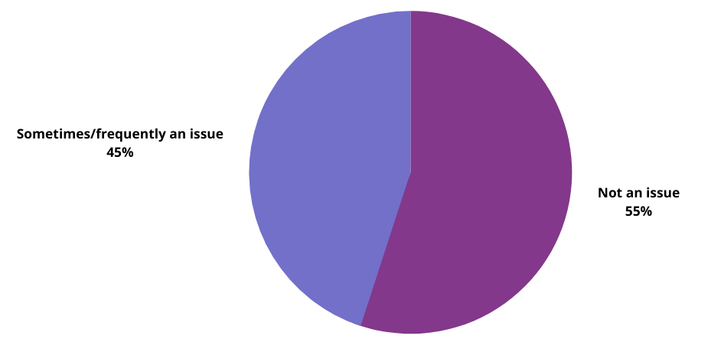
Issues in use of Floating Support: Not knowing when to refer
Notes:
62% knew 5 or less

Slide 10
Issues in use of Floating Support: Entry requirements of service
Notes:
62% knew 5 or less

Slide 11
Awareness of Services
Notes:
62% knew 5 or less

Slide 13
Homelessness Prevention Awareness Tool - Content
Defining Homelessness/Reasons for homelessness
Identifying Risks/Early warning signs
What do we mean by Homelessness Prevention
The role & benefits of Housing Related Support (Floating Support Services)
An Introduction to Floating Support Services

Slide 15
Points to Consider Risk factors in themselves do not definitively mean that someone would commence a homeless journey; more that the likelihood of becoming homeless increased and that this in itself also increased if there were multiple risks or triggers.
There is often a historical element to the homelessness, embedded in the family unit and family circumstances
The starting point of a homeless journey is often as a result of a sudden and in some cases unexpected trigger, outside of the individual’s control e.g. death of a parent
Triggers are inextricably linked to the service users other or additional needs, including their mental and physical health and other socio-economic factors

Slide 16
Early Warning Signs
ASB
Behavioural Issues
Missed Housing Payments
Hoarding
No Contact not answering calls
No Callers
Cultural Issues
Neighbour Complaints
Upkeep of Property
Enquiries from other services
Health Issues
Damage to Property
Repeated Calls to Emergency Services
Relationship Breakdown
Bereavement
Pets not being looked after
Garden Overgrown
Loss of Employment
Debt

Slide 17
ADD NICKY VIDEO

Slide 18
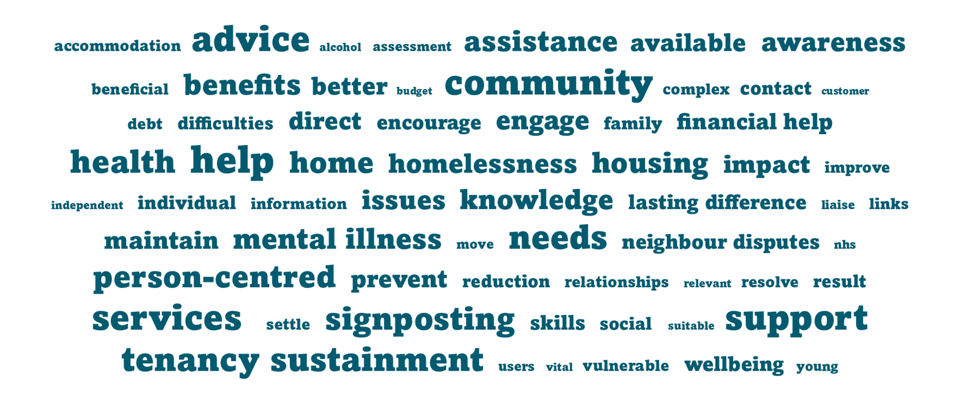
Floating Support - The difference it makes…

Slide 19
Homelessness Awareness Training tool – What people have told us so far:
I am aware of the indicators/early signs of homelessness.
Strongly agree: Before = 15% After = 73.5%
I know what FS is and how it can prevent homelessness.
Strongly agree: Before = 33% After = 85%
Indicate the number of FSS you know of.
6 or more: Before = 26% After = 96%
I would refer to FSS when I recognise someone at risk of homelessness.
Often/In most cases – Before = 46% After = 90%

Slide 20
Homelessness Awareness Training tool – what next?
HSC Leadership Centre – e-learning
Patient Client Council
Housing Rights & LANI
Housing Executive & NIFHA
AVAILABLE NOW!
https://www.homelessnesspreventionforum.com/
https://www.homelessnesspreventionforum.com/housing-support-training

Slide 21
Thank you
Get in touch at:
Paul.Fleming@niacro.co.uk
Declan.Morris@extern.org
“Awareness is like the sun. When it shines on things, they are transformed.”
Paul.Fleming@niacro.co.uk
Declan.Morris@extern.org
© Homelessness Prevention Forum

