Slide 1
Poverty and the Cost of Living: context and policy
Ann Marie Gray
Ulster University

Slide 2
Long terms problems in NI re poverty – exacerbated by more recent cost of living crisis
Factors such as low pay, educational inequalities, higher economic inactivity rates and poor social infrastructure contribute to economic hardship (and persistence of poverty) and more negative impact of rising inflation compared to other parts of the UK

Slide 3
The Northern Ireland Life and Times Survey (NILT, 2022) provided a worrying baseline in respect of the financial health of the population.
The survey took place during the final quarter of 2021 before the current crisis really started to bite. Findings show significant minority of households struggling financially and increase in hardship since start of pandemic

Slide 4
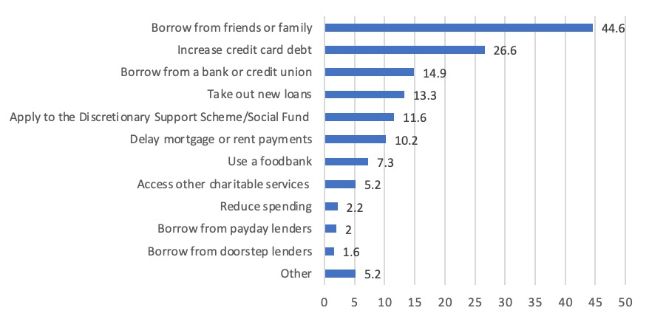
How do respondents cope with financial hardship? (%)

Slide 5
Coping (or not) with cost of living increases
Could your household afford to pay an unexpected, but necessary, expense of £500?
Did your household turn heating down or off because you could not afford the costs last winter, even though it was too cold in the house/flat?
Almost 25% of respondents said they could not – (one in ten of over 65s; 40% of 18-24 yr olds; 36% of 25-34 yr olds and 33% of 35-44 yr olds)
Less than two percentage points of a difference between the ability of those in paid employment (24.9%) and those not (26.4%) to afford an expense of £500
Just over 24 per cent of households reported having to turn the heating down or off due to costs.
Over half of respondents who described themselves as low income had turned the heating down or off because they could not afford it.

Slide 6
The proportion of respondents unable to afford a £500 expense should not surprise us - the Family Resources Survey (2019-20) found that 36% of households have no savings.
Nor is it surprising that there is less than two percentage points of a difference between the ability of those in paid employment (24.9%) and those not (26.4%) - since official statistics show that so many of those in paid employment are living, objectively, in poverty.
For fuller account of findings see - https://www.ark.ac.uk/ARK/sites/default/files/2022-05/update146.pdf

Slide 7
Impact of cost of living increases
National Institute of Economic and Social Research modelled the impact of inflation across the UK – likelihood of households in NI falling into destitution twice the UK average
NI Consumer Council (2022) - when inflation reached 10.1% lowest earning households in NI left with £29 pw after bills and costs
NI Consumer Council (2022)- 34% of households in NI in fuel poverty
Impact on housing affordability and homelessness – link to changing tenure in recent decades, acute shortage social housing, HB changes

Slide 8
Housing Costs

Slide 9
PRS rents and HB
A major cause of housing insecurity is the shortfall between Local Housing Allowance (LHA) and actual rents – shortfall £119 p/m.
LHS for those receiving Housing Benefit is based on bottom 30% of rents. Since NIHE’s own figures show less than 10% of rented properties in that bottom 30% of rents, PRS tenants have to make up the rest of their rent from their disposable income (or fall into arrears).

Slide 10
Impact long standing neglect of social infrastructure
Childcare – no NI childcare strategy, no equivalent to childcare expansion in GB – link to high rate of female economic inactivity
Social care and social care workforce – system under pressure, workforce crisis linked to issues re pay, progression and qualifications framework; failure to see ‘care’ as economically valuable
(https://www.ark.ac.uk/ARK/sites/default/files/2021-02/Gender_Budgeting-2.pdf)

Slide 11
Policy Implications – scope for improvement
In the latter part of the last Assembly mandate, the Minister for Communities commissioned independent reviews of welfare reform mitigations and of the discretionary support scheme which provide emergency assistance to those in the greatest hardship. Both provide focused and costed recommendations. [https://www.communities-ni.gov.uk/sites/default/files/publications/communities/dfc-welfare-mitigations-review-independent-advisory-panel-report-2022.pdf and https://www.communities-ni.gov.uk/sites/default/files/publications/communities/dfc-independent-review-of-discretionary-support-22.pdf]

Slide 12
In 2020 work commenced on the development of an anti-poverty strategy (APS) though this has yet to be concluded. The report of the Expert Panel notes that on ‘The Panel’s key assumption is that the purpose of an APS is to raise living standards and reduce living costs for those below an agreed, objectively-defined poverty line [https://www.communities-ni.gov.uk/system/files/publications/communities/dfc-social-inclusion-strategy-anti-poverty-expert-advisory-panel-recommendations.pdf]

Slide 13
But also important are strategies on gender equality, disability and sexual orientation which were being developed prior to collapse of political institutions.
https://www.communities-ni.gov.uk/system/files/publications/communities/dfc-social-inclusion-strategy-gender-expert-advisory-panel-report.pdf; https://www.communities-ni.gov.uk/publications/report-disability-strategy-expert-advisory-panel; https://www.communities-ni.gov.uk/system/files/publications/communities/dfc-social-inclusion-strategy-lgbtqi-expert-advisory-panel-recommendations.pdf

Slide 14
Fuel Poverty Strategy – long awaited
Homelessness Strategy – good enough?
Address shortfall in social housing supply (Housing Supply Strategy but also- Scotland and Wales both ended the Right to Buy in 2014 and statutory homelessness figures have reduced since then)
Public attitudes – NILT found strong support(80%) for idea that social security system should ‘enable people to live a life of dignity’

