Slide 1
Applying the Peer Learning Bubble Model with voluntary sector social work students in Northern Ireland
Dr Denise MacDermott and
Caoimhe Harkin-MacDermott

Slide 2
Webinar delivered by
Dr Denise MacDermott (Co-author) and Caoimhe Harkin-MacDermott (Co-author)
Ulster University BSc Social Work
Rachel McCloskey
Queen’s University, Belfast BSc Social Work
Emma McAlister
Open University
Lesley Ann Becket

Slide 3
Presentation Outline
Introducing the Peer Learning Bubble Model and the four domains
Student perspectives (Rachel, Emma and Lesley Ann)
Over to you (breakout rooms)
Reflections and what next

Slide 4
Origins of the Peer Learning Bubble Model MacDermott and Harkin-MacDermott (2021)
The Peer Learning Bubble Model was created and designed in response to the uncertain learning landscape presented in the first wave of the coronavirus pandemic in Northern Ireland.
“A hybrid learning model for social work placements and a virtual learning environment to support the ongoing assessment of student’s competence” (MacDermott and Harkin-MacDermott, 2021, p.368).
The coronavirus pandemic has impacted the ways in which social work education and placements have been delivered, promoting opportunities for alternative and creative ways of delivering professional education.

Slide 6
Rachel
What work did you complete as part of a Peer Learning Bubble?

Slide 7
Rachel
Present to peer group, using various digital skills to feedback on our service user group, as experts by experience.
Discuss with peers how our practice has developed. Reflect as a group on how we have applied Social Work theory in practice, what we felt worked positively, and what we would do differently in future practice. What is the learning from this?
Give peer to peer feedback, and help each other with new digital skills, which we progressed week to week with more confidence.

Slide 8
Rachel
Discuss topics of Power Inequalities, Human Rights and Social Injustice relating to our separate service user groups, and what key learning we have gained from this experience.
Action learning tasks
Present to peers through action learning tasks, from perspective of our service user group, on themes such as:
-Anti-Oppressive Practice
-What is Assessment?
-Collingwood Model
-Reflection in Practice
-Theory to Inform
-Theory to Intervene

Slide 9
What did you like about the Peer Learning Bubble sessions?
Safe space to be open and honest with peers. Safety to trial and error with new digital skills.
Opportunity to reflect in practice, the safety of a small group allowed us to be open and honest with each other, and we developed a supportive network with each other.
Reflecting on our practice in our own language, made understanding social work theory a lot more accessible to me.
Learn from peers who have been on placement with different service user groups. The different theories that they have been informed by.
Recognising how myself and my peers grew in confidence as the weeks progressed, with digital skills and presenting skills. This felt daunting at the start, but it became much more natural to everyone.

Slide 10
How did the Peer Learning Bubble sessions add to your learning on placement?
Being set Action Learning Tasks made me understand my placement setting better, as I researched and reflected a lot more, which increased my confidence with service users.
Action Learning Tasks prepared me for Mid-Point Review, Reflection and Case Study assignments. Through the research and theory that I presented; I was able to apply this to written work.
Discussing our practice in our own language helped my understanding much more. I feel I have progressed so much more through exploring and learning from each other.
Helped me with my ability to apply theory to practice, through discussing it with peers openly, but also learning from them. Giving and receiving feedback to each other helped me with confidence but also in understanding knowledge.

Slide 11
Rachel’s final reflection
Reflection in the Peer Learning Bubble was a form self-care.
A non-judgmental and safe space to be open and honest, with peers who are in the same position.
We became a supportive network to each other, allowing us to offload and feel supported.

Slide 12
Over to You
Breakout rooms
Q1. What are the potential benefits and opportunities of applying the model in practice learning settings?

Slide 13
Emma

Slide 14
What work did you complete as part of a Peer Learning Bubble?
Weekly Tasks
Presentations
Workshops

Slide 15
What did you like about the Peer Learning Bubble Sessions?
It provided a safe space to chat about PLO
Built up digital skills
Enhanced confidence
Friend network

Slide 16
How did the Peer Learning Bubble sessions add to your learning on placement?
Frequent sessions discussing any issues/questions raised
Learning gained through different experiences on PLO
Small group meaning more voices heard and more topics covered

Slide 17
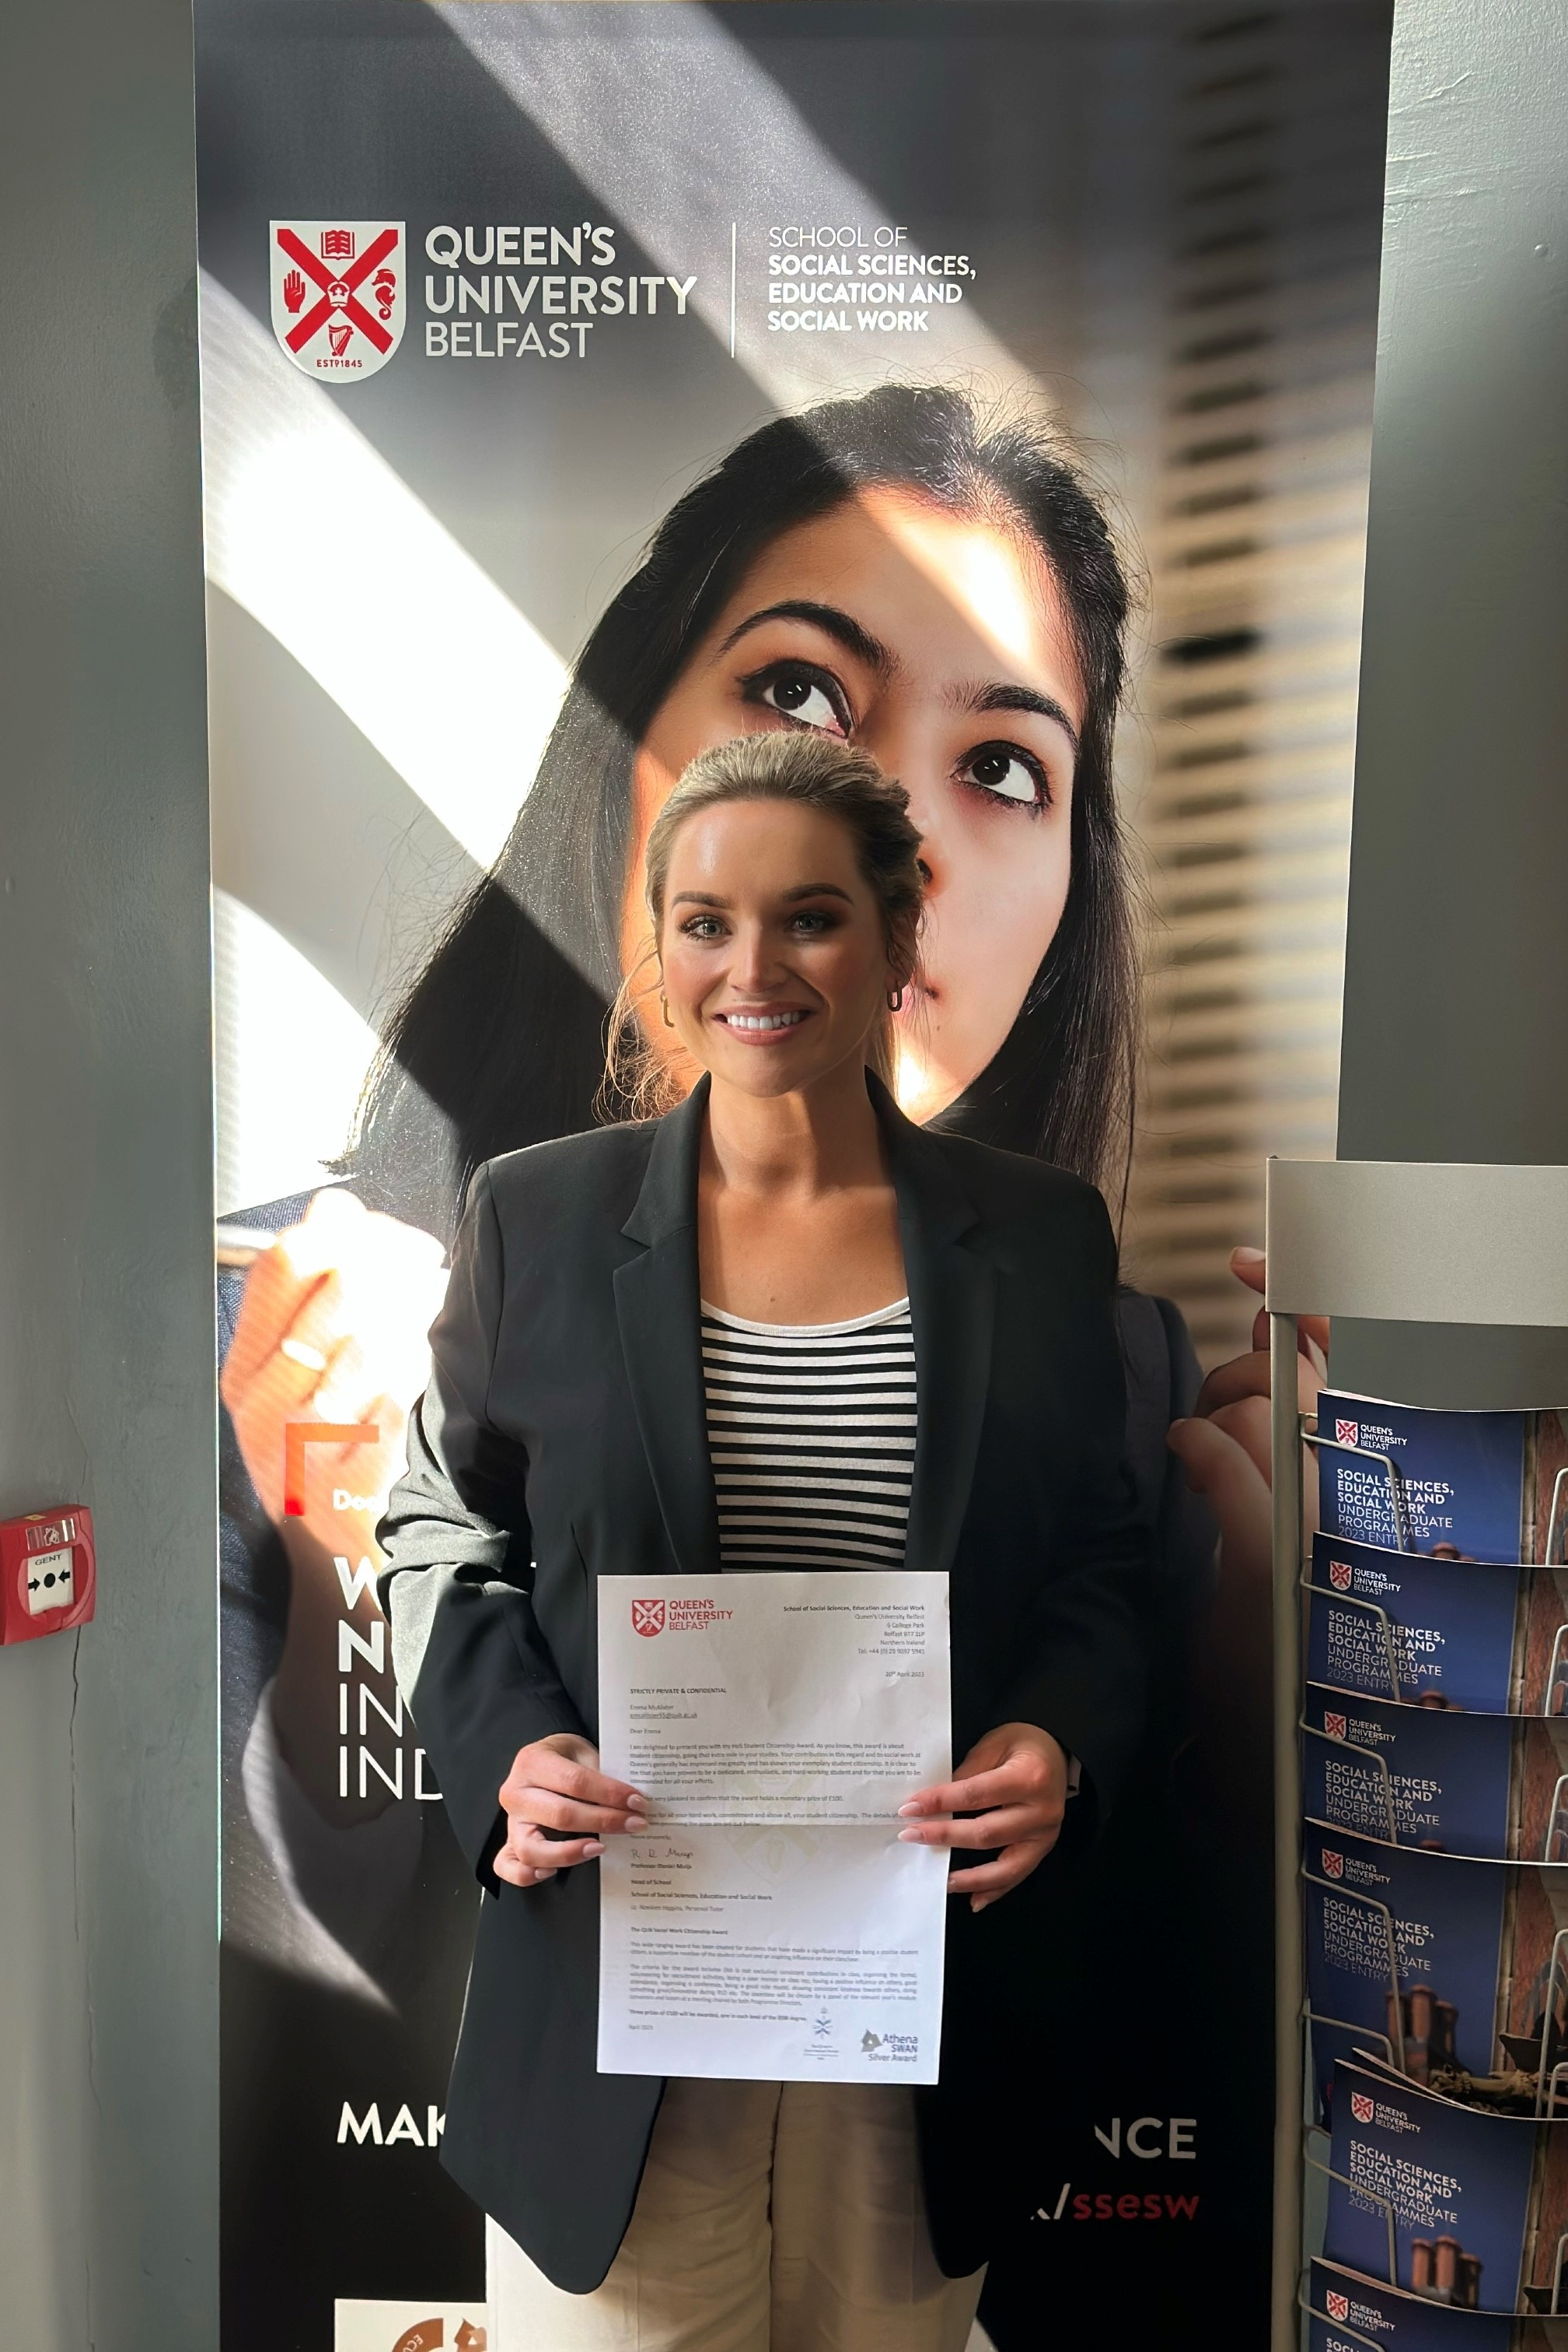
Emma McAlister Level Two Student Citizenship Award Winner
Level 2 student Emma McAlister was nominated for her outstanding contribution to developing highly innovative practice. During her first social work placement, Emma took part in a successful trial of the Peer Learning Bubble Model with fellow students from Ulster University.
She was invited to present on this model at the Northern Ireland Social Care Council conference on digital tools in social work education. Emma said: ‘I was extremely honoured to receive the award. It has given me a great boost going into the final year of my social work degree.’

Slide 18
Over to You
Breakout rooms
Q2. What support would you as a practice teacher, placement provider, social work student require to implement/ participate in the Peer Learning Bubble Model as part of the overall placement experience?

Slide 19
Lesley Ann

Slide 20
What work did we complete?
The purpose of Assessment
The Collingwood Model: Applying theory to practice
Endings in Social Work

Slide 21
What did I like about the sessions?
Spending time with peers sharing learning and knowledge
Additional support
Increasing knowledge and skills by developing presentations
Safe place to discuss any issues with placement or concerns
Learning about other services

Slide 22
How did the sessions add to learning on placement?
Provided a greater understanding how theory informs everyday practice within placement
Different points of view from peers regarding assessments, endings and approaches
More opportunity to explore other’s experiences

Slide 23
Research Project
Study title: (Re)designing and developing the Peer Learning Bubble Model through learning collaborations with placement providers, service users and social work students in Northern Ireland.
Aim
The aim is to evaluate the Peer Learning Bubble Model as an additional learning resource for the social work placement experience and final year students’ preparedness for practice.
Time 1 January 2023- June 2023 placement cycle
Time 2 August 2023-December 2023 placement cycle
Time 3 January 2024-June 2024 placement cycle

Slide 24
Workshops with students
More personal learning experience –small numbers
Sustainability – no travel involved (cost of living challenges)
Extension of supervision
Non -judgmental learning environment
Contribution to 6 Key Roles and Social Work Standards

Slide 25
Workshops with students
Became a more strategic learner- cross pollination of ideas- making theory to practice accessible.
Learning about different job roles and signposting for resources
Sometimes wifi access in placement sites was problematic
Increased confidence

Slide 26
Assessed Year in Employment
Using the Peer Learning Bubble Model for Assessed Year in Employment- experienced by NQSWs as a continuation of their placement experience and professional training.
A model to support ongoing professional participation and membership in a community of learning and practice (the transition from final year student to newly qualified social worker).
A supportive online community of learning and practice to encourage and promote Continued Professional Development and Professional in Practice pathways.
Notes:
”

Slide 27
Over to You
Breakout rooms
Q3. Thinking about the transition from final placement student to newly qualified social worker, how do you see the Peer Learning Bubble Model being applied to AYE?

Slide 28
Finally …..quick poll
Do you have a better understanding of how the Peer Learning Bubble Model can be used to enhance learning, provide support, and promote development in social work placements?

Slide 29
Interested in learning more?
a) Read
MacDermott, D. and Harkin-MacDermott, C. (2021) Perceptions of trainee practice teachers in Northern Ireland: assessing competence and readiness to practise during COVID 19. Practice, 33 (5), 355-374. doi.org/10.1080/09503153.2021.1904868 (Open Access)
https://www.tandfonline.com/doi/full/10.1080/09503153.2021.1904868
b) Contact us
dj.macdermott@ulster.ac.uk and caoimhe.macdermott@brysoncarewest.org
c) Share
Model infographic is available on the Northern Ireland Degree in Social Work Partnership website (www.nidswp.net)

