Slide 1
Family Support in Statutory Children's Social Services
Dr Una Lernihan
Programme Manager
Children's Social Services
(Family Support, Safeguarding, Looked After Children, Leaving and Aftercare)
Strategic Planning and Performance Group

Slide 2
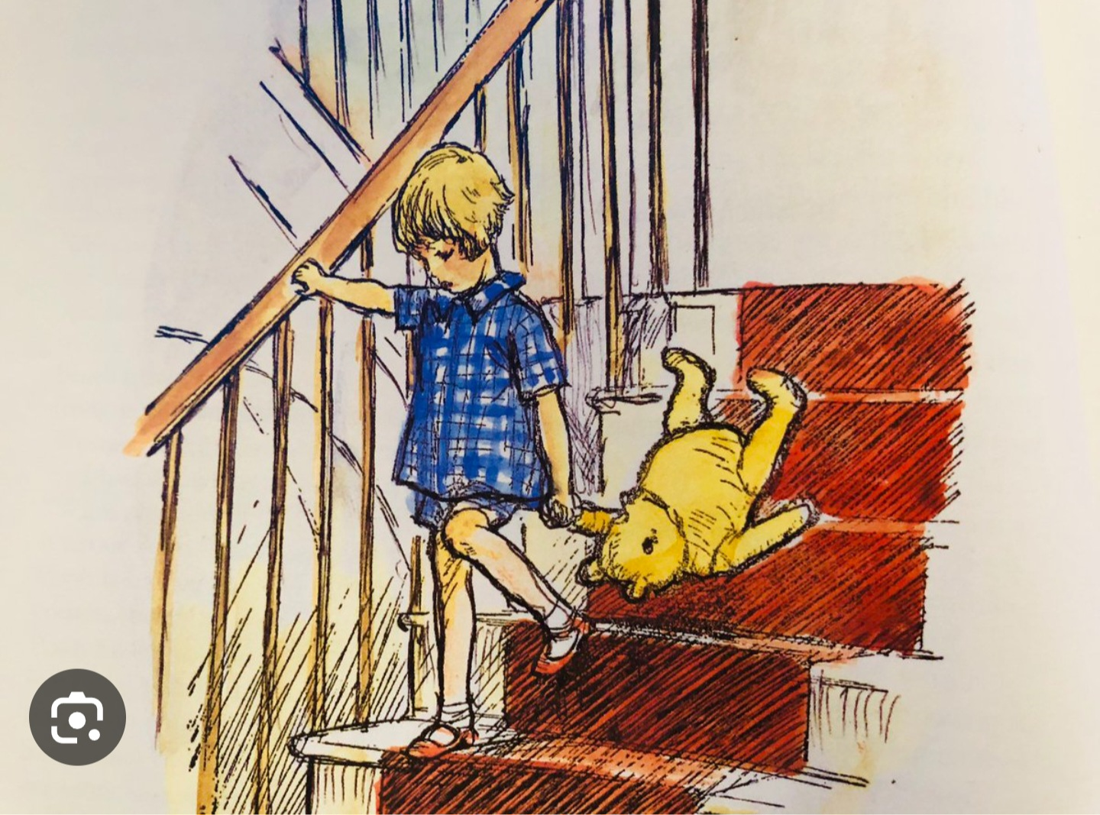

Slide 3
Trust Children's Social Services
Who is knocking on the door?
Why are they there?
Where have they come from?
How did they get there?
Where do they go?

Slide 4
The Right Help at the Right Time in the Right Place
Community and voluntary sector
Community based approaches eg Sure Start
Family Support hubs
The importance of relainships
Empowering Family Networks
  Signs of Safety
  Family Group Conferences
  Think Family
  Building Better Futures

Slide 5
Challenges and Opportunities
Supporting and respecting the social work and social care workforce across the system
Financial constraints
Children’s Social Care Review in Northern Ireland (Professor Ray Jones)
Adoption and Children Bill
Children's Strategic Reform Board
The intelligent use of data
A committed workforce

Slide 6
Raising your voice…..
Change will not come if we wait for some other person, if we wait for some other time. We are the ones we have been waiting for. We are the change that we seek
Barack Obama, 44th President of the United States

Slide 7
A parent's testimony – Michaela Lewis
Youtube link if you want to play directly from there: https://youtu.be/l9Cr38ezmWY

