Slide 1
Family Support - the voice of families
Learning from the Reaching Out, Supporting Families Programme
Funded by The National Lottery Community Fund

Slide 2
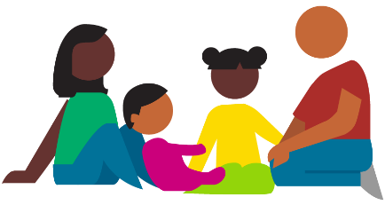
Reaching Out, Supporting Families
36 family support projects
Working in partnership with one or more V/C sector or statutory agency
Max £600k funding over five years
Three Programme outcomes:
More children and their families will have greater skills, knowledge and understanding to overcome adversity
More children and their families will come together to learn
More children and their families will be part of the community that they live in

Slide 3
Reaching Out, Supporting Families – reported outcomes
INCREASED CONFIDENCE
Increased confidence in parenting/caring role – a better understanding of their child’s needs and strategies to address those needs.
Higher levels of self-esteem – parents and children generally feeling better about and within themselves.
Increased social confidence – including the ability to seek support and engage in education.

Slide 4
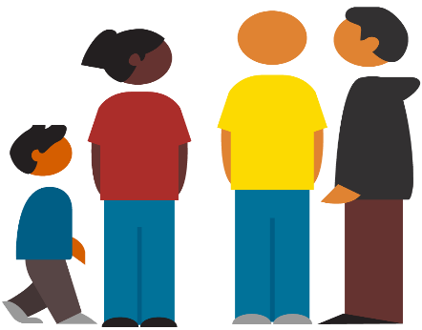
Reaching Out, Supporting Families – reported outcomes
ENHANCED WELLBEING
Increased ability to cope - including feeling more resilient and reduced levels of stress/anxiety.
Improved relationships - between children and parents, as well as other family relationships; better communication and a greater sense of trust.
Better health - both in terms of physical and mental health.

Slide 5
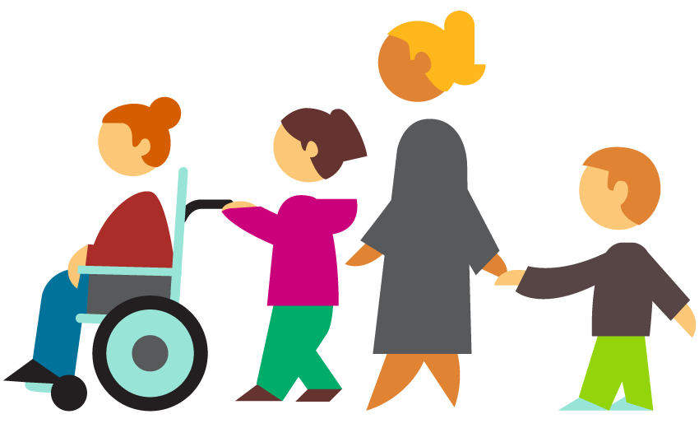
Reaching Out, Supporting Families – reported outcomes
REDUCED ISOLATION
Shared experiences – support received through sharing knowledge and experience in a safe place.
Building relationships – making friends, development of peer support etc.
Increased knowledge of other supports.

Slide 6
Reaching Out, Supporting Families - what helps families? Early support
I think possibly had more support been put in place earlier it would have been…I’m not going to say it would have been easier, but it would have taken a lot of the pressures away
Life is just…you’re looking down the barrel of a gun. And I think in terms of all services, you know, it should be given to you at the start. I think you shouldn’t have to go looking as much as we had to

Slide 7
Reaching Out, Supporting Families - what helps families?
Help to navigate a complex landscape of services
I think the resources there should be very well laid out, maybe online, or just a contact person working maybe in a non-profit organisation or working in the NHS or working in the hospital, a social worker even, could come out maybe at the start and just go through what’s there just to give you that blanket of support that you know you can avail of if you want to, you know, because the resources came to us because I had researched.
At the start of our journey with [her]… you don’t know what to ask for, you don’t know what’s available. It is completely - at the start - you find you’re in a dark tunnel with no torch you have no idea what resources are available, who is out there to help

Slide 8
Reaching Out, Supporting Families - what helps families? Proactive support
You are going through so much every day with your complex child… things can turn dark in an instant, we can end up in A&E, we could end up in ICU…you don’t have time to be scrawling through leaflets
…it just was a very easy gradual pathway that they made it…just… it was seamless. There was no issues. You asked and they gave you any information that you needed... They knew exactly what we would need and I didn’t know what I would need… her dad didn’t know what we would need but they knew exactly

Slide 9
Reaching Out, Supporting Families - what helps families?
Co-ordinated supports
I’m sure I’m not the only person in Northern Ireland this has happened to. There's a bit missing there somewhere along the line in communication, where [the hospital] should have been able to say to [the project]: “Look, we've got a family here. And there's going to be long roads ahead.” There's a big missing part there maybe that's the best way of putting it. I feel really strongly about this because I would hate to think that… I would feel so devastated for another mother to feel the way I was feeling
I think the resources there should be very well laid out, maybe online, or just a contact person working maybe in a non-profit organisation or working in the NHS or working in the hospital, a social worker even, could come out maybe at the start and just go through what’s there just to give you that blanket of support that you know you can avail of if you want to, you know, because the resources came to us because I had researched.

Slide 10
Reaching Out, Supporting Families - what helps families? Relationship based practice
Comments from parents illustrated that:
- Relationships create the conditions for change to take place
- Trusted relationships build the confidence to change
- Building relationships creates a sense of being part of something bigger
I had support from a counsellor and he was just unbelievable. He was just so supportive, so kind, so empathetic… I felt so comfortable with him. He really drilled down into the problems I was having or feelings I was having.
And do you know what? He just made me kind of face it in a way… things I would usually say, “Aye, I will, alight, that’ll do, no problem, ok, talk to you later” and would never do. But he always followed up on it. But, you know, at the start I was thinking, ‘this is torture’, But then I looked forward to it because I could feel it. I could feel a change in myself. But do you know what? I could feel the change in the atmosphere in the house as well.

Slide 11
Building relationships creates a sense of being part of something bigger
It is good to get out and speak to other people, because then I think I am not on my own and that’s that feeling of being part of something and you’re not the only person who’s going through depression, or has difficulties or is struggling with behaviour.
They gave me the confidence to start getting out there and making changes and doing things

Slide 12
Reaching Out, Supporting Families - what helps families?
Knowing it is ok to ask for help
Support that includes the whole family, sometimes including the extended family
Services that are person-led
Peer support
It’s a spectrum, it’s not just about disabilities it’s about people who experience mental health issues or there’s just such a ream of things and people, the last thing some people want is to be a burden and you’ve people that will know exactly what to do with the system and you’ve other people then that just don’t know what to do and it’s those people that may look like they’re doing great in life but deep down they you know they could be suffering massively because they’re afraid to ask for help or they feel like ‘oh I wouldn’t be entitled to that’, you know, and it’s not about being entitled it’s about availing of services that could massively benefit your life
….they allowed me to set my own goals and my own targets rather than them setting for me so I was basically only doing what I had said myself that I wanted to do they were just aiding me along they were holding my hand along the way and guiding me in the right direction

Slide 13
Thank you
Melanie Stone: mstone@effectiveservices.org
Click here for additional resources
www.effectiveservices.org

