Slide 2
Welcome
Introductions
Invitation for a safe space
Overview

Slide 3
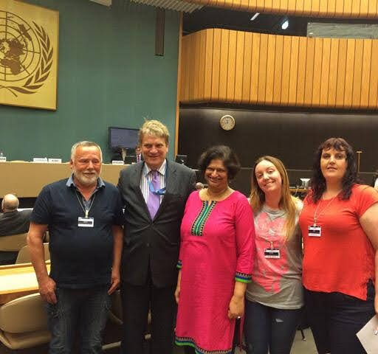
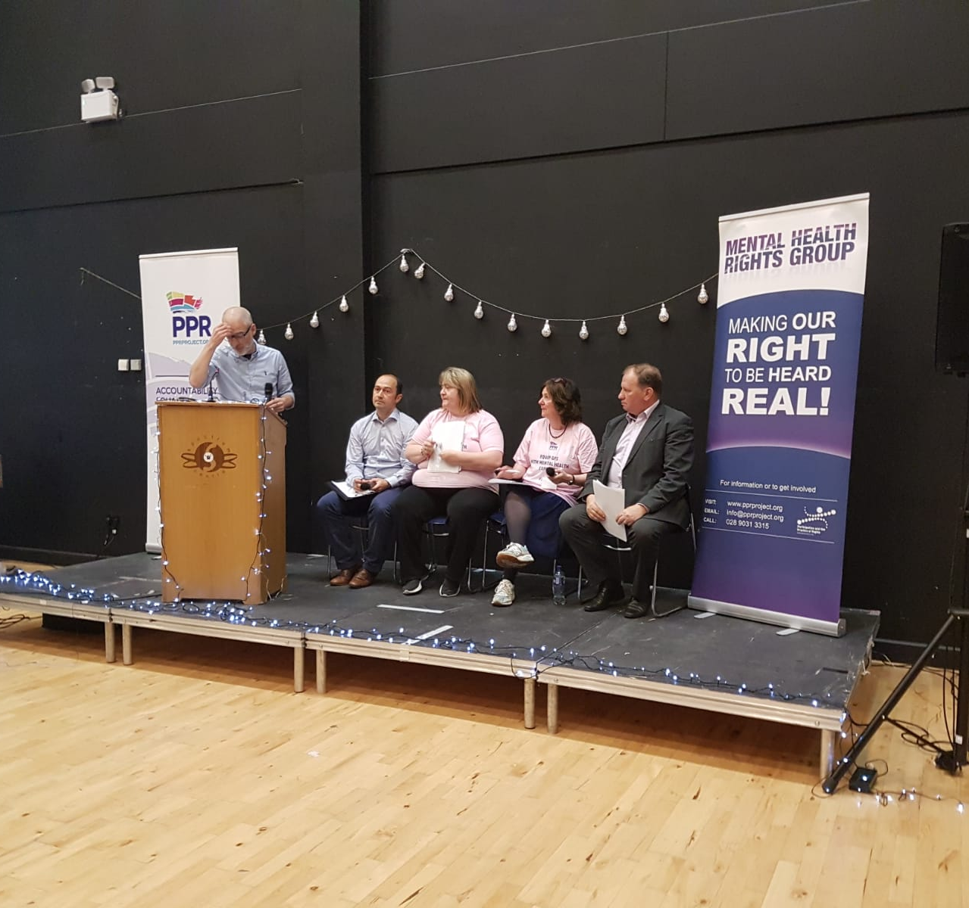
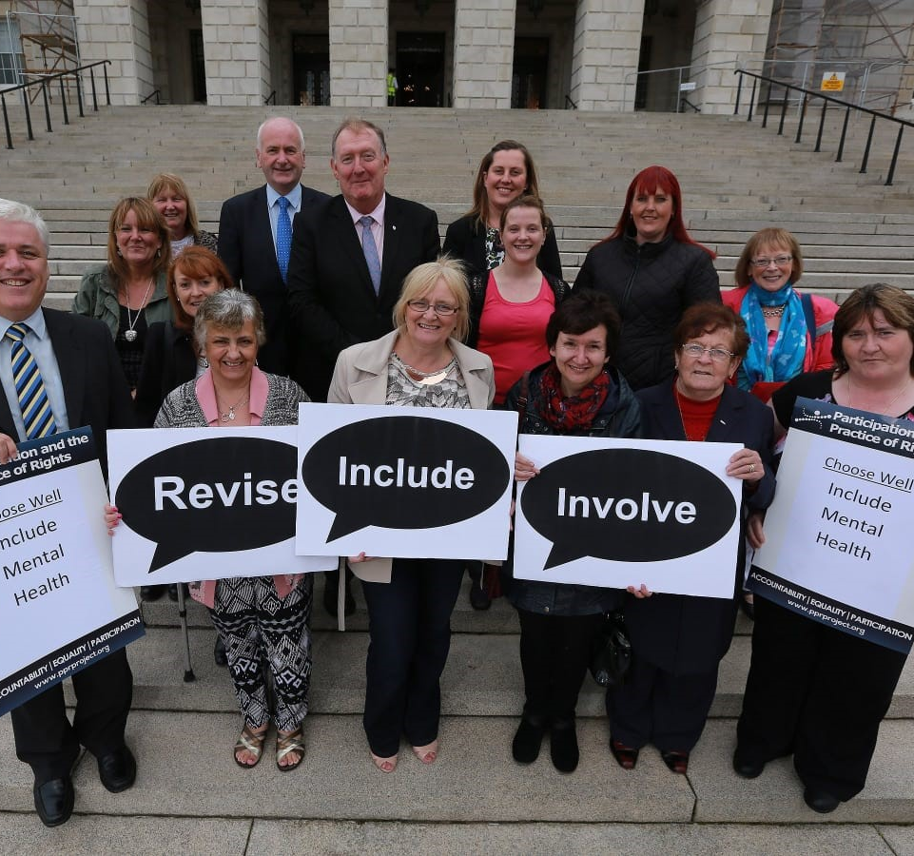
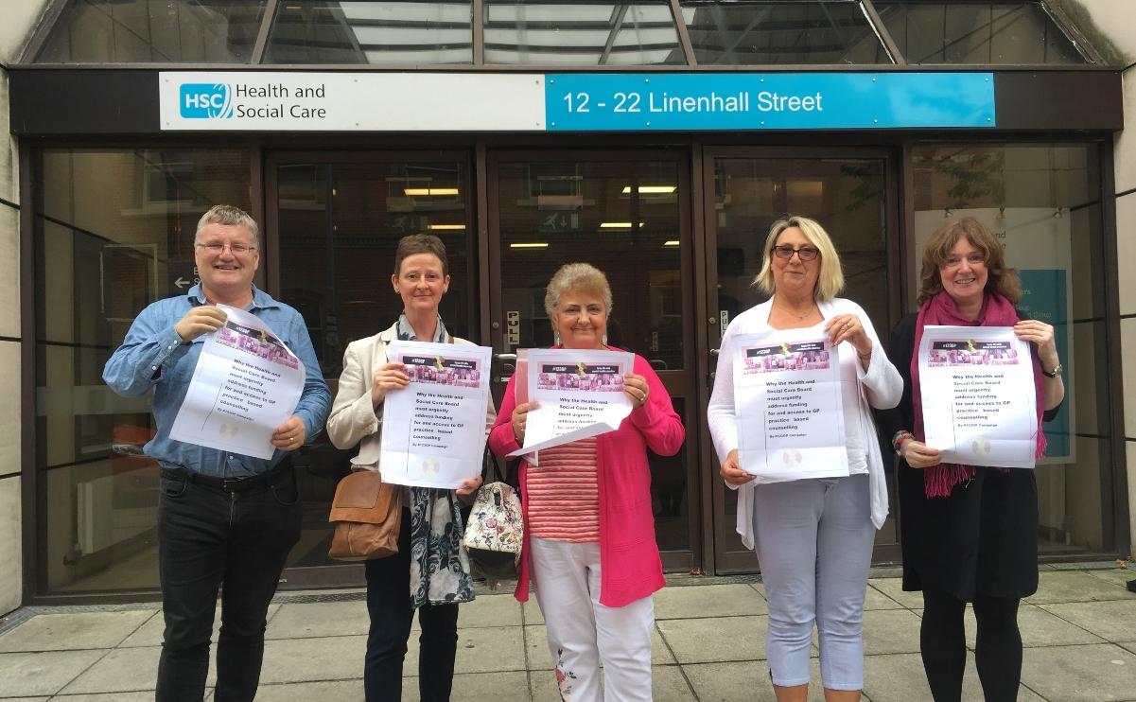
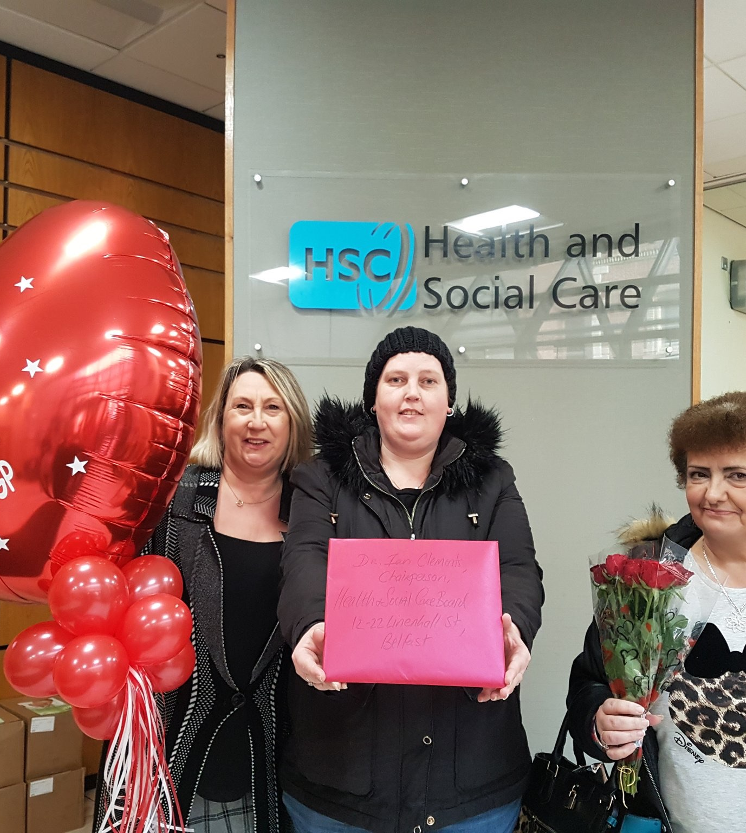
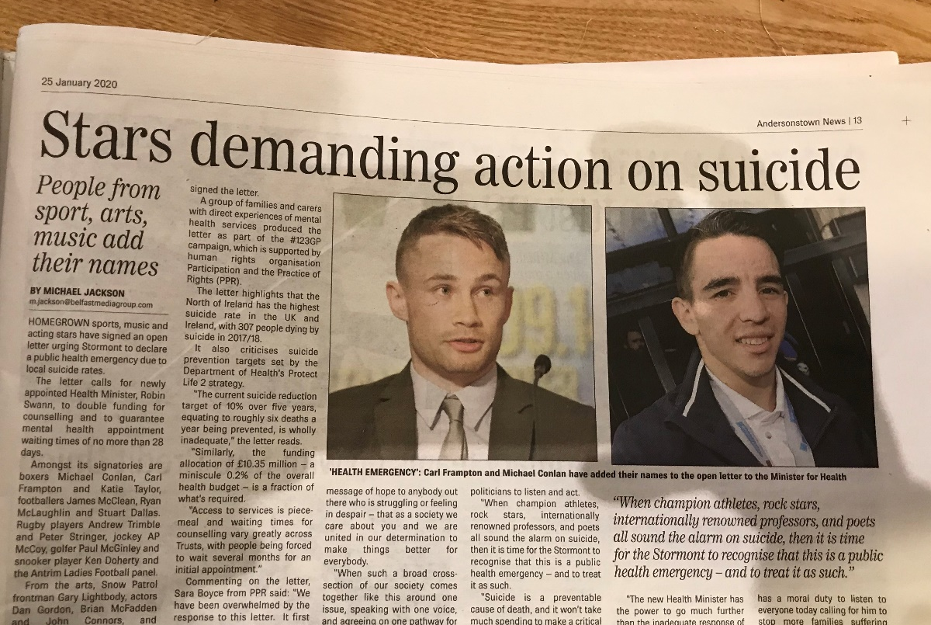
Evolution of the Mental Health Campaign
Sara Boyce PPR MH Campaign Organiser

Slide 4
Data – Talking Therapies
Waiting Times Jan-Sept 2022
There is no target waiting time that Trusts are bound by.
Western Trust
Talking therapy hubs don’t operate in Fermanagh and Omagh.
Southern Trust
Only 1 person seen within a month
70 people waiting longer than a month
They handed back £83,307.

Slide 5
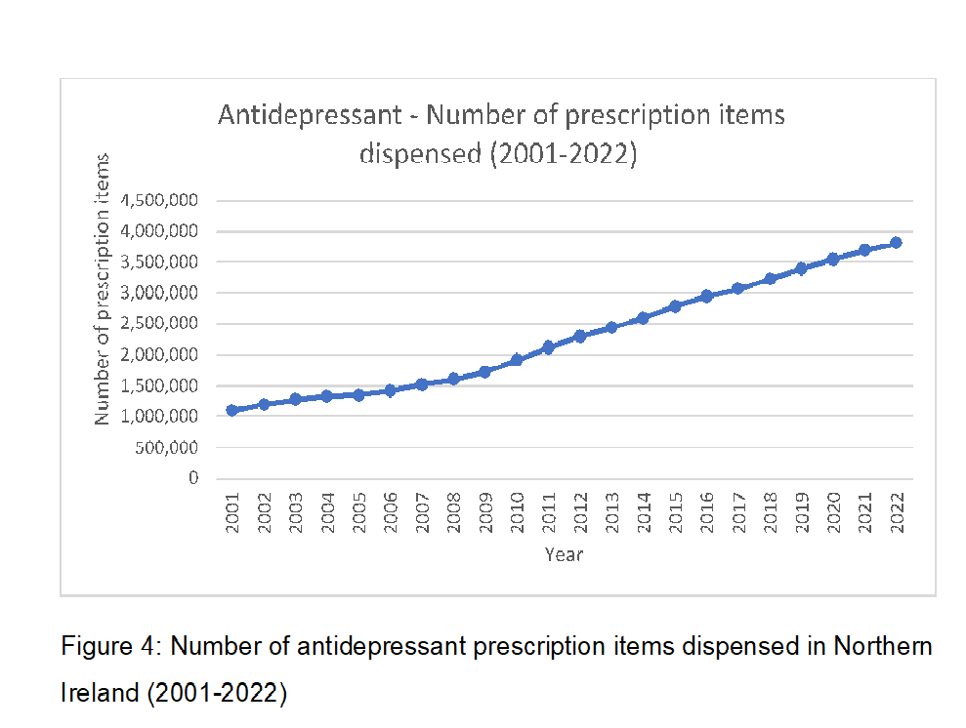
Data: Antidepressant Prescribing
The current budget across the five Trusts for talking therapies equates to £1.9m.
( Dept of Health Funding Plan for Mental Health Strategy)
Approximately £13m a year is spent on antidepressants.
Council area | People | % of population
Fermanagh & Omagh | 21,289 | 17.9%
Derry & Strabane | 35,434 | 23.4%
Mid Ulster | 24,729 | 16.2%
Overall | 382,288 | 19.9%

Slide 6
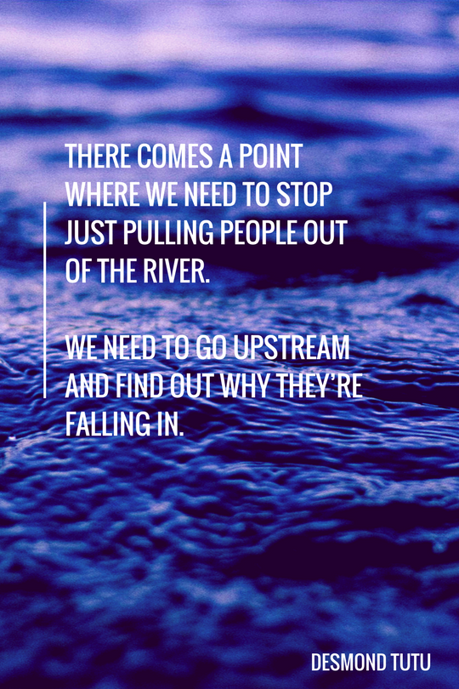
Data: Suicide & Inequality
The inequality gap has widened to over 3 times the rate of deaths in poor areas to wealthy areas
The percentage of suicides in 2022 from Northern Ireland’s most deprived areas (31.0 per cent) was over three times that of the least deprived areas (9.4per cent).
https://www.nlb.ie/blog/2022-05-123gp-responds-to-publication-of-suicide-statistics-for-2020

Slide 7
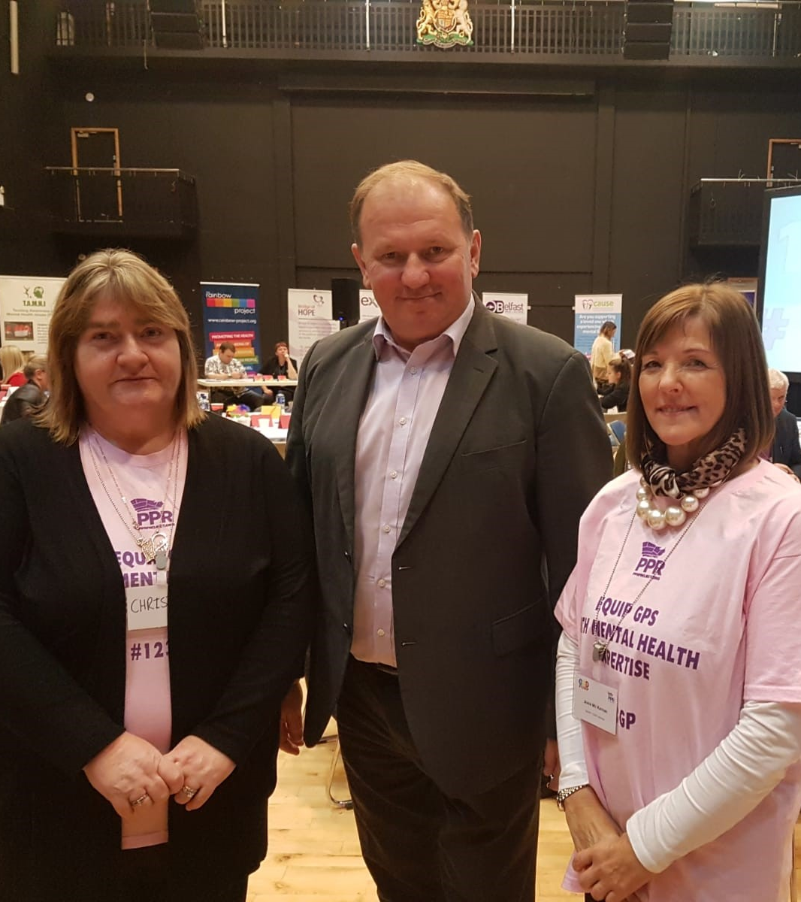
‘The crisis in mental health should be managed not as a crisis of individual conditions, but as a crisis of social obstacles which hinders individual rights. Mental health policies should address the “power imbalance” rather than “chemical imbalance’.
Professor Dainius Puras, UN Special Rapporteur on the Right to Health (2019)

Slide 8
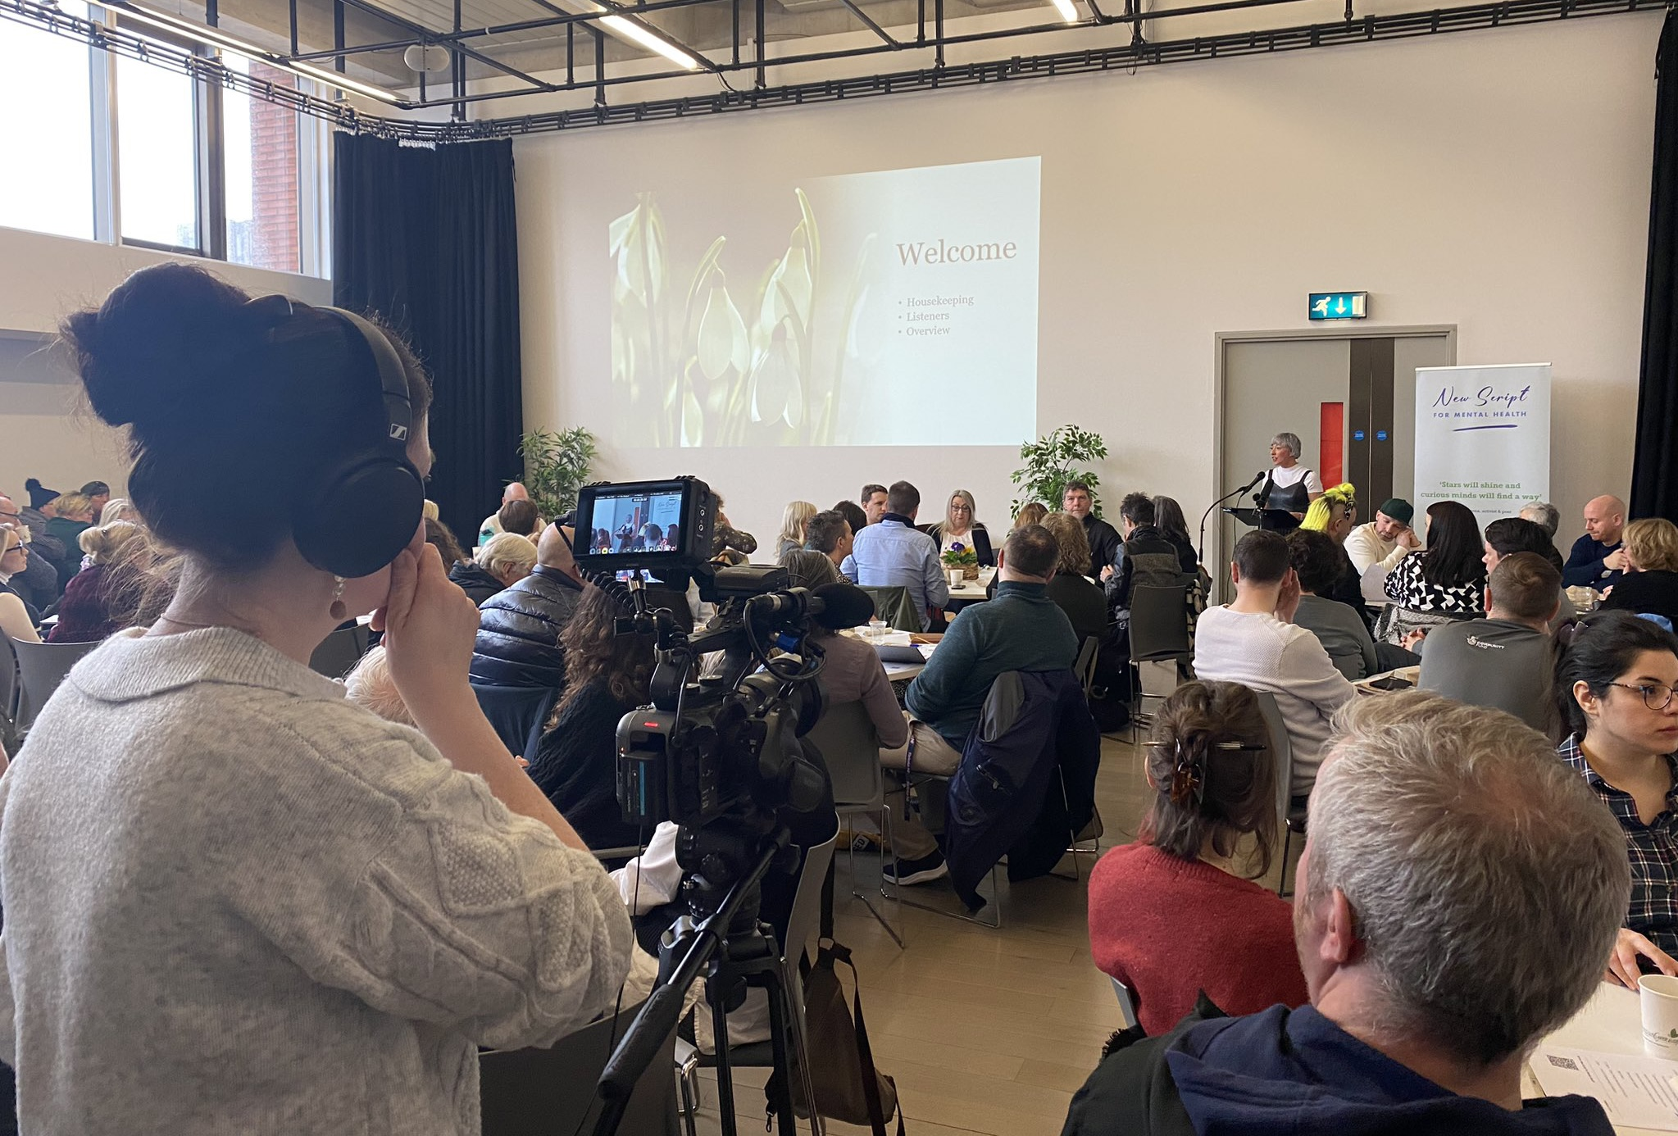
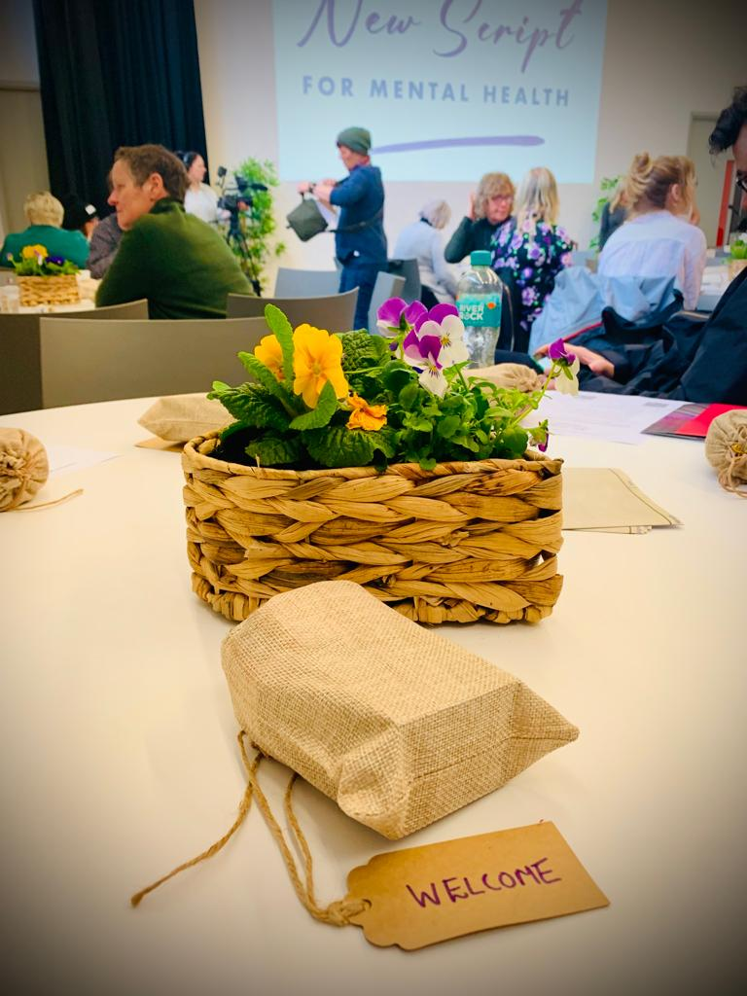
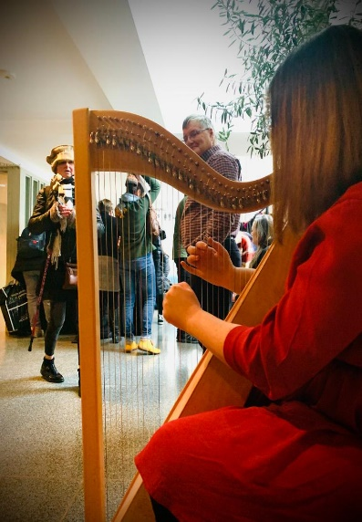
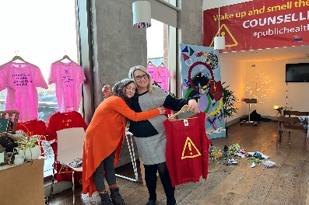
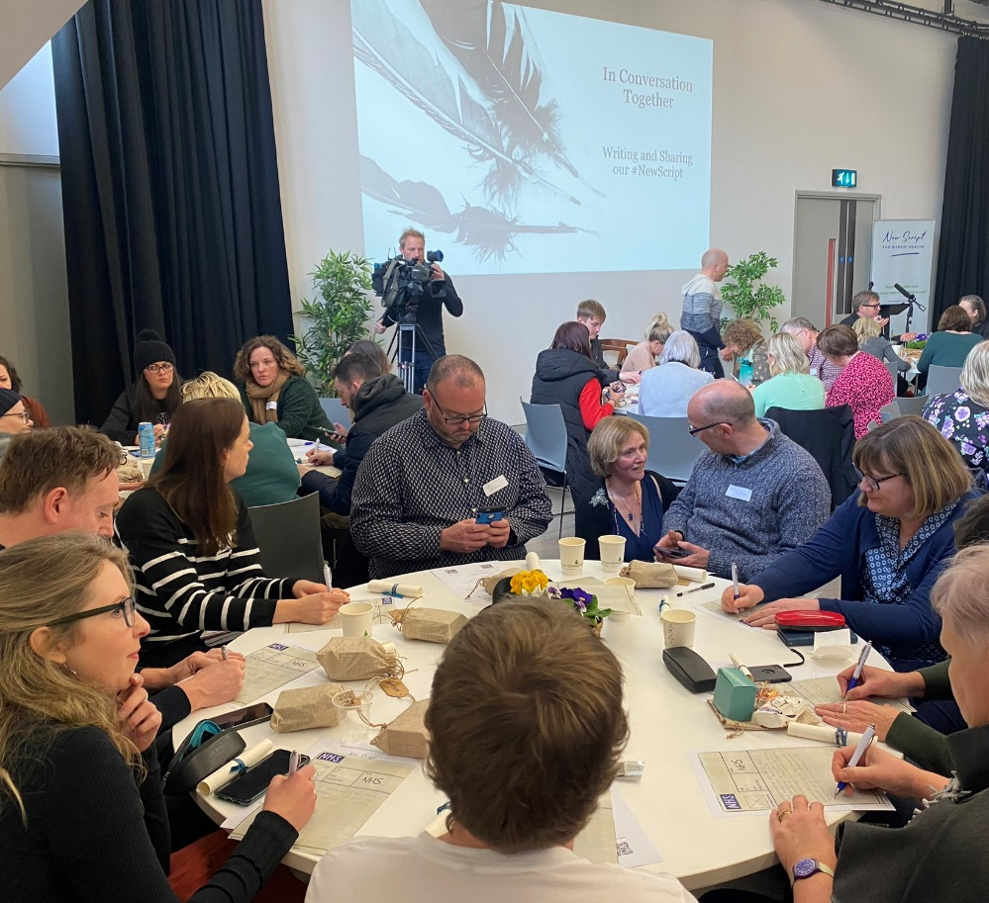
Time for a #NewScript for Mental Health

Slide 9
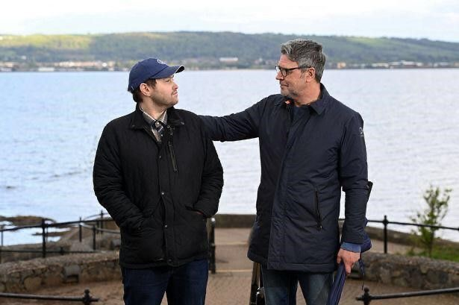
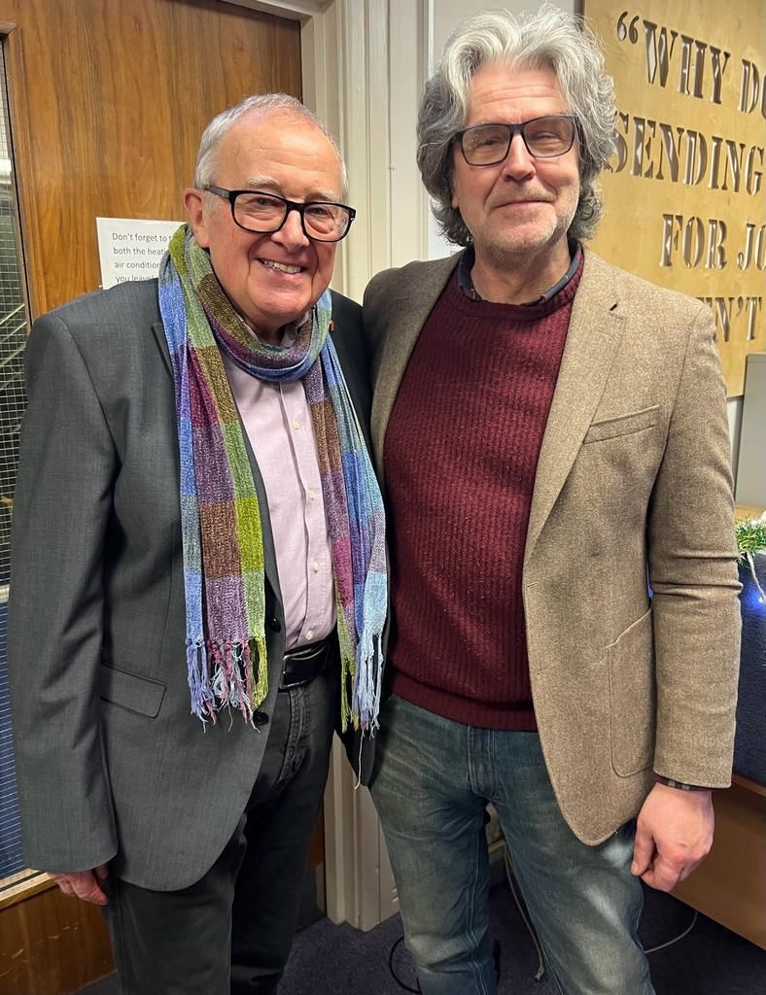
Accountability

Slide 10
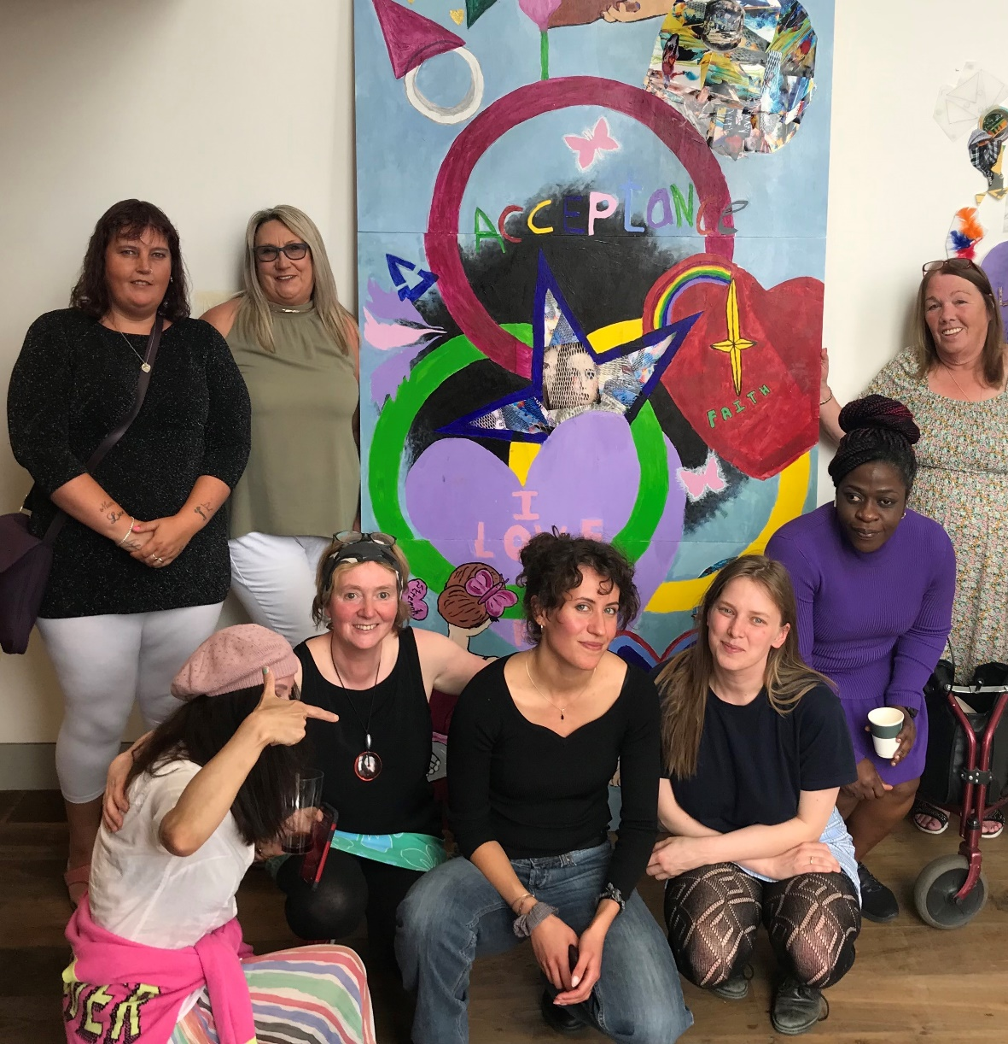
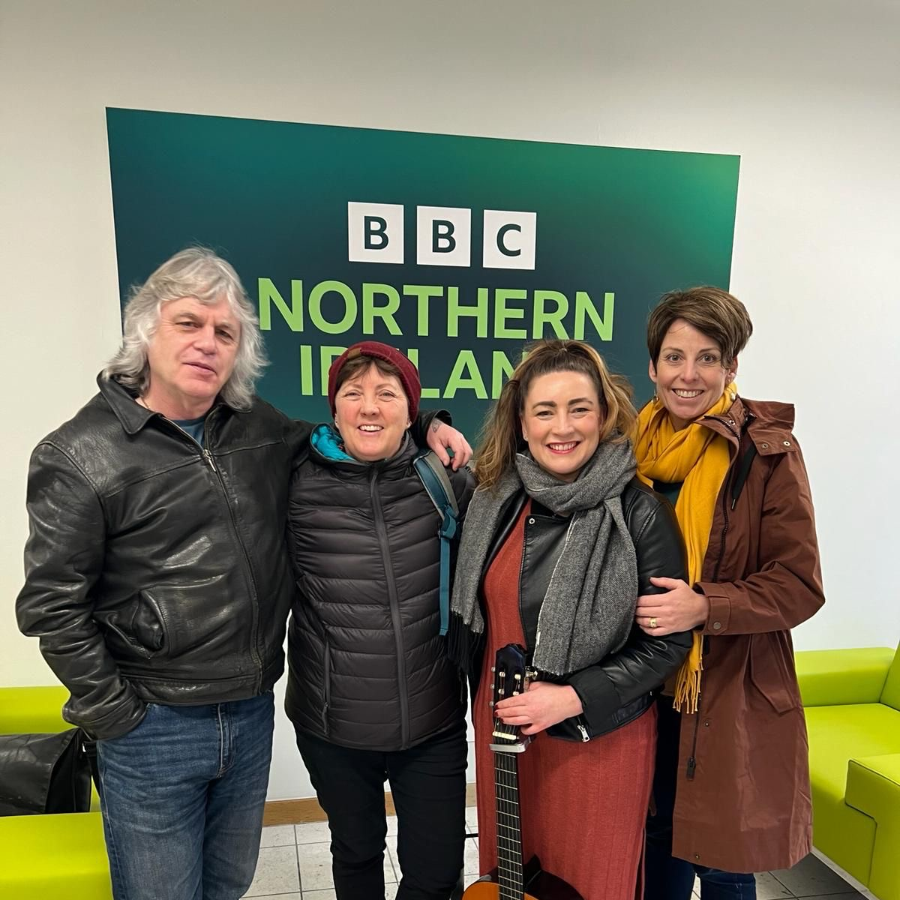
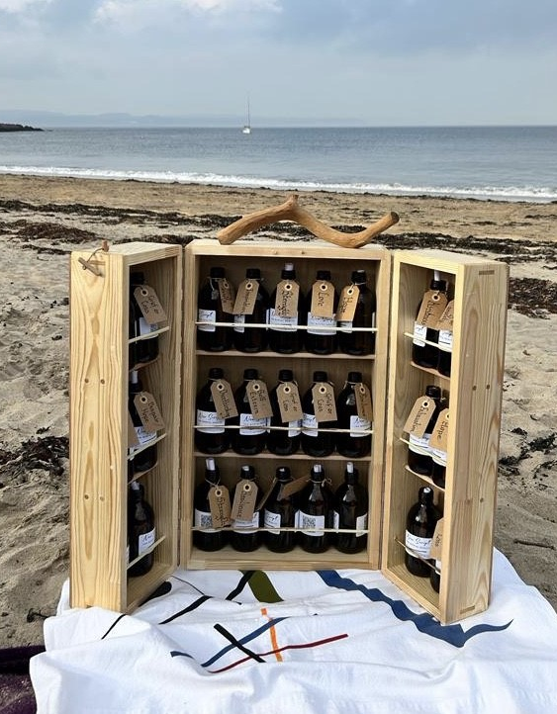
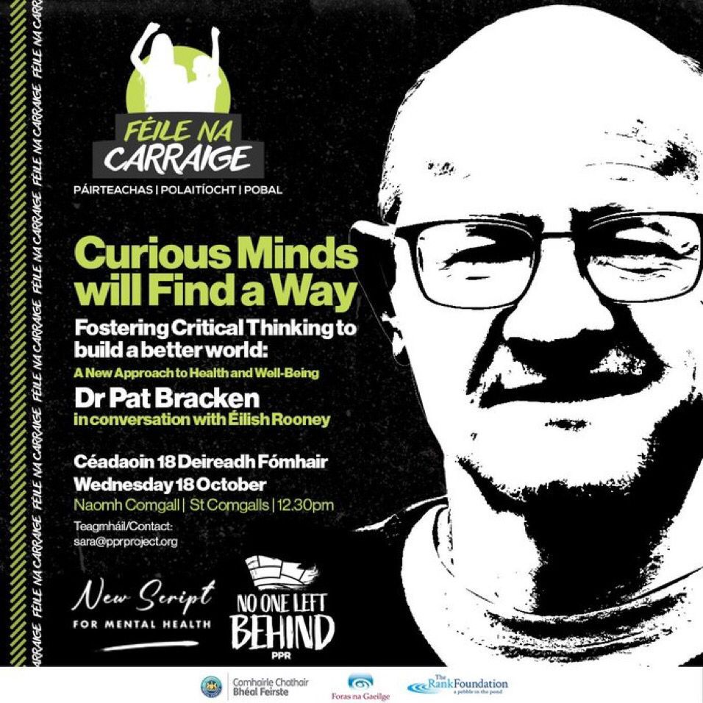
Alternatives: Creative, researched choices & new ways of understanding mental health!

Slide 11
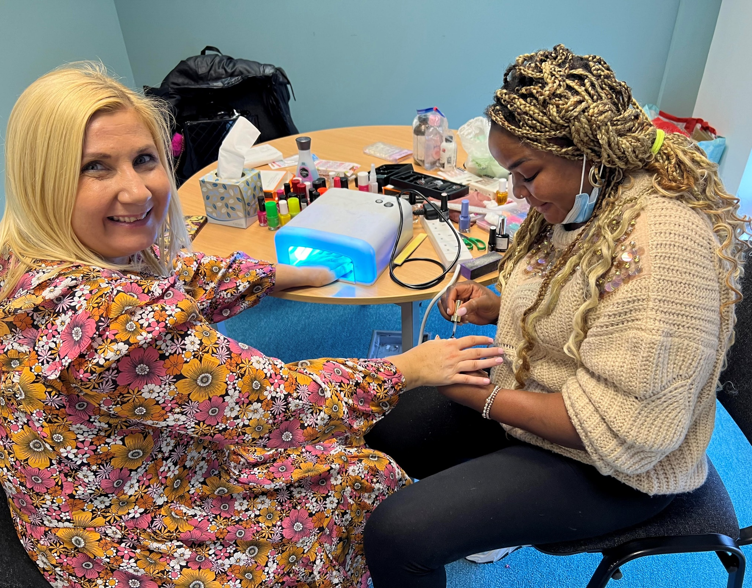
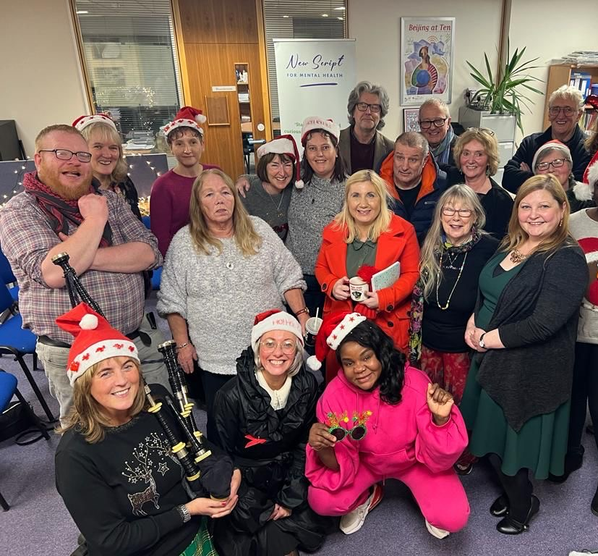
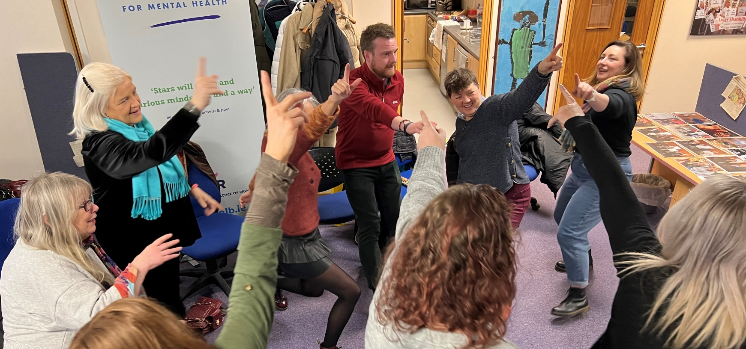
Collective Care

Slide 12
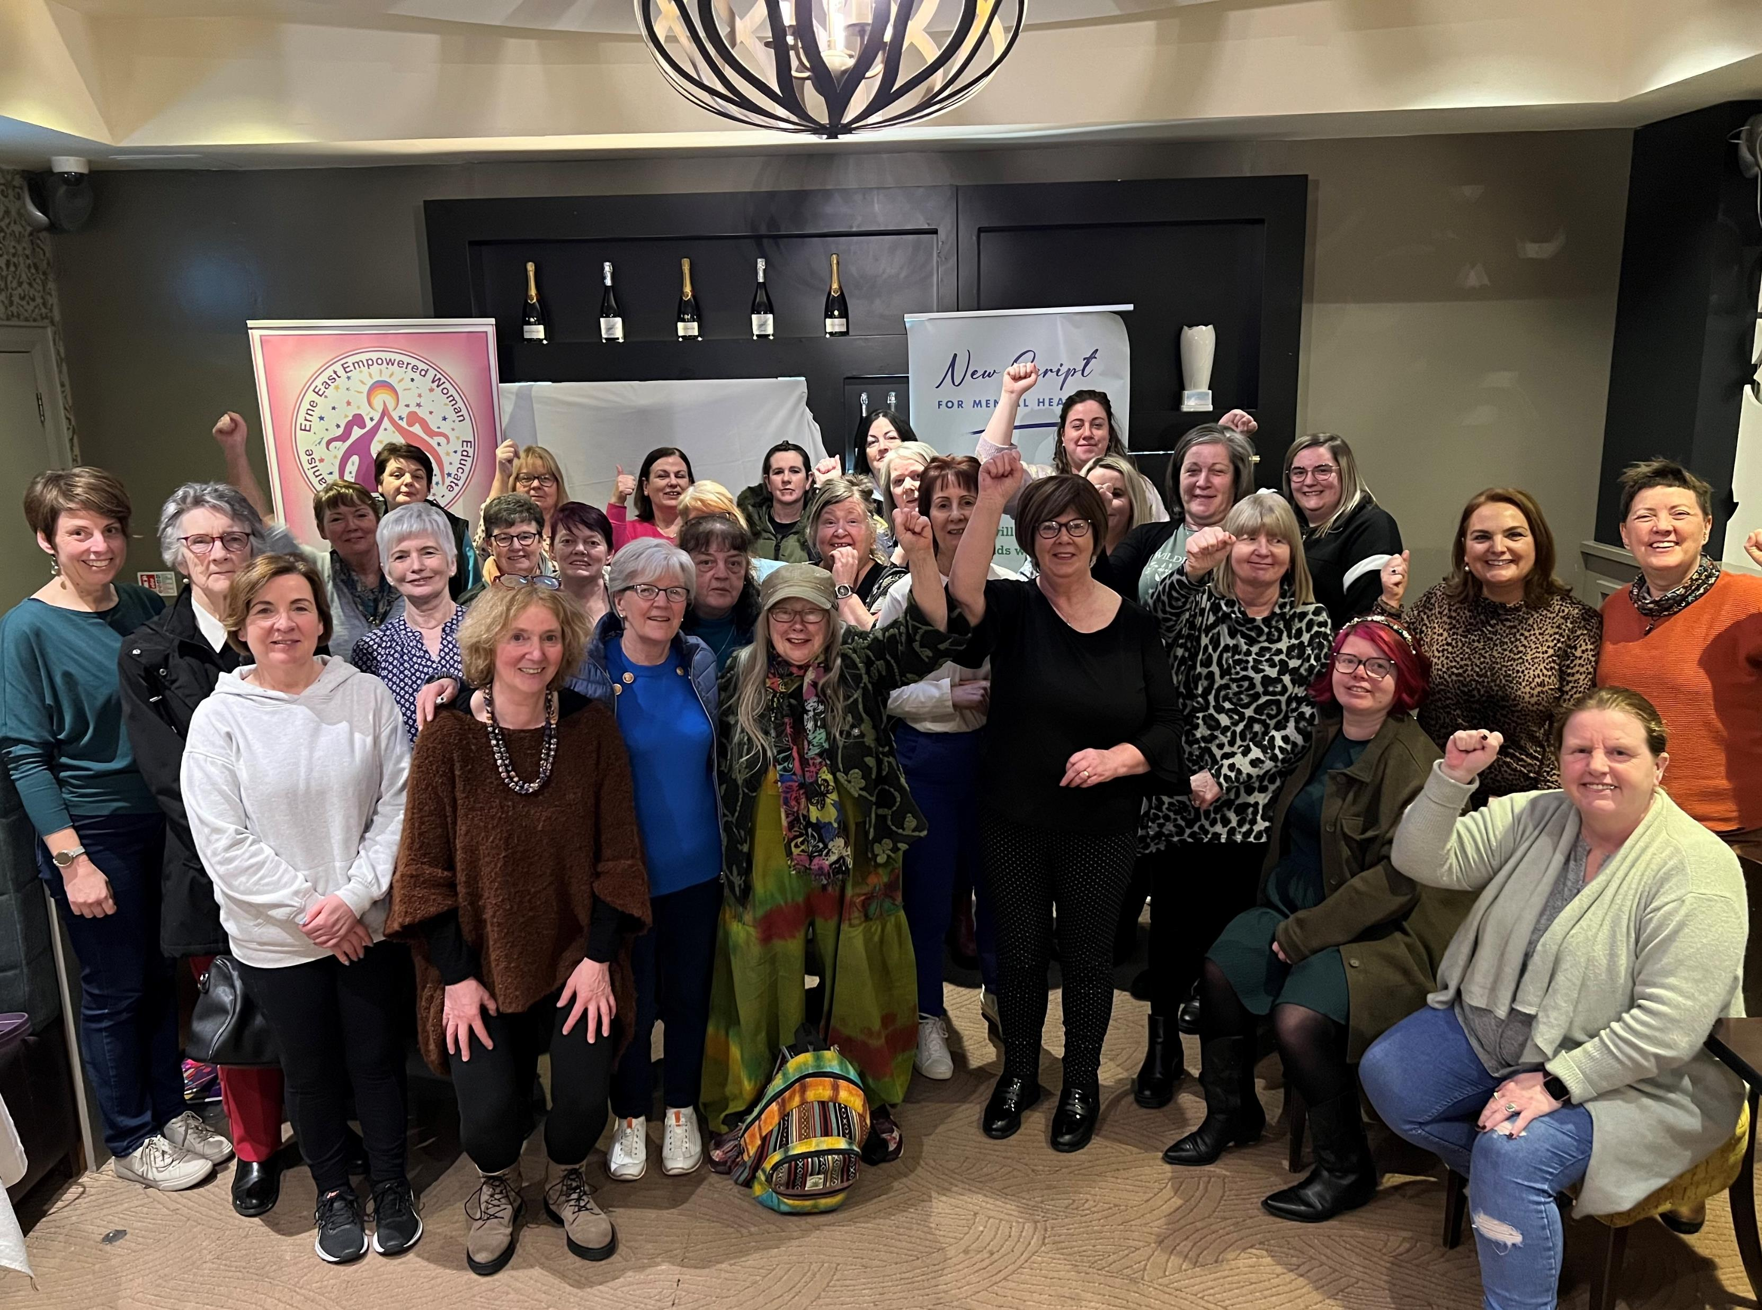
Purpose of Community Consultation
It’s time to have an open conversation about mental health.
We are creating opportunities to have this conversation.
We all have ideas from our own experiences and wisdom.
This consultation is about sharing those ideas.
Collectively creating a New Script for Mental Health.

Slide 13
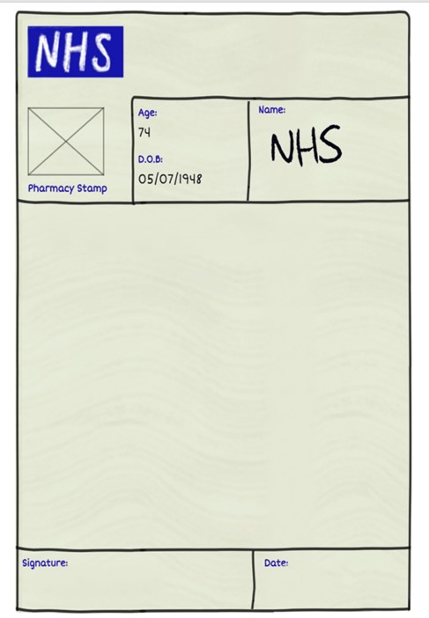
Methodology
‘Think about what you believe is needed to address the causes and results of emotional pain and distress. Then write your New Script for Mental Health’
Mix of consultation methods – online, video, workshops,
Stall at health & well-being event for young people
127 New Scripts completed
Responses anonymised
Thematic analysis
Ongoing

Slide 14
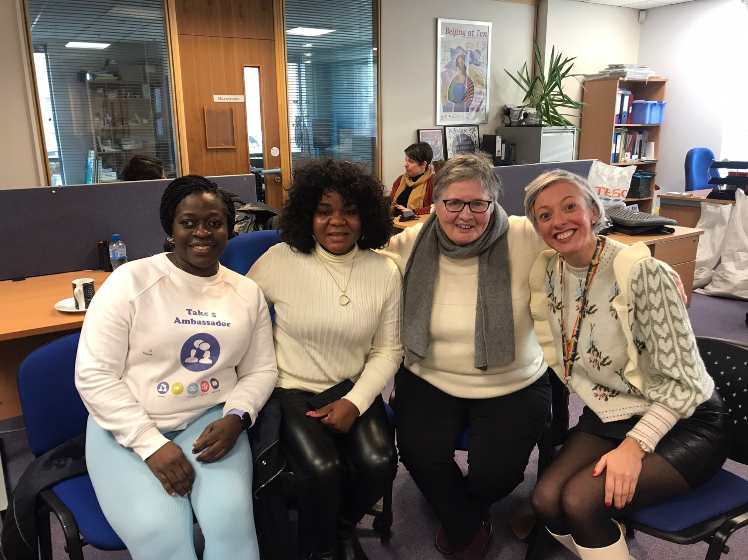
Key Themes
Reform mental health services
Wider options for people
Individual and collective empowerment
Address underlying causes of emotional pain and distress
Underpinning values

Slide 15
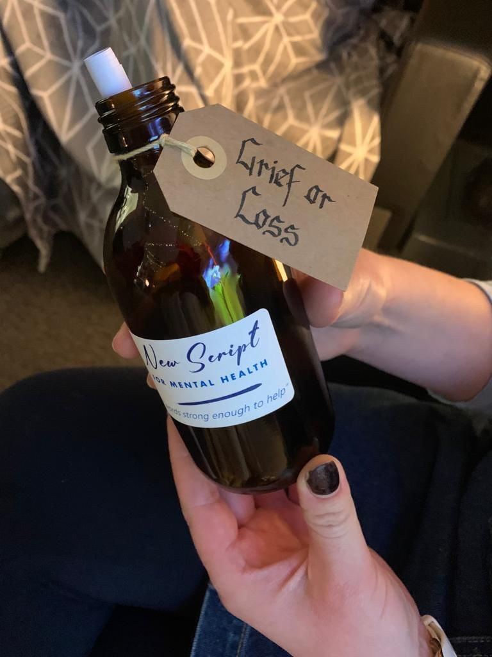
1. Reform Mental Health Services
‘Put talking therapy at the heart of the mental health framework. This means huge investment in making it acceptable to everyone, not just small increases in funding. A total refocusing is needed. There is a de-facto two-tier system of mental healthcare, where those who can pay £50-£60 per session of counselling have more options’.
‘Counselling and psychiatric support available in a timely manner through GPs, including for children and young people’.
‘Immediate access to counselling and for as long as needed’
‘Fully informed consent around prescribing of psychoactive drugs to include risks of long-term use and difficulties of coming off’
‘Provide early intervention, timely support for children and young people’

Slide 16
2. Wider Options for People
Access to arts and creativity
Access to nature
Non-drug-based approaches e.g. The Rest of the Story & social prescribing
Alternatives to ED for emotional distress
Rehab services
Community networks & support
‘Recognise the role that nature, creativity and the arts have, and support this’
‘Greater availability of social prescribing for social, creative and active pursuits. People may have a one-hour appointment with a mental health professional once a fortnight, but what support do they have in between these appointments?’.
‘More community-based initiatives like The Rest of the Story storytelling programme, to empower people to frame their own experience, enabling them to support each other in the community’.

Slide 17
3. Individual AND Collective Empowerment
A person, not a diagnosis
Connect with others with similar experiences
Empowered to tell your story
Value lived experience
Listen to activists & their solutions
Communities empower themselves, collective agency
Remove targets and focus on caring relationships
Warm handover
Whole systems approach
Improved record keeping and communication between services
Greater respect for mental health staff
“All services should be human rights informed. People using our Mental Health Services should not be treated as if they have no rights”

Slide 18
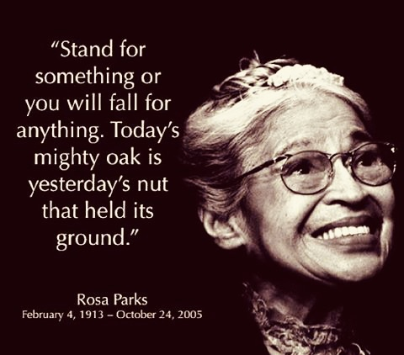
‘My new script for mental health involves power at the community level, redistribution of power downwards from those at the top to those at the bottom. This is crucial because too often those at the top want those at the bottom to blame themselves. For hunger, for illness, for substandard housing. In this way, redistribution of power promotes wellness’.
‘Trauma informed practise by all healthcare professionals and awareness of the impact of trauma.’
‘Additional funding for the community and voluntary sector and long-term funding for community-based peer support.’
‘Lobby for changes to our funding model so the Health Department can do multi-year funding.’

Slide 19
4. Address Underlying Causes of Emotional Pain & Distress
‘Shelter, food, clothing, love and proper income to provide.....are essential to human existence’
‘More social housing. Waiting lists are a joke. Affordable housing. Rental market is so stressful’. ‘Asylum seekers come from countries torn by war and poverty. We come traumatised and we face more trauma here. Asylum seekers need to be able to work and have access to services so we can live in dignity’
More social and affordable housing
Allow asylum seekers to work
Universal Basic Income
Address transport barriers
Stop privatisation of NHS

Slide 20
5. Underpinning Values

Slide 21
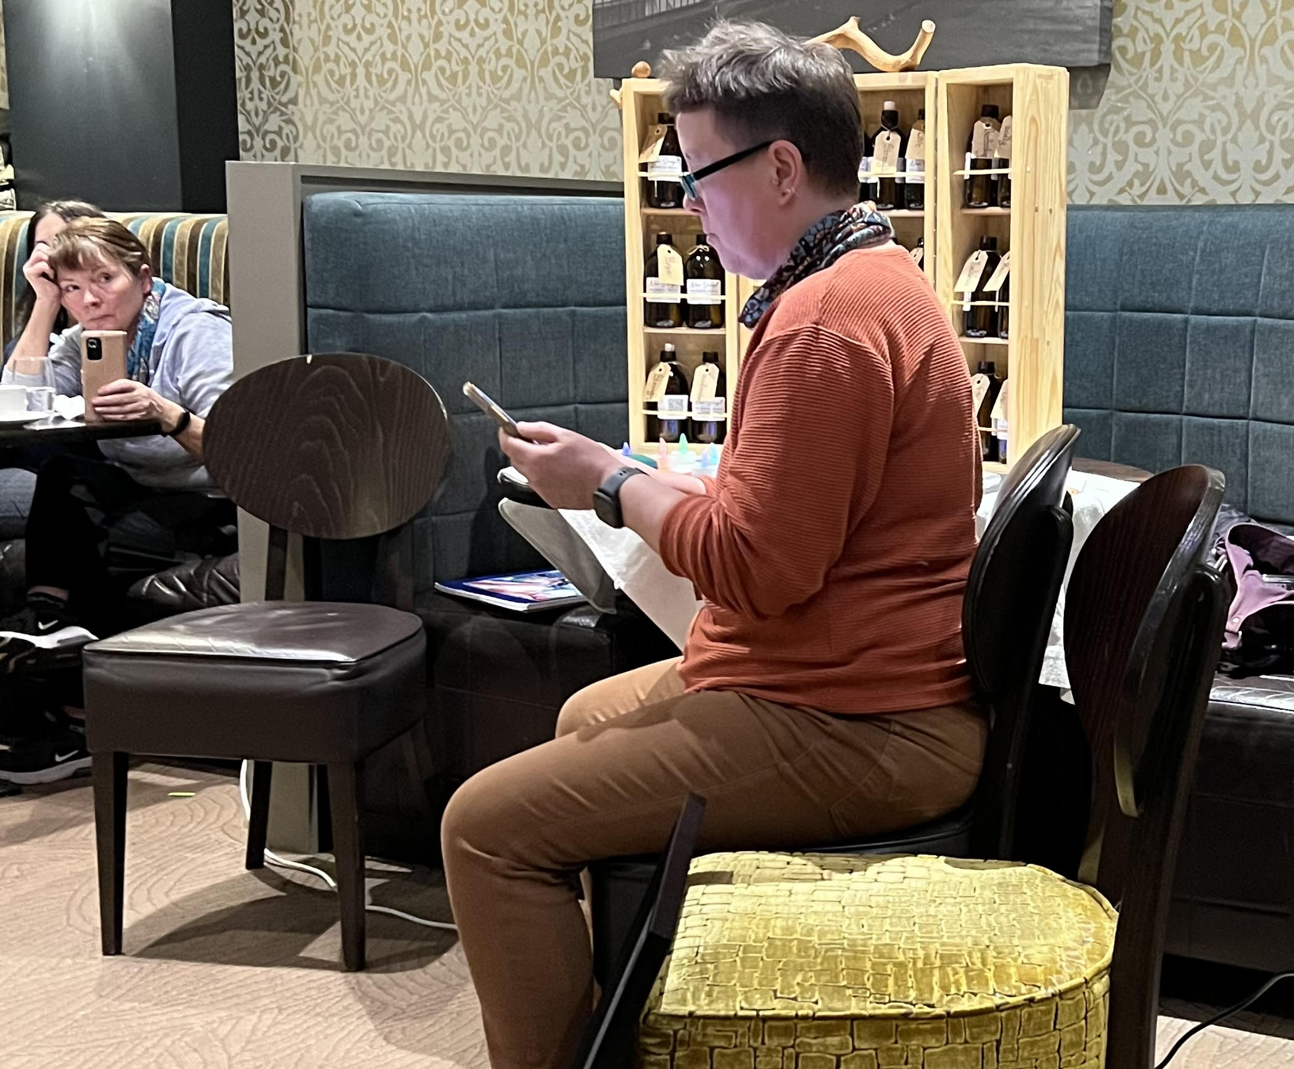
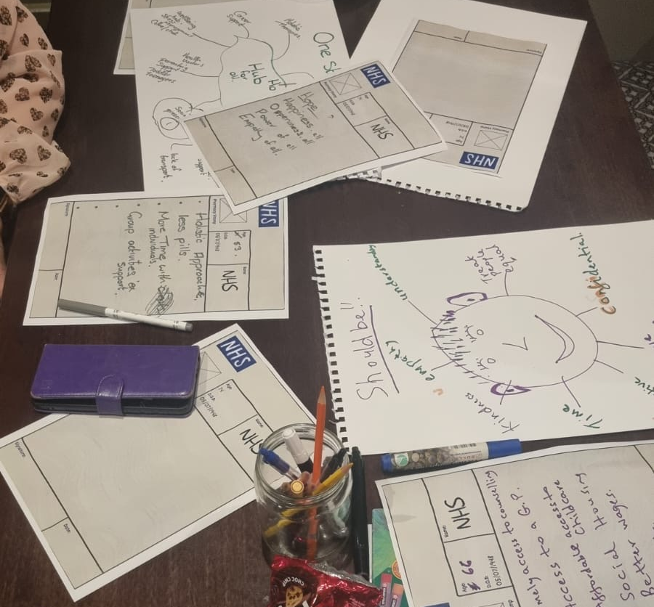
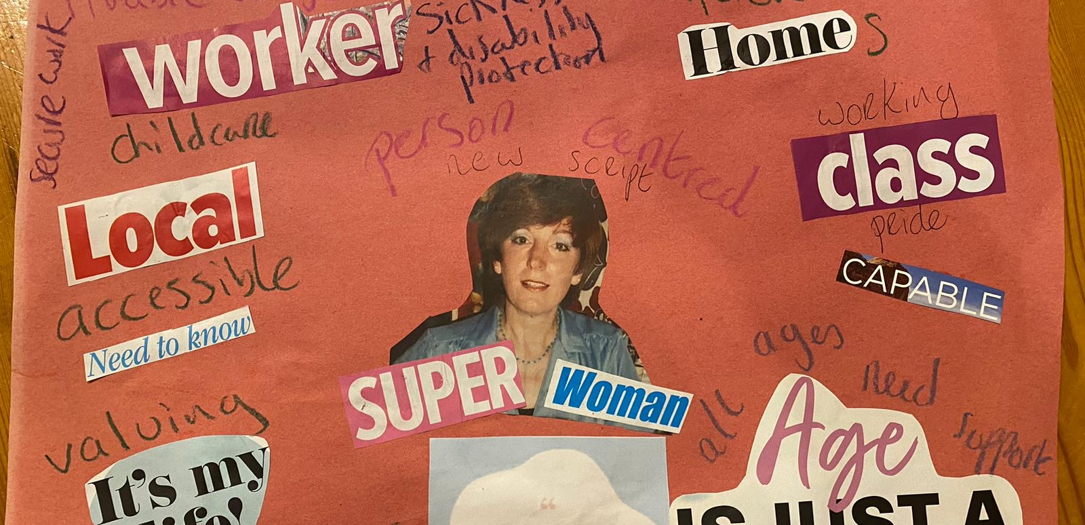
Why I got involved: Caroline’s Story
How I got involved: Launch Event 1^{stFeb} 2023
Hearing people real experiences and having someone to talk to you and support
Follow up, not drifting
My prescription
Creative, therapeutic writing
Coming into community

Slide 22
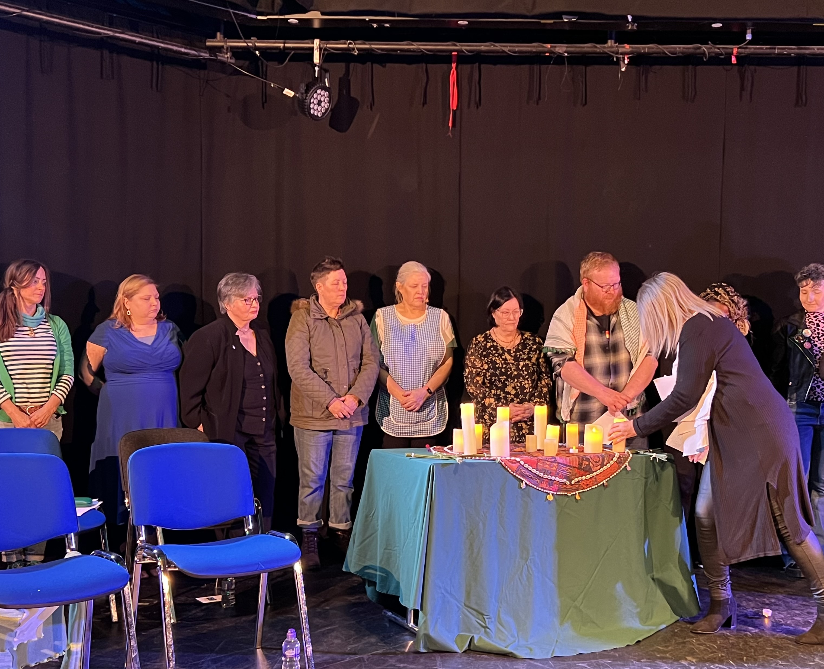
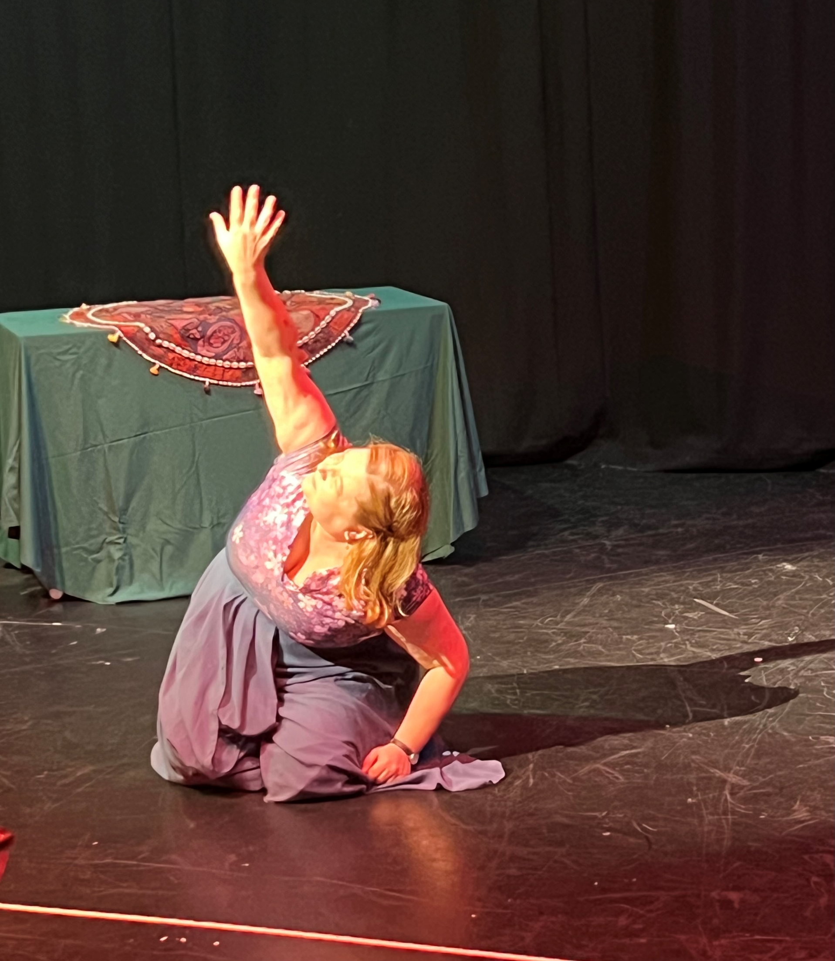
Why I got involved: Deirdre’s Story
How I got involved: Calligraphy writing
What I did and how I felt
Storytelling and art for healing and solidarity
Desperate Monologues
Poem: Nothing is ever in vain

Slide 23
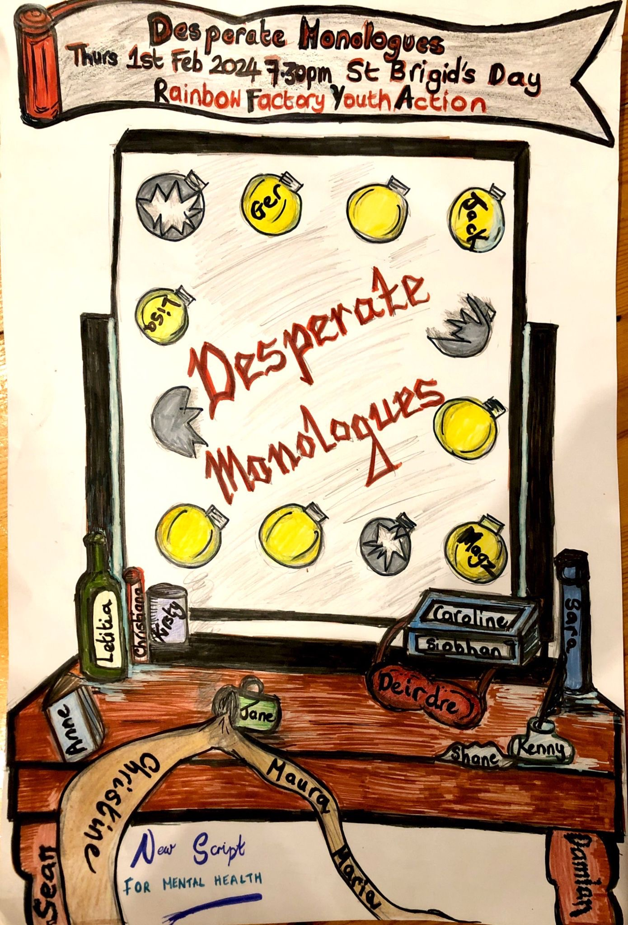
“Calligraphy Care”

Slide 24
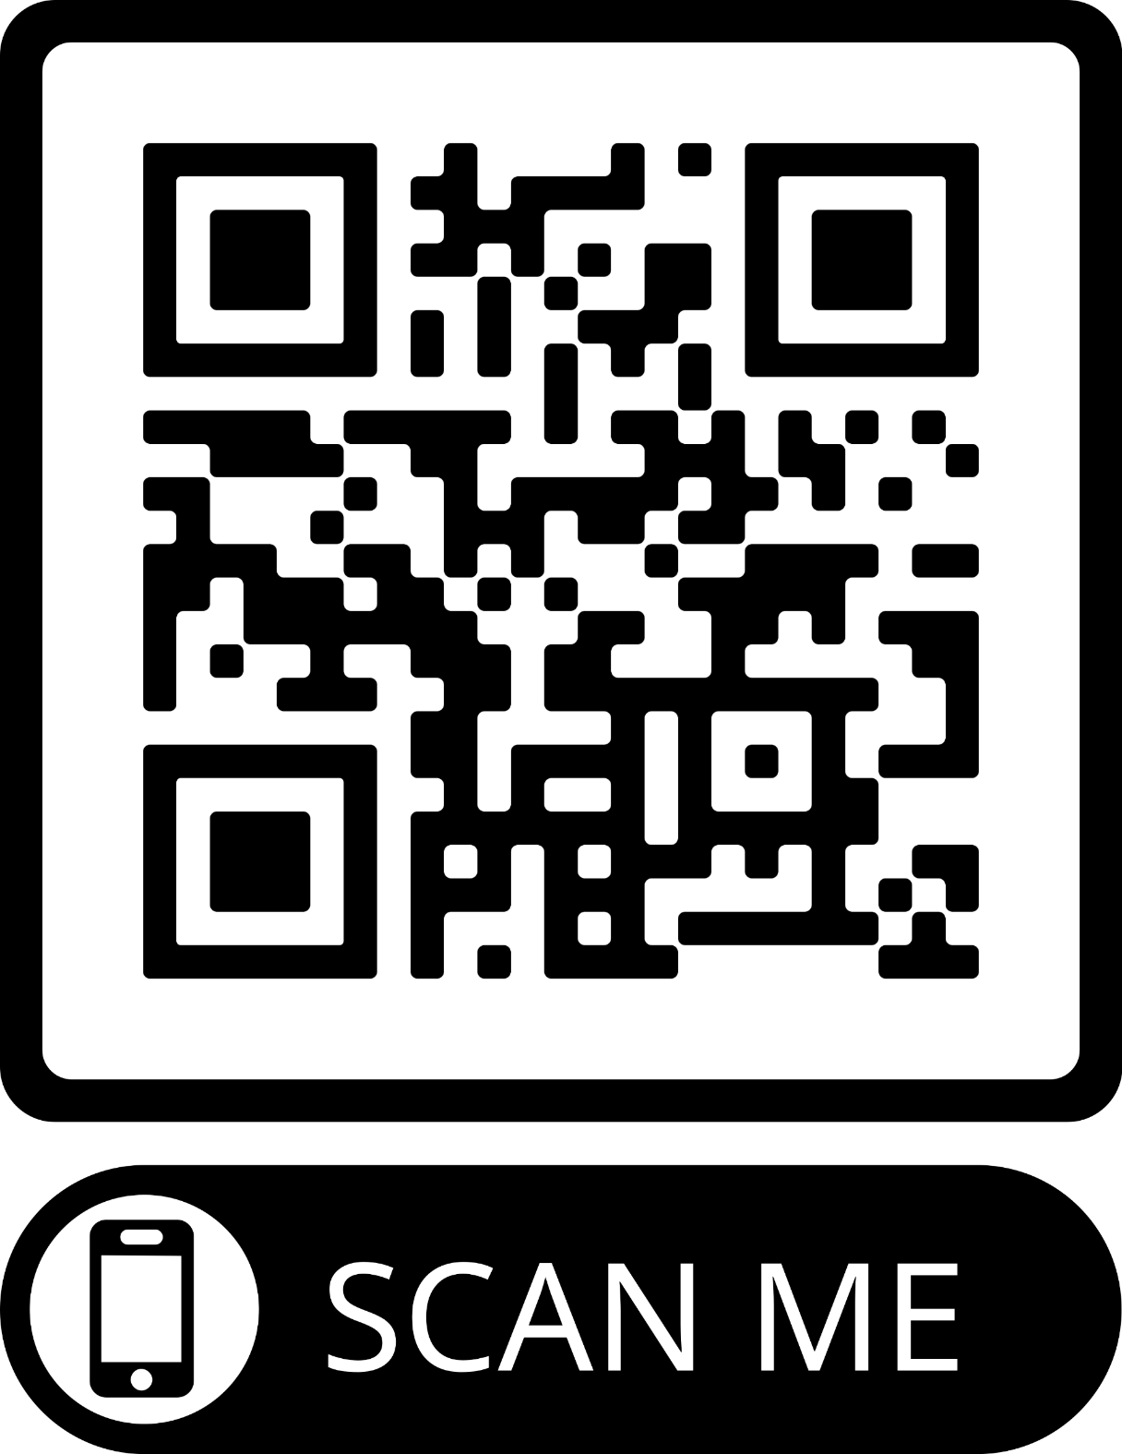
Writing and Sharing Your #NewScript

Slide 25
Take Action, Questions & Thanks
Sign up to mailing list
Share with others
Come along to a meeting
Attend Curious Minds Events and join the conversation
Apply to practice
Donate
Make a video on the phone with your New Script that we can share on SM

Slide 26
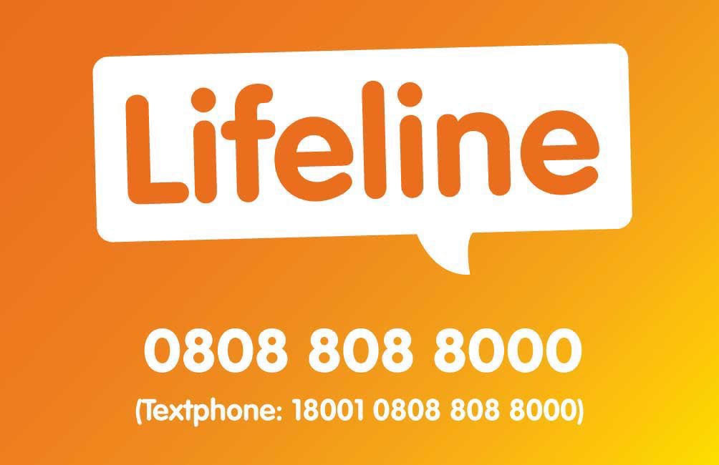
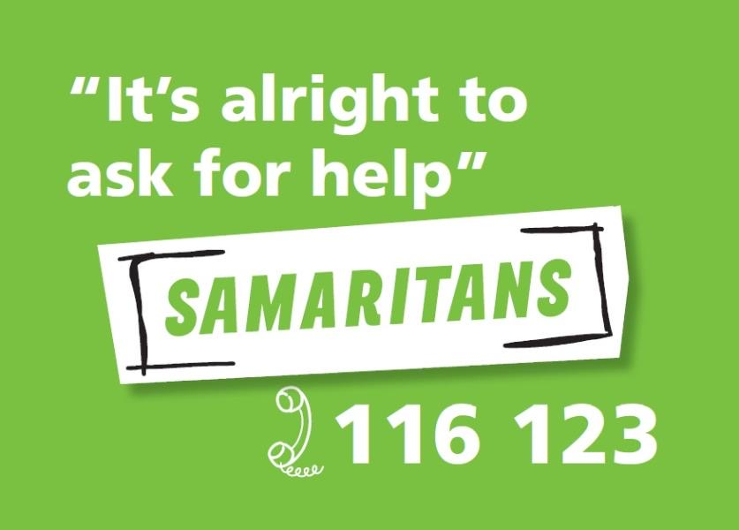
Thank You For Joining Us Today!
Free Online Co-Produced Safety Planning site for anyone struggling or
supporting someone who is suicidal www.stayingsafe.net

Slide 27
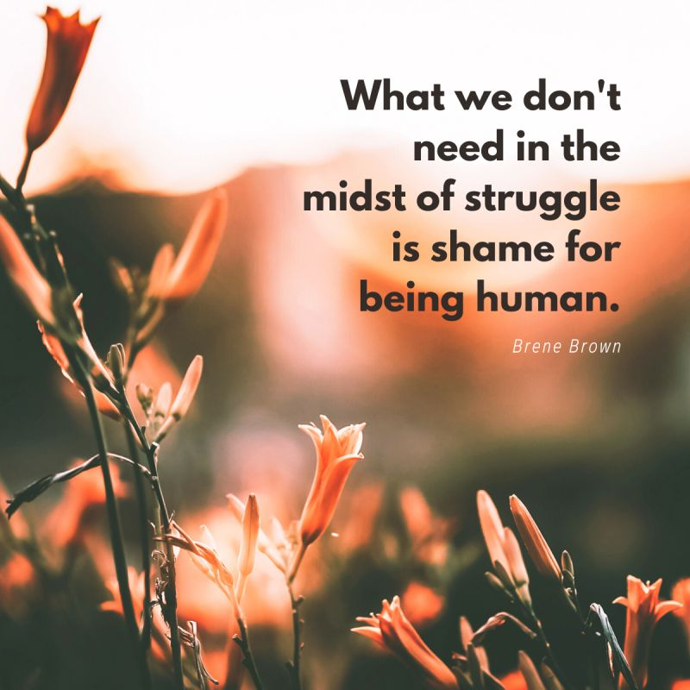
Contact Details and Resources
For further information please contact Sara Boyce, PPR on sara@pprproject.org or 07864074235
Website www.nlb.ie/campaigns/mental-health
Twitter @PPR_Org
Facebook https://www.facebook.com/pprproject/?locale=en_GB
You can find lots more data on our website using this link https://www.nlb.ie/blog/2023-10-ending-the-secrecy-around-mental-health- statistics
PPR blog: Inequality and Mental Health
https://www.nlb.ie/blog/2023-05-inequality-and-mental-health-joining-the-dots
International Institute for Psychiatric Drug Withdrawal (includes a video on safe withdrawal) https://iipdw.org/
World Health Organisation and United Nations (2023) Mental health, human rights and legislation: Guidance and Practice. Geneva. World Health Organisation and United Nations. https://iris.who.int/bitstream/handle/10665/373126/9789240080737-eng.pdf?sequence=1

