Slide 1


Promoting quality supervision in social work
The Social Work (NI) Supervision Policy 2024
1st March 2024
Notes:
Alison – introduction/housekeeping
Susan does slides 1 & 2
Hi my name is Susan Ritchie and I am a professional officer in the Office of Social services in the Department of Health
I would like to thank everyone for attending today – I am delighted with the interest in the new policy
Next slide – outline of the session

Slide 2
Seminar programme
12 -12.15 Aine Morrison Chief Social Work Officer, Department of Health
12.15-12.30 Susan Ritchie Professional Officer DoH - an outline of the 2024 SW Supervision Policy
12.30-12.45pm Dr Paula McFadden Senior SW Lecturer, Ulster University - Key messages from research in relation to social work supervision.
12.45pm -1pm Maria Emilsson Principal Social Worker Western Trust - the value of using group & peer supervision methods in social work supervision.
1pm – 1.15pm Marian O’Rourke Director of Regulation & Standards (NISCC) - the Social Work Leadership Framework & supervision and closing comments.
Notes:
Susan
Today we will hear from….slide
You will see that there is no question and answer session built into todays seminar .
Instead I would ask you to take any queries back to your organization and they can be addressed during the awareness sessions that will be delivered in your organisation.
Introduce Aine Morrison CSWO DoH who will talk to us about the importance of supervision in sw and explain the evolution of the 2024 sw supervision policy

Slide 3
Introduction
Aine Morrison
Chief Social Work Officer
Notes:
Thankyou to all for attending
I am delighted to be able to launch today’s policy
It is so important that the sw profession has a robust supervision policy in place that promotes quality supervision and supports social work practitioners in their role.
The SW Supervision Policy 2024 applies to all social workers employed in H&SCTs and in the Childrens Court Guardian Agency for NI……..but we hope that other employers of social work find it useful and adopt it.
So why is supervision important in SW – next slide

Slide 4
Supervision in social work
social workers at all levels require and have a right to regular supervision and support to maintain and develop their skills and standards of practice.
supervision provides a formal and on-going process that is vital to quality practice, professional development, practitioner well-being and enhanced relationships with service users and colleagues.
supervision plays a key role in developing confident and competent practitioners who will deliver a good quality social work service with improved outcomes for children, adults, families and communities
it is key that both employers and social workers embrace the importance of supervision and the Social Work (NI) Supervision Policy.
Notes:
SW’s need regular supervision to
develop skills
maintain standards of practice
professional development
maintain wellbeing
develop confidence and competence in role
facilitate improved outcomes for those they work with
It is therefore key that organization’s embrace its importance and that supervisees and supervisors work jointly to ensure quality supervision takes place regularly

Slide 5
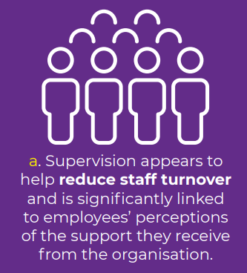
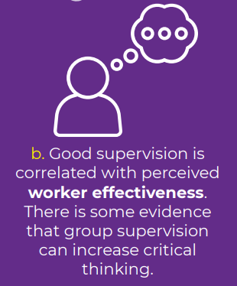
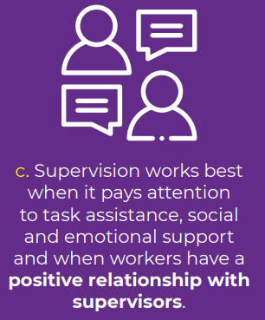
The Role of supervision in social work
Notes:
Later Paula McFadden will share further research in relation to supervision….but the supervision policy references SCIE research indicating that good quality, regular supervision -
Can reduce staff turnover
Improve worker effectiveness
Works best when there is a positive relationship between supervisor and supervisee
Next slide continues these points

Slide 6
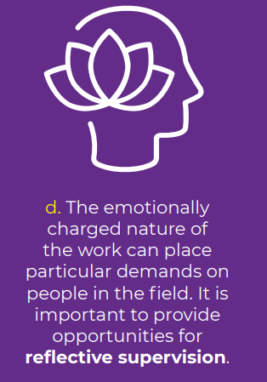

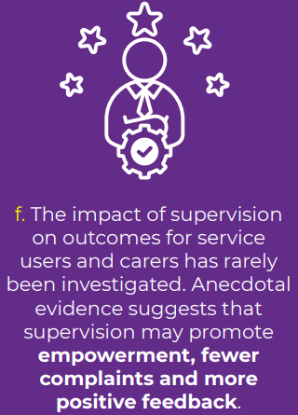
Notes:
Works best where it promotes reflection
Where expert knowledge is shared
Promotes better outcomes for those we work with

Slide 7
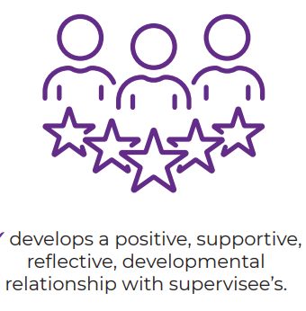
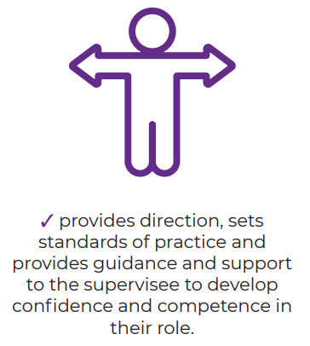

Notes:
Key to good quality supervision is the role of the supervisor.
The supervisory role is a highly responsible one that requires strong SW skills, knowledge and values
A supervisor should
- develop a positive, reflective and developmental relationship with the supervisee
- provide direction, guidance and support - but promote independent decision making and confidence in role
-promote the use of up to date knowledge and research to promote best practice
Continues on next page

Slide 8
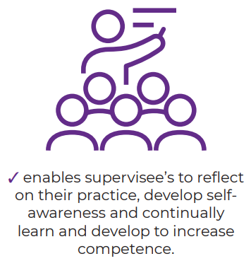
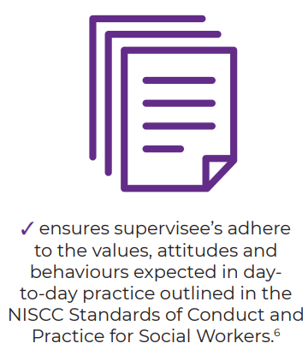

Notes:
A good supervisor:
- enables reflection, learning & development
- models and adheres to sw values, attitudes and behaviours
- understands that the sw role can impact of well-being and addresses it in supervision

Slide 9
Evolution of 2024 Supervision Policy
2016 Social Work Strategy (DoH) – review of supervision arrangements for social work and the existing social work supervision policy (2008)
2018 and 2019 - two regional surveys of supervision in social work
2019 COVID crisis – delayed further policy development of the draft policy
2019-23 Tested the draft policy in H&SCT’s – looking at feedback to inform policy completion
2024 Social Work Supervision policy launch
Notes:
Just to provide you with some background context to the new policy…..
A key priority of the Social Work Strategy (DOH 2016) was to strengthen the capacity and capability of the workforce and at that time there was a sense that the existing sw supervision policy was not completely relevant to contemporary practice
So two regional surveys of supervision in social work were undertaken in 2018 and 2019 And I will talk more about those in my next 2 slides
In 2019 regional working groups developed a draft policy and guidance – many of those involved in those groups are present today and I would like to take the opportunity to thank all those who worked to develop the draft policy and guidance at that time.
The COVID 19 crisis delayed further policy development – instead the draft policy was piloted in sites across H&SCT’s to provide assurance that policy recommendations would be effective and fit for purpose, and the policy and guidance were amended to reflect that feedback between 2019-23.
Today marks the completion of that work with the launch of the policy

Slide 10
Key issues from supervision surveys (1)
Joint professional responsibility for employers, supervisors, and supervisees to ensure supervision and professional supports are adequate and effective.
Line managers are often challenged to adequately balance all supervisory functions in individual supervision, with organizational/operational management dominating.
While individual supervision should meet all functions of supervision, group supervision can enhance the professional development function.
The increasing variety of roles and settings that social workers practice in mean that a ‘one size fits all’ approach was not helpful, and flexibility was needed.
Notes:
As mentioned previously two regional surveys of supervision in social work were undertaken in 2018 and 2019 to determine the prevalence, quality and impact of professional supervision for social workers from both the supervisee and supervisor perspectives.
The surveys provided a rich source of intelligence and evidence about supervision practice and
informed the draft social work supervision policy developed by the regional group.
Key messages were about the challenge of adequately covering all the functions of supervision by relying only on 1-1 LM supervision, that services should be able to adapt supervision methods to suits their service requirements (onto next slide)

Slide 11
Key Issues from supervision surveys (2)
• Individual supervision on its own is not enough; social workers thrive in a healthy collegiate team environment.
• Providing professional supervision is a skilled task.
• The challenge function in supervision is an important element of good professional governance.
• The impact of supervision needs regular evaluation.
Notes:
That social workers learn from their peers and thrive in a team environment so group learning approaches should be utilised more often
That supervisors should be trained in supervision skills
That supervision should seek feedback regularly to ensure it is meeting practitioner and supervisor needs

Slide 12
Social Work (NI) Supervision Policy 2024
Takes into account:
feedback from the surveys,
feedback from those teams that tested the draft policy
messages from supervision research
Provides a flexible approach to allow services to develop a model of supervision that suits their staff and service
Allows supervision to be facilitated through a range of methods that will ensure all functions of supervision are strengthened and met.
Notes:
So in conclusion the SW Sup policy 2024 takes into account ….
Read slide
So I am now going to hand you over to Susan Ritchie PO OSS who is going to provide further details on the policy content

Slide 13
Overview of the
Social Work (NI) Supervision Policy 2024
Susan Ritchie
Professional Officer
Department of Health
Notes:
Thankyou - Aine has provided the context of the supervision policy
I am going to provide an outline of the content and what the policy may mean for you as a supervisee or supervisor
This will be a very brief overview and you will learn more about the policy in organizational awareness sessions

Slide 14
Underpinning values and principles
All SW’s receive monthly supervision (may be 6 weekly for more senior positions).
NQSW’s supervision meets NISCC requirements for AYE.
SW’s line managed by a different discipline receive professional sw supervision 4 times annually.
All staff who provide supervision should be trained.
Supervision is a collective responsibility.
Supervision supports reflection, professional development and application of values.
Supervision supports application of knowledge, evidence to improve practice.
Supervision recognises emotional impact of role.
Group supervision can enhance learning component of supervision.
Professional consultations to discuss complex casework could be considered a form of supervision
Notes:
So the starting point for the policy was identifying the underpinning values and principles
There are more within the policy itself but these are some of the key ones
Read slide…….I will be referring later in the session to these principles and values

Slide 15
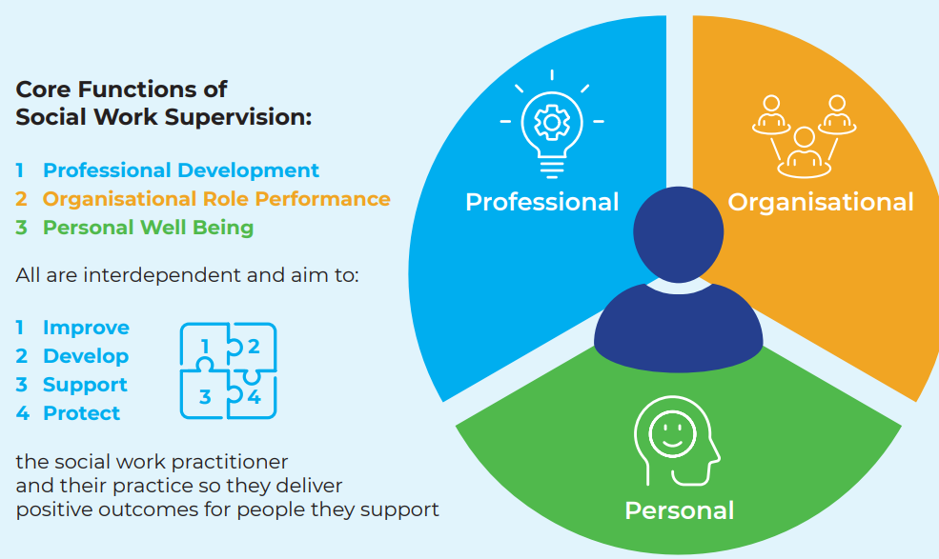
N. Ireland supervision policy framework
Notes:
So the policy framework provides 3 core functions of supervision
All are interdependent and overlap
All Supervision functions must be met – but they can be met using different methods to do so
Read slide

Slide 16
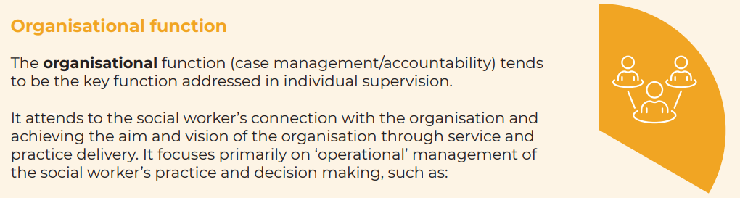
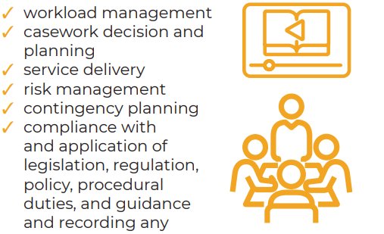
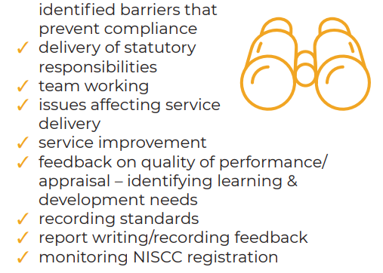
Notes:
This is the function of supervision that focusses on case discussions/casework decisions, risk management, compliance with statutory functions, legislation, policy etc
It is where the supervisor provides direction, sets standards of practice, and when required to provides an evidence base and guidance to support decision making
As part of it supervisors model and also ensure practitioners adhere to social work values attitudes and behaviours.
It is not a standalone function but interlinks with professional development and the personal wellbeing functions…For example where a reflective discussion concerning casework and decision making takes place and at the same time it is evident the role is impacting on wellbeing and that is discussed – this crosses all 3 functions
The organizational function will primarily be met through 1-1 supervision with a line manager however professional consultation with a principal or senior practitioner to discuss and reflect on complex casework also meets the organisational function, and I will explain that further into the presentation

Slide 17
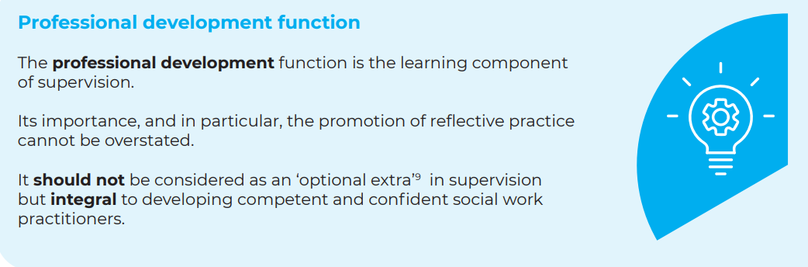
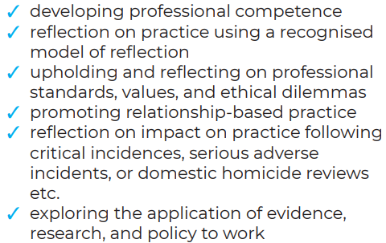
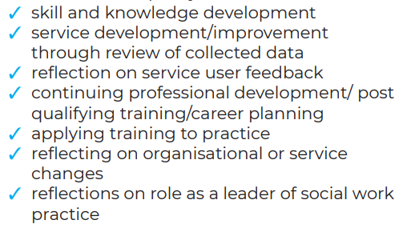
Notes:
This is the learning component of supervision and is integral to developing competent and confident practitioners
Reflective discussions are how we learn and improve our practice
A Key message of the policy is that Individual supervision should always use any opportunities to reflect on practice and address the professional development function
However it is recognized that individual supervision is dominated with the demands of the organizational function as outlined in the previous slide. And that can place limits on how much the professional development function is addressed.
Therefore the policy outlines a menu of group supervision methods that can be used alongside or in place of individual supervision at 4 points in the year to enhance the pd function

Slide 18
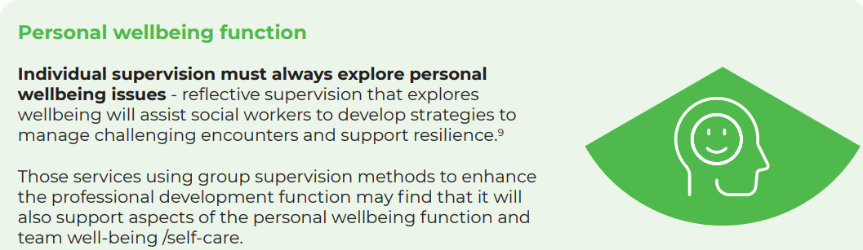
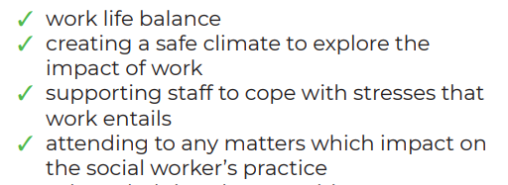
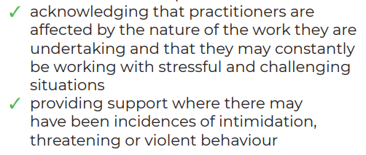
Notes:
The third function of supervision is the Personal well-being function – which must always be explored in individual supervision
Where a social worker either experiences
a role related violent incident or
The role is having a detrimental impact on wellbeing
This should be
discussed in individual supervision
If applicable an incident debrief/or personal impact assessment offered
Risk management plans /safe working practices reviewed
Organisational processes in relation to wellbeing followed
A practitioner wellbeing and support plan put in place and reviewed
Wider lessons learned for the service shared
So what are the key messages of the policy about the 3 functions of supervision?

Slide 19
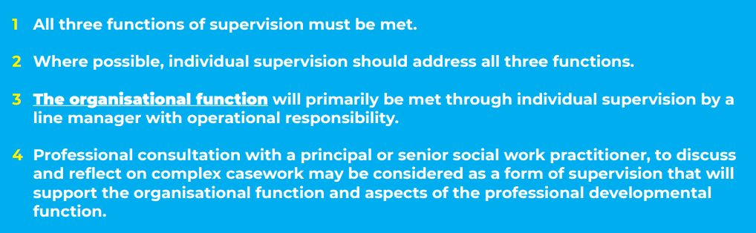

Notes:
Read the slides

Slide 20
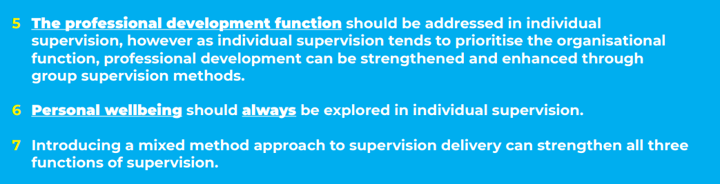
Notes:
Read slide
So what can all this look like in practice?
Here are examples of how a service might use the mixed methods approach to supervision And what supervision could look like for practitioners

Slide 21
Models of supervision – what might it look like in practice?:?
Service settings will consider a model of supervision that best suits their practitioners and service…some options…..
Notes:
Read the slide
So a service may decide that monthly individual line manager supervision remains and that it meets all the functions and supervisory needs of staff in their service – so no other methods of sup are used
or

Slide 22
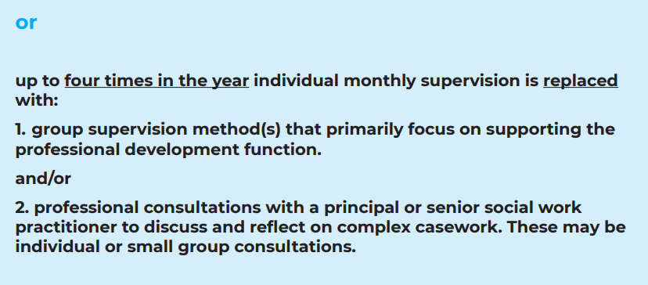
Notes:
A service may decide that up to four times in a year individual LM supervision will be replaced
4 times in the year it could be a group supervision method that replaces individual supervision
or
it could be 4 professional consultations with a SW senior or PP that replace ind LM supervision
Or it could be a mixture of both 4 times in the year
$ times max important so practitioners still receive individual supervision regularly across the year
However there is a third option available

Slide 23
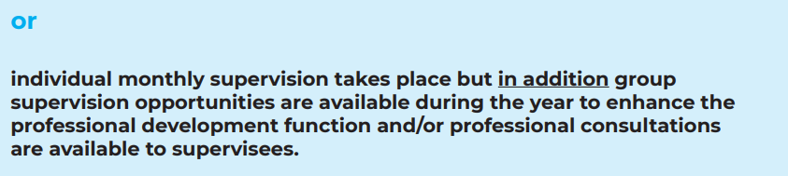
Notes:
That a service continues with individual monthly LM supervision but in addition makes groupwork or professional consultations available as required across the year
So they are 3 examples of how a service can used a mixed method approach to supervision

Slide 24
Menu of supervision methods
Individual Supervision
Notes:
So I have referred to a mixed menu of sup methods- let me just go over those methods
individual supervision continues for all – policy sets some standards around it
Monthly majority with SWLM
Mostly in person some may be on line
In the unavoidable absence of a line manager, senior social work practitioners who are trained in supervision skills may supervise social workers as a temporary measure.
Individual supervision minutes should be typed, shared, and signed by both parties within ten working days.
• There may be times where frequency of individual supervision is increased to meet/ address supervisee needs
Case decisions made in individual supervision should be recorded as a note on a service users digital record. As this is a record that can be viewed by the service user, it is important that wording is considered for potential impact on the service user and agreed with the line manager.
So we have said that …..Up to four times in a year individual monthly line manager supervision may be replaced by: • 1. professional consultation with a principalor senior social work practitioner to discuss and reflect on complex casework and/or • 2. a range of group-work supervision methods to support and enhance the professional development function….what do they mean?

Slide 25
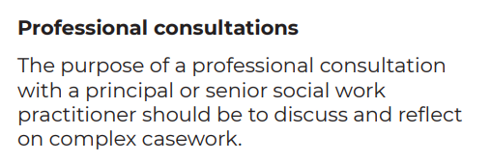

Slide 26

1. Group Supervision
3. Social Work Forums
2. Peer Group Supervision
4. ‘Service specific’
Notes:
Group supervision methods – Im not going to explain what each one is as the policy clearly describes each method and its purpose……and Maria will be discussing the value of using group and peer supervision in her presentation but key messages are that-
Requires a qualified social worker with relevant training and experience.
Does not have to be facilitated by the supervisee’s line manager.
Works best when in person.
Should support the Prof dev function of supervision
Decisions made re casework should go back through the LM with operational responsibility for agreement

Slide 27
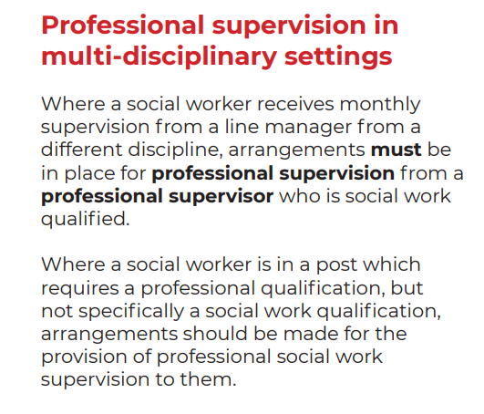

Slide 28

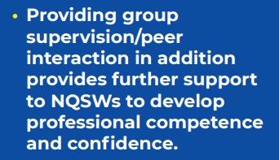
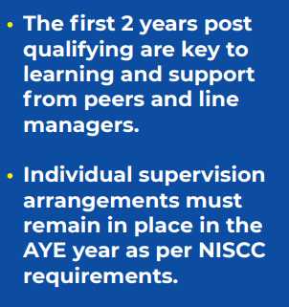

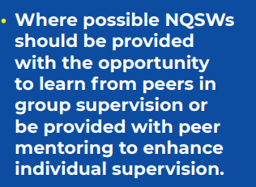
Notes:
Read slide

Slide 29
What AYE social workers said about supervision
‘For me the function of supervision has promoted conversations and reflection on a number of areas such as unconscious bias, value conflicts, ethical challenges and the importance of engaging in these discussions to improve service delivery. Equally through supervision my manager and I have been able to identify opportunities to meet the learning needs highlighted in my summary of learning’
Key message : Supervision as a vital
‘safe space’ to explore emotions and
discuss ethical dilemmas and professional challenges
(NISCC AYE Audit 2023)
‘Reflection during supervision is an important tool to identify the pressures and issues a practicing social worker is dealing with. A lack of resources and services for service users puts continuous strain on the practitioner. Having supervision take place at fixed times is important for my own wellbeing.’
‘I have used supervision and peer support to guide me through the challenges I have faced throughout this year. I have found this to be an invaluable part of my experience as a newly qualified social worker.’
Notes:
Working in close proximity to social work colleagues and managers positively impacts on a NQSW’s quality of practice and improves motivation to remain in the profession.
Regular access to and interactions with peers helps NQSWs to develop and enhance their confidence and competence in decision-making.
Peer support, advice, and guidance is beneficial to NQSWs in both the immediate and longer terms.
Supervisors/managers should demonstrate and model compassion, encouragement and a reflective, learning culture in their interactions with NQSWs.

Slide 30
Assuring quality supervision
1. Service supervision plans
2. Supervision Agreements
3. Annual Supervision Audit
Notes:
Service sup plan
outlines the methods of supervision that will be used in a service to meet the functions of supervision,
identifies who will deliver different methods of supervision
Identifies who needs trained
Completed by a senior manager
Supervision agreement
Contract between a supervisor and a supervisee – outlines the supervision arrangements for each social worker- must refer to the supervision plan where a mixed methods approach is taking place so sw staff are clear on their supervision arrangements
Next page for audit

Slide 31
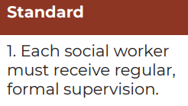

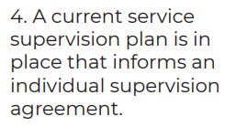
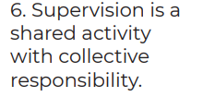
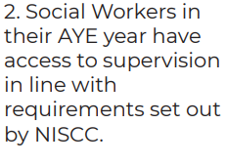
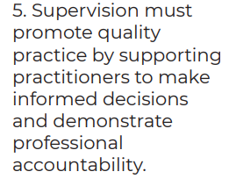
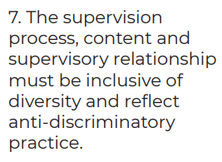
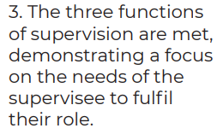
Supervision standards and audit
Notes:
So how do we assure that the policy is implemented and that practitioners are receiving supervision to the standard required?
Annually each organization will audit supervision against 7 key standards
This will assure the organization that supervision is taking place in keeping with the policy
Where its not improvement plans will be developed= in most organisations
this will be led by sw governance leads

Slide 32
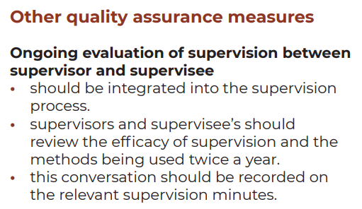
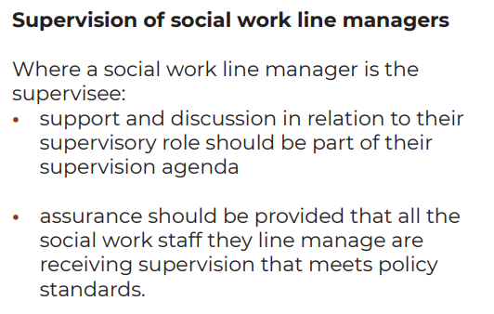
Notes:
But we have other ways of assuring quality supervision too
Evaluation integrated into sup twice a year
Managers of line managers being assured sw staff are receiving sup and they get the opportunity reflect on supervision

Slide 33


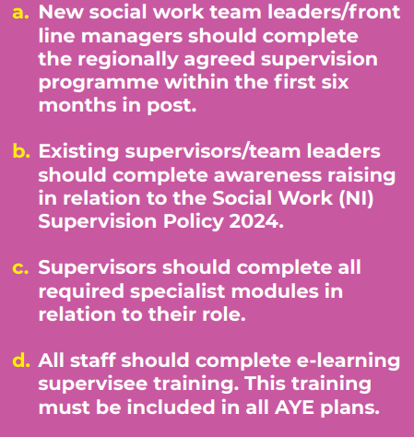
Notes:
Finally – to be assured that those who deliver supervision are skilled and those who receive supervision understand its importance training is key…

Slide 34
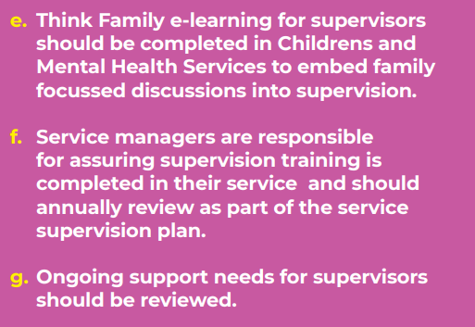
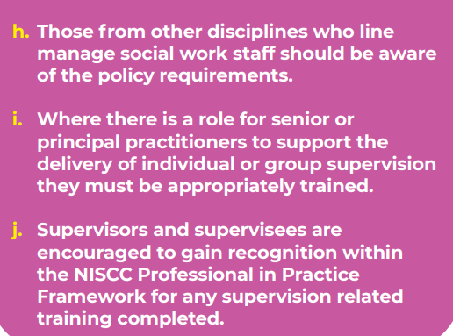

Slide 35
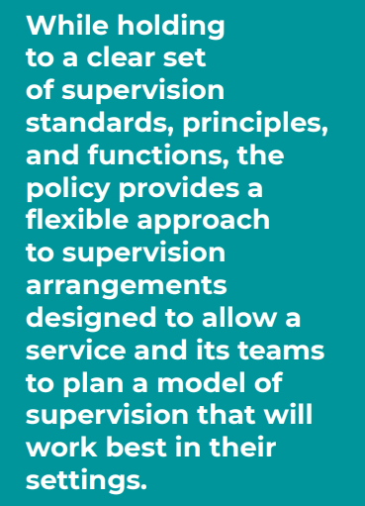

A final
Notes:
So I hope it has been useful to hear about the contents of the policy
The take away message is ….read slide
Im now going to hand you over to Paula Mcfadden

Slide 36

Social work Supervision and key messages from research
Dr Paula McFadden
Ulster University

Slide 37
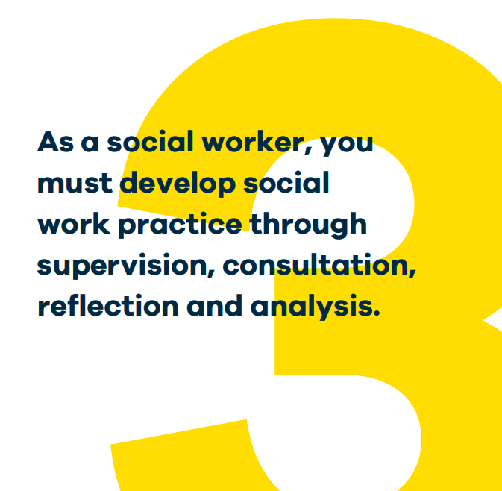
NI Social Care Council and Social Work England – Standards and Requirements
Social Work England
Regular ‘protected time with their {social workers} manager’ should be used to discuss and evaluate social workers’ responsibilities and the impact of work on their well-being (Social Work England, 2020).
Northern Ireland Social Care Council

Slide 38
Definition of Reflective Supervision?
Not uniformly conceptualised nor agreed …
Reflective Supervision was not defined in a uniform fashion and there was limited evidence pertaining to supervisory practice.
More research is in progress to focus on what works and what improvements are needed (Ravalier, McFadden et al).

Slide 39

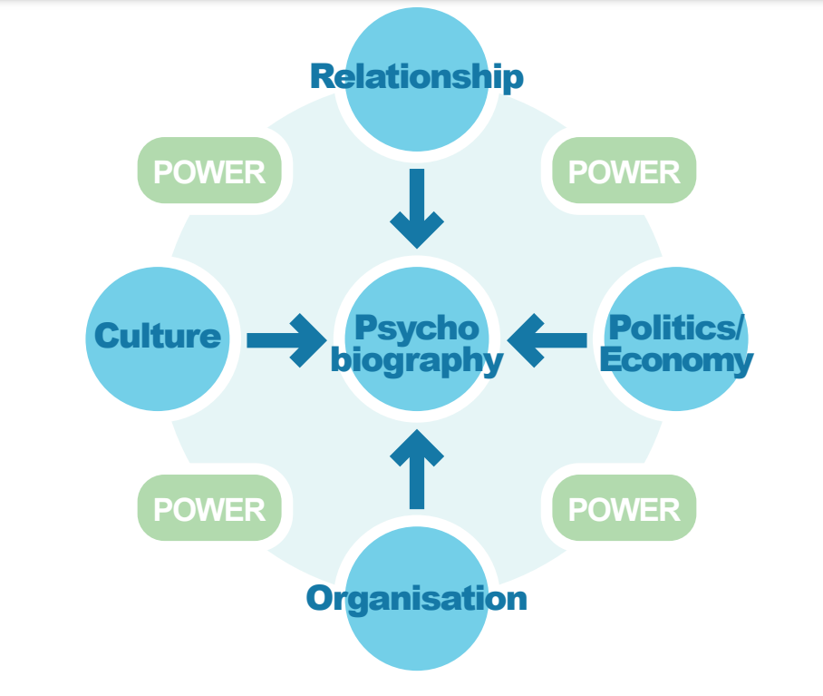
Professor Stand Houston – Reflective Practice Model

Slide 40

Systematic Research on Reflective Supervision
What does best practice for social work supervision look like?
Why doesn’t supervision happen and what to do to make it happen?
How supervision impacts social worker well-being and service user outcome?
Jermaine M Ravalier, Paulina Wegrzynek, Annabel Mitchell, John McGowan, Paula Mcfadden, Caroline Bald, A Rapid Review of Reflective Supervision in Social Work, The British Journal of Social Work, Volume 53, Issue 4, June 2023
Notes:
40

Slide 41

Barriers to Reflective Supervision
Peet (2011) noted how case (resource) management interferes with adoption of a reflective lens in supervisory encounters, with others highlighting issues around its singular focus on accountability (Pitt et al., 2021).
This fails to acknowledge the broader needs of the social work practitioners such as their affective factors (Bradbury Jones, 2013; Wilkins et al., 2017) and autonomy.
Manthorpe et al. (2015) argued that reflection is perceived as an ‘optional extra’ within supervision, even for the newly qualified social workers.
The lack of/limitations of supervision training for social work managers affect their confidence and motivation to (begin to) deliver RS (Bourn and Wilkins et al., 2017; Turney and Ruch, 2018).

Slide 42

Enablers of Reflective Supervision
Managers (and practice teachers for social work students) are seen as facilitators of reflective practice (Ruch, 2007; Wilson, 2013)
A good relationship between a supervisor and a social worker is pertinent to the success of the interactional supervisory process (Harlow, 2016).
Pitt et al. (2021) found that flexibility and an ‘open door policy’ with supervisors allow social workers to benefit from a more needs-based supervision.

Slide 43

Relationship Based Supervision and Resilience
Role of positive relationships between managers / supervisors and social workers in building worker resilience.
Protected time and space needed to support managers and social workers in reflective supervisory practice
Pressures on managers time can detract from protected time
Managers need supported to be able to support social workers
Systemic rewards from reflective supportive supervision impact on service users, social workers, managers, and organizations

Slide 44
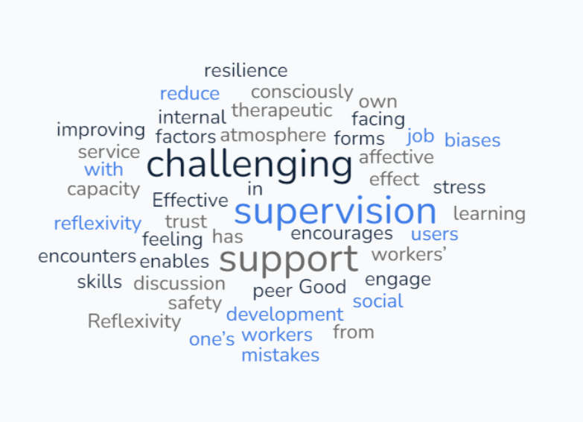


Benefits for Social Workers

Slide 45
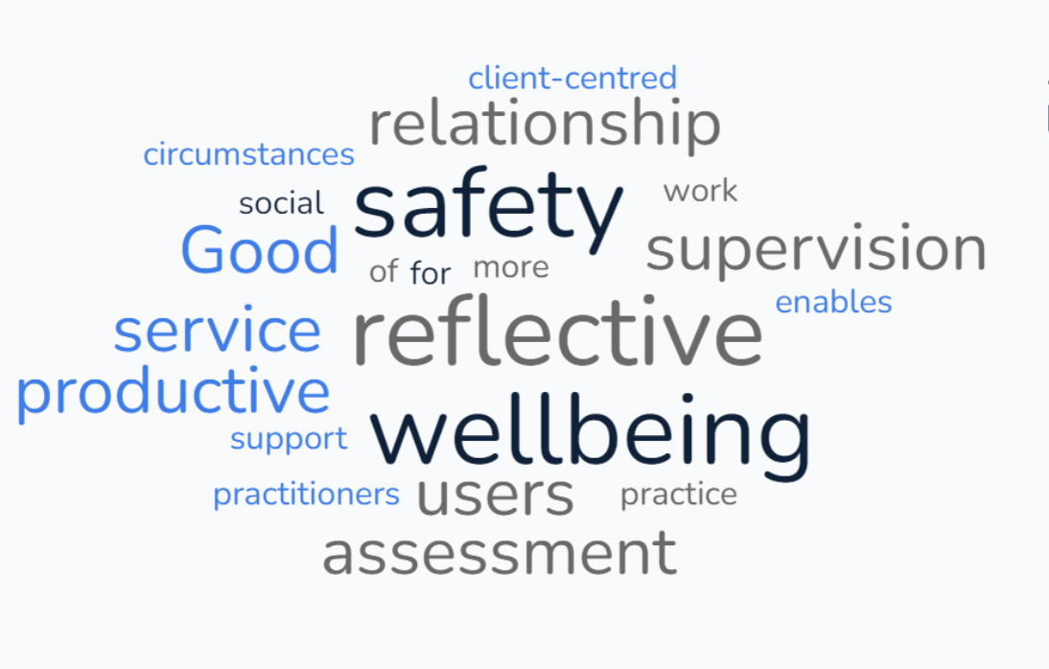

Benefits to Service Users

Slide 46
In Summary: Reflective Supervision in Social Work:
Main findings from Ravalier, McFadden et al (2023)
Supportive, available manager or a peer-group enables reflective practice.
Regularity of supervisory sessions and acknowledgement of a social worker’s autonomy are seen as enablers of reflexivity.
In contrast, task-oriented approach that is overly focused on accountability and hindered by the sparsity of resources proves problematic for both social workers and service users.

Slide 47

Thank you for listening….

Slide 48







The Value of Group and Peer Supervision
In Social Work
Maria Emilsson
Principal Social Worker
LDG (SW) Development Lead

Slide 49
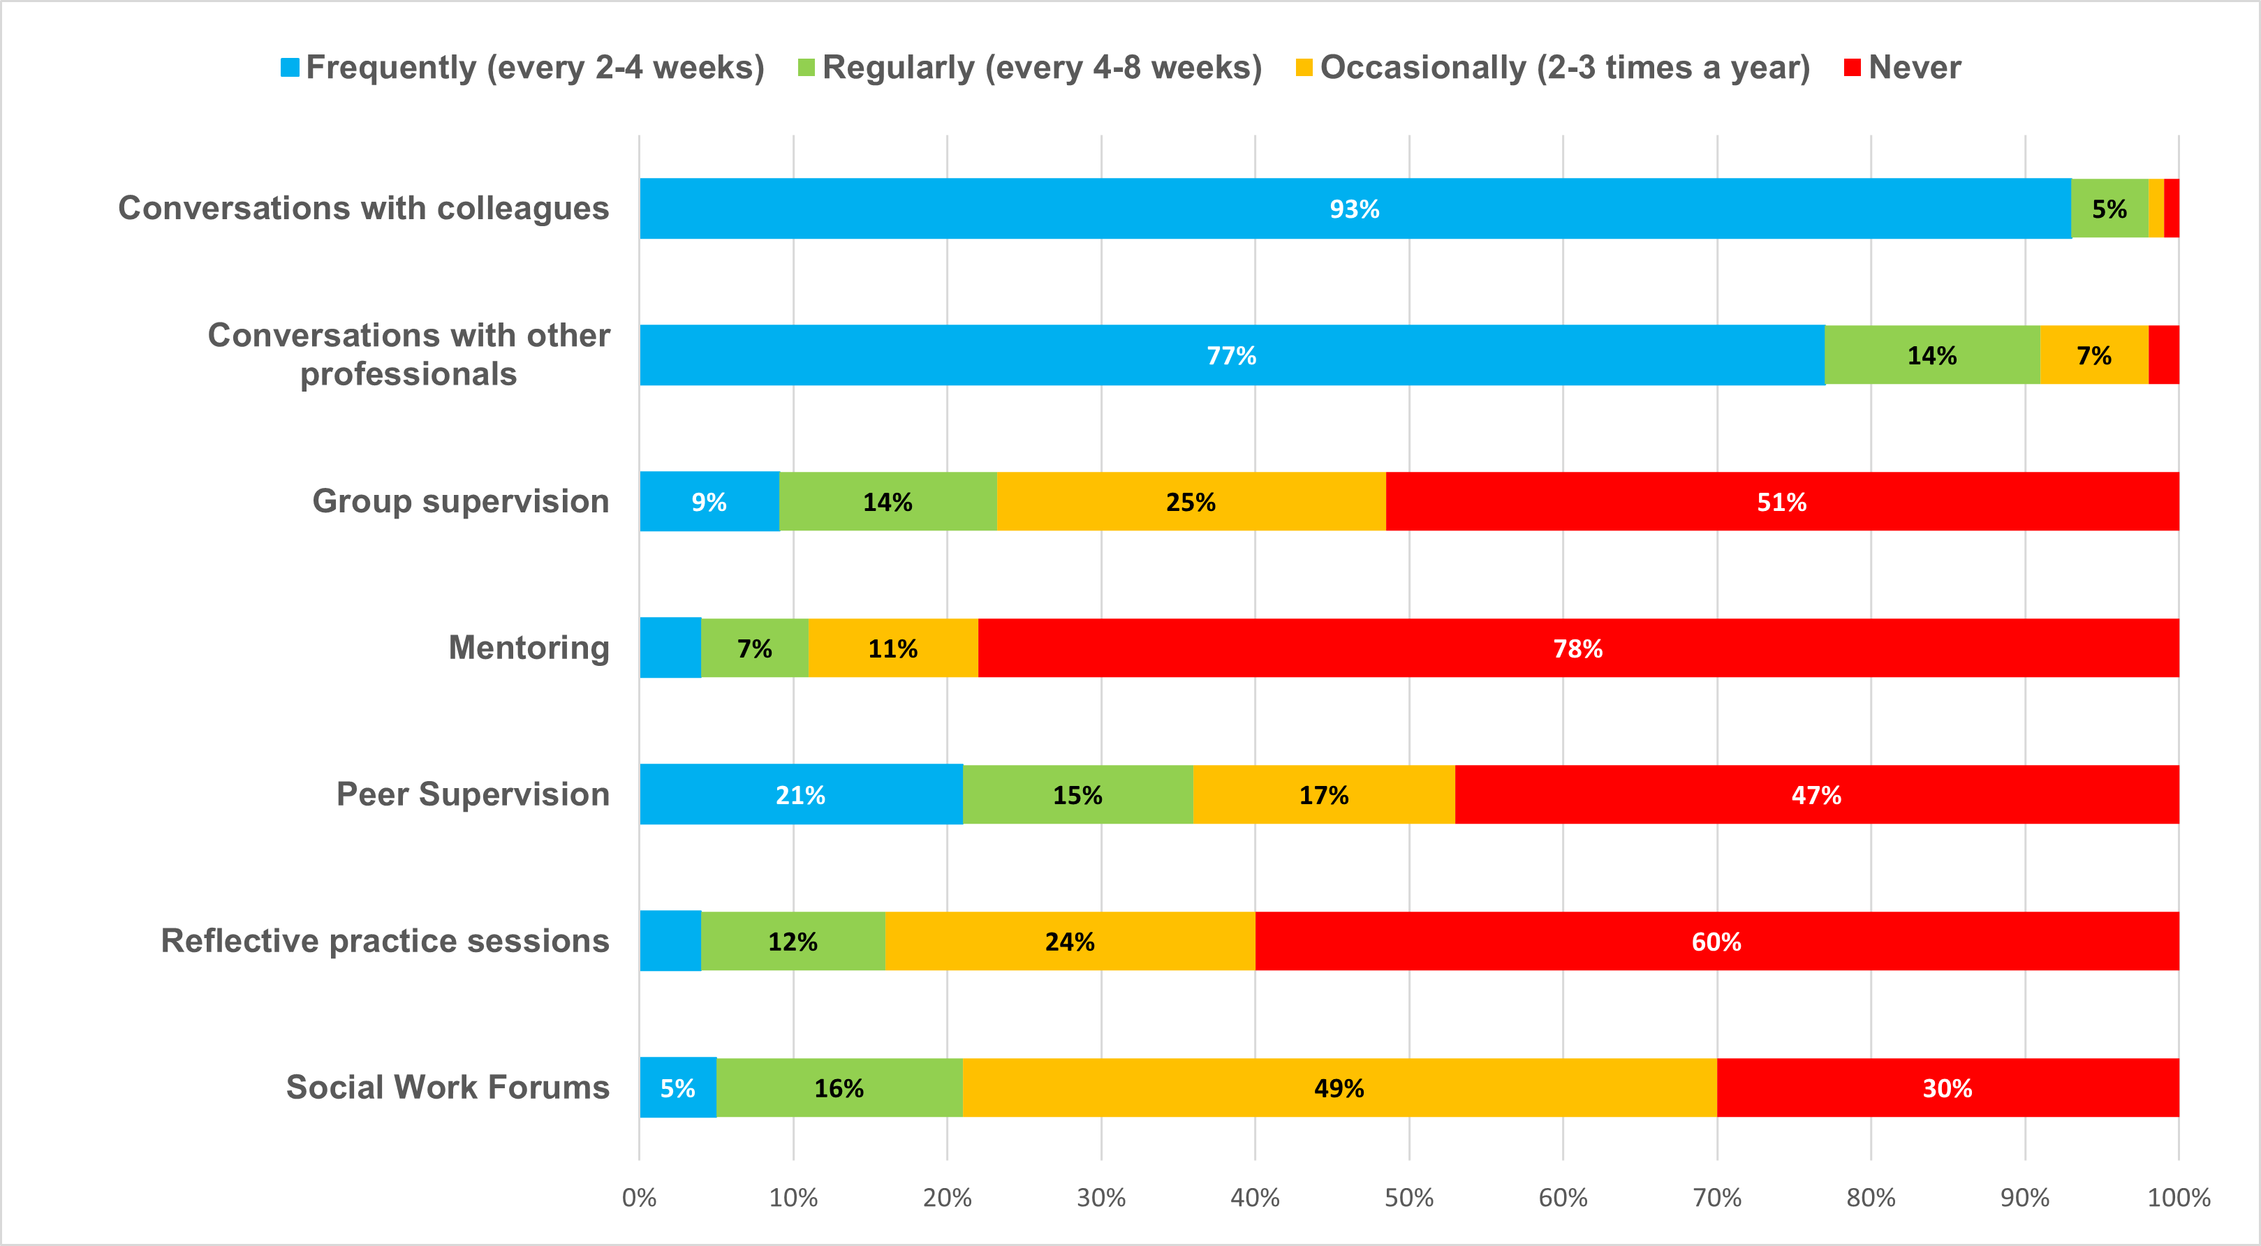
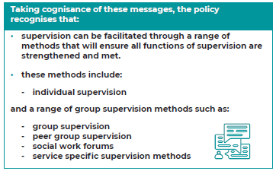
2020 Supervision Survey Policy
“We asked where else do SW get support from?”
Fig.1
Fig.1 Extract from Social Work Supervision in Northern Ireland Survey, 2020 (page 21)
Notes:
Social workers avail of a range of professional support systems. The survey listed these and asked respondents to indicate the frequency of which they use these supports. All of these are mechanisms to support supervision, not replace it. As shown in the table below, the most frequently used forms of support are informal and ad hoc consultations and conversations with peers and colleagues. This raises questions about how robust these methods are, how they are recorded and how can the quality be assured.
While holding to a clear set of supervision standards, principles, and functions, the policy provides a flexible approach to supervision arrangements designed to allow a service and its teams to plan a model of supervision that will work best in their settings. Group supervision in encouraged to be used to enhance Individual supervision

Slide 50



“No one knows as much as All of Us.”
Group
Group
Peer
“Group supervision is facilitator-led via a formal, prearranged process that is agreed by the supervisor and supervisees. It involves the use of a group setting to enable members to reflect on their work. By pooling skills, experience and knowledge, the aim of the session is to improve the skills and capability of both individuals and the group. “
“Peer supervision usually refers to reciprocal arrangements in which peers work together for mutual benefit where developmental feedback is emphasised and self directed learning and evaluation is encouraged” (Benshoff, J.M. 1992)
Notes:
“Know one knows as much as all of us do” Needs to have safety in the group: The underlying assumptions that ‘people do the best they can with the resources they have' and ‘it's OK to make mistakes' need to be present. The degree of effectiveness of the peer supervision is directly related to the degree to which supervisees feel safe in sharing their incompetence in front of their peers and thus exposing themselves to their learning edges.
The goal of the session may be to solve problems, plan work and set priorities, learn from others or make decisions

Slide 51

Non-Negotiables
Helpful
“The quality of everything we do depends on the quality of the thinking we do first
The quality of our thinking depends on the way we treat each other while we are thinking.” (Nancy Kline, Time to Think.)
Structure
Predictability
Not Constraining
Psychological Safety
Trust
Sticking to agreed rules of engagement
Shared Goal
Buy in – Beig Purposeful
Notes:
Needs to have safety in the group: The underlying assumptions that ‘people do the best they can with the resources they have' and ‘it's OK to make mistakes' need to be present. The degree of effectiveness of the peer supervision is directly related to the degree to which supervisees feel safe in sharing their incompetence in front of their peers and thus exposing themselves to their learning edges.
Challenges if structure and agreement is not in place. For the facilitator, challenges can include being more demanding because of the multiple dynamics, it can confuse boundaries of responsibility and structures or require them to focus on individual and group dynamics at the same time. For the group, it can reflect or amplify dysfunctional team processes, be dominated by a few loud voices, allowing others to hide, or can make it seem less relevant to group members who are at different stages of professional development
Both need to have an agreed structure and purpose – Why are we here, what are we trying to achieve , how will we best do that
There are established models, some may feel clunky when getting used to them
Within team or between sw and other professionals from other disciplines

Slide 52


Different Perspectives
Different Viewpoints
Diversity of experience, background, approach
Thinking happens between group members
Support Curiosity
New Learning
Reflective Discussion
Time to think, think aloud and reflect collectively
Consider different options
Practice sitting back and listen to others
Promotes Emotional Intelligence
Grow your group – Build your system
Professional Development
Function
Beddoe & Davys, 2016; Morrison, 2005; Davys and Beddoe, 2010
Notes:
The impact of the group process may foster a sense of team cohesion and reduce the risk of dependence upon an individual supervisor. It can expand the skills and knowledge base of group members and may increase the pool of options and ideas. It may also help the development of more innovative practice. However, there are disadvantages. (Morrison, 2005; Davys and Beddoe, 2010
it enables supervisees to “think aloud”, or reflect with colleagues, about their practice both to better understand or assess the difficulties that clients are experiencing and to improve the subsequent service provided (Beddoe & Davys, 2016).

Slide 53


Personal
Function
Shared Experience and Empathy
Easier to be understanding of others flaws then our own…
Practice compassion with others and self The realisation that I’m not on my own
Collective Hope – “Hope is the belief the future can be better than today and you have the power to make it so.” C. Hellman
The group holding and containing feelings

Slide 54


Organisational
Function
Problem Solving
Discussion issues affecting the team
Promote team working
Collective approach to meeting Statutory Functions
Supporting each other around practice
Inform Decision Making
Case and Clinical Discussions
Group work / Group Care settings
Multi Disciplinary setting
Notes:
Practice is complex and often crises driven
Individual supervision becomes task focused
Less time for reflective space
Reflective discussion and decision making
for example, group discussion of cases or debriefings) can play a significant part in encouraging reflective practice and in providing support, and ad hoc supervision (where advice or guidance is sought as and when it is needed) plays a crucial role in the day-to-day work of practitioners and supervisors Getting the most out of supervision - RiPfA
.

Slide 55

The 4 C’s
of The 21st Century?
Proctor, B. (2008). Group supervision: A guide to creative practice (2nd ed.). Thousand Oaks, CA: Sage.
Confidence,
Competence,
Compassion, and
Creativity
Communication,
Collaboration,
Critical Thinking, and
Creativity
Notes:
4 C increase confidence, competence, compassion, and creativity Bridgid Proctor, who also suggested that engaging in group supervision that worked well, promoted participants to make better use of individual supervision

Slide 56

Words to finish..
“People, teams and organisations are more productive, effective and innovative when they regularly take time out to reflect, learn and adapt.”
Schippers, West and Dawson, 2012, Journal of Management
Tannembaum and Cerasoly, 2013, Human Factors

Slide 57


Thank You

Slide 58
Leadership Framework for Social Work
Marian O’Rourke
Director of Regulation and Standards
Northern Ireland Social Care Council
1st March 2024

Slide 59

Implementation of Leadership Framework
Framework developed under auspices of Social Work Strategy
Recognising and supporting leadership at all levels
Strengthening professional identity
Enabling leadership to thrive
Requires ownership, optimism and opportunity

Slide 61


Professional supervision provides important opportunity to:
explore; support; develop; reflect
on leadership from the perspective of: leading self; leading practice; leading with others; leading the profession

Slide 62

What happens next
Service supervision plans will be completed in your service areas with support from governance leads
New supervision agreements
New formats to record individual supervision
New experiences in supervision
Training for supervisees and supervisors 24/25

Slide 63
Thankyou for listening

