Slide 1
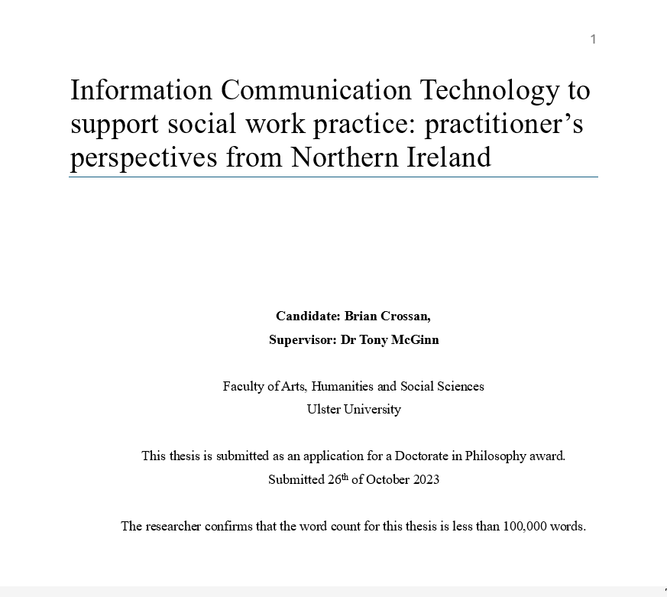

Slide 2
Agenda
The types of barriers within current systems and how they manifest.
Social workers’ responses to the barriers to practice and the threats they pose to relationship-based practice.
What might Encompass offer or change for social workers and service users?
The role of the social worker in the design and implementation of future systems

Slide 3
Background to Research
Key questions
Why?
What?
How?
Found?
Notes:
Why? As an asocial work practitioner, I was keen to explore social workers' views on their ICT ahead of the proposed digital transformation in NI.
For too long, social workers’ views had not been considered, or they had not participated in technological/ policy changes and
Appeared to be consumed by administration and not utilising ICT.

Slide 4
The what
The study in numbers…
126
5
8
4

Slide 5
How? Study partnership
Encompass
“We are calling time on the current situation of multiple, ageing digital systems and a large reliance on the paper record” (NI Health Minister Robin Swann, June 2020)
Notes:
GAPS…………………….

Slide 6
How… Objectives
What social workers find …technology
1. Important.
2. Usefulness/Ease of Use.
3. Capabilities/Availability
4. Multi-disciplinary intersections
5. Future ICT

Slide 7
How …Method

Slide 8
Trusts
Interviewed from each Trust
Trust | Number Interviewed | Sample % | NIHSC % (Northern Ireland Social Care Census 2022)
Belfast Trust | 28 | 22.5% | 23%
Northern Trust | 23 | 18% | 21%
Southern Trust | 23 | 18% | 19%
South-Eastern | 23 | 18% | 18%
Western Trust | 29 | 23.5% | 19%
Total | 126

Slide 9
Comparison of Sample Practice Settings with Known Population Proportions
Directorate
Setting | Study Sample | Study % | Nisara 2021 stats %
Primary Care and Older People | 53 | 42.1 | 18.2
Woman and Children | 47 | 37.3 | 54.6
Adult Mental Health & Disability | 26 | 20.6 | 27.2
Total | 126

Slide 10
The found…
standardisation
barriers to practice
Accessibility
problems

Slide 11
Types of Barriers
Some of the problems
Bureaucracy
Multiple systems
Performance
Integration/Redundancy

Slide 12
Problems Contributing to Duplication in Social Work Systems
Duplication

Slide 13
Powerless leading to ambivalence
Question why they had come into the profession
Frustration and bewilderment
sense of anxiety due to a fear of litigation
Disillusionment and frustration,
Removed from organisation
Witness inefficiencies and wastage
Disconnect between social workers and employers on what is deemed reasonable
Guilty and regretful because time demands compromised their practice.
Avoiding face-to-face work and visits/ calls as they fear that it will lead to extra and administration
“Workarounds”

Slide 14
Currently, the average career of a social worker lasts for seven and a half years.
(BASW, 2023)
https://new.basw.co.uk/about-social-work/psw-magazine/articles/burnout-has-always-been-there-award-winning-social-worker

Slide 15
Threatening relationship-based practice
“I went to social work school to work with people, not to push buttons…so I would like to do hands-on work with people …instead of the time I spend here sitting at my desk.” (Female, Southern Trust)

Slide 16
Threatening relationship-based practice
“I went to social work school to work with people, not to push buttons…so I would like to do hands-on work with people …instead of the time I spend here sitting at my desk.” (Female, Southern Trust)
"It just takes you away from time that you could be spending with patients." (Male, South Eastern Trust)
"We are spending most of the day in front of the computer and not in the wards…it's up to me to get the whole thing sorted online before sending it away." (Female, Western Trust)

Slide 17
Threatening relationship-based practice
"You're actually typing up everything in Word and then transcribing it over to those other systems." (Female, South Eastern Trust)
"You have to go across several systems, and it doesn't transfer over. It just takes so much time." (Female, Western Trust)
"I felt very disillusioned…the work sat on the file, and no one will ever read it. I spent over three weeks on it. It's soul-destroying. It leaves you demoralised; people only read the synopsis." (Female, Southern Trust)

Slide 18
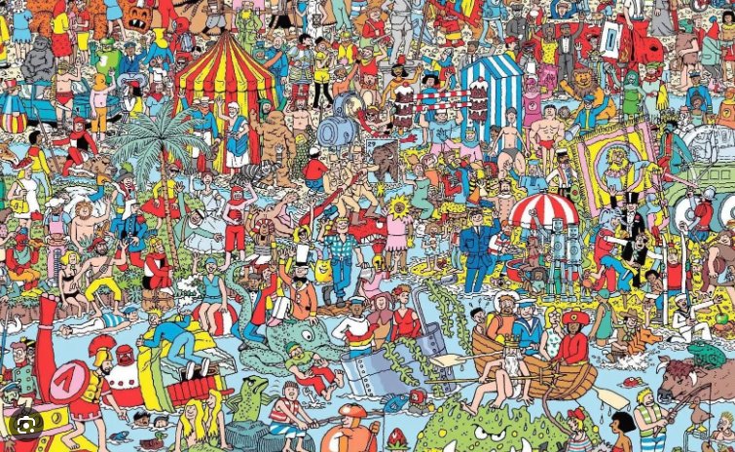
Identity erosion… What is unique?

Slide 19
Accessibility Issues present barriers
Privacy and confidentiality
Professional issues
Regional differences
Hardware and infrastructure

Slide 20
What SWs hope can change
One system- eliminating regional differences
Better accessibility
Quality of technology and the infrastructure
Remove the paper
less time-consuming and more intuitive
Integration “Something New Should Not Mean Something Extra”

Slide 21
Standardisation over Innovation?
Yes… for now

Slide 22
What do SWs Think...
Encompass can’t change
Curb all bureaucracy
Remove administrative duties
Implementation phase “haves and have-nots”
Systems that self-govern- self reporting governance.
Multi-disciplinary tensions-admin left to SW’s
Work in Silos

Slide 23
Social workers designing and implementing future systems
More control and input
Social workers are experts.
Interested in participation
increasingly digitally capable
Systems that promote identity
Tools that aid social workers in daily practice.
Not governance-gathering tools.

Slide 24
Innovation…
"We have kind of abandoned it and just designed our own-we have developed our old systems to try and make it work for our service users." (Male, Belfast Trust)
"I would say maybe having champions for technology…so, maybe every team has their own champion (Female, Western Trust)
"Because we are so administrative, it has actually pushed us into a position of smarter working, so from that point of view, we have come on a long way (Female, Southern Trust)

Slide 25
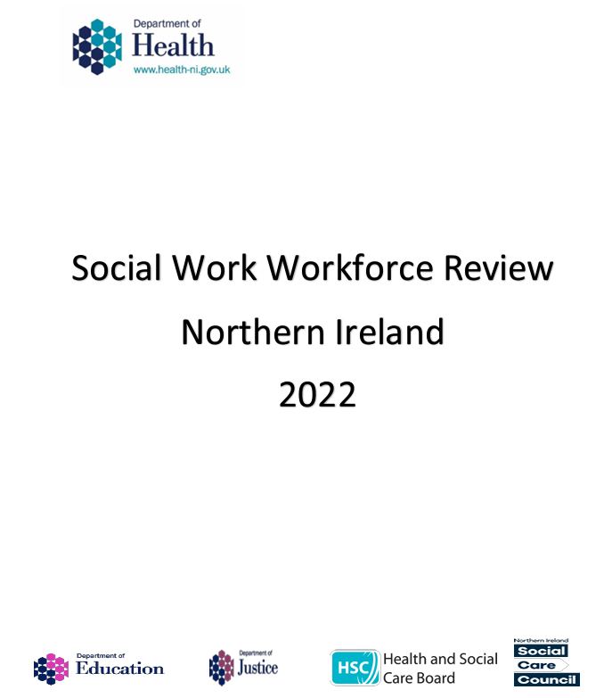
The SW Strategy 2012- 2022
10 years on…what has changed? We have failed!
“Reducing unnecessary bureaucracy for social workers p14.
“pro-active use of technology” p22
“bureaucracy, workload pressure, insufficient time” p27
“Increase the use of technology to improve efficiency,”p67

Slide 26
Safe Staffing
What will we be talking about in 2032?
Northern Ireland, social work-specific legislation is planned for safe staffing across the governmental sector.
Burnout, retention
Who in Social Work is actively challenging bureaucracy?
Where are the champions?

Slide 27
What will we be talking about in 2032?
Northern Ireland, social work-specific legislation is planned for safe staffing across the governmental sector- recruitment/ retention
Who in Social Work is actively challenging unnecessary bureaucracy?
Who is going to champion?
Who is going to lead?

Slide 28
Conclusions
Take home- protecting SW Identity
Bureaucratic Systems threaten relationship-based social work
1
Standardise to Survive
2
What Encompass can and can't change
3
Challenge Bureaucracy
4
Champion Participation
5

Slide 29
“Brian, I hope all this work that you’re gathering goes somewhere, and people get to see what's really going on for social workers because if we don’t do something about the way we work… I don’t think people will know what a social worker does anymore.”
(Social worker from South-Eastern Trust November 2022)

