Slide 1




Supporting LGBTQ+ Young People and their Families
Prof Gary Mallon (he/him)
Dr Danielle Mackle (she/her)
SHAPING A
BETTER WORL
SINCE 1845

Slide 2


Northern Ireland Social Care Council
Supporting LGBTQ+ Children and Young People
October 16, 2024
Dr. Gerald P. Mallon

Slide 3
Supporting LGBTQ+ Children and Young People
There are a range of ways you can help support the LGBTQ+ children, young people and families you work with.
And . . .
Every social worker and every social service agency can and should do this!

Slide 4
Understanding an LGBTQ+ Young Person’s Lived Experience
It’s important to remember that any child or young person you’re working with could be LGBTQ+, whether or not they have disclosed their sexual orientation or gender expression to you.

Slide 5
Three Areas to Consider in This Seminar
What Do LGBTQ+ Youth Need from Social Work Professionals?
What Do Agencies and Policy Makers Need to Be Competent in Practicing with LGBTQ+ Children, Youth, and Families
What You Can Do Personally!

Slide 6
What Do LGBTQ+ Youth Need from Social Work Professionals?
Professionals who are ”fit to practice” means adhering to the Standards of Conduct and Practice which involves required attitudes, behaviours and competence, rather than using your personal or religious values to guide you in your practice.

Slide 7
What Do LGBTQ+ Youth Need from Social Work Professionals?
Social Workers who have done their homework, i.e. look for ways to expand their fund of knowledge about LGBTQ+ children, youth, and families. Don’t expect the youth to educate you – do your own homework – read, know the resources, do some research, talk to LGBTQ+ people with lived experience – cultural guides

Slide 8

What Do LGBTQ+ Youth Need from Social Work Professionals?
To actively engage families in helping/supporting their LGBTQ+ child
To employ the skills necessary to help families support their LGBTQ+ child, and to be brave enough to challenge the bias, myths, and lies about LGBTQ+ persons

Slide 9

What Do LGBTQ+ Youth Need from Social Work Professionals?
To forcefully reject and work toward eliminating all conversion practices – they do not work and are harmful to LGBTQ+ children and youth

Slide 10
What Do LGBTQ+ Youth Need from Social Work Professionals?
To support accessible gender affirming healthcare services for trans youth – to vociferously speak against politicians that make health care decisions and legislation that are politically motivated, harmful to these young people and NOT in the best interest of trans children, youth, and their families.

Slide 11

What Do LGBTQ+ Youth Need from Social Work Professionals?
To work toward tackling anti- LGBTQ+ hate crimes through advocacy and legislation

Slide 12

What Do LGBTQ+ Youth Need from Social Work Professionals?
To work toward delivering LGBTQ+ inclusive education, particularly with respect to relationships and sexuality education

Slide 13
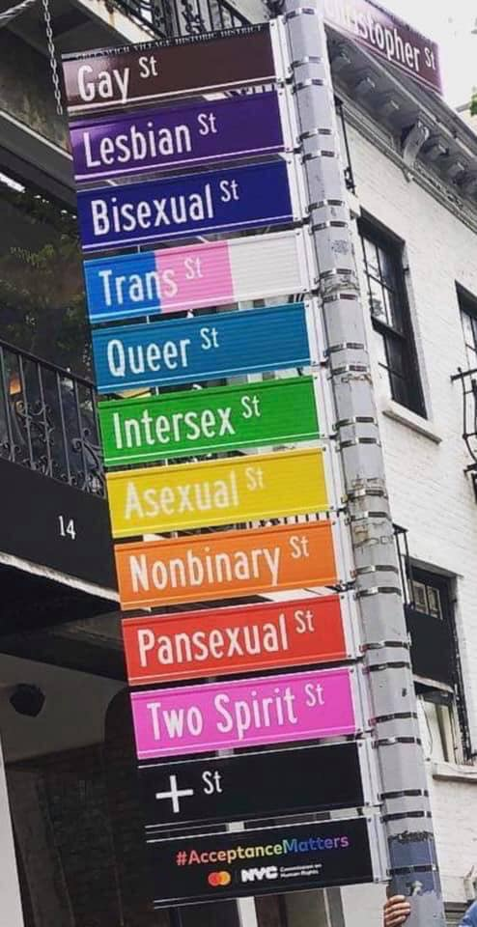
What Do Agencies and Policy Makers Need to Be Competent in Practicing with LGBTQ+ Children, Youth, and Families
To create LGBTQ+ affirming environments in agencies

Slide 14

What Do Agencies and Policy Makers Need to Be Competent in Practicing with LGBTQ+ Children, Youth, and Families
Help organizations to develop written policies, appropriate and supportive supervisory practices and coaching about sexual orientation and gender identity expression

Slide 15

What Do Agencies and Policy Makers Need to Be Competent in Practicing with LGBTQ+ Children, Youth, and Families
To have consequences for professionals who refuse to provide LGBTQ+ affirming care for these young people

Slide 16

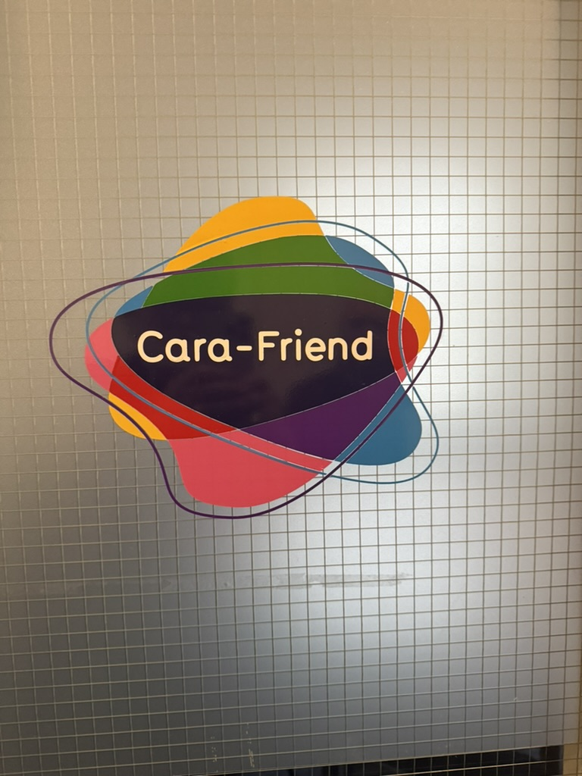
What Do Agencies and Policy Makers Need to Be Competent in Practicing with LGBTQ+ Children, Youth, and Families
To partner with LGBTQ+ organisations to assist you with resources, services, and training

Slide 17
What Do Agencies and Policy Makers Need to Be Competent in Practicing with LGBTQ+ Children, Youth, and Families
To work toward assisting faith communities to be supportive of LGBTQ+ youth, or finding supportive faith communities that are welcoming to LGBTQ+ people

Slide 18
What Do Agencies and Policy Makers Need to Be Competent in Practicing with LGBTQ+ Children, Youth, and Families
To hold political leaders accountable for making responsible decisions that affect the lives of LGBTQ+ children youth and families rather than making decisions that are politically expedient for them

Slide 19
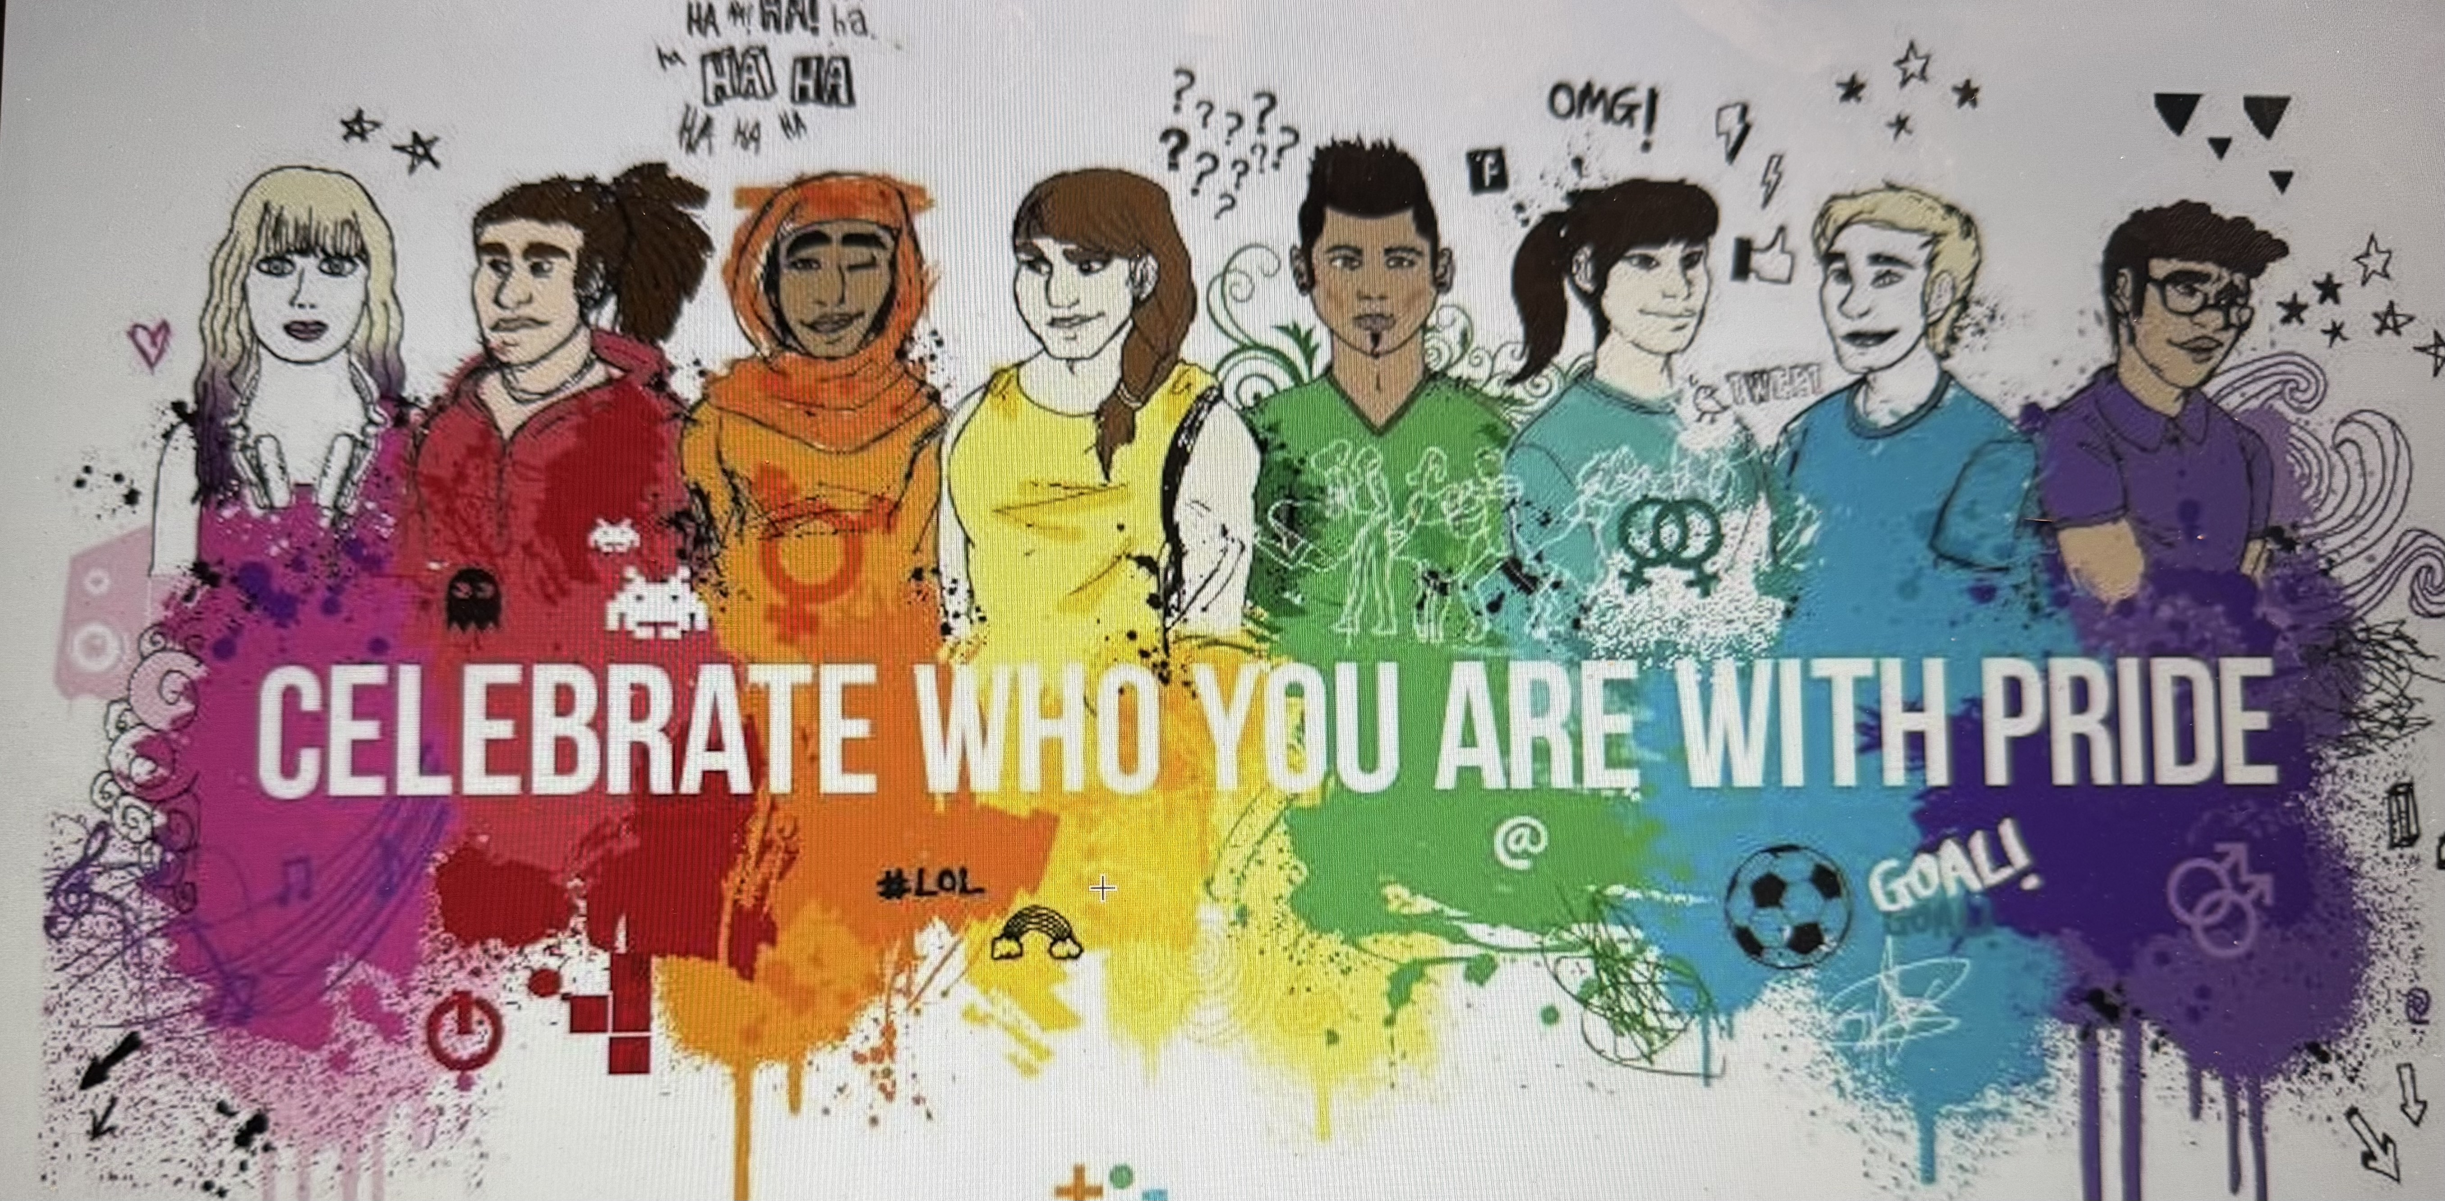
What Do Agencies and Policy Makers Need to Be Competent in Practicing with LGBTQ+ Children, Youth, and Families
To be an active advocate for LGBTQ+ children, youth, and families when bias, discrimination, or outright hatred is being perpetrated

Slide 20
What You Can Do Personally!
Don’t accept anti- LGBTQ+ behavior
Don’t laugh at LGBTQ+ jokes, even those that your own family might make
Deal with the big red button on top of your head – what are YOUR issues about LGBTQ+ identity
Realize it doesn’t matter if ”You don’t get it”
Most importantly, how can you help parents to continue to love that LGBTQ+ child as they are

Slide 21

What You Can Do Personally!
Be brave in your practice and support of LGBTQ+ young people and their families
Be prepared for backlash from colleagues and communities
Remember what we are called to do as social work professionals – Working Together to Make a Difference
Know that your competent action or inaction can make a difference in the life of an LGBTQ+ youth

Slide 22

References
Mallon, G.P. (2019). LGBTQ Youth Issues: Practical Guide for Youth Workers Serving Lesbian, Gay, Bisexual, Transgender and Questioning Youth. Washington, DC: CWLA Press.

Slide 23
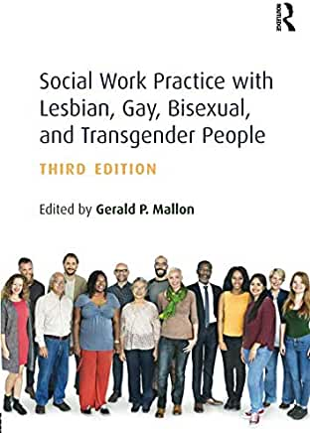
References
Mallon, G.P. (2011). Social Work Practice with LGBT People, 3rd ed. New York: Routledge

Slide 25
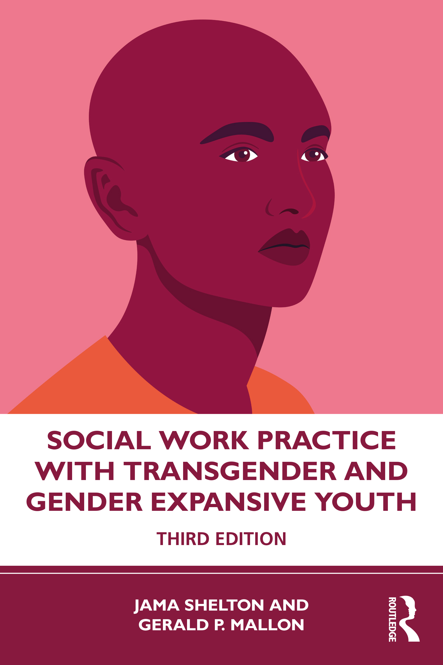
Shelton, J., & Mallon, G.P. (Eds.) (2021). Social Work Practice with Transgender and Gender Expansive Youth. New York: Routledge

Slide 26
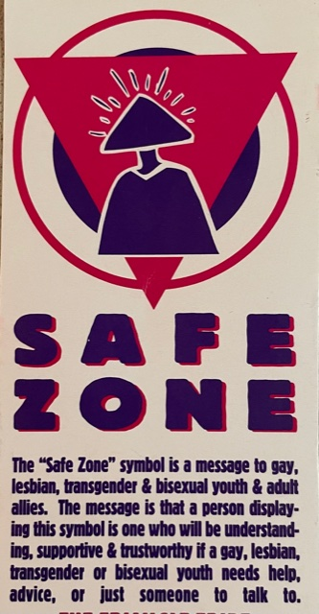

Gerald P. Mallon, DSW
Silberman School of Social
Work at Hunter College
New York, New York
+1-917-940-5455
gmallon@hunter.cuny.edu
Notes:
This is essential.
All participants should have this information for future reference.
The presenter becomes the “cultural guide” for the participant.
Many participants do call for further information, to talk about a case, or to identify a resource.

Slide 27


