Slide 1


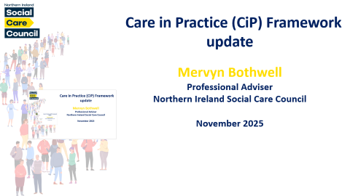

Care in Practice (CiP) Framework
update
Mervyn Bothwell
Professional Adviser
Northern Ireland Social Care Council
November 2025

Slide 2

The Social Care Workforce Strategy 2025-2035
Notes:
Purpose of today – to promote the strategy and encourage you to be part of it!
To focus specifically on priority actions 3 and 4 which outline the importance of learning and development for social care practitioners, leaders and managers.
DOH reform of social care links with the work of NISCC

Slide 3
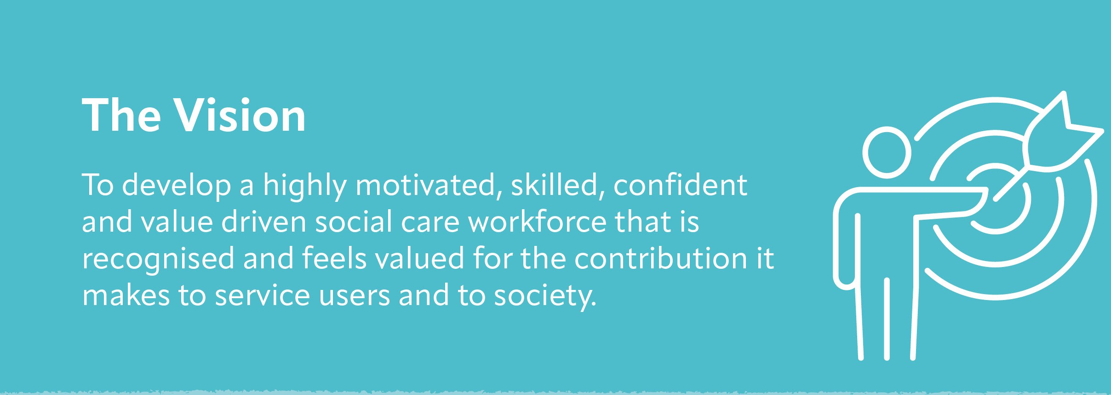
Notes:
DOH have developed the first social care workforce strategy because they want to implement this vision.

Slide 4
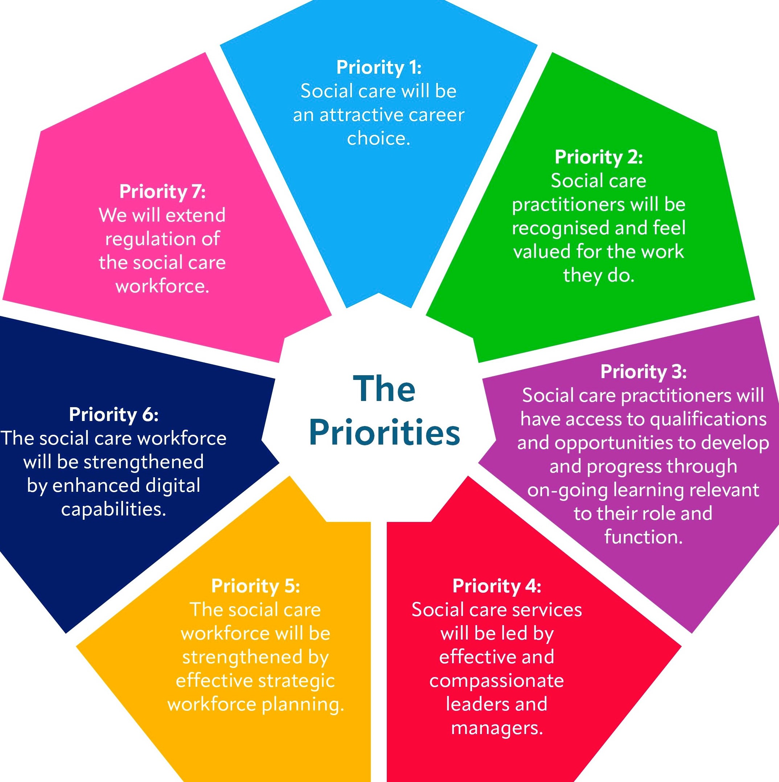
Notes:
All the priorities interlink and have a range of different actions behind them. However, to set the context of today’s Forum. We are focusing on 3 and 4 which outlines learning and development.

Slide 5


Notes:
Social care practitioners need the right knowledge and skills to have energy, confidence and resilience in being able to adapt to changing social care needs.
Learning and improvement opportunities are key to supporting staff in their work.

Slide 6

What we need to do
Create a learning culture in which social care practitioners can continuously improve their practice by developing their skills and knowledge
Ensure social care practitioners can access training and qualifications tailored to individual circumstances
Notes:
A learning culture will support the development of knowledgeable and confident staff who can deliver safe and sustainable services.
It is important to recognise the diverse range of roles - therefore need to have training available to meet the specific individual circumstances E.G those living with multiple health conditions, childhood trauma, dementia, mental ill-health, autism and learning, physical and sensory disabilities.

Slide 7
Key Actions:
Develop and implement the Care in Practice (CiP) Framework
1
Implement the Level 2 Certificate in Safe and Effective Practice
2
Notes:
The CiP Framework gives social care practitioners access to continuous learning and development using their practice experience, knowledge and skills in working to support service users (increasingly those with complex needs) across all the programmes of care within the health and social care system.
There are two interlinked parts to the CiP Framework, a continuous professional learning pathway and a qualification pathway.
The level 2 certificate is a new qualification that sits within the CIP framework. New staff are encouraged to take up this qualification within the first 6 months of their employment.
Personal Assistants are supported to access training via Trusts.

Slide 8


Care in Practice – the journey so far
Qualification Based Register (QBR)
Develop and deliver a proposal for the introduction of a QBR for the social care workforce register.
Career Pathway for Social Care
Develop and deliver a career pathway framework for the registered social care workforce in Northern Ireland.
Continuous Learning Framework
Develop and deliver a continuous professional learning and development framework for the registered social care workforce, aligned to registration requirements.

Slide 9
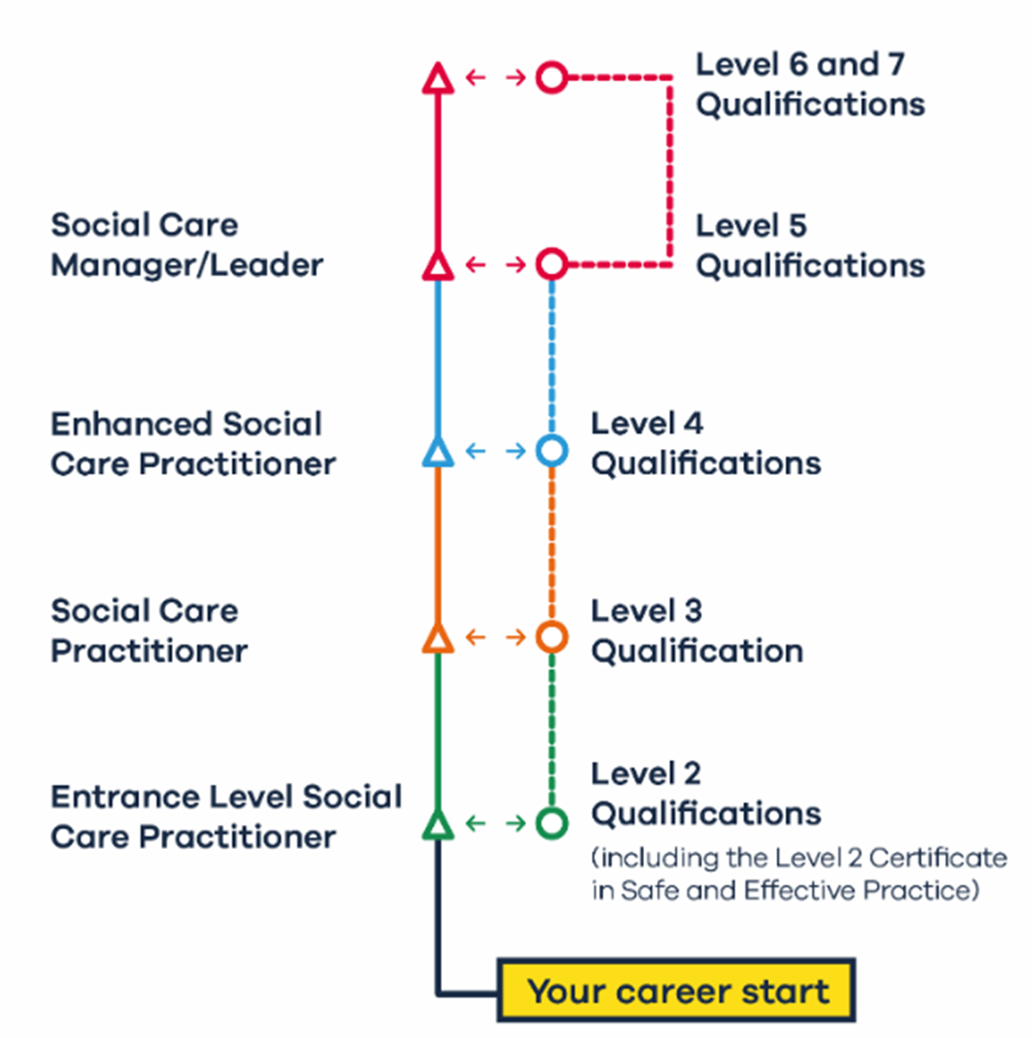
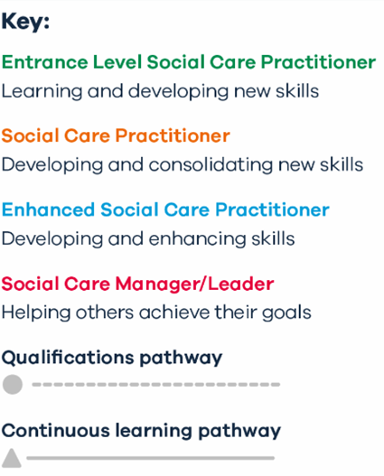
The Care in Practice Framework (CiP)
Notes:
To recognise the professional identity of the social care workforce the title of the social care practitioner is part of the CiP Framework
These have been introduced into the CiP Framework to better represent and promote cohesion, identity and to emphasise the value of the social care workforce.
The CiP Framework has sufficient agility to support social care practitioners to practice and develop within their current role or grow into an enhanced role. Each role within social care will fall into one of these categories.
An incremental process to build knowledge, skills and experience ……….

Slide 10


CiP Interactive Web Resource – QR Code
CIP Framework
Notes:
To recognise the professional identity of the social care workforce the title of the social care practitioner is part of the CiP Framework
These have been introduced into the CiP Framework to better represent and promote cohesion, identity and to emphasise the value of the social care workforce.
The CiP Framework has sufficient agility to support social care practitioners to practice and develop within their current role or grow into an enhanced role. Each role within social care will fall into one of these categories.
An incremental process to build knowledge, skills and experience ……….

Slide 11
H&SC Diplomas Review
Who? – subject matter experts within the field of Health and Social Care (H&SC)
What? – H&SC Diplomas are part of a suite of work-based qualifications, ranging from Level 1 – 7, that provide skills and knowledge in H&SC aligned with job role, included in the CiP Framework
Why? – to make sure that qualifications reflect changing and developing workforce requirements, practice advancements, legislative and regulatory changes.
When? – it is anticipated that the review of all qualifications on the Care in Practice Framework will be completed by September 2026.

Slide 12


Qualification Review – Level 2
Level 2 Certificate in Safe and Effective Practice is in place
100+ have commenced/completed
Added to DfE L2 H&SC App. Framework
Level 2 Diploma reviewed by sector
7/11 mandatory units within L2 Cert
Qualification added to Apprenticeship Framework

Slide 13
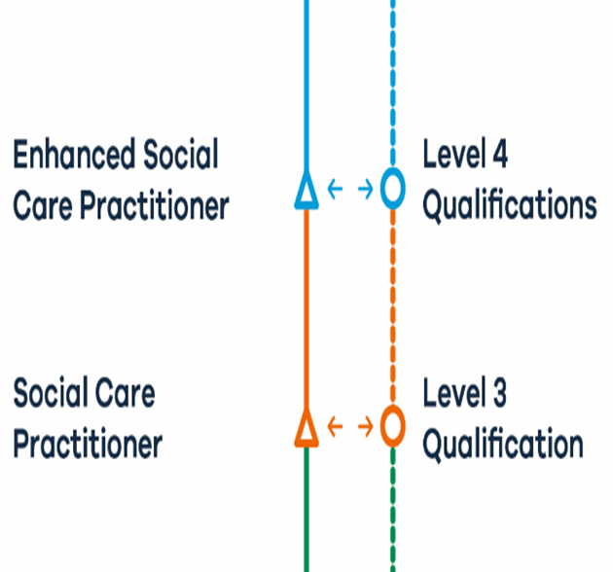
Qualification Review – Level 3
Level 3 Diploma in H&SC Practice (NI)
Redesigned to develop and consolidate skills:
building on Level 2 knowledge and skills
providing for progression to the Level 4 for those who wish to develop their careers in a way that meets their aspirations.
Reviewed and redeveloped January-April 2025
Should be added soon to Level 3 Apprenticeships Framework

Slide 14
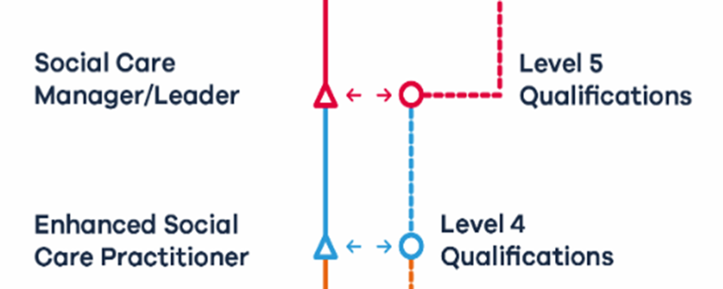
Qualification Review – Level 4
Level 4 Diploma in Enhanced H&SC Practice (NI)
Developed and designed to:
-provide progressive development opps
-address key areas of underpinning knowledge
-lead to opportunities for competence
assessment in areas aligned to an enhanced
social care practitioner role and context
Reviewed in July 2025

Slide 15
Qualification Review – Level 5
Level 4 Diplomas in L&M for H&SC (Adult Management & Adult Residential Management)
Reviewed from September 2025
Qualification specification to be completed in
early 2026

Slide 16

Next Steps
We are on course for all of the reviewed Diploma qualifications to be available for registration from September 2026
Consideration of development of Level 6 and Level 7 qualifications
Scoping work re Social Services Practitioner’s
Award-March 2026

Slide 17

National Occupational Standards (NOS) Review 2025

Slide 18

What are National Occupational Standards?
NOS are benchmarks of good practice
They describe what employees in any occupation:
should be able to do
the standard they should achieve in practice
the knowledge and understanding they need to do their job, safely and effectively
NOS form the basis of qualifications and training programmes required to work in the social care sector.

Slide 19

Aims of the NOS Review
To ensure:
All 212 NOS (150 H&SC and 62 CCLD) are reviewed.
The NOS are current, reflect sector needs, support effective best practice and embed government priorities into occupational competence.
Gaps in the NOS are identified and addressed.
The language is appropriate and relevant to the practitioner’s role.
A reduction in duplication across individual and the su suites of NOS.
Are fit for purpose and fit for the future

Slide 20

So far….
147 NOS have been reviewed
National consultation took place 04 August-19 Sept
UK partners reviewed survey analysis and made
final decisions on changes
Release in 2026

Slide 21
Training Support Programme
Administered on behalf of DoH
Available across Independent sector and to organisations supporting adults and children
Qualifications and training initiatives
Oversubscribed-55 organisations; £331k
Funding of assessors

Slide 22

National Occupational Standards (NOS) Review 2024 – 2025 - NISCC Learning Zone
Contact:
Mervyn.bothwell@niscc.hscni.net

