Slide 1

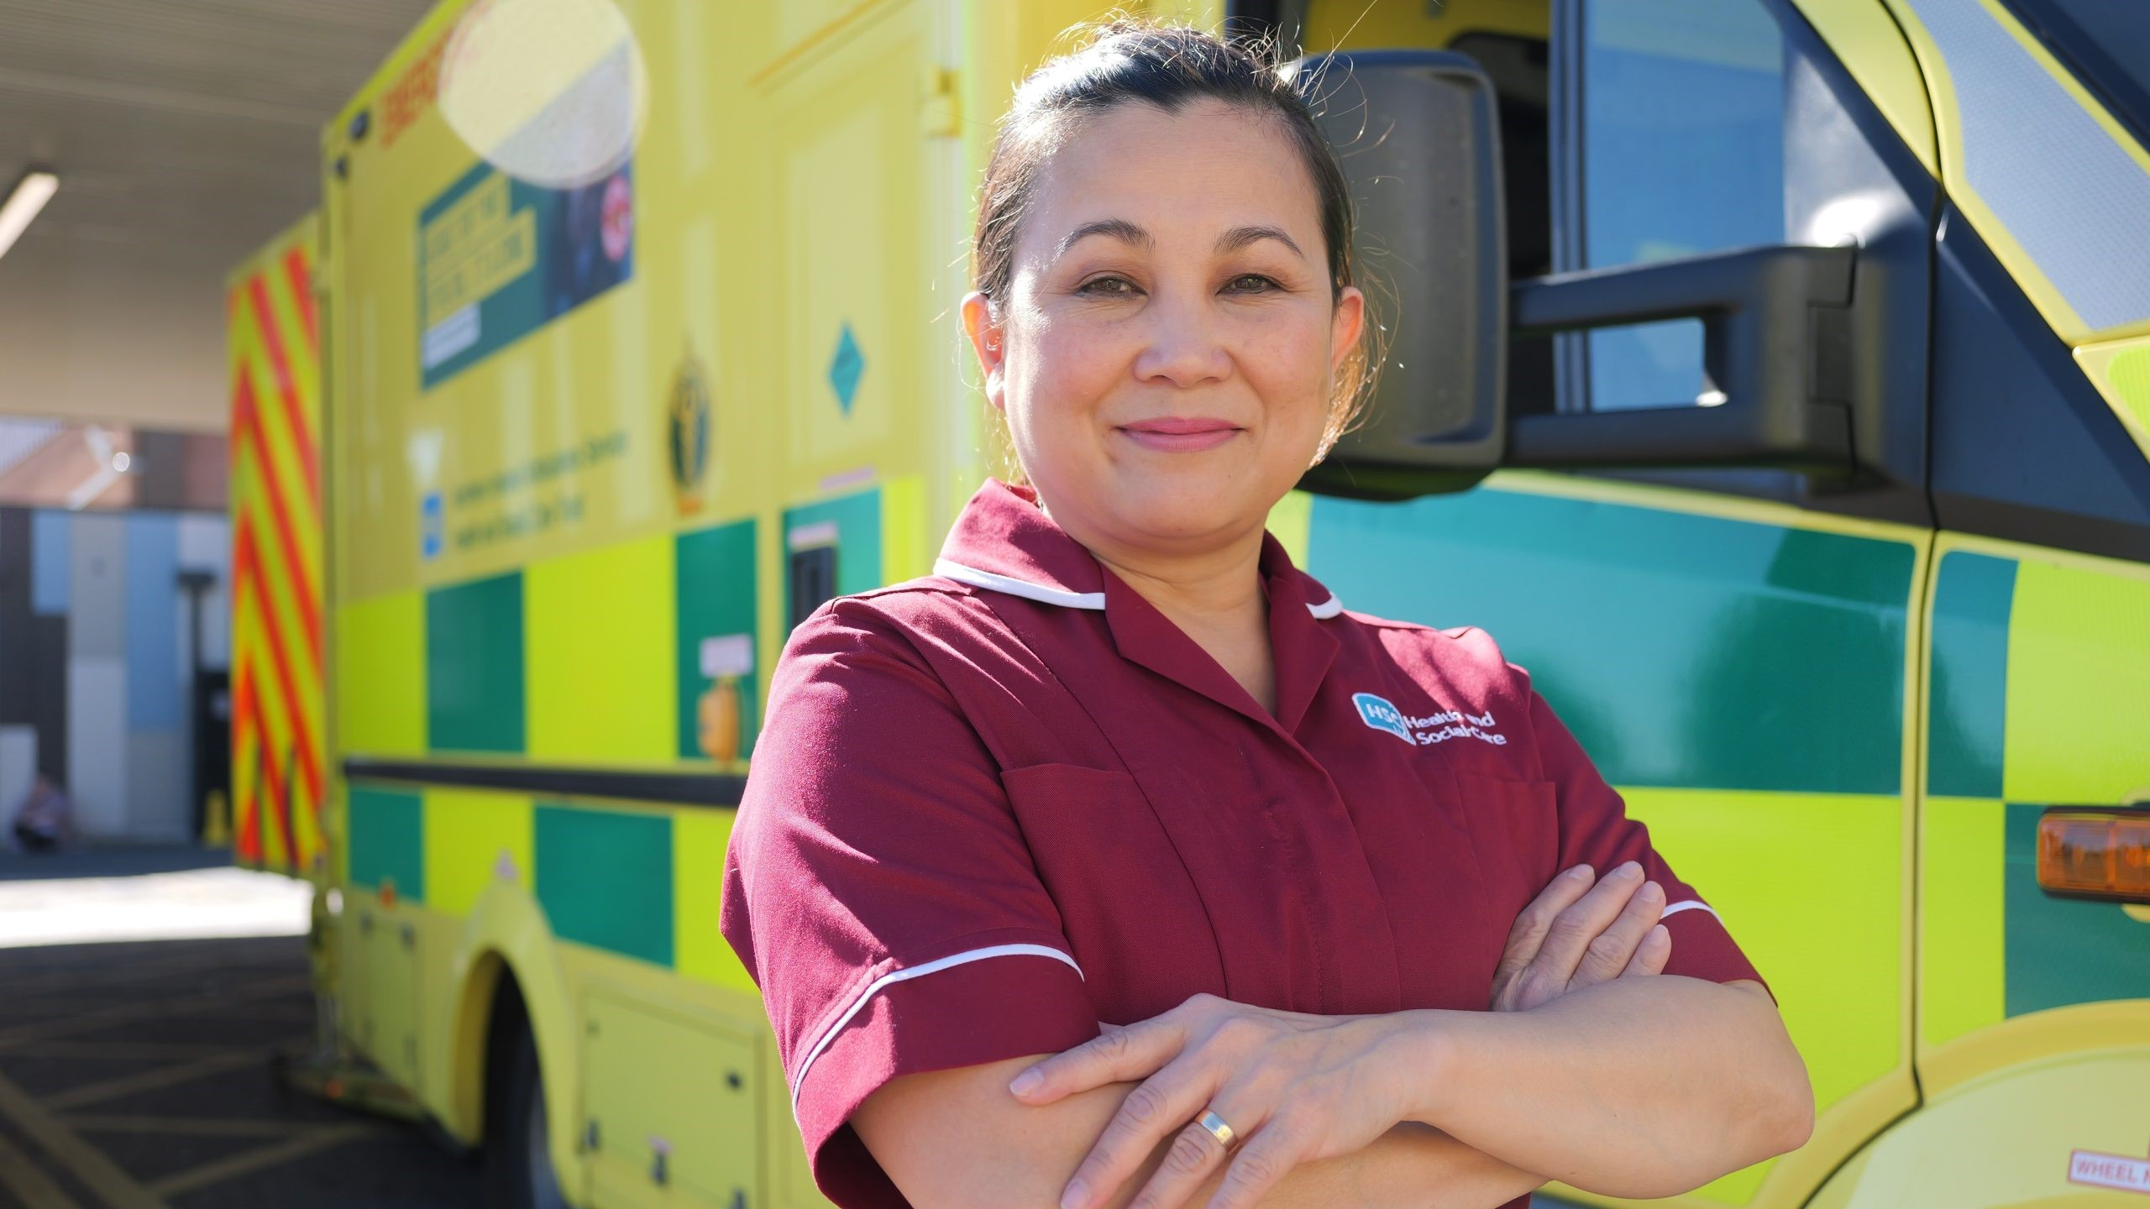
Welcoming Internationally educated practitioners-supporting integration and belonging in Northern Ireland
Jonah Atos , R.N.
International Nurse Coordinator
Western Health and Social Care Trust
Regional Director Filipino Nurses Association UK
Board Member Foyle Race Equality Forum
Committee member RCN Anti-racism subgroup
Alumni Florence Nightingale Foundation

Slide 2
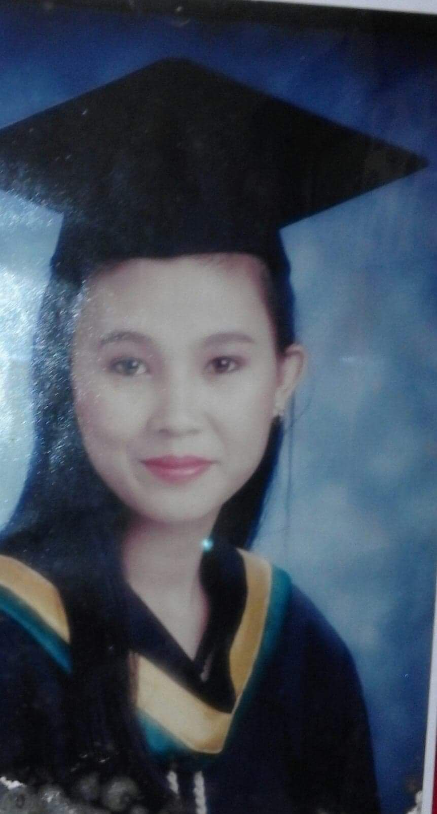
Before coming to Northern Ireland
Education
Work experience
Academic English Test

Slide 3
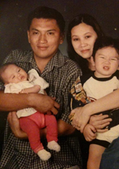
Top 3 reasons leaving home
Professional
Social
Financial/family

Slide 4
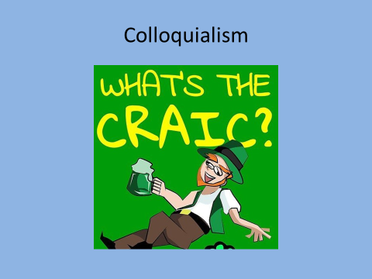

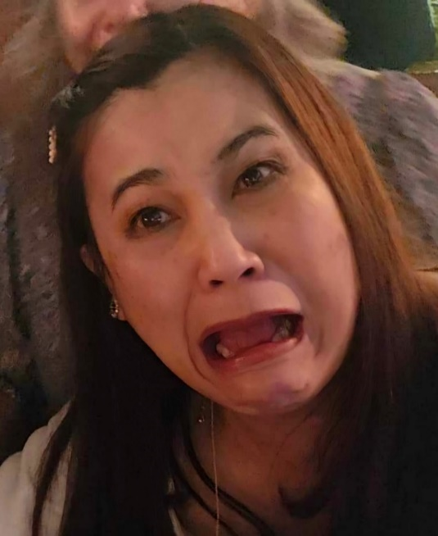

My personal experience Colloquialism

Slide 5

My personal experience Colloquialism
‘Breath of fresh air ‘

Slide 6

Communication over telephone

Slide 7
Supporting our Ethnically Diverse Workforce
The 4 Pillars
NHS International Retention Toolkit
Making new recruits feel welcome
Creating strong foundation
Building Belonging
Maximising personal and professional growth

Slide 8
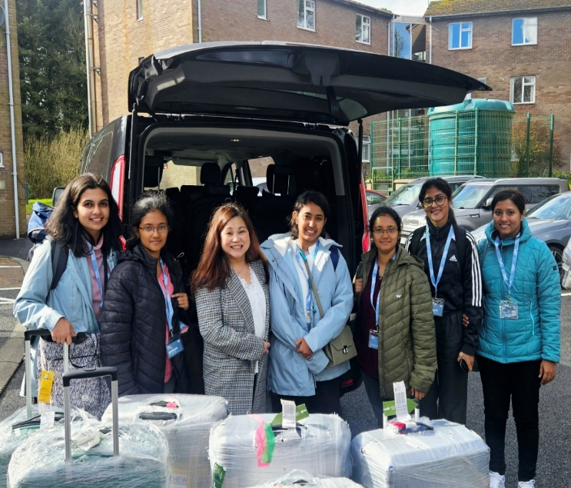
Pillar 1: Making new recruits feel welcome
Airport welcome
Welcome by community at accommodation
Hot food
Welcome groceries
WIFI
Sim card
Recruitment pack
Timetable
Emergency Numbers
Meet and greet with managers
Meet and greet before arrival

Slide 9
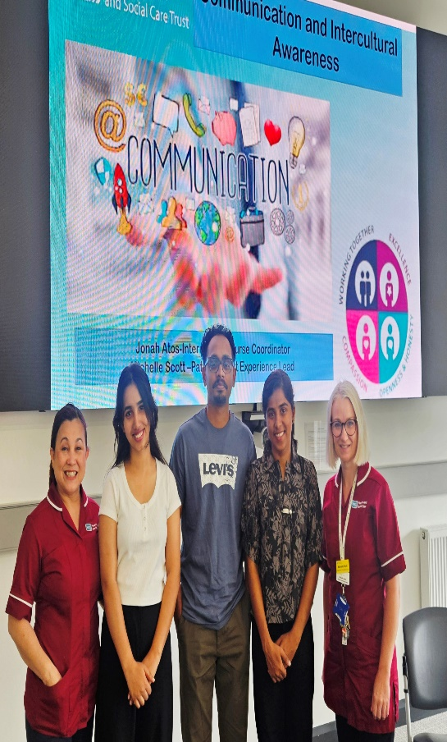
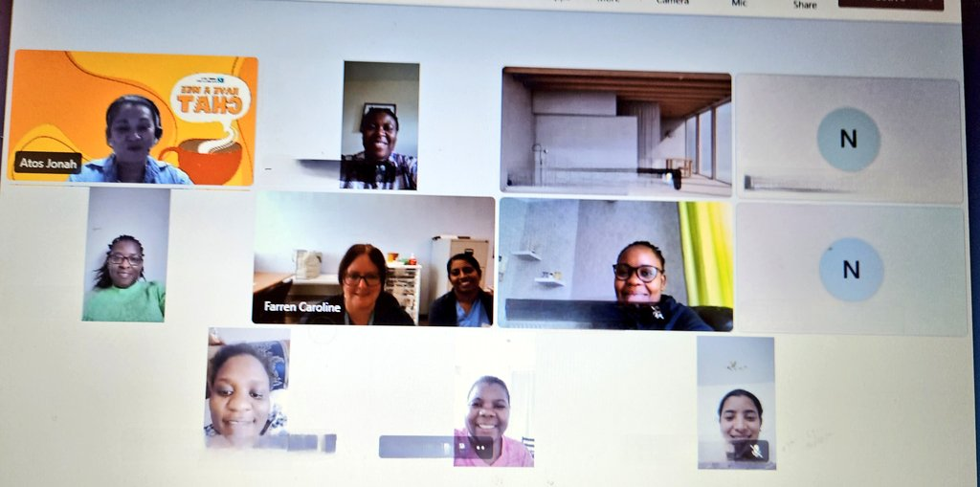
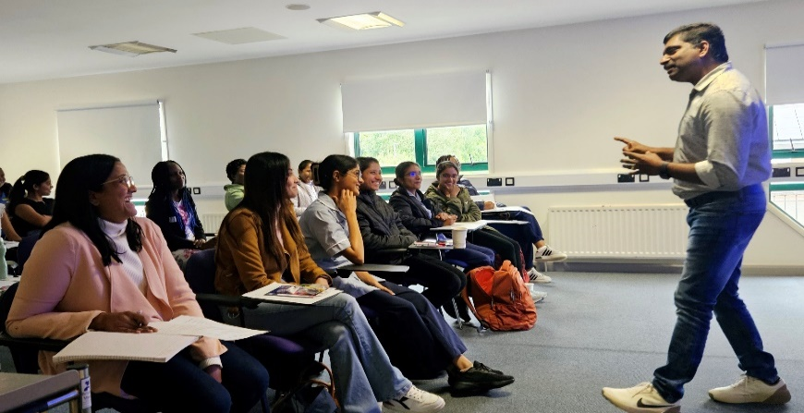
Pillar 2: Creating strong foundation
Communication training and Intercultural Awareness training
Buddy system
CHAT session
Targeted Induction

Slide 10
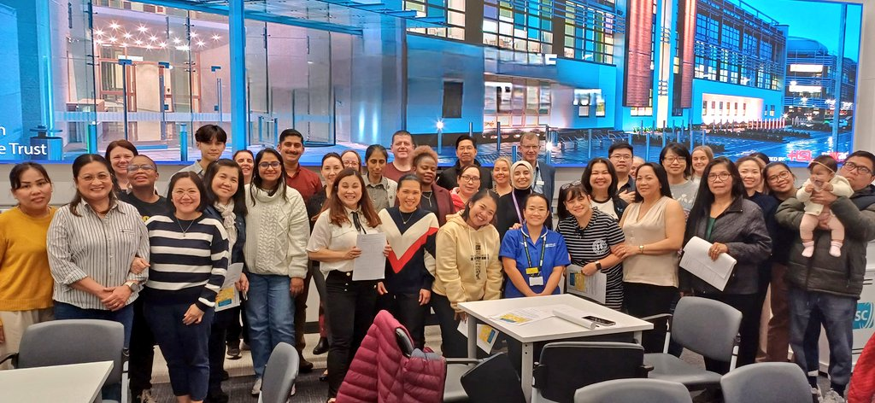
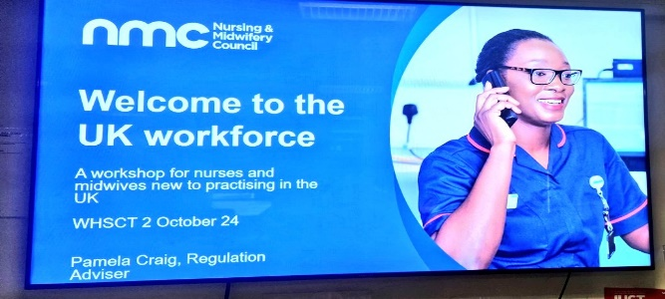
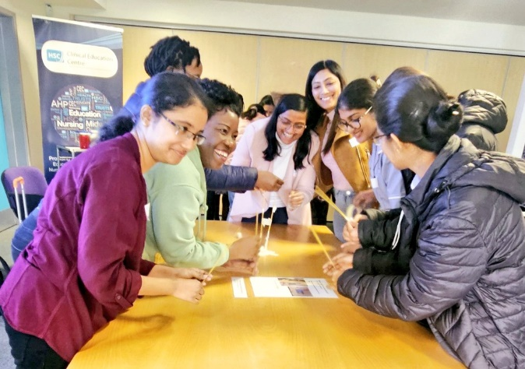


Pillar 3: Building belonging
Health and well-being
Welcome by Nursing regulator and networking
Ethnically Diverse Staff Network
Celebrating cultures

Slide 11
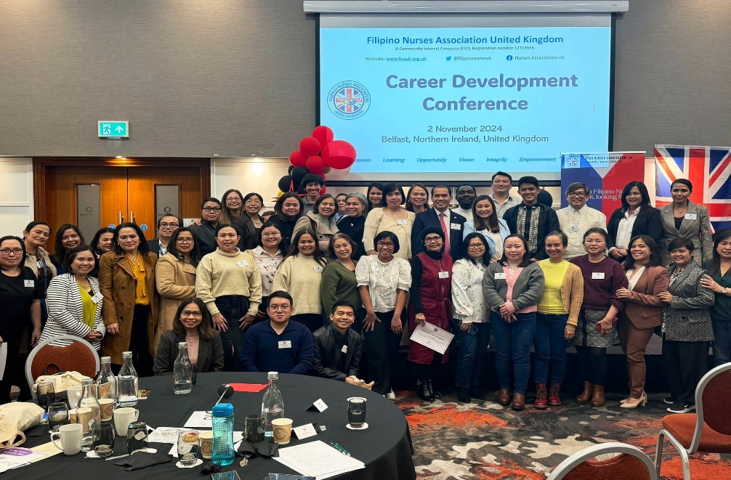

Pillar 4: Personal & Professional Growth
Career development days
Interviewing preparation
Access to leadership and educational opportunities
Career clinics/UK ENIC

Slide 12


How can we truly support the Ethnically Diverse Workforce?

Slide 13

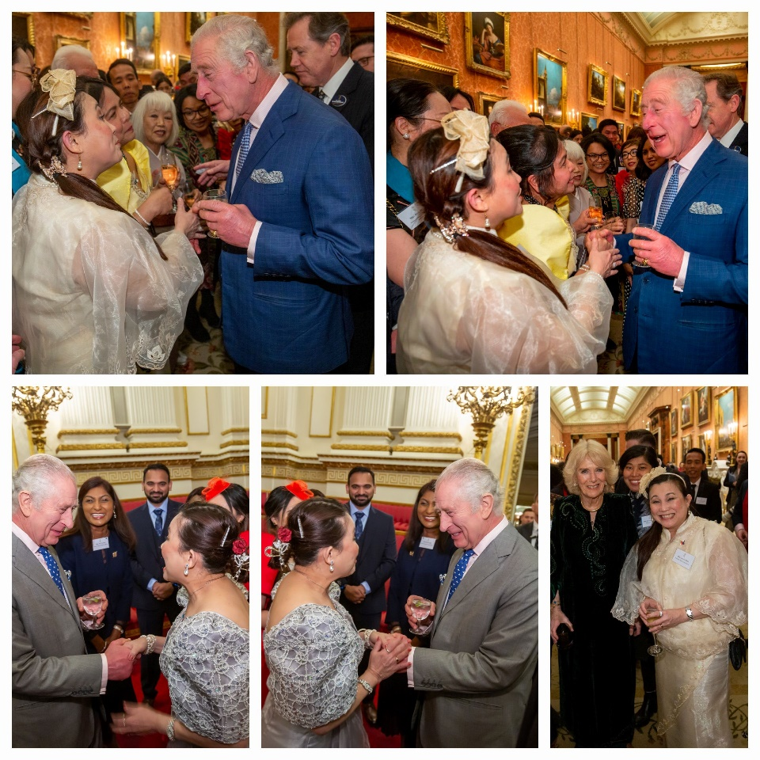
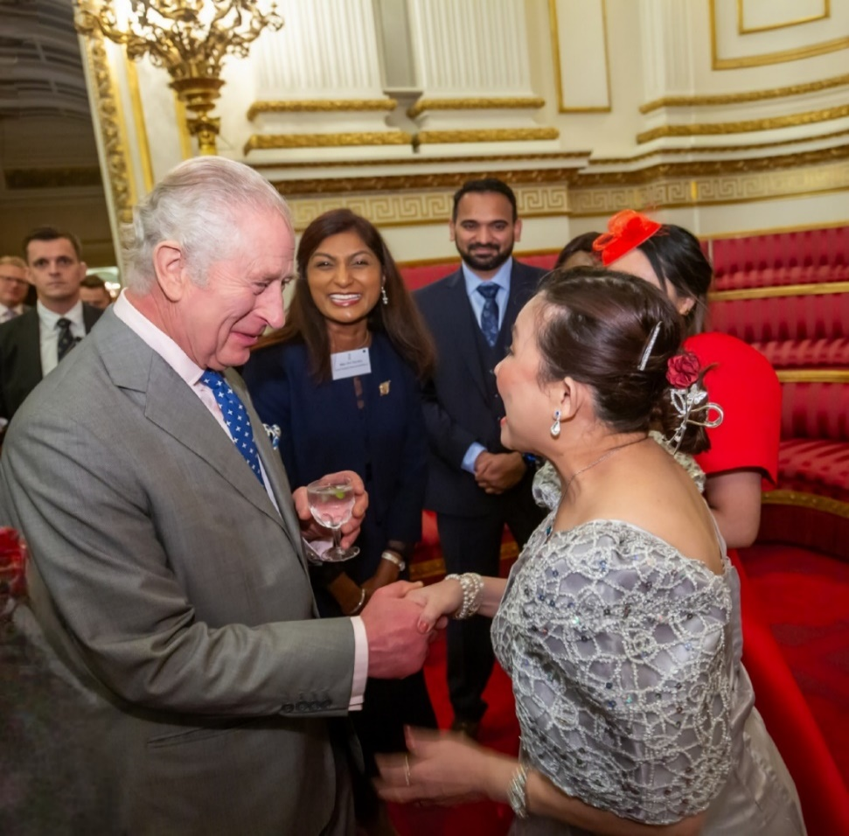
What’s the craic?

Slide 14

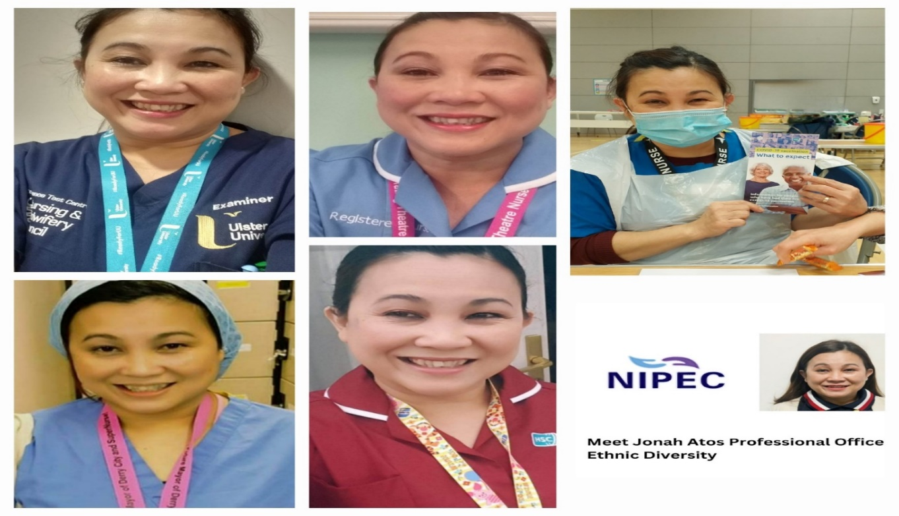

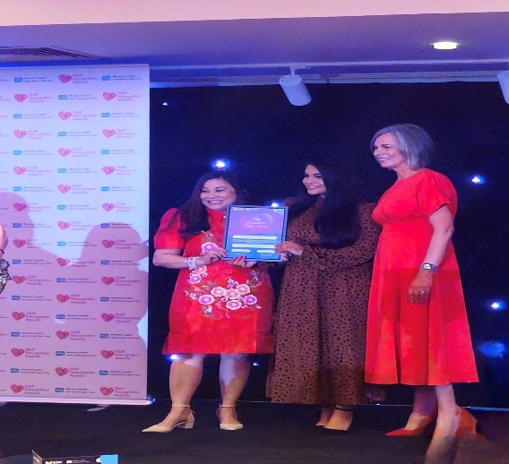
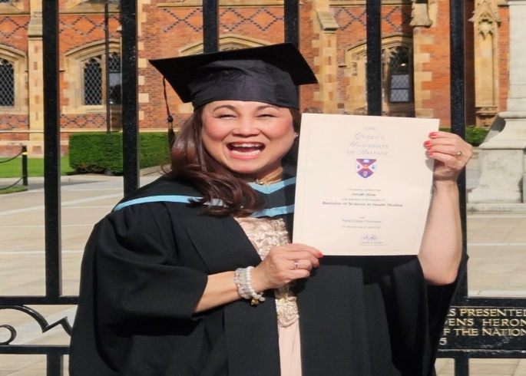
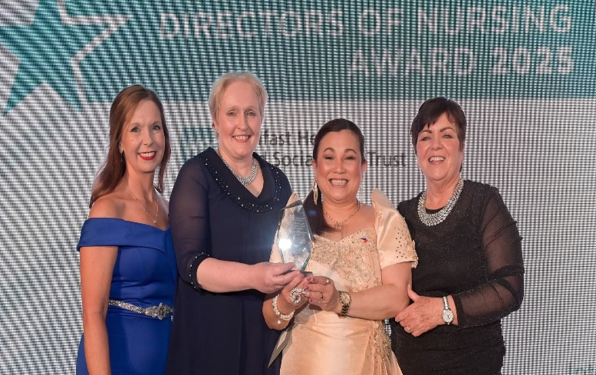
Salamat (Thank you)
Notes:
RCN , Hummingbird, CRC

