Slide 1
Intro Slide Title 1
Survey of social care practitioners in children’s services
Dr Shirley Boyle

Slide 2
Methods
Obtain views from SCP in children’s services
Inform development - qualifications & CIP
Survey open September
Sent to all relevant staff by Council
Regular prompts
Challenges

Slide 3

Preliminary analysis!

Slide 4
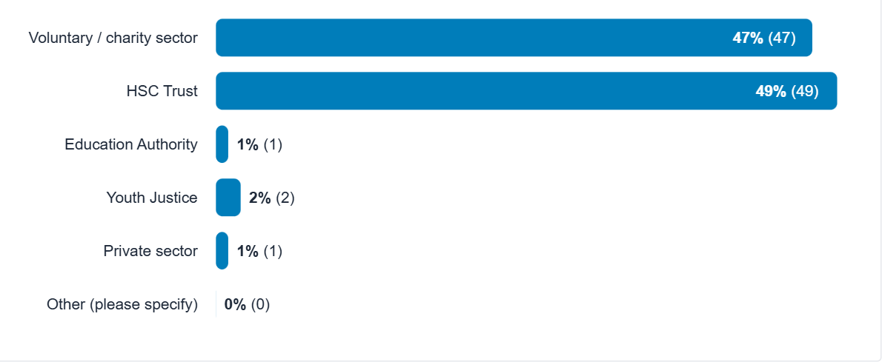
Who participated…
What type of organisation are you employed in?

Slide 5
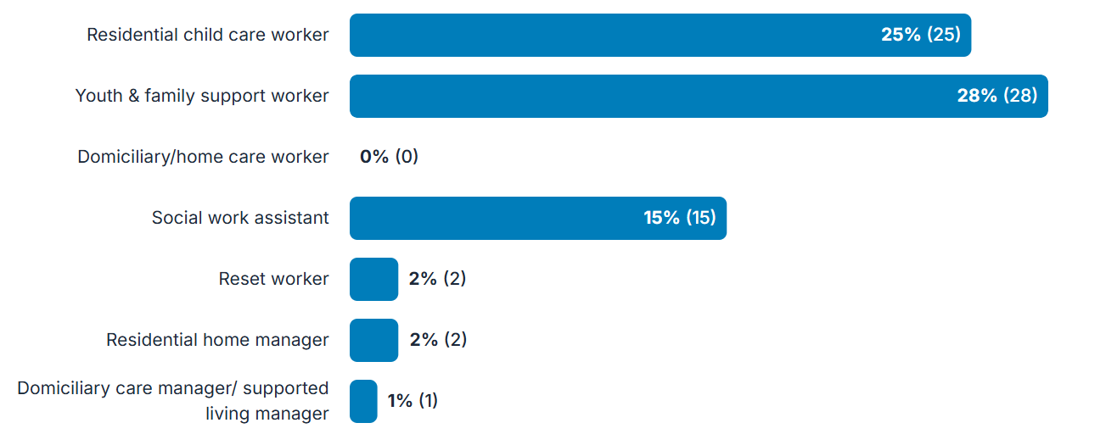
What category best describes your role?

Slide 6
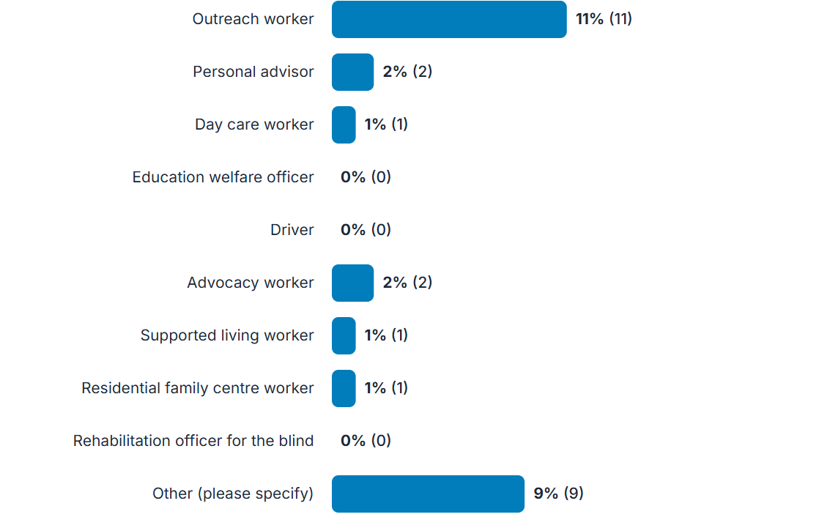
Notes:
Other- youth conference Co-ordinator, Youth worker JNC, Project Manager , sure start Leader, Housing Practitioner in Supported Accommodation for 16-21 yr olds , Project Worker - Families/children/friends of prisoners, Family Services Manager

Slide 7
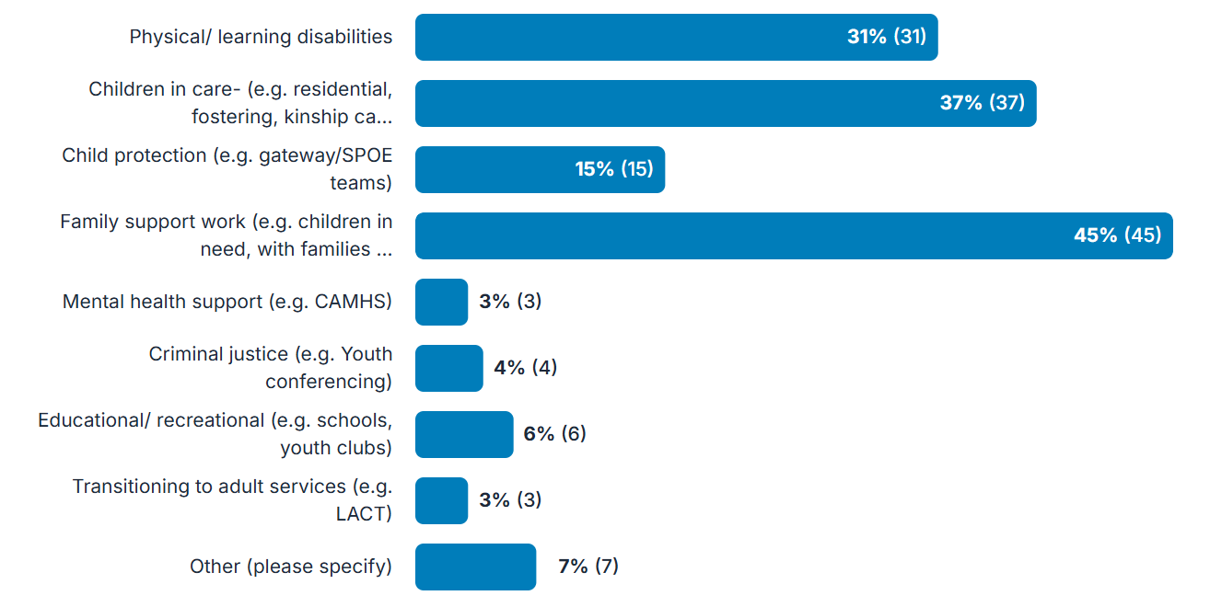
What best describes the service or groups of children and young people that you work with?
Notes:
Other- homeless, Early Years, children with a confirmed diagnosis of Autism and ADHD, Youth homelessness, Children with families involved in Criminal Justice System, Unaccompanied asylum seeking children (LCAC)

Slide 8
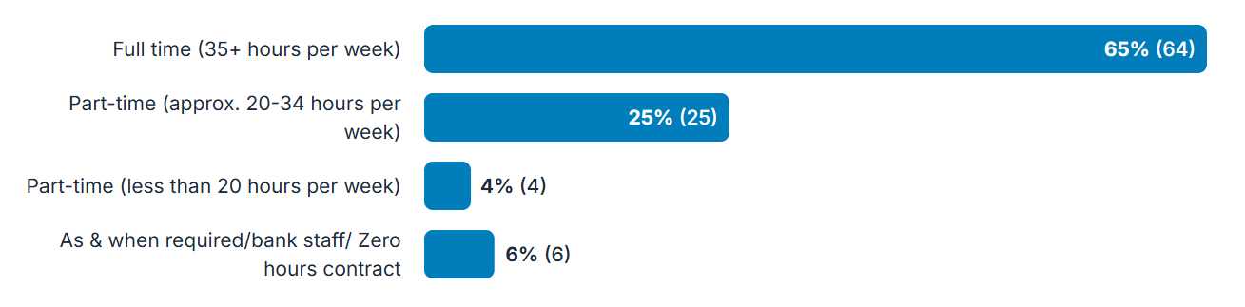
Contract details

Slide 9
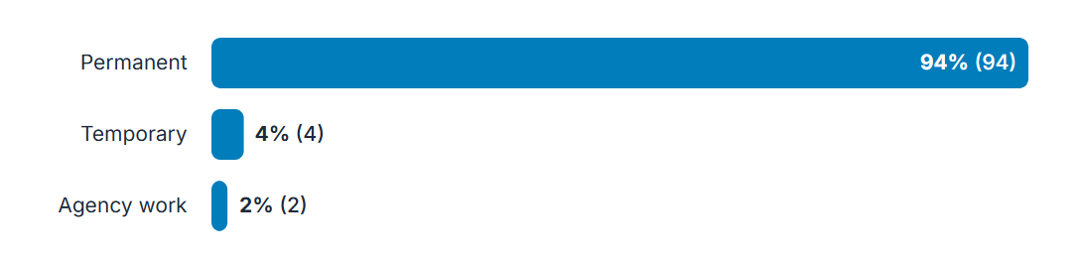

Slide 10
15% have a second job
Bank work e.g. in Children Residential, CAH, adult disability services, special needs school
Deliver training
Youth work
Domiciliary
Adult supported living
Pharmacy technician

Slide 11


Slide 12
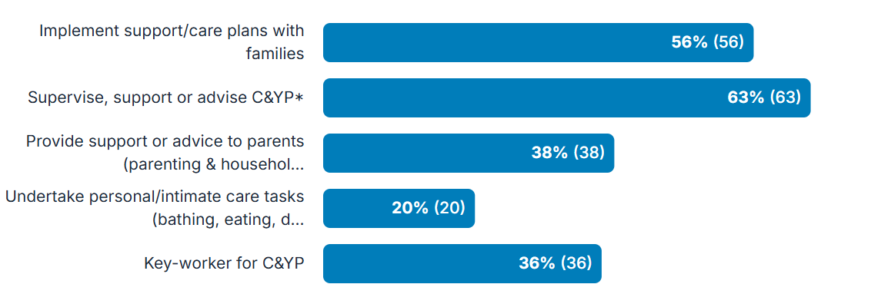
Roles & responsibilities

Slide 13
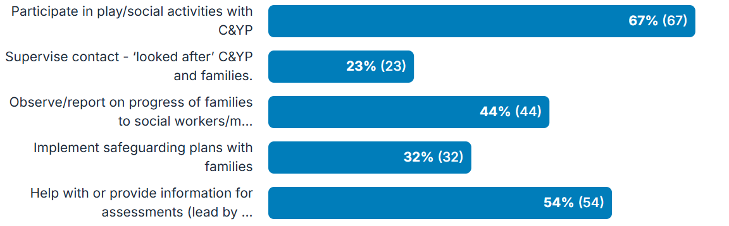

Slide 14
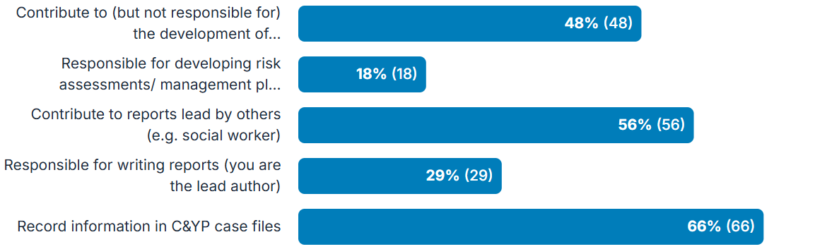

Slide 15
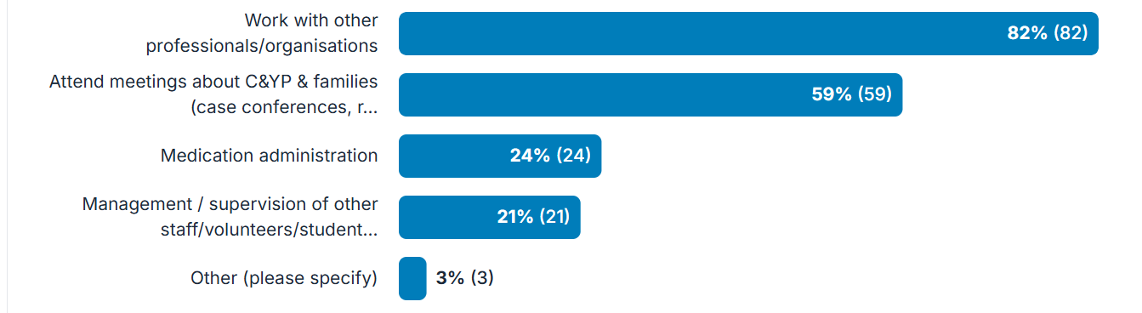

Slide 16

Qualifications

Slide 17
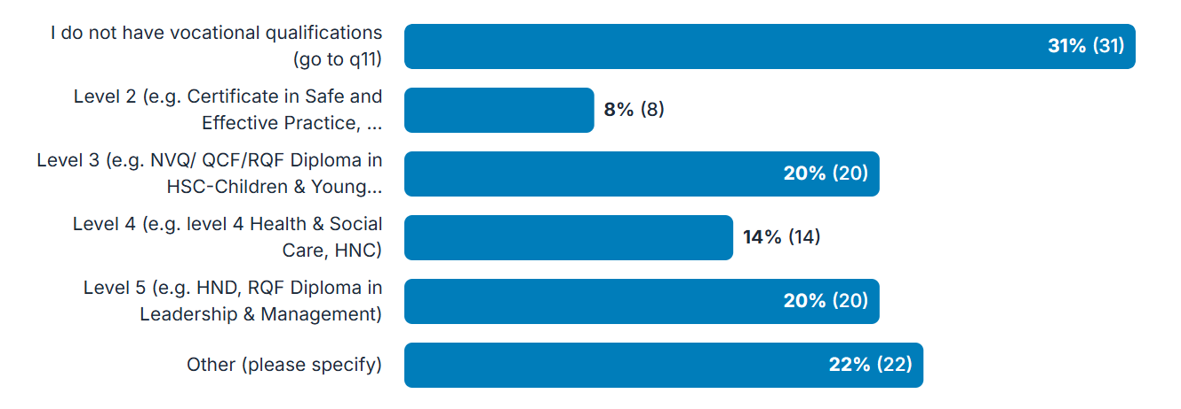
HSC Vocational qualifications

Slide 18
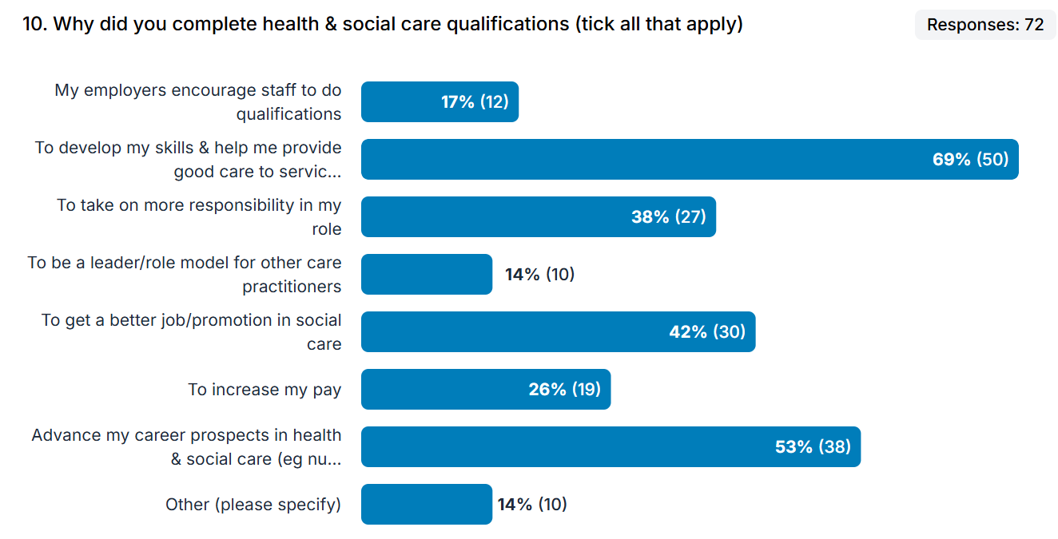

Slide 19
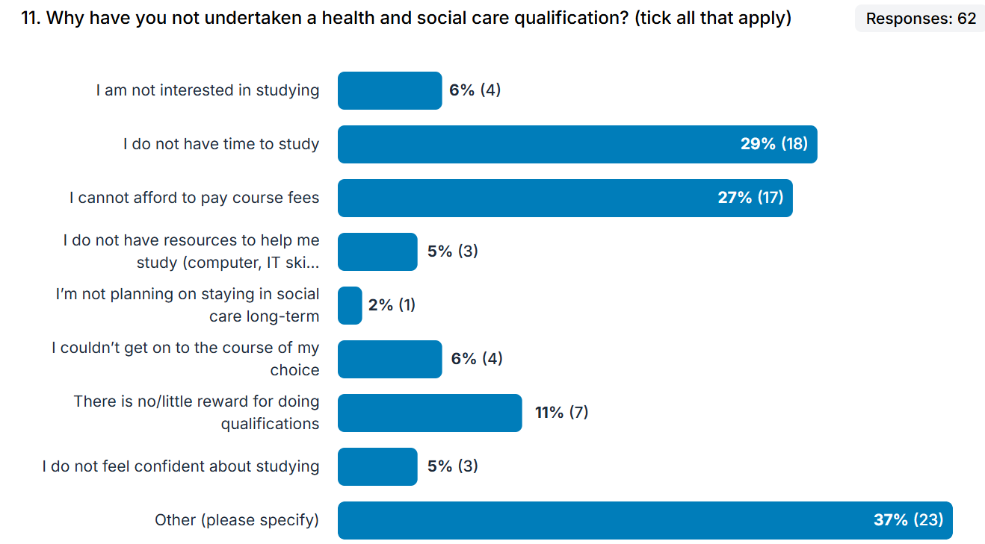

Slide 20

GCSE english

Slide 21
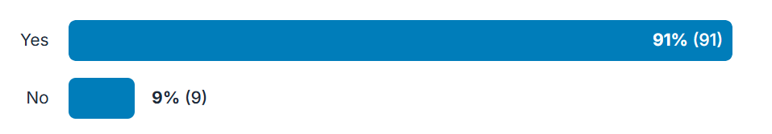
GCSE maths

Slide 22
Other qualifications obtained/completing
80% held other qualifications
Ranged from vocational qualifications (GNVQ) to post-graduate
Overwhelmingly most of these were cognate qualifications

Slide 23


Slide 24
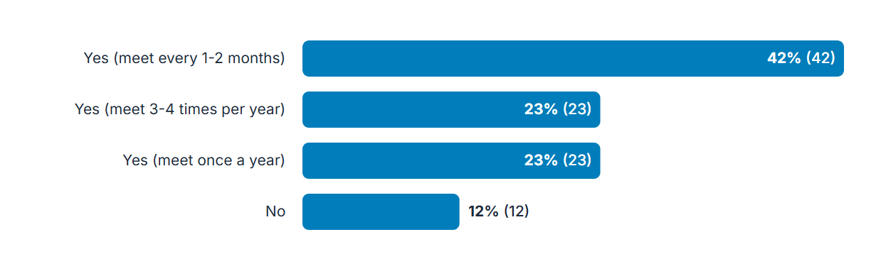
16. Do you meet with a line manager to agree a plan of learning & development opportunities/training for the year ahead?

Slide 25
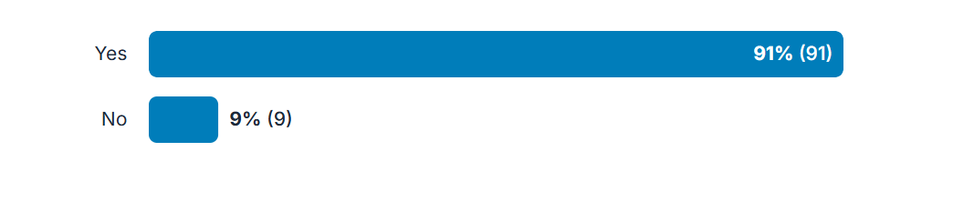
17. Do you have access to ongoing learning & development opportunities/training through your work?

Slide 26

Mandatory
training

Slide 27
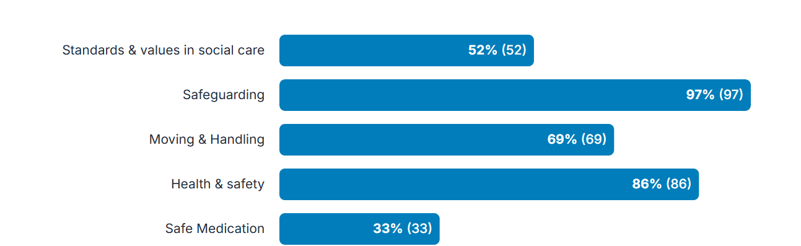
18. What areas of mandatory training are required for your job? (tick all that apply)

Slide 28
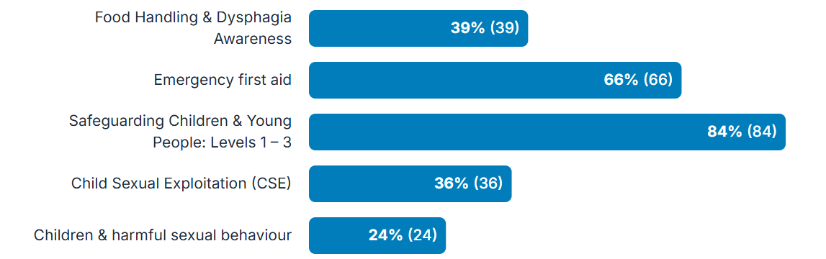

Slide 29
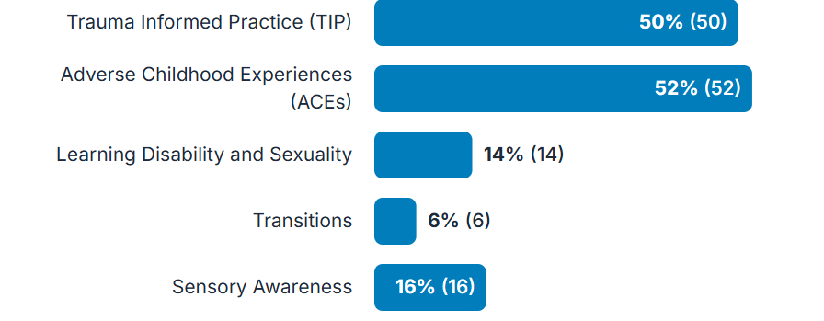

Slide 30
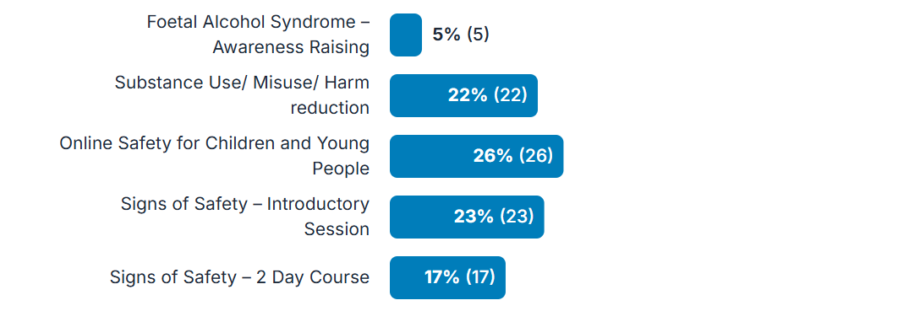

Slide 31


Slide 32


Slide 33
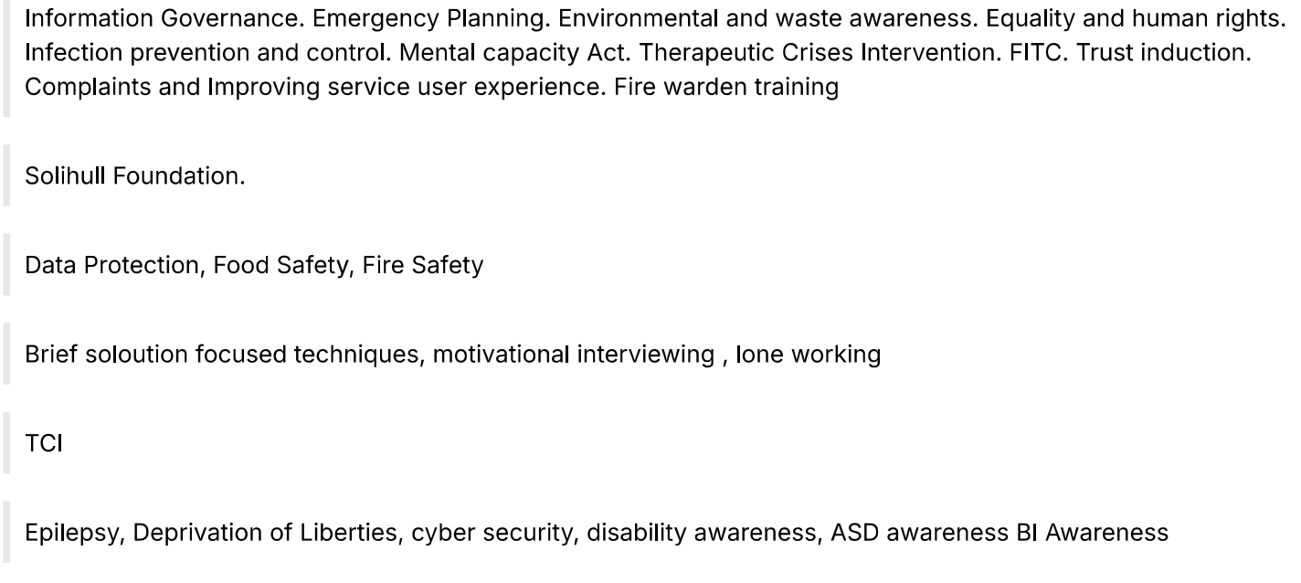
Other

Slide 34

CIP framework

Slide 35
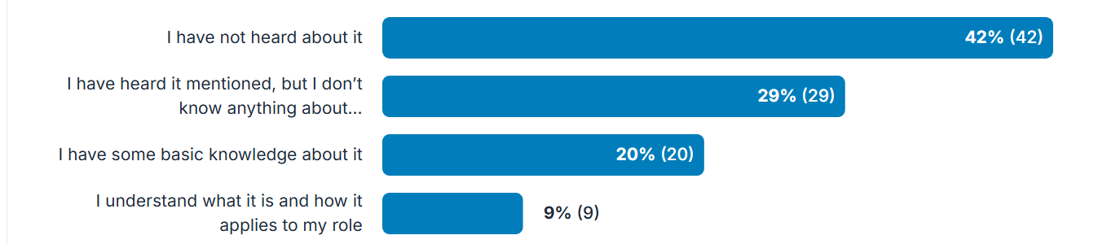
Knowledge about the CIP framework

Slide 36
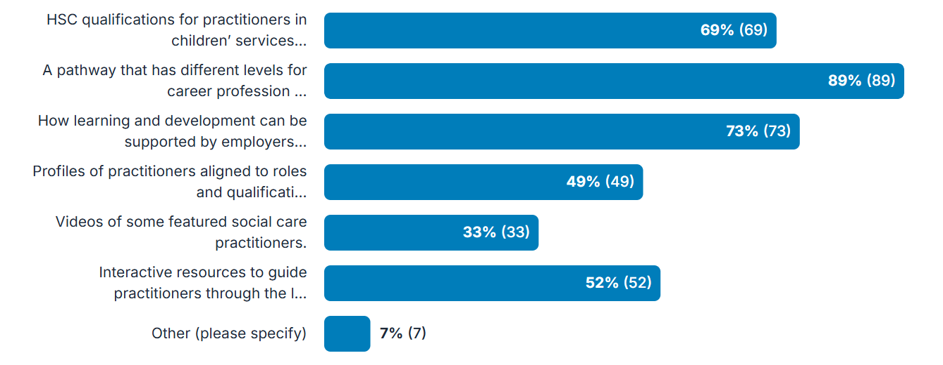
Qualifications for SCP in Childrens: what’s important?

Slide 37

Scale questions

Slide 38
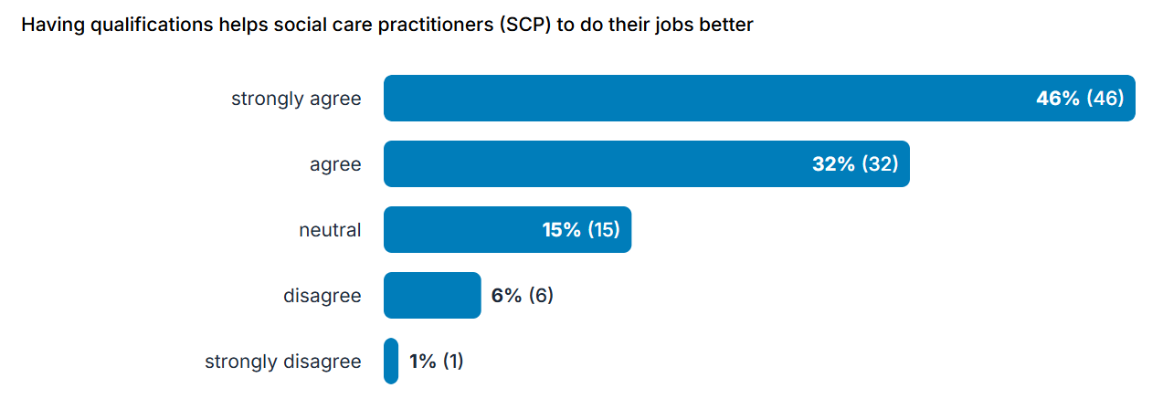
10 statements about SC qualifications
1.

Slide 39
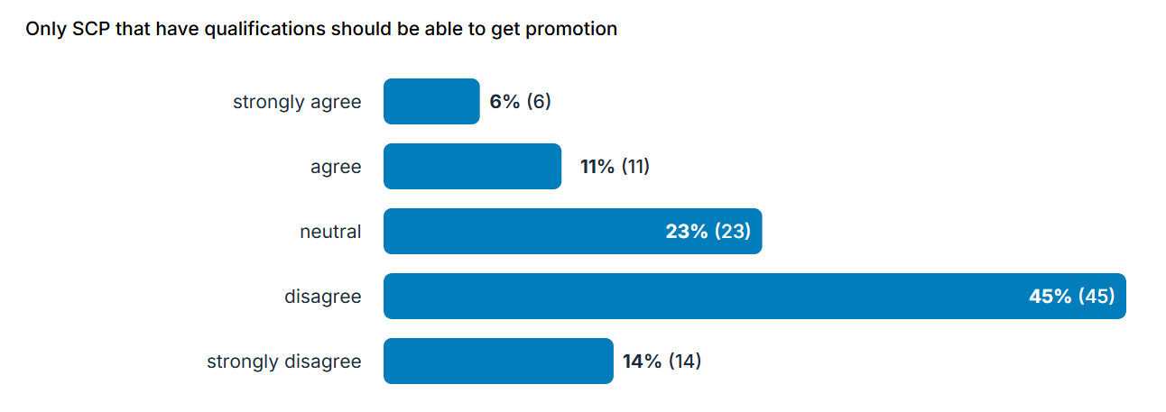
2

Slide 40
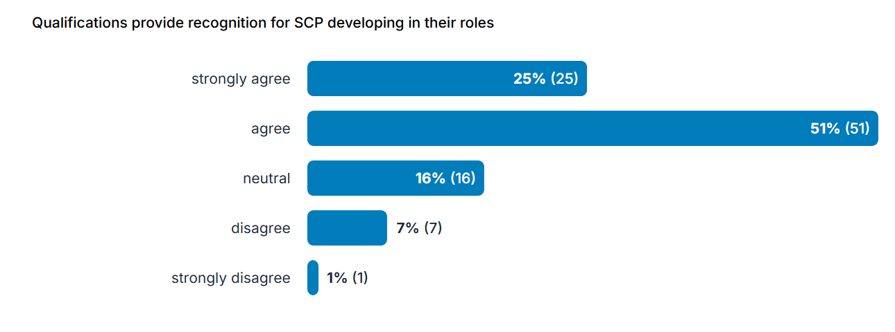
3

Slide 41
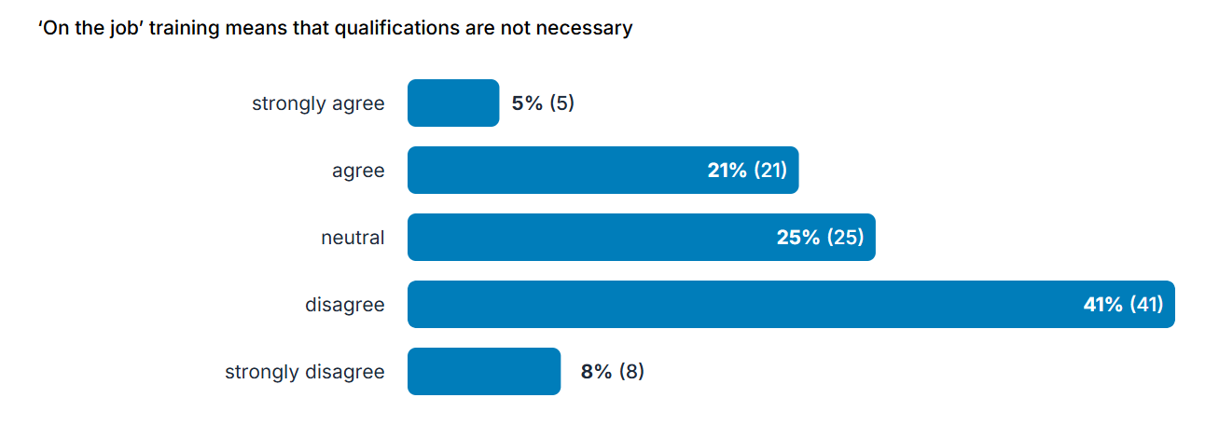
4

Slide 42
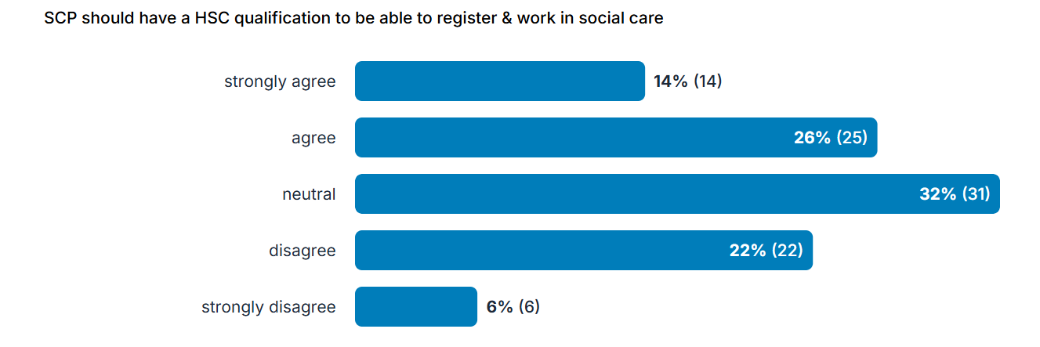
5

Slide 43
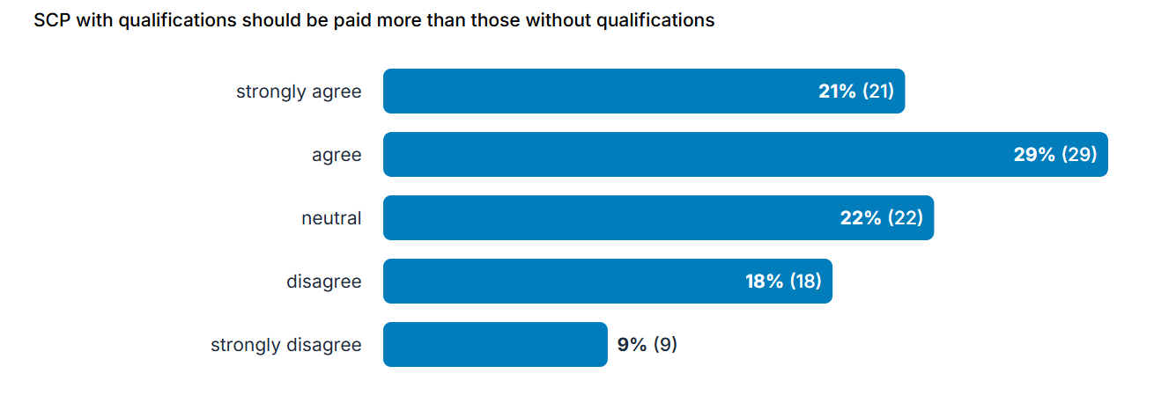
6

Slide 44
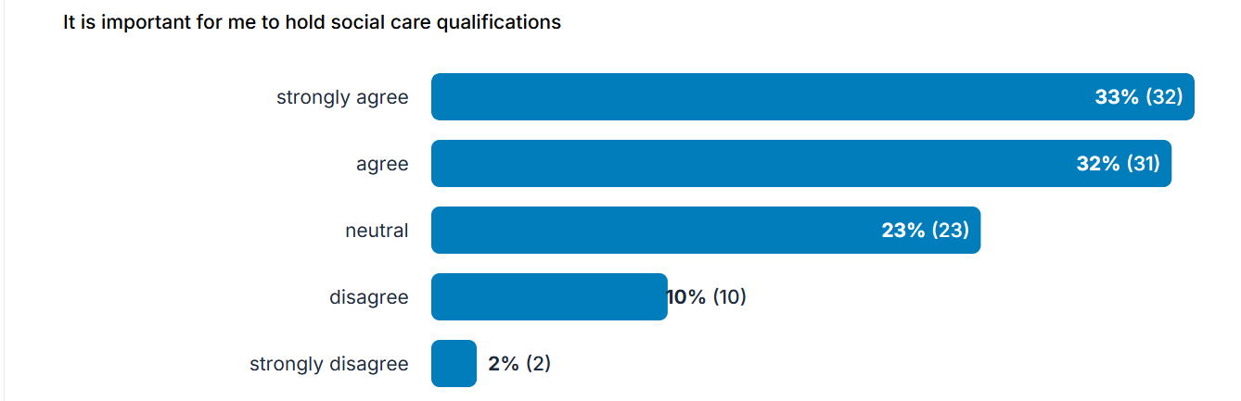
7

Slide 45
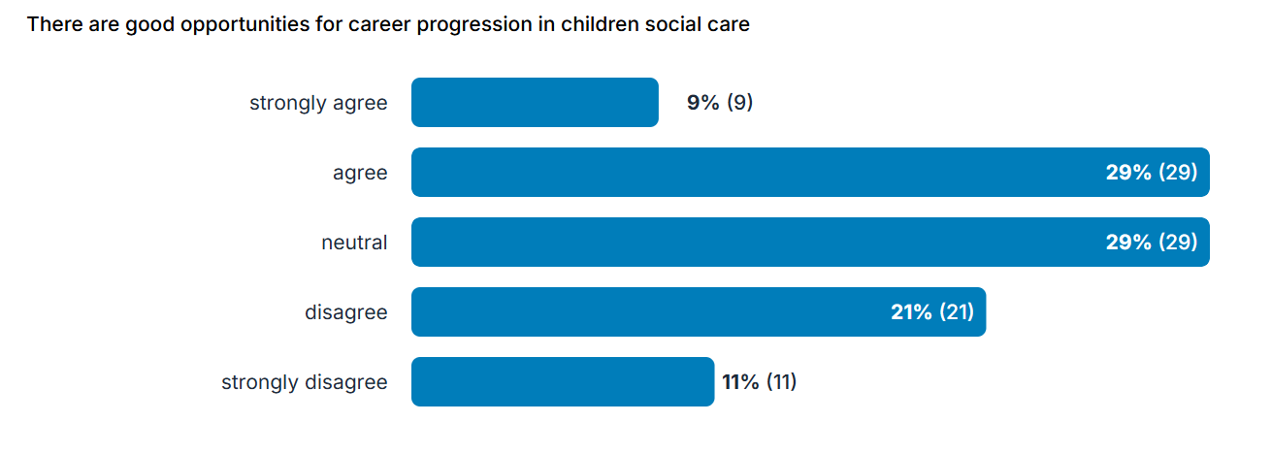
8

Slide 46
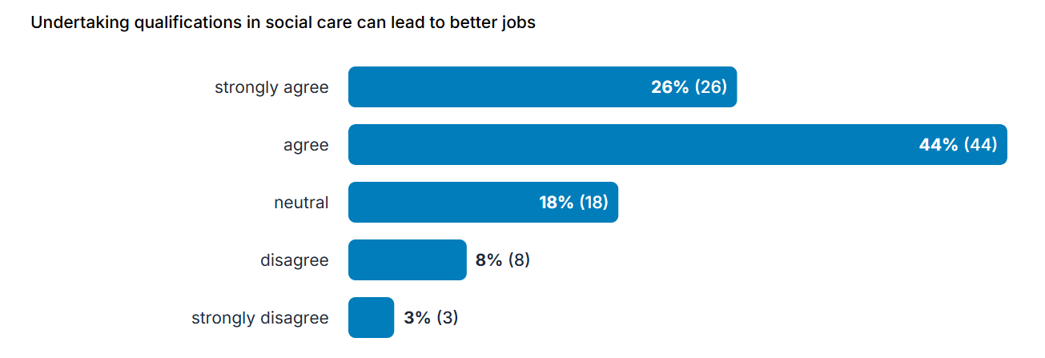
9

Slide 47
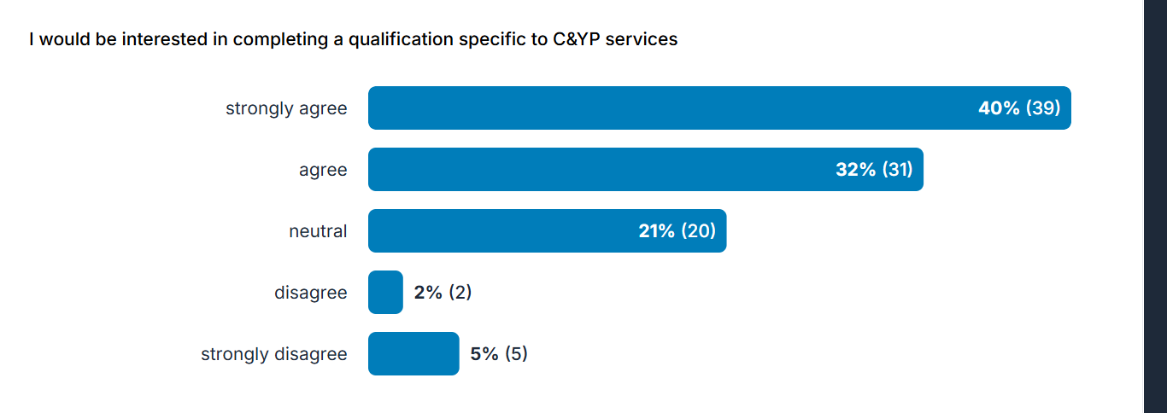
10

Slide 48


Slide 49
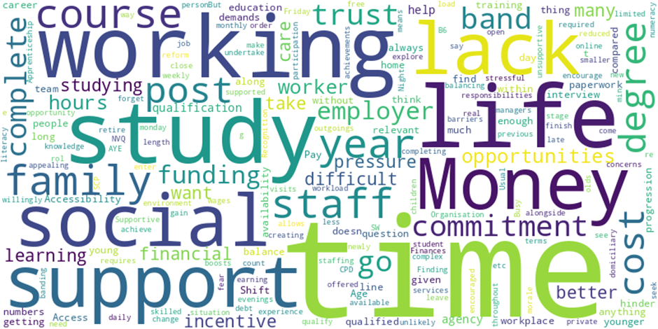
What helps or hinders social care workers to do qualifications?

Slide 50

What are the best things about working in children and young people’s social care services?

Slide 51
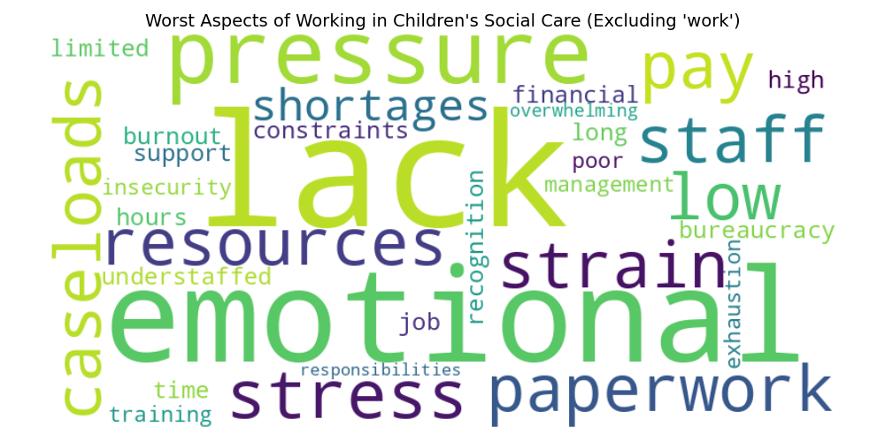
What are the worst things about working in children and young people’s social care services?

Slide 52
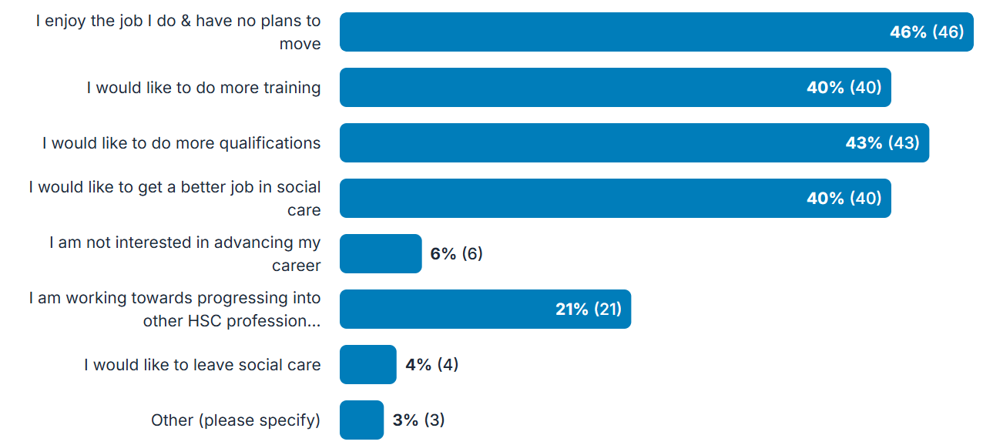
Your future plans

Slide 53

Aspirations for CSC

Slide 54
Recognition & pay
Value experience alongside qualifications
Carrer development & training opportunities
Work-life balance and support
Resources & practical support
Recognition of role importance

Slide 55

Demographics of participants

Slide 56
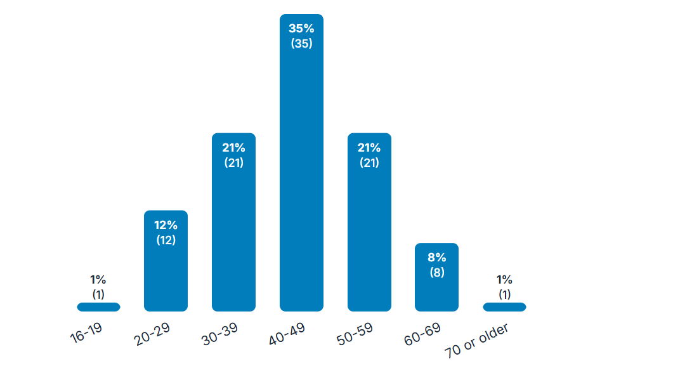
Age

Slide 57
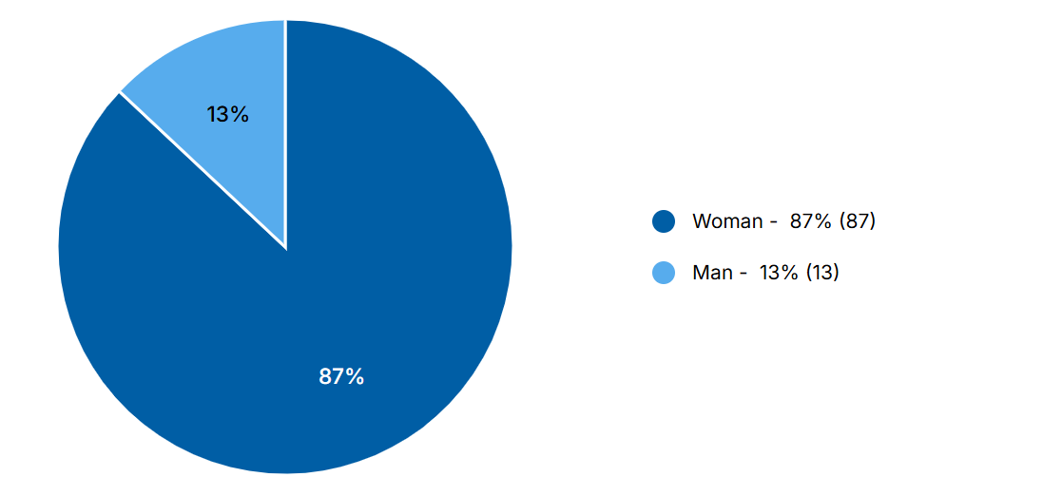
Gender
(other categories available)

Slide 58
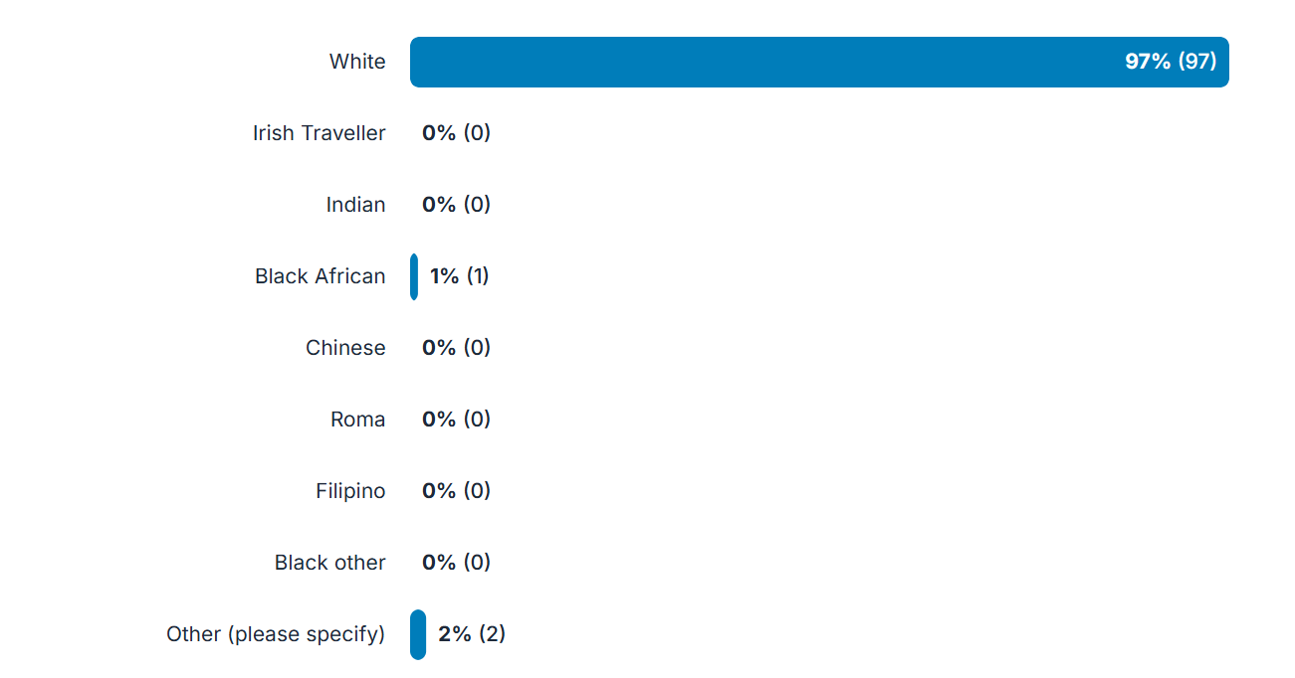
Ethnicity

Slide 59
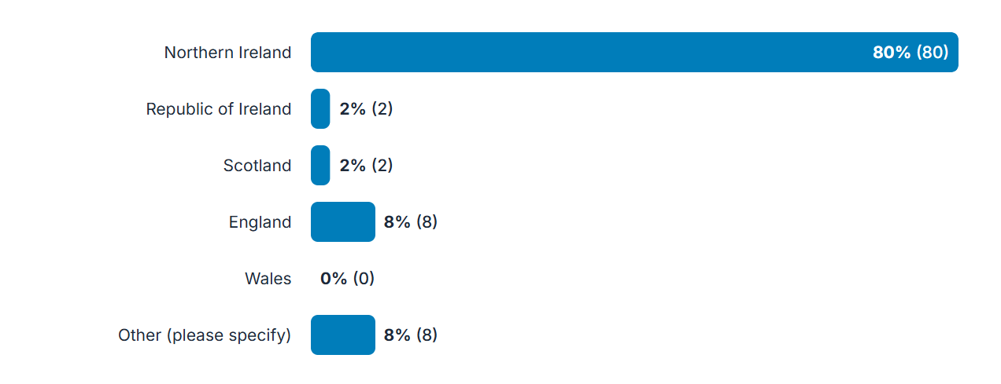
Place of birth

Slide 60
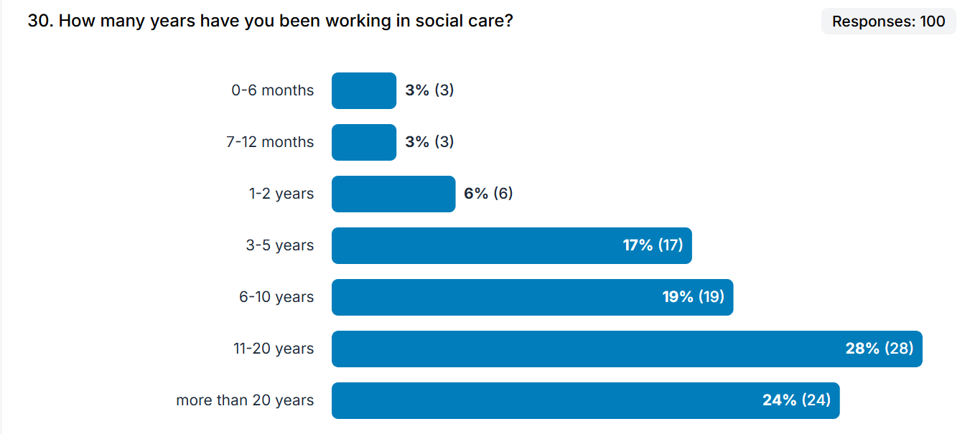

Slide 61
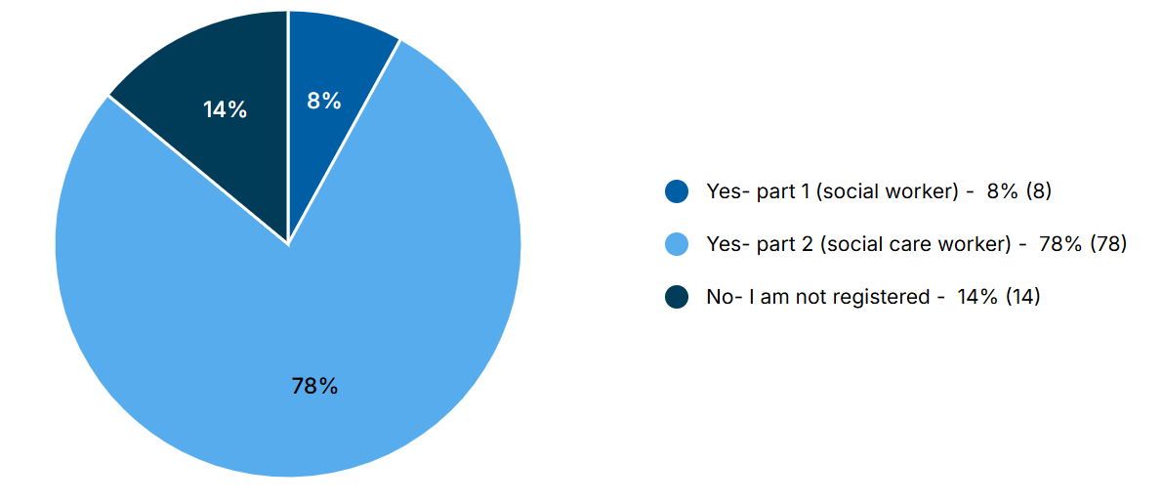
Registered with SCC

Slide 62

Slide Title 30
Thank you

Slide 63
Slide Title 31

