Slide 1

A Digital Learning Strategy for the Social Care Council
Social Care Managers Forum
18 & 27 November 2025
Social Care Managers Forum
18 & 27 November 2025

Slide 2
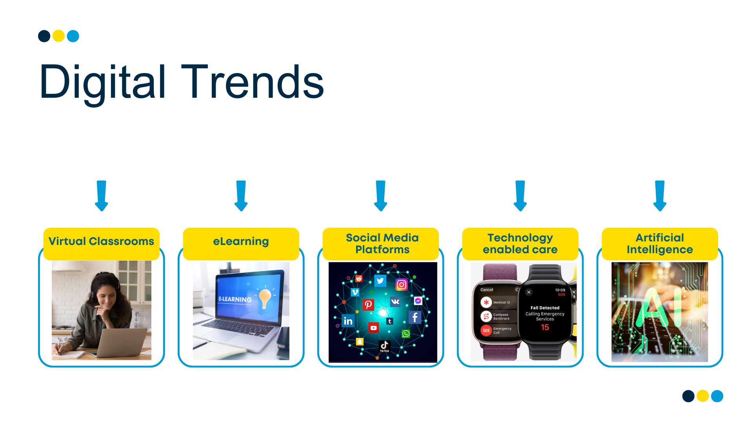


Slide 3
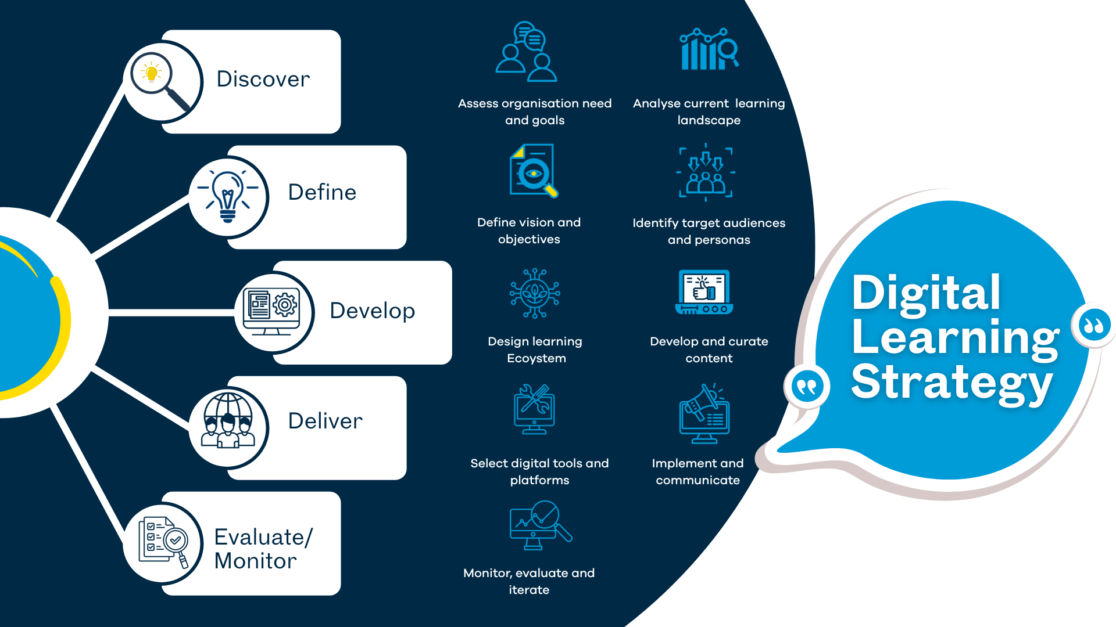


Slide 4







Strategic Context
Notes:
HSC Northern Ireland – Digital Strategy 2022-2040 – Building our digital capabilities – 6 core digital capabilities including creating a digital skilled workforce by providing all staff with the right digital skills.
Health and Social Care Workforce Strategy 2026 (2018)
All-Ireland Digital Capability Framework for Health and Social Care (2020)

Slide 5
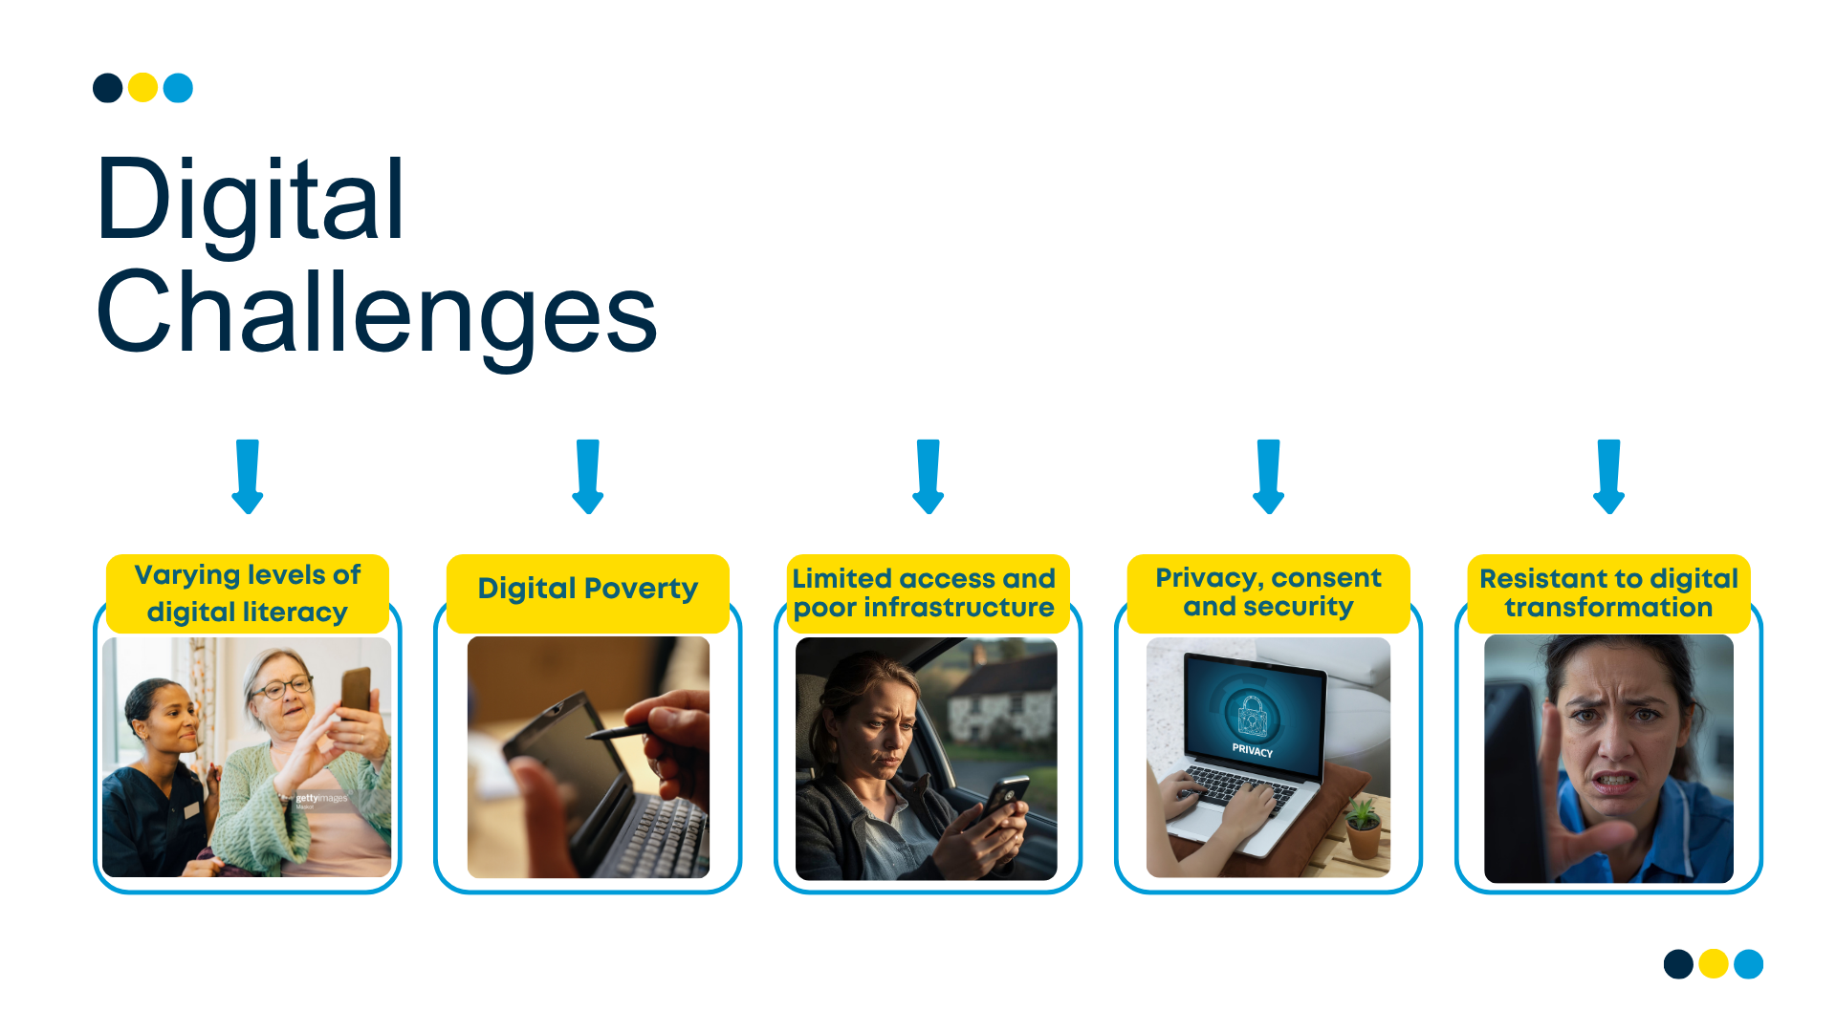
Notes:
Women are more likely to suffer from digital exclusion on average and are 19% less likely than men to access mobile connectivity (GSMA, 2023). Uk Digital Strategy reported in 2025

Slide 6
What the SSC research found
SCC Technology Survey 1 – 2019/2020
20% of registrants did not have required skills in digital technology to use for L&D
13% stated they could not solve a problem using online help
10% could not check the information found online is accurate
7% could not buy and install apps on a device.
Survey 2 - Awareness of technology
56% of social care staff indicated they were aware of technology that could help provide social care.
80% of social care mangers were more aware
71% of respondents to the survey indicated they did not know where to find information on technologies but would like to receive training on how technologies could help social care delivery.
Concerns about technology:
50.1% selected loss of human interaction
32.4% selected they were concerned about jobs being replaced by technology
30.4% stating they had concerns about privacy and security issues with digital technology
Notes:
Women are more likely to suffer from digital exclusion on average and are 19% less likely than men to access mobile connectivity (GSMA, 2023). Uk Digital Strategy reported in 2025

Slide 7
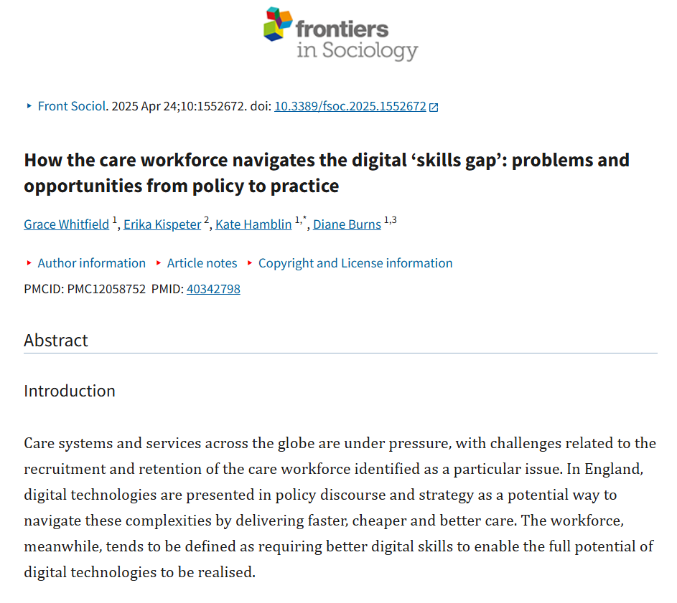
What current evidence says
Office of National Statistics, 2021
7.9 million people will still lack digital skills in 2025
NIRSA Digital Skills in NI (Jan 2025)
Over 1 in 5 people (23%) had no digital skills (344,000 people)
25% of females reported having no digital skills
55% of those aged 65 and over had no digital skills
UK Digital Strategy, 2025
Women 19% less likely than men to access mobile connectivity
Notes:
Women are more likely to suffer from digital exclusion on average and are 19% less likely than men to access mobile connectivity (GSMA, 2023). Uk Digital Strategy reported in 2025

Slide 8


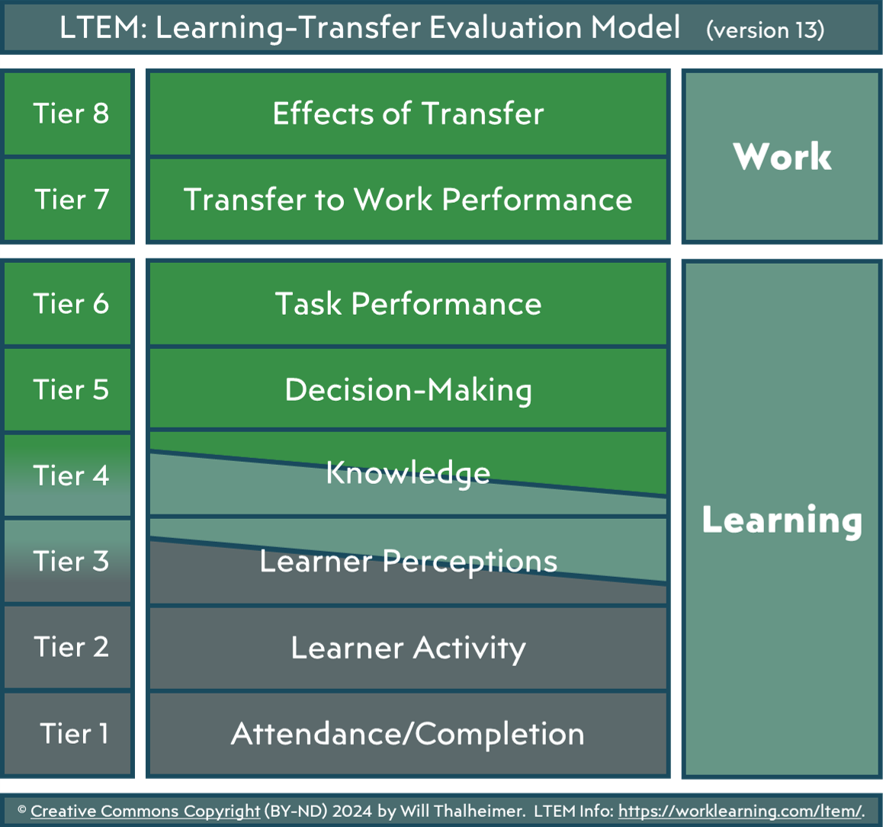

Evidence informed
  How to assess and analysis learning need
  How people learn in the modern world/workplace
  How to design to provide good user experience, products, solutions or service
  How to evaluate learning transfer

Slide 9

Social Care Council - Strategic Priority
Establish a qualifications and CLF for SC strengthens workforce capability
Ensure high-quality Qualifying and PQ SW Education and Training
Promote uptake and engagement in CPL through development of a Digital Learning Strategy
Develop the capability of the workforce
Embed PIP for SW as benchmark for safety, quality, improvement and continued FTP
Support the development of SW leadership capability using the DOH Leadership Framework

Slide 10
SSC Digital Learning Strategy Vision and Objectives
Develop and enhance workforce digital capability and competence
To develop digitally confident and capable SW & SC workforce that has access to high quality digital learning solutions that meets their needs and drives excellent in service deliver in NI
Measure impact and drive continuous improvement
Foster inclusion and accessibility
Encourage collaboration and sharing
Support regulatory compliance and CLP
Notes:
Purpose of the strategy add here

Slide 11
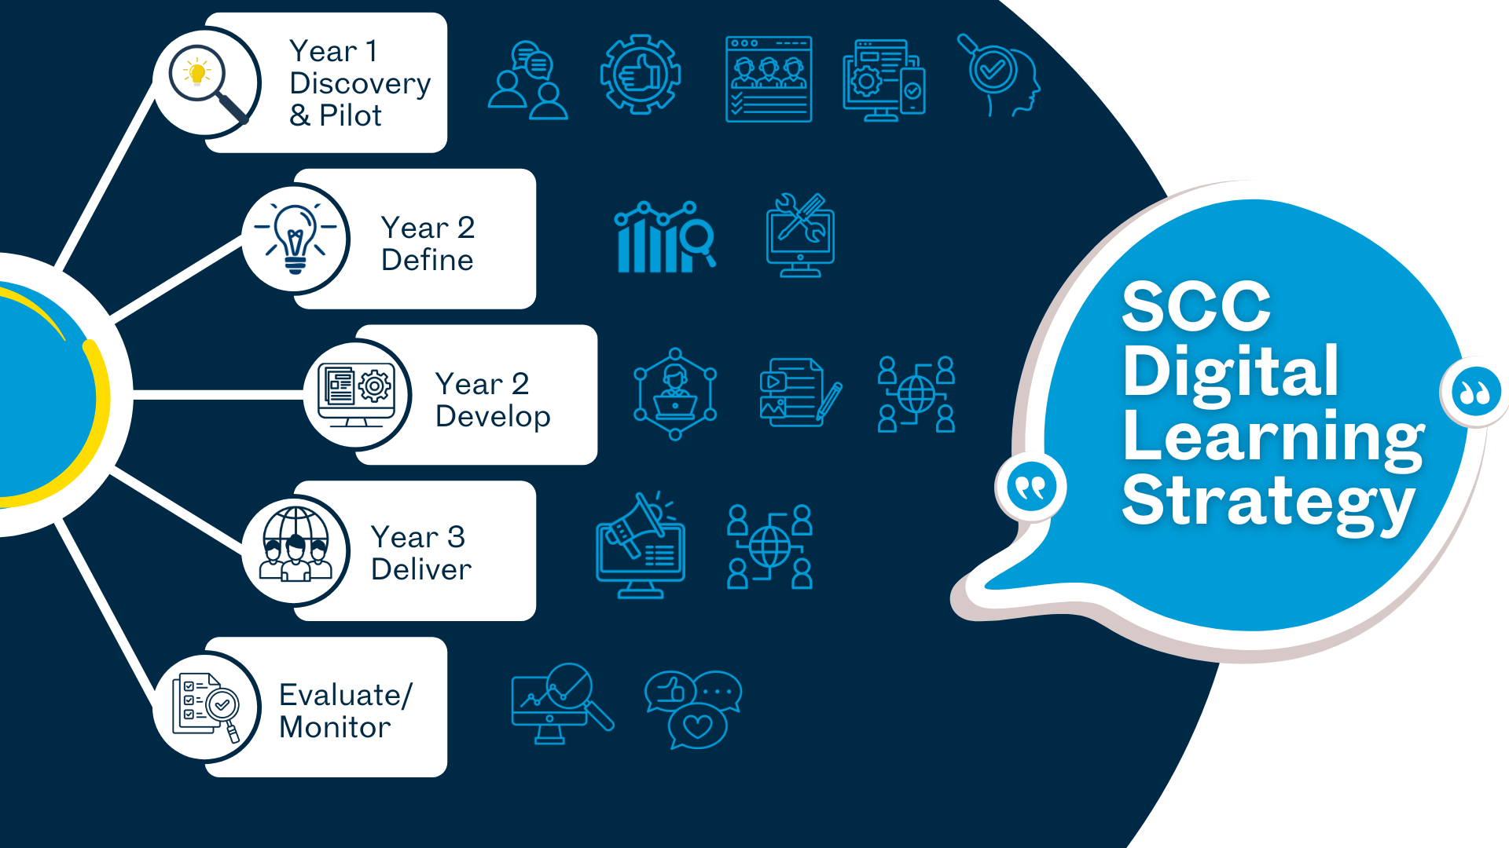

Slide 12
Actions and Priorities
Learning Zone – promote as centralised, free hub, trusted, accessible and inclusive
Scope need for digital credentialing/digital badges
Embed digital skills in review of qualifications and NOS
Consider digital technology as part of the review of Standards of Conduct and Practice
Engage with sector to understand needs, challenges, accessibility – survey/focus groups
Conduct a digital learning needs analysis
Introduce and promote current self assessment tools aligned to ICT Essential Skills Standards and All Ireland Digital Capability Framework
Establish need for a digital champions network across employers
Scope need for digital capability toolkit or digital skills resource
Notes:
Purpose of the strategy add here

Slide 13


Digital Skills for Social Work

Slide 14

Building Digital Capability
- Table Exercise

Slide 15

Table Exercise
Nominate a scribe and a spokesperson
Review the questions
On the sheet provided, record your tables answers to the following questions:
  What comes to mind when you think of digital capability?
  What workplace digital devices do you and staff have access to? And, which of these do you and staff use most frequently when carrying out work-based tasks?
  What are the digital challenges that you, your employer and other practitioners face?
  What digital opportunities are you and your employer using / considering using?

Slide 16

Table Exercise

Slide 17

Next Steps
Feedback from today will be used to inform the final Digital Learning Strategy and how it is implemented in practice, from April 2026
Support the development of a sector digital capability scoping survey
Help to guide thinking around the development of future digital learning resources

Slide 18



Visit our Learning Zone today
Mairead Harkin
Workforce Engagement Officer (Digital Learning Lead)
e: mairead.harkin@niscc.hscni.ni
https://learningzone.niscc.info/
Notes:
Thank you for listening and if you want to check out our Learning Zone and resources – please use the QRC on the screen.

