Slide 1

Autumn/Winter Vaccination Programme 2025/26 Information for Care Home Managers Caroline Lecky, Nurse Consultant Care Homes PHA

Slide 2
Role & expectation of HCWs re: vaccination
We have a duty of care to protect the people we look after from infections
flu vaccination reduces transmission of influenza to:
vulnerable residents
ourselves
colleagues and family members
flu vaccine uptake in HSCWs significantly lowers rates of flu-like illness, hospitalisation and mortality in elderly individuals in long-term care settings
flu vaccination reduces sickness absences and contributes to delivery of HSC services during winter pressures

Slide 3
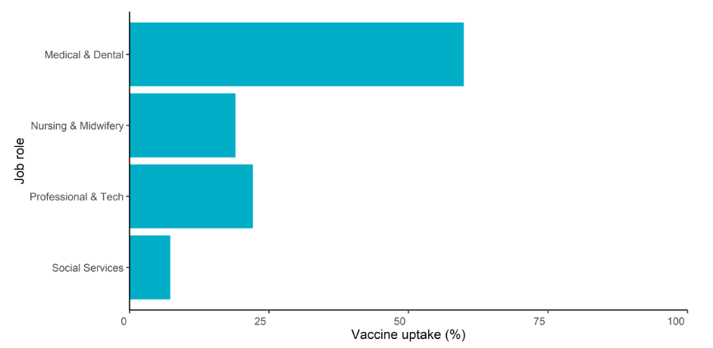
Flu vaccine: uptake rates
N.I HCW Flu vaccine uptake rates by job role, 2024/25
Source:
Seasonal influenza vaccination surveillance in Northern Ireland Autumn/Winter 2024/25 | HSC Public Health Agency
Notes:
Individuals may have more than one eligibility criteria for vaccination, however most will only have one reason for vaccination recorded on VMS. This particularly impacts estimates of vaccine uptake in health and social care workers, including care home staff. Estimated vaccine uptake in eligible health and social care workers has decreased since 2021/22. Estimated vaccine uptake remained relatively similar between 2023/24 and 2024/25 for all Trust-employed health and social care workers (21.6-21.4%) and frontline-Trust employed health and social care workers (21.5-21.7%). Estimated vaccine uptake decreased in care home staff in 2024/25 (6.5%) compared to 2023/24 (10.2%) (Figure 5.1).

Slide 4

4. What you can do to improve uptake
Be seen to support vaccination: lead by example
Be a champion: talk positively about vaccination within the care home; with residents, their families and staff
Support access: encourage staff to get the flu jab when the pharmacist is in attendance at the care home (and promote the alternative measures, i.e. Trust vaccination teams or drop-in at local community pharmacy)
Celebrate success: acknowledge homes that achieve high uptake
**Make every contact count**

Slide 5
Thankyou for your time today
Sandra Aitcheson flu vaccine 2025 on Vimeo

